Slide 1
File uploading in PHP

Slide 2
Summary of the previous lecture
Creating database in MySQL using WAMP
Connecting PHP with MySQL
Inserting data in database
CONNECTIONS: user registration

Slide 3
Outline
FILES super global variable
File uploading in PHP
Storing reference of uploaded file in database
User registration in CONNECTIONS web application with file upload

Slide 4
1. $_FILES: super-global variable
$_FILES: contains any item uploaded to the server when the post method is used
an array type variable
Created automatically
Can be accessed on other pages

Slide 5
1. $_FILES: super-global variable…
Keeps information about
Name
Size
Type
Tmp_name

Slide 6
1. $_FILES: super-global variable…
FORM attributes required:
Method should be post
Enctype should be multipart/form-data
<form enctype=“multipart/form-data” method=“post” action=“upload.php”>

Slide 7
1. $_FILES: super-global variable…
<body>
<form method=“post” enctype=“multipart/form-data” action=“action.php”>
<input type=“text” name=“name”>
<input type=“file” name=“pic”>
<input type=“submit”>
</form></body>
Asad
File type
Choose File
No File Chosen
Mypci.jpg
submit
name
$_POST
Asad
name
$_FILES
[name]
=>file name
[type]
=>file type
[size]
=>file size
[tmp_name]
=>tmp name
pic

Slide 8
1. $_FILES: super-global variable…
Accessing file information
  $_FILES[‘input-field name’][‘name’];
  $_FILES[‘pic’][‘name’];
  $_FILES[‘input-field name’][‘type’];
  $_FILES[‘pic’][‘type’];
  $_FILES[‘input-field name’][‘size’];
  $_FILES[‘pic’][‘size’];

Slide 9




1. $_FILES: super-global variable…
enctype
method
Input field
Submit button

Slide 10
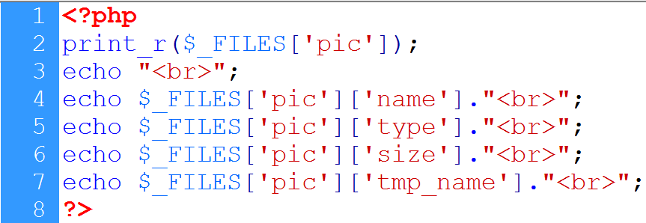
1. $_FILES: super-global variable…
Display files array
File name
File type
tmp name
File size

Slide 11

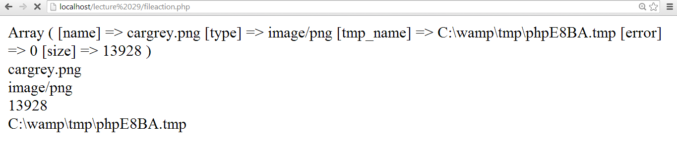
1. $_FILES: super-global variable…
Selected file
File name
File type
Files array
File size
Temp name

Slide 12
2. Uploading file
move_uploaded_file():
bool move_uploaded_file ( string $filename , string $destination );
This function checks to ensure that the file designated by filename is a valid upload file (meaning that it was uploaded via PHP's HTTP POST upload mechanism)
If the file is valid, it will be moved to the filename given by destination

Slide 13
2. Uploading file…
basename():
returns the filename from a path
Example:
<?PHP
echo basename("/home/httpd/html/index.php");
?>
retutns index.php

Slide 14
2. Uploading file…
File upload steps:
  Identify the file to be uploaded
    tmp_name is used
  Define destination
    Location + file name
  Upload the file

Slide 15

2. Uploading file…
File name
File tmp name
Folder + filename
File uploaded

Slide 16
2. Uploading file…
Restricting Users:
  Size restriction
  Type restriction
  File rename

Slide 17
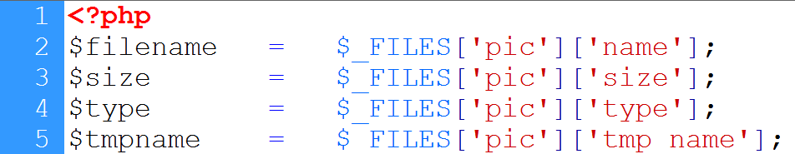

2. Uploading file…
Retrieving file attributes
File rename
Size and type
File uploaded

Slide 18
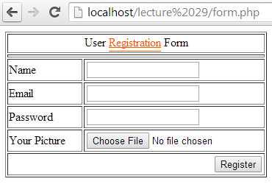
3. Storing reference to database
Method is post
Enctype=“multipart/form-data”
name
email
password
picture

Slide 19
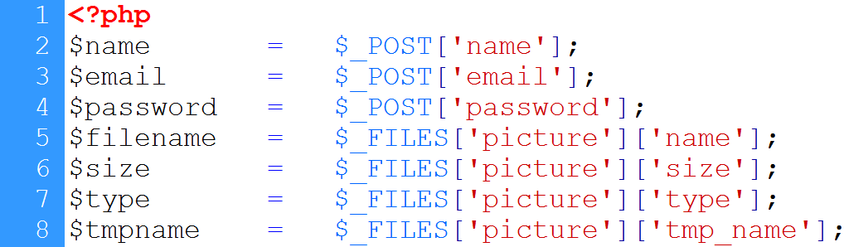

3. Storing reference to database…

Slide 20
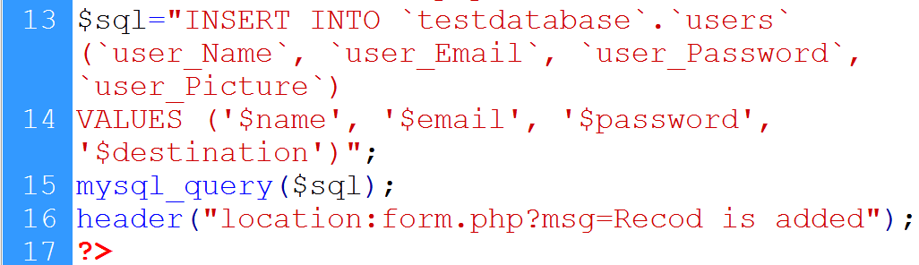
3. Storing reference to database…
DB connection
Insert query
Executing query
redirection

Slide 21
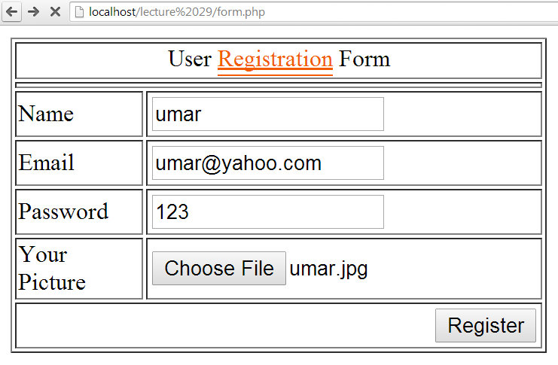
3. Storing reference to database…

Slide 22
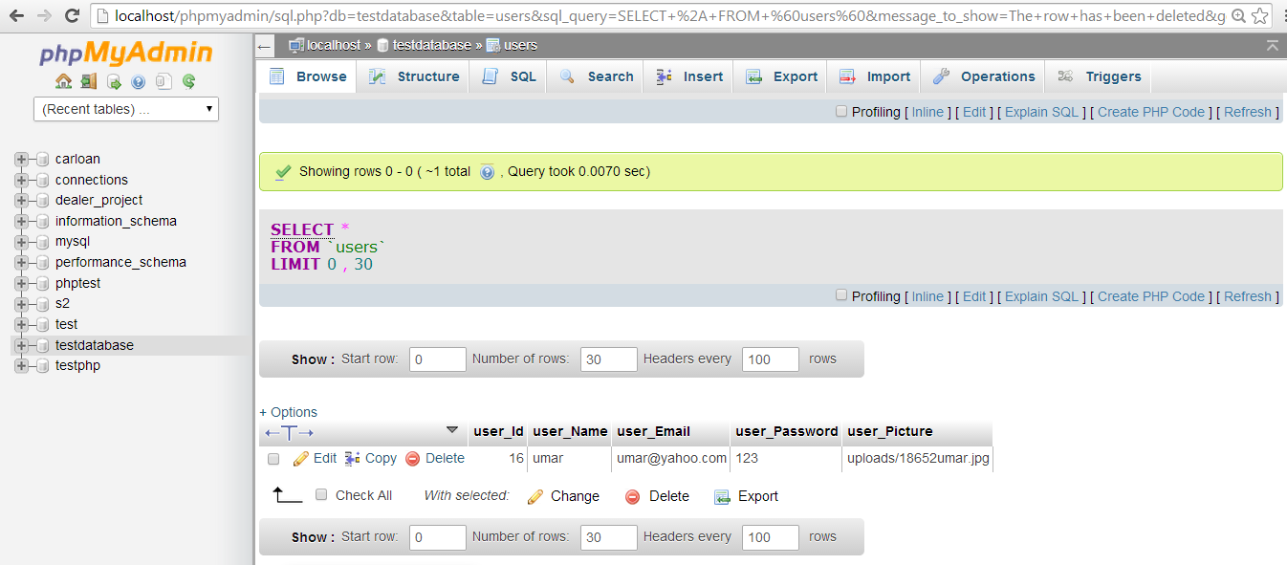
3. Storing reference to database…
Record is added

Slide 23

3. Storing reference to database…

Slide 24
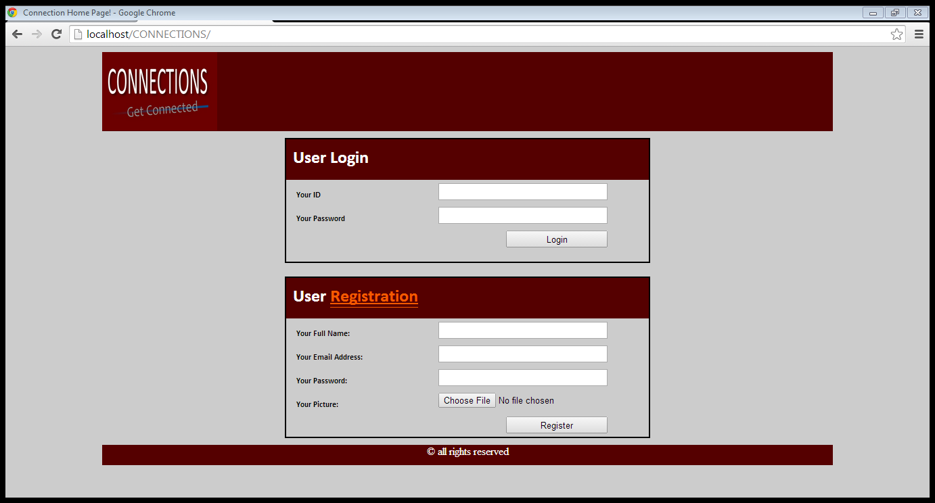
4. CONNECTIONS: registration action
post
name
email
password
pic

Slide 25

4. CONNECTIONS: registration action…
Input is retrieved
File is uploaded
DB connection

Slide 26
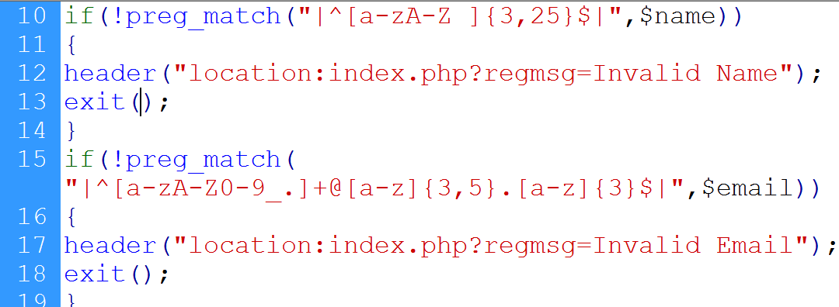
4. CONNECTIONS: registration action…
Input is validated

Slide 27
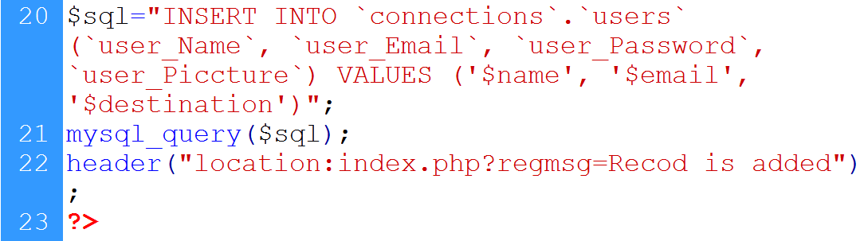
4. CONNECTIONS: registration action…
‘$password’,
Data is inserted

Slide 28
Summary
FILES super global variable
File uploading in PHP
Storing reference of uploaded file in database
User registration in CONNECTIONS web application with file upload

Slide 29
References
Chapter 30, “Beginning PHP and MySQL” by W. Jason Gilmore, Apress publisher, 4th edition; 2010, ISBN-13 (electronic): 978-1-4302-3115-8.

