Slide 1

CUI Abbottabad
Department of Computer Science
Data Structures and Algorithms
Lecture No. 31
Sorting - III

Slide 2
Agenda
Sorting Algorithms
  Quick Sort
    Introduction
    Algorithms
    Complexity Analysis

Slide 3
Quick Sort: Basic Idea
Pick one element in the array, which will be the pivot.
Make one pass through the array, called a partition step, re-arranging the entries so that:
  entries smaller than the pivot are to the left of the pivot.
  entries larger than the pivot are to the right

Slide 4
Basic Idea
Recursively apply quicksort to the part of the array that is to the left of the pivot, and to the part on its right.
No merge step, at the end all the elements are in the proper order

Slide 5
Quicksort
A[p…q]
≤
A[q+1…r]
Sort an array A[p…r]
Divide
  Partition the array A into 2 subarrays A[p..q] and A[q+1..r], such that each element of A[p..q] is smaller than or equal to each element in A[q+1..r]
  Need to find index q to partition the array

Slide 6
Quicksort
A[p…q]
≤
A[q+1…r]
Conquer
  Recursively sort A[p..q] and A[q+1..r] using Quicksort
Combine
  Trivial: the arrays are sorted in place
  No additional work is required to combine them
  The entire array is now sorted

Slide 7
QUICKSORT
Alg.: QUICKSORT(A, p, r)
if p < r
then q ← PARTITION(A, p, r)
QUICKSORT (A, p, q)
QUICKSORT (A, q+1, r)
Initially: p=1, r=n
Recurrence:
T(n) = T(q) + T(n – q) + f(n)

Slide 8
Example
Given an array of n elements (e.g., integers):
If array only contains one element, return
Else
  pick one element to use as pivot.
  Partition elements into two sub-arrays:
    Elements less than or equal to pivot
    Elements greater than pivot
  Quicksort two sub-arrays
  Return results

Slide 9
Example
We are given array of n integers to sort:
40
20
10
80
60
50
7
30
100

Slide 10
Pick Pivot Element
There are a number of ways to pick the pivot element. In this example, we will use the first element in the array:
40
20
10
80
60
50
7
30
100

Slide 11
Partitioning Array
Given a pivot, partition the elements of the array such that the resulting array consists of:
  One sub-array that contains elements >= pivot
  Another sub-array that contains elements < pivot
The sub-arrays are stored in the original data array.
Partitioning loops through, swapping elements below/above pivot.

Slide 12
pivot_index = 1
40
20
10
80
60
50
7
30
100
1 2 3 4 5 6 7 8 9
too_big_index
too_small_index

Slide 13
While data[too_big_index] <= data[pivot]
++too_big_index
pivot_index = 1
40
20
10
80
60
50
7
30
100
1 2 3 4 5 6 7 8 9
too_big_index
too_small_index

Slide 14
While data[too_big_index] <= data[pivot]
++too_big_index
pivot_index = 1
40
20
10
80
60
50
7
30
100
1 2 3 4 5 6 7 8 9
too_big_index
too_small_index

Slide 15
While data[too_big_index] <= data[pivot]
++too_big_index
pivot_index = 1
40
20
10
80
60
50
7
30
100
1 2 3 4 5 6 7 8 9
too_big_index
too_small_index

Slide 16
While data[too_big_index] <= data[pivot]
  ++too_big_index
While data[too_small_index] > data[pivot]
  --too_small_index
pivot_index = 1
40
20
10
80
60
50
7
30
100
1 2 3 4 5 6 7 8 9
too_big_index
too_small_index

Slide 17
While data[too_big_index] <= data[pivot]
  ++too_big_index
While data[too_small_index] > data[pivot]
  --too_small_index
pivot_index = 1
40
20
10
80
60
50
7
30
100
1 2 3 4 5 6 7 8 9
too_big_index
too_small_index

Slide 18
While data[too_big_index] <= data[pivot]
  ++too_big_index
While data[too_small_index] > data[pivot]
  --too_small_index
If too_big_index < too_small_index
  swap data[too_big_index] and data[too_small_index]
pivot_index = 1
40
20
10
80
60
50
7
30
100
1 2 3 4 5 6 7 8 9
too_big_index
too_small_index

Slide 19
While data[too_big_index] <= data[pivot]
  ++too_big_index
While data[too_small_index] > data[pivot]
  --too_small_index
If too_big_index < too_small_index
  swap data[too_big_index] and data[too_small_index]
pivot_index = 1
40
20
10
30
60
50
7
80
100
1 2 3 4 5 6 7 8 9
too_big_index
too_small_index

Slide 20
While data[too_big_index] <= data[pivot]
  ++too_big_index
While data[too_small_index] > data[pivot]
  --too_small_index
If too_big_index < too_small_index
  swap data[too_big_index] and data[too_small_index]
While too_small_index > too_big_index, go to 1.
pivot_index = 1
40
20
10
30
60
50
7
80
100
1 2 3 4 5 6 7 8 9
too_big_index
too_small_index

Slide 21
While data[too_big_index] <= data[pivot]
  ++too_big_index
While data[too_small_index] > data[pivot]
  --too_small_index
If too_big_index < too_small_index
  swap data[too_big_index] and data[too_small_index]
While too_small_index > too_big_index, go to 1.
pivot_index = 1
40
20
10
30
60
50
7
80
100
1 2 3 4 5 6 7 8 9
too_big_index
too_small_index

Slide 22
While data[too_big_index] <= data[pivot]
  ++too_big_index
While data[too_small_index] > data[pivot]
  --too_small_index
If too_big_index < too_small_index
  swap data[too_big_index] and data[too_small_index]
While too_small_index > too_big_index, go to 1.
pivot_index = 1
40
20
10
30
60
50
7
80
100
1 2 3 4 5 6 7 8 9
too_big_index
too_small_index

Slide 23
While data[too_big_index] <= data[pivot]
  ++too_big_index
While data[too_small_index] > data[pivot]
  --too_small_index
If too_big_index < too_small_index
  swap data[too_big_index] and data[too_small_index]
While too_small_index > too_big_index, go to 1.
pivot_index = 1
40
20
10
30
60
50
7
80
100
1 2 3 4 5 6 7 8 9
too_big_index
too_small_index

Slide 24
While data[too_big_index] <= data[pivot]
  ++too_big_index
While data[too_small_index] > data[pivot]
  --too_small_index
If too_big_index < too_small_index
  swap data[too_big_index] and data[too_small_index]
While too_small_index > too_big_index, go to 1.
pivot_index = 1
40
20
10
30
60
50
7
80
100
1 2 3 4 5 6 7 8 9
too_big_index
too_small_index

Slide 25
While data[too_big_index] <= data[pivot]
  ++too_big_index
While data[too_small_index] > data[pivot]
  --too_small_index
If too_big_index < too_small_index
  swap data[too_big_index] and data[too_small_index]
While too_small_index > too_big_index, go to 1.
pivot_index = 1
40
20
10
30
60
50
7
80
100
1 2 3 4 5 6 7 8 9
too_big_index
too_small_index

Slide 26
While data[too_big_index] <= data[pivot]
  ++too_big_index
While data[too_small_index] > data[pivot]
  --too_small_index
If too_big_index < too_small_index
  swap data[too_big_index] and data[too_small_index]
While too_small_index > too_big_index, go to 1.
pivot_index = 1
40
20
10
30
7
50
60
80
100
1 2 3 4 5 6 7 8 9
too_big_index
too_small_index

Slide 27
While data[too_big_index] <= data[pivot]
  ++too_big_index
While data[too_small_index] > data[pivot]
  --too_small_index
If too_big_index < too_small_index
  swap data[too_big_index] and data[too_small_index]
While too_small_index > too_big_index, go to 1.
pivot_index = 1
40
20
10
30
7
50
60
80
100
1 2 3 4 5 6 7 8 9
too_big_index
too_small_index

Slide 28
While data[too_big_index] <= data[pivot]
  ++too_big_index
While data[too_small_index] > data[pivot]
  --too_small_index
If too_big_index < too_small_index
  swap data[too_big_index] and data[too_small_index]
While too_small_index > too_big_index, go to 1.
pivot_index = 1
40
20
10
30
7
50
60
80
100
1 2 3 4 5 6 7 8 9
too_big_index
too_small_index

Slide 29
While data[too_big_index] <= data[pivot]
  ++too_big_index
While data[too_small_index] > data[pivot]
  --too_small_index
If too_big_index < too_small_index
  swap data[too_big_index] and data[too_small_index]
While too_small_index > too_big_index, go to 1.
pivot_index = 1
40
20
10
30
7
50
60
80
100
1 2 3 4 5 6 7 8 9
too_big_index
too_small_index

Slide 30
While data[too_big_index] <= data[pivot]
  ++too_big_index
While data[too_small_index] > data[pivot]
  --too_small_index
If too_big_index < too_small_index
  swap data[too_big_index] and data[too_small_index]
While too_small_index > too_big_index, go to 1.
pivot_index = 1
40
20
10
30
7
50
60
80
100
1 2 3 4 5 6 7 8 9
too_big_index
too_small_index

Slide 31
While data[too_big_index] <= data[pivot]
  ++too_big_index
While data[too_small_index] > data[pivot]
  --too_small_index
If too_big_index < too_small_index
  swap data[too_big_index] and data[too_small_index]
While too_small_index > too_big_index, go to 1.
pivot_index = 1
40
20
10
30
7
50
60
80
100
1 2 3 4 5 6 7 8 9
too_big_index
too_small_index

Slide 32
While data[too_big_index] <= data[pivot]
  ++too_big_index
While data[too_small_index] > data[pivot]
  --too_small_index
If too_big_index < too_small_index
  swap data[too_big_index] and data[too_small_index]
While too_small_index > too_big_index, go to 1.
pivot_index = 1
40
20
10
30
7
50
60
80
100
1 2 3 4 5 6 7 8 9
too_big_index
too_small_index

Slide 33
While data[too_big_index] <= data[pivot]
  ++too_big_index
While data[too_small_index] > data[pivot]
  --too_small_index
If too_big_index < too_small_index
  swap data[too_big_index] and data[too_small_index]
While too_small_index > too_big_index, go to 1.
pivot_index = 1
40
20
10
30
7
50
60
80
100
1 2 3 4 5 6 7 8 9
too_big_index
too_small_index

Slide 34
While data[too_big_index] <= data[pivot]
  ++too_big_index
While data[too_small_index] > data[pivot]
  --too_small_index
If too_big_index < too_small_index
  swap data[too_big_index] and data[too_small_index]
While too_small_index > too_big_index, go to 1.
pivot_index = 1
40
20
10
30
7
50
60
80
100
1 2 3 4 5 6 7 8 9
too_big_index
too_small_index

Slide 35
While data[too_big_index] <= data[pivot]
  ++too_big_index
While data[too_small_index] > data[pivot]
  --too_small_index
If too_big_index < too_small_index
  swap data[too_big_index] and data[too_small_index]
While too_small_index > too_big_index, go to 1.
Swap data[too_small_index] and data[pivot_index]
pivot_index = 1
40
20
10
30
7
50
60
80
100
1 2 3 4 5 6 7 8 9
too_big_index
too_small_index

Slide 36
While data[too_big_index] <= data[pivot]
  ++too_big_index
While data[too_small_index] > data[pivot]
  --too_small_index
If too_big_index < too_small_index
  swap data[too_big_index] and data[too_small_index]
While too_small_index > too_big_index, go to 1.
Swap data[too_small_index] and data[pivot_index]
7
20
10
30
40
50
60
80
100
pivot_index = 5
1 2 3 4 5 6 7 8 9
too_big_index
too_small_index

Slide 37
Partition Result
7
20
10
30
40
50
60
80
100
1 2 3 4 5 6 7 8 9
<= data[pivot]
> data[pivot]

Slide 38
Recursion: Quicksort Sub-arrays
7
20
10
30
40
50
60
80
100
1 2 3 4 5 6 7 8 9
<= data[pivot]
> data[pivot]

Slide 39
Example
A[p…r]
pivot x=5
5
3
2
6
4
1
3
7
5
3
2
6
4
1
3
7
i
j
i
j
3
3
2
6
4
1
5
7
3
3
2
6
4
1
5
7
i
j
i
j
A[p…q]
A[q+1…r]
3
3
2
1
4
6
5
7
3
3
2
1
4
6
5
7
i
j
j
i

Slide 40
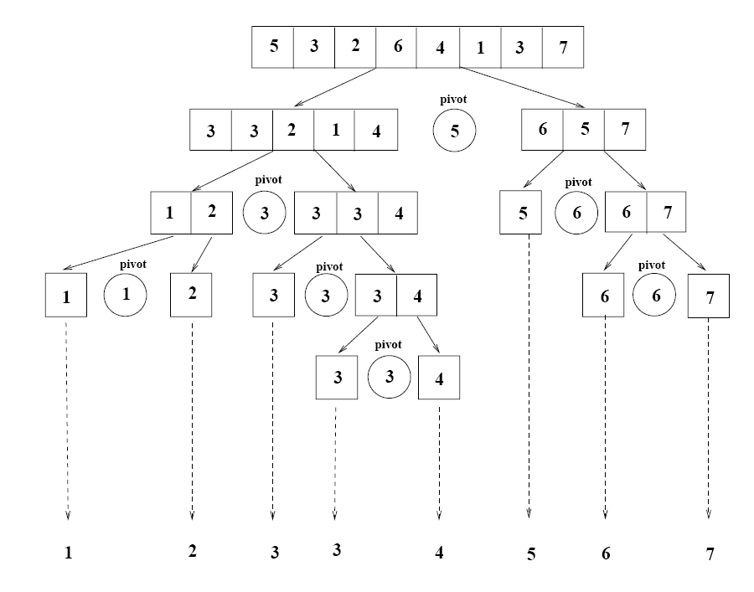
Example

Slide 41
Partitioning the Array
Alg. PARTITION (A, p, r)
x ← A[p]
i ← p – 1
j ← r + 1
while TRUE
do repeat j ← j – 1
until A[j] ≤ x
do repeat i ← i + 1
until A[i] ≥ x
if i < j
then exchange A[i] ↔ A[j]
else return j
p
r
A:
5
3
2
6
4
1
3
7
i
j
A[p…q]
≤
A[q+1…r]
A:
a_{p}
a_{r}
j=q
i
Each element is
visited once!
Running time: Θ(n)
n = r – p + 1

Slide 42
Recurrence
Alg.: QUICKSORT(A, p, r)
if p < r
then q ← PARTITION(A, p, r)
QUICKSORT (A, p, q)
QUICKSORT (A, q+1, r)
Initially: p=1, r=n
Recurrence:
T(n) = T(q) + T(n – q) + n

Slide 43
Choosing the Pivot
Some fixed element: e.g. the first, the last, the one in the middle.
Bad choice - may turn to be the smallest or the largest element, then one of the partitions will be empty
Randomly chosen (by random generator) - still a bad choice

Slide 44
Choosing the Pivot
The median of the array
(if the array has N numbers, the median is the [N/2] largest number).
This is difficult to compute - increases the complexity.

Slide 45
Choosing the Pivot
The median-of-three choice:
take the first, the last and the middle element.
Choose the median of these three elements.

Slide 46
Find the Pivot
int median3 ( int [ ]a, int left, int right)
{ int center = (left + right)/2;
if (a [left] > a [ center]) swap (a [ left ], a [center]);
if (a [center] > a [right]) swap (a[center], a[ right ]);
if (a [left] > a [ center]) swap (a [ left ], a [center]);
swap(a [ center ], a [ right-1 ]);
return a[ right-1 ];
}

Slide 47
Quick Sort
{ int i = left, j = right - 1;
for ( ; ; )
{ while (a [i ] < pivot) {i++ }
while ( pivot < a [j ] ) {j-- }
if (i < j) swap (a[ i ], a [ j ]);
else break; }
swap (a [ i ], a [ right-1 ]);
quickSort ( a, left, i-1);
quickSort (a, i+1, right); }

Slide 48
Worst Case Partitioning
Worst-case partitioning
  One region has one element and the other has n – 1 elements
  Maximally unbalanced
Recurrence: q=1
  T(n) = T(1) + T(n – 1) + n,
  T(1) = Θ(1)
  T(n) = T(n – 1) + n
  =
n
n
1
n - 1
n
1
n - 2
n - 1
n
1
n - 3
n - 2
1
2
3
1
1
2
Θ(n²)
When does the worst case happen?

Slide 49
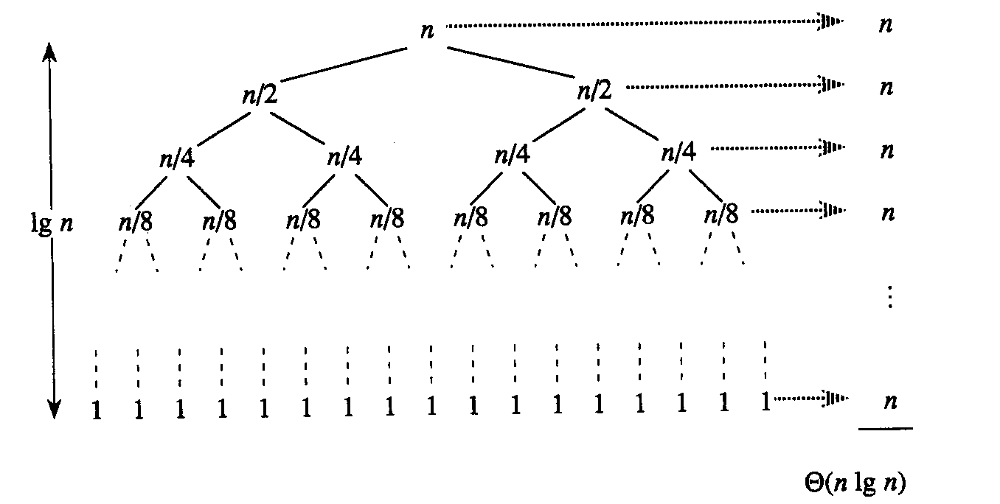
Best Case Partitioning
Best-case partitioning
  Partitioning produces two regions of size n/2
Recurrence: q=n/2
  T(n) = 2T(n/2) + Θ(n)
  T(n) = Θ(nlgn) (Master theorem)

Slide 50
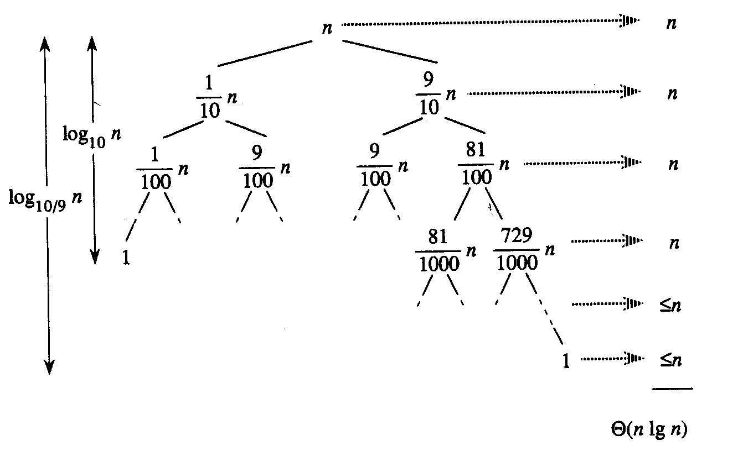
Case Between Worst and Best
9-to-1 proportional split
Q(n) = Q(9n/10) + Q(n/10) + n

Slide 51
Complexity of Quick Sort
Average-case O(NlogN)
Worst Case: O(N²)
This happens when the pivot is the smallest (or the largest) element.
Then one of the partitions is empty, and we repeat recursively the procedure for N-1 elements.

Slide 52
Complexity of Quick Sort
Best-case O(NlogN)
The pivot is the median of the array,
the left and the right parts have same size.
There are logN partitions, and to obtain each partitions we do N comparisons (and not more than N/2 swaps). Hence the complexity is O(NlogN)

Slide 53
Advantages and Disadvantages
Advantages:
  One of the fastest algorithms on average
  Does not need additional memory (the sorting takes place in the array - this is called in-place processing )
Disadvantages:
  The worst-case complexity is O(N²)

Slide 54
Applications
Commercial applications
Quick Sort generally runs fast
No additional memory
The above advantages compensate for the rare occasions when it runs with O(N²)

Slide 55
Applications
Warning:
Never use in applications which require a guarantee of response time:
Life-critical
(medical monitoring,
life support in aircraft, space craft)
Mission-critical
(industrial monitoring and control in handling dangerous materials, control for aircraft, defense, etc)
unless you assume the worst-case response time

Slide 56
Comparison with Merge Sort
Merge sort guarantees O(NlogN) time
Merge sort requires additional memory with size N
Usually Merge sort is not used for main memory sorting, only for external memory sorting

Slide 57
Summary
  Summary

Slide 58
  THANK YOU
  Q & A

