Slide 1

CUI Abbottabad
Department of Computer Science
Data Structures and Algorithms
Lecture No. 30
Sorting - II

Slide 2
Agenda
Sorting Algorithms
  Insertion Sort
    Introduction
    Algorithms
  Merge Sort
    Introduction
    Algorithms
  Complexity Analysis

Slide 3
Insertion Sort
Idea: like sorting a hand of playing cards
  Start with an empty left hand and the cards facing down on the table.
  Remove one card at a time from the table, and insert it into the correct position in the left hand
    compare it with each of the cards already in the hand, from right to left
  The cards held in the left hand are sorted
    these cards were originally the top cards of the pile on the table

Slide 4
Insertion Sort
To insert 12, we need to make room for it by moving first 36 and then 24.
6
10
24
36
12

Slide 5
Insertion Sort
6
10
24
36
12

Slide 6
Insertion Sort
6
10
24
36
12

Slide 7
Insertion Sort
input array
5 2 4 6 1 3
at each iteration, the array is divided in two sub-arrays:
left sub-array
right sub-array
sorted
unsorted

Slide 8
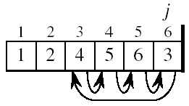
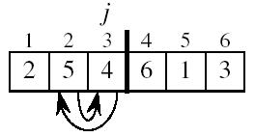
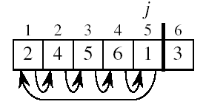
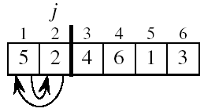
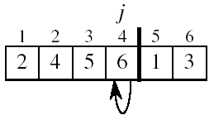
Insertion Sort

Slide 9
INSERTION-SORT
Alg.: INSERTION-SORT(A)
for j ← 2 to n
do key ← A[ j ]
//Insert A[ j ] into the sorted sequence A[1 . . j -1]
i ← j - 1
while i > 0 and A[i] > key
do A[i + 1] ← A[i]
i ← i – 1
A[i + 1] ← key
Insertion sort – sorts the elements in place
1
2
3
4
5
6
7
8
a₁
a₂
a₃
a₄
a₅
a₆
a₇
a₈
key

Slide 10
Loop Invariant for Insertion Sort
Alg.: INSERTION-SORT(A)
for j ← 2 to n
do key ← A[ j ]
//Insert A[ j ] into the sorted sequence A[1 . . j -1]
i ← j - 1
while i > 0 and A[i] > key
do A[i + 1] ← A[i]
i ← i – 1
A[i + 1] ← key
Invariant: at the start of the for loop the elements in A[1 . . j-1] are in sorted order

Slide 11
Analysis of Insertion Sort
INSERTION-SORT(A)
for j ← 2 to n
do key ← A[ j ]
//Insert A[ j ] into the sorted sequence A[1 . . j -1]
i ← j - 1
while i > 0 and A[i] > key
do A[i + 1] ← A[i]
i ← i – 1
A[i + 1] ← key
cost times
c₁ n
c₂ n-1
0 n-1
c₄ n-1
c₅
c₆
c₇
c₈ n-1
t_{j}: # of times the while statement is executed at iteration j
Notes:
₇

Slide 12
Best Case Analysis
The array is already sorted
  A[i] ≤ key upon the first time the while loop test is run (when i = j -1)
  t_{j} = 1
T(n) = c₁n + c₂(n -1) + c₄(n -1) + c₅(n -1) + c₈(n-1) = (c₁ + c₂ + c₄ + c₅ + c₈)n + (c₂ + c₄ + c₅ + c₈)
= an + b = Θ(n)
“while i > 0 and A[i] > key”

Slide 13
Worst Case Analysis
The array is in reverse sorted order
  Always A[i] > key in while loop test
  Have to compare key with all elements to the left of the j-th position ⇒ compare with j-1 elements ⇒ t_{j} = j
  a quadratic function of n
T(n) = Θ(n²) order of growth in n²
“while i > 0 and A[i] > key”
using
we have:

Slide 14
Comparisons and Exchanges in Insertion Sort
INSERTION-SORT(A)
for j ← 2 to n
do key ← A[ j ]
//Insert A[ j ] into the sorted sequence A[1 . . j -1]
i ← j - 1
while i > 0 and A[i] > key
do A[i + 1] ← A[i]
i ← i – 1
A[i + 1] ← key
cost times
c₁ n
c₂ n-1
0 n-1
c₄ n-1
c₅
c₆
c₇
c₈ n-1
≈ n²/2 comparisons
≈ n²/2 exchanges

Slide 15
Insertion Sort - Summary
Advantages
  Good running time for “almost sorted” arrays Θ(n)
Disadvantages
  Θ(n²) running time in worst and average case
  ≈ n²/2 comparisons and exchanges

Slide 16
Sorting
Insertion sort
  Design approach:
  Sorts in place:
  Best case:
  Worst case:
Bubble Sort
  Design approach:
  Sorts in place:
  Running time:
incremental
Yes
Θ(n)
Θ(n²)
incremental
Yes
Θ(n²)

Slide 17
Sorting
Selection sort
  Design approach:
  Sorts in place:
  Running time:
Merge Sort
  Design approach:
  Sorts in place:
  Running time:
incremental
Yes
Θ(n²)
divide and conquer
No
Let’s see!!

Slide 18
Divide-and-Conquer
Divide the problem into a number of sub-problems
  Similar sub-problems of smaller size
Conquer the sub-problems
  Solve the sub-problems recursively
  Sub-problem size small enough ⇒ solve the problems in straightforward manner
Combine the solutions of the sub-problems
  Obtain the solution for the original problem

Slide 19
Merge Sort

Slide 20
Merge Sort Approach
To sort an array A[p . . r]:
Divide
  Divide the n-element sequence to be sorted into two subsequences of n/2 elements each
Conquer
  Sort the subsequences recursively using merge sort
  When the size of the sequences is 1 there is nothing more to do
Combine
  Merge the two sorted subsequences

Slide 21
Merge Sort
p
q
r
1
2
3
4
5
6
7
8
Alg.: MERGE-SORT(A, p, r)
if p < r Check for base case
then q ← ⎣(p + r)/2⎦ Divide
MERGE-SORT(A, p, q) Conquer
MERGE-SORT(A, q + 1, r) Conquer
MERGE(A, p, q, r) Combine
Initial call: MERGE-SORT(A, 1, n)
5
2
4
7
1
3
2
6

Slide 22
Example – 1
Divide
1
2
3
4
5
6
7
8
5
2
4
7
1
3
2
6
q = 4
1
2
3
4
5
6
7
8
5
2
4
7
1
3
2
6
1
2
3
4
5
6
7
8
5
2
4
7
1
3
2
6
1
2
3
4
5
6
7
8
5
2
4
7
1
3
2
6

Slide 23
Example – 1
Conquer
and
Merge
1
2
3
4
5
6
7
8
1
2
2
3
4
5
6
7
1
2
3
4
5
6
7
8
2
4
5
7
1
2
3
6
1
2
3
4
5
6
7
8
2
5
4
7
1
3
2
6
1
2
3
4
5
6
7
8
5
2
4
7
1
3
2
6

Slide 24
Example – 2
1
2
3
4
5
6
7
8
9
10
11
Divide
4
7
2
6
1
4
7
3
5
2
6
q = 6
1
2
3
4
5
6
7
8
9
10
11
q = 3
4
7
2
6
1
4
7
3
5
2
6
q = 9
1
2
3
4
5
6
7
8
9
10
11
4
7
2
6
1
4
7
3
5
2
6
1
2
3
4
5
6
7
8
9
10
11
4
7
2
6
1
4
7
3
5
2
6
1
2
4
5
7
8
4
7
6
1
7
3

Slide 25
Example –2
Conquer
and
Merge
1
2
3
4
5
6
7
8
9
10
11
1
2
2
3
4
4
5
6
6
7
7
1
2
3
4
5
6
7
8
9
10
11
1
2
4
4
6
7
2
3
5
6
7
1
2
3
4
5
6
7
8
9
10
11
2
4
7
1
4
6
3
5
7
2
6
1
2
3
4
5
6
7
8
9
10
11
4
7
2
1
6
4
3
7
5
2
6
1
2
4
5
7
8
4
7
6
1
7
3

Slide 26
Merging
p
q
r
1
2
3
4
5
6
7
8
2
4
5
7
1
2
3
6
Input: Array A and indices p, q, r such that p ≤ q < r
  Subarrays A[p . . q] and A[q + 1 . . r] are sorted
Output: One single sorted subarray A[p . . r]

Slide 27
Merging
Idea for merging:
  Two piles of sorted cards
    Choose the smaller of the two top cards
    Remove it and place it in the output pile
  Repeat the process until one pile is empty
  Take the remaining input pile and place it face-down onto the output pile
p
q
r
1
2
3
4
5
6
7
8
2
4
5
7
1
2
3
6
A1← A[p, q]
A[p, r]
A2← A[q+1, r]

Slide 28
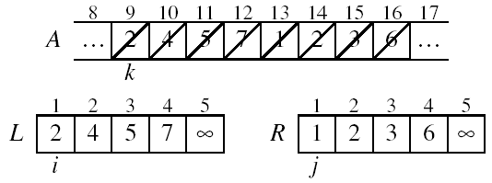
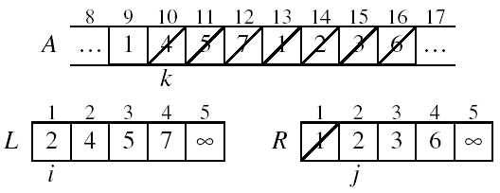
Example: MERGE(A, 9, 12, 16)
p
q
r
Divide
Merge

Slide 29
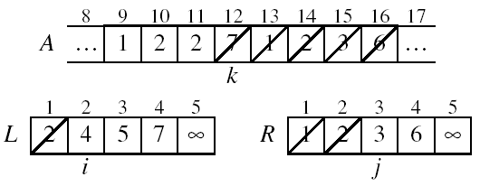
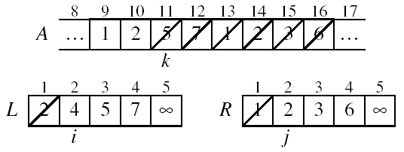
Example: MERGE(A, 9, 12, 16)
Merge
Merge

Slide 30
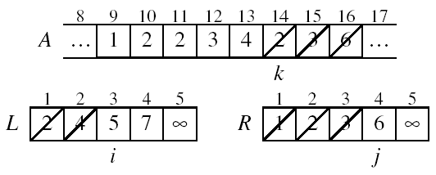
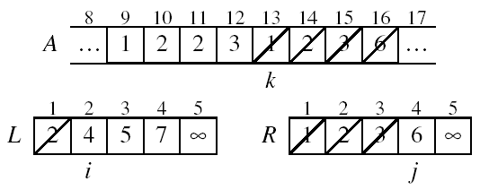
Example (cont.)
Merge
Merge

Slide 31
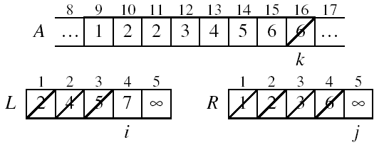
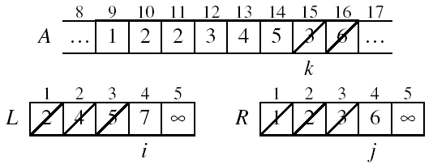
Example (cont.)
Merge
Merge

Slide 32
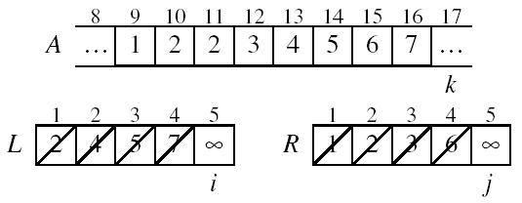
Example (cont.)
Done!

Slide 33
Merge - Pseudocode
p
q
r
Alg.: MERGE(A, p, q, r)
Compute n₁ and n₂
Copy the first n₁ elements into L[1 . . n₁ + 1] and the next n₂ elements into R[1 . . n₂ + 1]
L[n₁ + 1] ← ∞; R[n₂ + 1] ← ∞
i ← 1; j ← 1
for k ← p to r
do if L[ i ] ≤ R[ j ]
then A[k] ← L[ i ]
i ←i + 1
else A[k] ← R[ j ]
j ← j + 1
1
2
3
4
5
6
7
8
2
4
5
7
1
2
3
6
n₁
n₂
p
q
L
2
4
5
7
∞
q + 1
r
R
1
2
3
6
∞

Slide 34
Running Time of Merge
(assume last for loop)
Initialization (copying into temporary arrays):
  Θ(n₁ + n₂) = Θ(n)
Adding the elements to the final array:
  - n iterations, each taking constant time ⇒ Θ(n)
Total time for Merge:
  Θ(n)

Slide 35
Analyzing Divide-and Conquer Algorithms
The recurrence is based on the three steps of the paradigm:
  T(n) – running time on a problem of size n
  Divide the problem into a subproblems, each of size n/b: takes D(n)
  Conquer (solve) the subproblems aT(n/b)
  Combine the solutions C(n)
Θ(1) if n ≤ c
T(n) = aT(n/b) + D(n) + C(n) otherwise

Slide 36
MERGE-SORT Running Time
Divide:
  compute q as the average of p and r: D(n) = Θ(1)
Conquer:
  recursively solve 2 subproblems, each of size n/2 ⇒ 2T (n/2)
Combine:
  MERGE on an n-element subarray takes Θ(n) time ⇒ C(n) = Θ(n)
Θ(1) if n =1
T(n) = 2T(n/2) + Θ(n) if n > 1

Slide 37
Solve the Recurrence
T(n) = c if n = 1
2T(n/2) + cn if n > 1
Use Master’s Theorem:
Compare n with f(n) = cn
Case 2: T(n) = Θ(nlgn)

Slide 38
Analyzing merge sort
cost of sorting N items using merge sort = cost of sorting left half (N/2 items) + cost of sorting right half (N/2 items) + cost of merging (N items)
more concisely: Cost(N) = 2Cost(N/2) + C₁N + C₂
Cost(N) = 2Cost(N/2) + C₁*N + C₂ can unwind Cost(N/2)
= 2( 2Cost(N/4) + C₁N/2 + C₂) + C₁N + C₂
= 4Cost(N/4) + 2C₁N + 3C₂ can unwind Cost(N/4)
= 4( 2Cost(N/8) + C₁N/4 + C₂) + 2C₁N + 3C₂
= 8Cost(N/8) + 3C₁N + 7C₂ can continue unwinding
= …
= NCost(1) + (log₂N)C₁N + (N-1) C₂
= C₁N log₂ N + (C'+C₂)N - C₂ where C' = Cost(1)
➔ O(N log N)

Slide 39
Merge Sort - Discussion
Running time insensitive of the input
Advantages:
  Guaranteed to run in Θ(nlgn)
Disadvantage
  Requires extra space ≈N

Slide 40
Sorting challenge 1: Huge, Randomly - Ordered Files
Selection sort?
  NO, always takes quadratic time
Bubble sort?
  NO, quadratic time for randomly-ordered keys
Insertion sort?
  NO, quadratic time for randomly-ordered keys
Mergesort?
  YES, it is designed for this problem

Slide 41
Sorting Challenge 2
Problem: sort a file that is already almost in order
Applications:
  Re-sort a huge database after a few changes
  Doublecheck that someone else sorted a file
Which sorting method to use?
  Mergesort, guaranteed to run in time ∼NlgN
  Selection sort
  Bubble sort
  A custom algorithm for almost in-order files
  Insertion sort

Slide 42
Sorting Files That are Almost in Order
Selection sort?
  NO, always takes quadratic time
Bubble sort?
  NO, bad for some definitions of “almost in order”
  Ex: B C D E F G H I J K L M N O P Q R S T U V W X Y Z A
Insertion sort?
  YES, takes linear time for most definitions of “almost in order”
Merge sort or custom method?
  Probably not: insertion sort simpler and faster

Slide 43
Summary
  Summary

Slide 44
  THANK YOU
  Q & A

