Slide 1

CUI Abbottabad
Department of Computer Science
Data Structures and Algorithms
Lecture No. 28
Searching

Slide 2
Agenda
Searching Algorithms
  Linear Search
  Binary Search
  Difference between both
  Complexity Analysis

Slide 3
Problem: Search
We are given a list of records.
Each record has an associated key.
Give efficient algorithm for searching for a record containing a particular key.
Efficiency is quantified in terms of average time analysis (number of comparisons) to retrieve an item.

Slide 4
Search
[ 0 ]
[ 1 ]
[ 2 ]
[ 3 ]
[ 4 ]
[ 700 ]
…
Number 701466868
Number 281942902
Number 233667136
Number 580625685
Number 506643548
Number 155778322
Each record in list has an associated key.
In this example, the keys are ID numbers.
Given a particular key, how can we efficiently retrieve the record from the list?
Number 580625685

Slide 5
Linear Search
Step through array of records, one at a time.
Look for record with matching key.
Search stops when
  record with matching key is found
  or when search has examined all records without success.

Slide 6
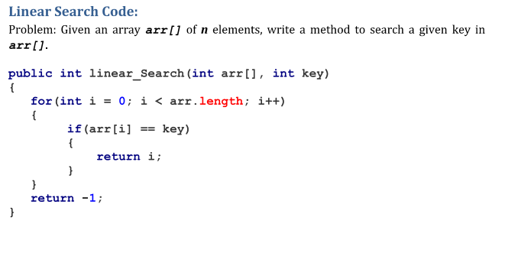
Pseudocode for Linear Search

Slide 7
Linear Search Analysis
What are the worst and average case running times for Linear search?
We must determine the O-notation for the number of operations required in search.
Number of operations depends on n, the number of entries in the list.

Slide 8
Worst Case Time for Linear Search
For an array of n elements, the worst case time for Linear search requires n array accesses: O(n).
Consider cases where we must loop over all n records:
  desired record appears in the last position of the array
  desired record does not appear in the array at all

Slide 9
Average Case for Linear Search
Assumptions:
  All keys are equally likely in a search
  We always search for a key that is in the array
Example:
We have an array of 10 records.
If search for the first record, then it requires 1 array access; if the second, then 2 array accesses. etc.
The average of all these searches is:
  (1+2+3+4+5+6+7+8+9+10)/10 = 5.5

Slide 10
Average Case Time for Linear Search
Generalize for array size n.
Expression for average-case running time:
(1+2+…+n)/n = n(n+1)/2n = (n+1)/2
Therefore, average case time complexity for Linear search is O(n).

Slide 11
Binary Search
Perhaps we can do better than O(n) in the average case?
Assume that we are give an array of records that is sorted. For instance:
  an array of records with integer keys sorted from smallest to largest (e.g., ID numbers), or
  an array of records with string keys sorted in alphabetical order (e.g., names).

Slide 12
Binary Search Pseudocode
…
if(size == 0)
found = false;
else {
middle = index of approximate midpoint of array segment;
if(target == a[middle])
target has been found!
else if(target < a[middle])
search for target in area before midpoint;
else
search for target in area after midpoint;
}
…

Slide 13
Binary Search
Example: sorted array of integer keys. Target=7.
[ 0 ]
[ 1 ]
[ 2 ]
[ 3 ]
[ 4 ]
[ 5 ]
[ 6 ]
3
6
7
11
32
33
53

Slide 14
Binary Search
Example: sorted array of integer keys. Target=7.
[ 0 ]
[ 1 ]
[ 2 ]
[ 3 ]
[ 4 ]
[ 5 ]
[ 6 ]
3
6
7
11
32
33
53
Find approximate midpoint

Slide 15
Binary Search
Example: sorted array of integer keys. Target=7.
[ 0 ]
[ 1 ]
[ 2 ]
[ 3 ]
[ 4 ]
[ 5 ]
[ 6 ]
3
6
7
11
32
33
53
Is 7 = midpoint key? NO.

Slide 16
Binary Search
Example: sorted array of integer keys. Target=7.
[ 0 ]
[ 1 ]
[ 2 ]
[ 3 ]
[ 4 ]
[ 5 ]
[ 6 ]
3
6
7
11
32
33
53
Is 7 < midpoint key? YES.

Slide 17
Binary Search
Example: sorted array of integer keys. Target=7.
[ 0 ]
[ 1 ]
[ 2 ]
[ 3 ]
[ 4 ]
[ 5 ]
[ 6 ]
3
6
7
11
32
33
53
Search for the target in the area before midpoint.

Slide 18
Binary Search
Example: sorted array of integer keys. Target=7.
[ 0 ]
[ 1 ]
[ 2 ]
[ 3 ]
[ 4 ]
[ 5 ]
[ 6 ]
3
6
7
11
32
33
53
Find approximate midpoint

Slide 19
Binary Search
Example: sorted array of integer keys. Target=7.
[ 0 ]
[ 1 ]
[ 2 ]
[ 3 ]
[ 4 ]
[ 5 ]
[ 6 ]
3
6
7
11
32
33
53
Target = key of midpoint? NO.

Slide 20
Binary Search
Example: sorted array of integer keys. Target=7.
[ 0 ]
[ 1 ]
[ 2 ]
[ 3 ]
[ 4 ]
[ 5 ]
[ 6 ]
3
6
7
11
32
33
53
Target < key of midpoint? NO.

Slide 21
Binary Search
Example: sorted array of integer keys. Target=7.
[ 0 ]
[ 1 ]
[ 2 ]
[ 3 ]
[ 4 ]
[ 5 ]
[ 6 ]
3
6
7
11
32
33
53
Target > key of midpoint? YES.

Slide 22
Binary Search
Example: sorted array of integer keys. Target=7.
[ 0 ]
[ 1 ]
[ 2 ]
[ 3 ]
[ 4 ]
[ 5 ]
[ 6 ]
3
6
7
11
32
33
53
Search for the target in the area after midpoint.

Slide 23
Binary Search
Example: sorted array of integer keys. Target=7.
[ 0 ]
[ 1 ]
[ 2 ]
[ 3 ]
[ 4 ]
[ 5 ]
[ 6 ]
3
6
7
11
32
33
53
Find approximate midpoint.
Is target = midpoint key? YES.

Slide 24
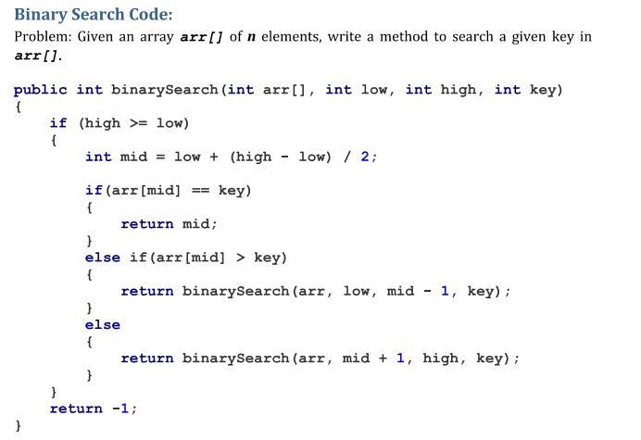
Binary Search Implementation

Slide 25
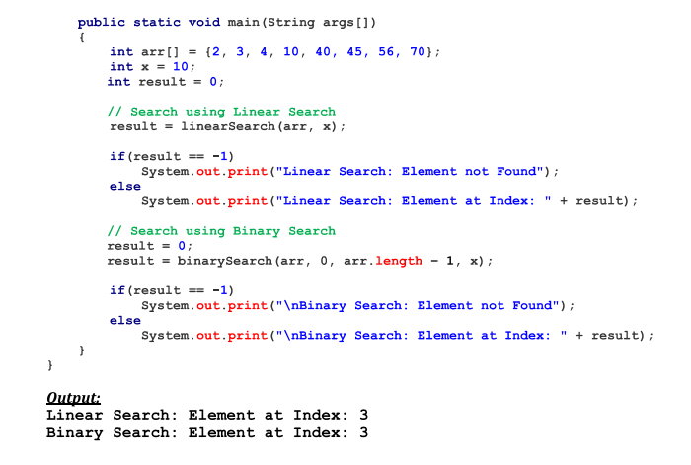
Binary Search Implementation

Slide 26
Relation to Binary Search Tree
Array of previous example:
3
6
7
11
32
33
53
Corresponding complete binary search tree
11
6
33
3
7
32
53

Slide 27
Search for target = 7
Find midpoint:
3
6
7
11
32
33
53
Start at root:
11
6
33
3
7
32
53

Slide 28
Search for target = 7
Search left subarray:
3
6
7
11
32
33
53
Search left subtree:
11
6
33
3
7
32
53

Slide 29
Search for target = 7
Find approximate midpoint of subarray:
3
6
7
11
32
33
53
Visit root of subtree:
11
6
33
3
7
32
53

Slide 30
Search for target = 7
Search right subarray:
3
6
7
11
32
33
53
Search right subtree:
11
6
33
3
7
32
53

Slide 31
Binary Search: Analysis
Worst case complexity?
What is the maximum depth of recursive calls in binary search as function of n?
Each level in the recursion, we split the array in half (divide by two).
Therefore maximum recursion depth is floor(log₂n) and worst case = O(log₂n).
Average case is also = O(log₂n).

Slide 32
Can we do better than O(log₂n)?
Average and worst case of Linear search = O(n)
Average and worst case of binary search = O(log₂n)
Can we do better than this?
  YES. Use a hash table!
  We will discuss it in coming lectures

Slide 33
Summary
  Summary

Slide 34
  THANK YOU
  Q & A

