Slide 1

CUI Abbottabad
Department of Computer Science
Data Structures and Algorithms
Lecture No. 27
Minimum Spanning Tree

Slide 2
Agenda
Minimum Spanning Tree
  Kruskal Algorithm
    Introduction
    Operation
    Algorithm
  Prim’s Algorithm
    Introduction
    Operation
    Algorithm

Slide 3
Spanning Trees
Suppose it is required to develop a system of roads between six major cities.
A survey of the area revealed that only the roads shown in the graph could be constructed.

Slide 4
Spanning Trees. Cont..
For economic reasons, it is desired to construct the least possible number of roads to connect the six cities.
One such set of roads is
Note that the subgraph representing these roads is a tree, it is connected & circuit-free (six vertices and five edges)

Slide 5
Definition: Spanning Trees
A spanning tree for a graph G is a subgraph of G that contains every vertex of G and is a tree.
REMARK:
Every connected graph has a spanning tree.
A graph may have more than one spanning trees.
Any two spanning trees for a graph have the same number of edges.
If a graph is a tree, then its only spanning tree is itself.

Slide 6
Spanning Trees
A spanning tree of a graph is just a subgraph that contains all the vertices and is a tree.
A graph may have many spanning trees.
Graph A
Some Spanning Trees from Graph A
or
or
or

Slide 7
Complete Graph
All 16 of its Spanning Trees

Slide 8
MINIMUM SPANNING TREE
A minimal spanning tree for a weighted graph is a spanning tree that has the least possible total weight compared to all other spanning trees of the graph.
If G is a weighted graph and e is an edge of G then w(e) denotes the weight of e and w(G) denotes the total weight of G.
T₁
W(T₁)=15
T₂
W(T₂)=11
T₃
W(T₃)=14

Slide 9
Minimum Spanning Trees
The Minimum Spanning Tree for a given graph is the Spanning Tree of minimum cost for that graph.
Complete Graph
Minimum Spanning Tree
7
2
2
5
3
3
4
1
1

Slide 10
MST
MST for given G may not be unique
Since MST is a spanning tree:
  # edges : |V| - 1
If the graph is unweighted:
  All spanning trees have same weight

Slide 11
Minimum Spanning Tree
Problem: given a connected, undirected, weighted graph, find a spanning tree using edges that minimize the total weight
6
4
5
9
14
2
10
15
3
8

Slide 12
Minimum Spanning Tree
Which edges form the minimum spanning tree (MST) of the below graph?
A
6
4
H
5
B
9
C
14
2
10
G
E
15
D
3
8
F

Slide 13
Minimum Spanning Tree
Answer:
A
6
4
H
5
B
9
C
14
2
10
G
E
15
D
3
8
F

Slide 14
Real Life Application of a MST
A cable TV company is laying cable in a new neighborhood.
If it is constrained to bury the cable only along certain paths, then there would be a graph representing which points are connected by those paths.
Some of those paths might be more expensive, because they are longer, or require the cable to be buried deeper; these paths would be represented by edges with larger weights.
A minimum spanning tree would be the network with the lowest total cost.

Slide 15
Algorithms for Obtaining the Minimum Spanning Tree
Kruskal's Algorithm
Prim's Algorithm

Slide 16
Kruskal’s Algoritm
The steps are:
1. The forest is constructed - with each node in a separate tree.
2. The edges are placed in a priority queue.
3. Until we've added n-1 edges,
1. Extract the cheapest edge from the queue,
2. If it forms a cycle, reject it,
3. Else add it to the forest. Adding it to the forest will join two trees together.
Every step will have joined two trees in the forest together, so that at the end, there will only be one tree in T.

Slide 17
Complete Graph
B
4
C
4
2
1
A
4
E
1
F
D
2
3
10
G
5
5
6
3
4
I
H
2
3
J

Slide 18
A
4
B
A
1
D
B
4
C
B
4
D
B
4
C
B
10
J
C
2
E
4
2
1
C
1
F
D
5
H
A
4
E
1
F
2
D
6
J
E
2
G
D
3
10
G
5
F
3
G
F
5
I
5
6
3
4
I
G
3
I
G
4
J
H
2
3
J
H
2
J
I
3
J

Slide 19
Sort Edges
(in reality they are placed in a priority queue - not sorted - but sorting them makes the algorithm easier to visualize)
1
1
A
D
C
F
C
2
E
E
2
G
B
4
C
H
2
J
F
3
G
4
2
1
G
3
I
I
3
J
A
4
E
1
F
2
A
4
B
B
4
D
D
3
10
G
5
B
4
C
G
4
J
5
6
3
4
I
F
5
I
D
5
H
H
2
3
J
D
6
J
B
10
J

Slide 20
Add Edge
1
1
A
D
C
F
C
2
E
E
2
G
B
4
C
H
2
J
F
3
G
4
2
1
G
3
I
I
3
J
A
4
E
1
F
2
A
4
B
B
4
D
D
3
10
G
5
B
4
C
G
4
J
5
6
3
4
I
F
5
I
D
5
H
H
2
3
J
D
6
J
B
10
J

Slide 21
Add Edge
1
1
A
D
C
F
C
2
E
E
2
G
B
4
C
H
2
J
F
3
G
4
2
1
G
3
I
I
3
J
A
4
E
1
F
2
A
4
B
B
4
D
D
3
10
G
5
B
4
C
G
4
J
5
6
3
4
I
F
5
I
D
5
H
H
2
3
J
D
6
J
B
10
J

Slide 22
Add Edge
1
1
A
D
C
F
C
2
E
E
2
G
B
4
C
H
2
J
F
3
G
4
2
1
G
3
I
I
3
J
A
4
E
1
F
2
A
4
B
B
4
D
D
3
10
G
5
B
4
C
G
4
J
5
6
3
4
I
F
5
I
D
5
H
H
2
3
J
D
6
J
B
10
J

Slide 23
Add Edge
1
1
A
D
C
F
C
2
E
E
2
G
B
4
C
H
2
J
F
3
G
4
2
1
G
3
I
I
3
J
A
4
E
1
F
2
A
4
B
B
4
D
D
3
10
G
5
B
4
C
G
4
J
5
6
3
4
I
F
5
I
D
5
H
H
2
3
J
D
6
J
B
10
J

Slide 24
Add Edge
1
1
A
D
C
F
C
2
E
E
2
G
B
4
C
H
2
J
F
3
G
4
2
1
G
3
I
I
3
J
A
4
E
1
F
2
A
4
B
B
4
D
D
3
10
G
5
B
4
C
G
4
J
5
6
3
4
I
F
5
I
D
5
H
H
2
3
J
D
6
J
B
10
J

Slide 25
Cycle
Don’t Add Edge
1
1
A
D
C
F
C
2
E
E
2
G
B
4
C
H
2
J
F
3
G
4
2
1
G
3
I
I
3
J
A
4
E
1
F
2
A
4
B
B
4
D
D
3
10
G
5
B
4
C
G
4
J
5
6
3
4
I
F
5
I
D
5
H
H
2
3
J
D
6
J
B
10
J

Slide 26
Add Edge
1
1
A
D
C
F
C
2
E
E
2
G
B
4
C
H
2
J
F
3
G
4
2
1
G
3
I
I
3
J
A
4
E
1
F
2
A
4
B
B
4
D
D
3
10
G
5
B
4
C
G
4
J
5
6
3
4
I
F
5
I
D
5
H
H
2
3
J
D
6
J
B
10
J

Slide 27
Add Edge
1
1
A
D
C
F
C
2
E
E
2
G
B
4
C
H
2
J
F
3
G
4
2
1
G
3
I
I
3
J
A
4
E
1
F
2
A
4
B
B
4
D
D
3
10
G
5
B
4
C
G
4
J
5
6
3
4
I
F
5
I
D
5
H
H
2
3
J
D
6
J
B
10
J

Slide 28
Add Edge
1
1
A
D
C
F
C
2
E
E
2
G
B
4
C
H
2
J
F
3
G
4
2
1
G
3
I
I
3
J
A
4
E
1
F
2
A
4
B
B
4
D
D
3
10
G
5
B
4
C
G
4
J
5
6
3
4
I
F
5
I
D
5
H
H
2
3
J
D
6
J
B
10
J

Slide 29
Cycle
Don’t Add Edge
1
1
A
D
C
F
C
2
E
E
2
G
B
4
C
H
2
J
F
3
G
4
2
1
G
3
I
I
3
J
A
4
E
1
F
2
A
4
B
B
4
D
D
3
10
G
5
B
4
C
G
4
J
5
6
3
4
I
F
5
I
D
5
H
H
2
3
J
D
6
J
B
10
J

Slide 30
Add Edge
1
1
A
D
C
F
C
2
E
E
2
G
B
4
C
H
2
J
F
3
G
4
2
1
G
3
I
I
3
J
A
4
E
1
F
2
A
4
B
B
4
D
D
3
10
G
5
B
4
C
G
4
J
5
6
3
4
I
F
5
I
D
5
H
H
2
3
J
D
6
J
B
10
J

Slide 31
Minimum Spanning Tree
Complete Graph
B
4
C
4
B
C
4
4
2
1
2
1
A
E
A
4
1
F
E
F
1
D
2
2
D
3
10
G
G
5
3
5
6
3
4
I
I
H
H
2
3
3
J
2
J

Slide 32
Kruskal’s Algorithm
Kruskal()
{
T = ∅;
for each v ∈ V
MakeSet(v);
sort E by increasing edge weight w
for each (u,v) ∈ E (in sorted order)
if FindSet(u) ≠ FindSet(v)
T = T U {{u,v}};
Union(FindSet(u), FindSet(v));
}

Slide 33
Kruskal’s Algorithm
Run the algorithm:
Kruskal()
{
T = ∅;
for each v ∈ V
MakeSet(v);
sort E by increasing edge weight w
for each (u,v) ∈ E (in sorted order)
if FindSet(u) ≠ FindSet(v)
T = T U {{u,v}};
Union(FindSet(u), FindSet(v));
}
2
19
9
14
17
8
25
5
21
13
1

Slide 34
Kruskal’s Algorithm
Run the algorithm:
Kruskal()
{
T = ∅;
for each v ∈ V
MakeSet(v);
sort E by increasing edge weight w
for each (u,v) ∈ E (in sorted order)
if FindSet(u) ≠ FindSet(v)
T = T U {{u,v}};
Union(FindSet(u), FindSet(v));
}
2
19
9
14
17
8
25
5
21
13
1

Slide 35
Kruskal’s Algorithm
Run the algorithm:
Kruskal()
{
T = ∅;
for each v ∈ V
MakeSet(v);
sort E by increasing edge weight w
for each (u,v) ∈ E (in sorted order)
if FindSet(u) ≠ FindSet(v)
T = T U {{u,v}};
Union(FindSet(u), FindSet(v));
}
2
19
9
14
17
8
25
5
21
13
1

Slide 36
Kruskal’s Algorithm
Run the algorithm:
Kruskal()
{
T = ∅;
for each v ∈ V
MakeSet(v);
sort E by increasing edge weight w
for each (u,v) ∈ E (in sorted order)
if FindSet(u) ≠ FindSet(v)
T = T U {{u,v}};
Union(FindSet(u), FindSet(v));
}
2
19
9
14
17
8
25
5
21
13
1?

Slide 37
Kruskal’s Algorithm
Run the algorithm:
Kruskal()
{
T = ∅;
for each v ∈ V
MakeSet(v);
sort E by increasing edge weight w
for each (u,v) ∈ E (in sorted order)
if FindSet(u) ≠ FindSet(v)
T = T U {{u,v}};
Union(FindSet(u), FindSet(v));
}
2
19
9
14
17
8
25
5
21
13
1

Slide 38
Kruskal’s Algorithm
Run the algorithm:
Kruskal()
{
T = ∅;
for each v ∈ V
MakeSet(v);
sort E by increasing edge weight w
for each (u,v) ∈ E (in sorted order)
if FindSet(u) ≠ FindSet(v)
T = T U {{u,v}};
Union(FindSet(u), FindSet(v));
}
2?
19
9
14
17
8
25
5
21
13
1

Slide 39
Kruskal’s Algorithm
Run the algorithm:
Kruskal()
{
T = ∅;
for each v ∈ V
MakeSet(v);
sort E by increasing edge weight w
for each (u,v) ∈ E (in sorted order)
if FindSet(u) ≠ FindSet(v)
T = T U {{u,v}};
Union(FindSet(u), FindSet(v));
}
2
19
9
14
17
8
25
5
21
13
1

Slide 40
Kruskal’s Algorithm
Run the algorithm:
Kruskal()
{
T = ∅;
for each v ∈ V
MakeSet(v);
sort E by increasing edge weight w
for each (u,v) ∈ E (in sorted order)
if FindSet(u) ≠ FindSet(v)
T = T U {{u,v}};
Union(FindSet(u), FindSet(v));
}
2
19
9
14
17
8
25
5?
21
13
1

Slide 41
Kruskal’s Algorithm
Run the algorithm:
Kruskal()
{
T = ∅;
for each v ∈ V
MakeSet(v);
sort E by increasing edge weight w
for each (u,v) ∈ E (in sorted order)
if FindSet(u) ≠ FindSet(v)
T = T U {{u,v}};
Union(FindSet(u), FindSet(v));
}
2
19
9
14
17
8
25
5
21
13
1

Slide 42
Kruskal’s Algorithm
Run the algorithm:
Kruskal()
{
T = ∅;
for each v ∈ V
MakeSet(v);
sort E by increasing edge weight w
for each (u,v) ∈ E (in sorted order)
if FindSet(u) ≠ FindSet(v)
T = T U {{u,v}};
Union(FindSet(u), FindSet(v));
}
2
19
9
14
17
8?
25
5
21
13
1

Slide 43
Kruskal’s Algorithm
Run the algorithm:
Kruskal()
{
T = ∅;
for each v ∈ V
MakeSet(v);
sort E by increasing edge weight w
for each (u,v) ∈ E (in sorted order)
if FindSet(u) ≠ FindSet(v)
T = T U {{u,v}};
Union(FindSet(u), FindSet(v));
}
2
19
9
14
17
8
25
5
21
13
1

Slide 44
Kruskal’s Algorithm
Run the algorithm:
Kruskal()
{
T = ∅;
for each v ∈ V
MakeSet(v);
sort E by increasing edge weight w
for each (u,v) ∈ E (in sorted order)
if FindSet(u) ≠ FindSet(v)
T = T U {{u,v}};
Union(FindSet(u), FindSet(v));
}
2
19
9?
14
17
8
25
5
21
13
1

Slide 45
Kruskal’s Algorithm
Run the algorithm:
Kruskal()
{
T = ∅;
for each v ∈ V
MakeSet(v);
sort E by increasing edge weight w
for each (u,v) ∈ E (in sorted order)
if FindSet(u) ≠ FindSet(v)
T = T U {{u,v}};
Union(FindSet(u), FindSet(v));
}
2
19
9
14
17
8
25
5
21
13
1

Slide 46
Kruskal’s Algorithm
Run the algorithm:
Kruskal()
{
T = ∅;
for each v ∈ V
MakeSet(v);
sort E by increasing edge weight w
for each (u,v) ∈ E (in sorted order)
if FindSet(u) ≠ FindSet(v)
T = T U {{u,v}};
Union(FindSet(u), FindSet(v));
}
2
19
9
14
17
8
25
5
21
13?
1

Slide 47
Kruskal’s Algorithm
Run the algorithm:
Kruskal()
{
T = ∅;
for each v ∈ V
MakeSet(v);
sort E by increasing edge weight w
for each (u,v) ∈ E (in sorted order)
if FindSet(u) ≠ FindSet(v)
T = T U {{u,v}};
Union(FindSet(u), FindSet(v));
}
2
19
9
14
17
8
25
5
21
13
1

Slide 48
Kruskal’s Algorithm
Run the algorithm:
Kruskal()
{
T = ∅;
for each v ∈ V
MakeSet(v);
sort E by increasing edge weight w
for each (u,v) ∈ E (in sorted order)
if FindSet(u) ≠ FindSet(v)
T = T U {{u,v}};
Union(FindSet(u), FindSet(v));
}
2
19
9
14?
17
8
25
5
21
13
1

Slide 49
Kruskal’s Algorithm
Run the algorithm:
Kruskal()
{
T = ∅;
for each v ∈ V
MakeSet(v);
sort E by increasing edge weight w
for each (u,v) ∈ E (in sorted order)
if FindSet(u) ≠ FindSet(v)
T = T U {{u,v}};
Union(FindSet(u), FindSet(v));
}
2
19
9
14
17
8
25
5
21
13
1

Slide 50
Kruskal’s Algorithm
Run the algorithm:
Kruskal()
{
T = ∅;
for each v ∈ V
MakeSet(v);
sort E by increasing edge weight w
for each (u,v) ∈ E (in sorted order)
if FindSet(u) ≠ FindSet(v)
T = T U {{u,v}};
Union(FindSet(u), FindSet(v));
}
2
19
9
14
17?
8
25
5
21
13
1

Slide 51
Kruskal’s Algorithm
Run the algorithm:
Kruskal()
{
T = ∅;
for each v ∈ V
MakeSet(v);
sort E by increasing edge weight w
for each (u,v) ∈ E (in sorted order)
if FindSet(u) ≠ FindSet(v)
T = T U {{u,v}};
Union(FindSet(u), FindSet(v));
}
2
19?
9
14
17
8
25
5
21
13
1

Slide 52
Kruskal’s Algorithm
Run the algorithm:
Kruskal()
{
T = ∅;
for each v ∈ V
MakeSet(v);
sort E by increasing edge weight w
for each (u,v) ∈ E (in sorted order)
if FindSet(u) ≠ FindSet(v)
T = T U {{u,v}};
Union(FindSet(u), FindSet(v));
}
2
19
9
14
17
8
25
5
21?
13
1

Slide 53
Kruskal’s Algorithm
Run the algorithm:
Kruskal()
{
T = ∅;
for each v ∈ V
MakeSet(v);
sort E by increasing edge weight w
for each (u,v) ∈ E (in sorted order)
if FindSet(u) ≠ FindSet(v)
T = T U {{u,v}};
Union(FindSet(u), FindSet(v));
}
2
19
9
14
17
8
25?
5
21
13
1

Slide 54
Kruskal’s Algorithm
Run the algorithm:
Kruskal()
{
T = ∅;
for each v ∈ V
MakeSet(v);
sort E by increasing edge weight w
for each (u,v) ∈ E (in sorted order)
if FindSet(u) ≠ FindSet(v)
T = T U {{u,v}};
Union(FindSet(u), FindSet(v));
}
2
19
9
14
17
8
25
5
21
13
1

Slide 55
Kruskal’s Algorithm
Run the algorithm:
Kruskal()
{
T = ∅;
for each v ∈ V
MakeSet(v);
sort E by increasing edge weight w
for each (u,v) ∈ E (in sorted order)
if FindSet(u) ≠ FindSet(v)
T = T U {{u,v}};
Union(FindSet(u), FindSet(v));
}
2
19
9
14
17
8
25
5
21
13
1

Slide 56
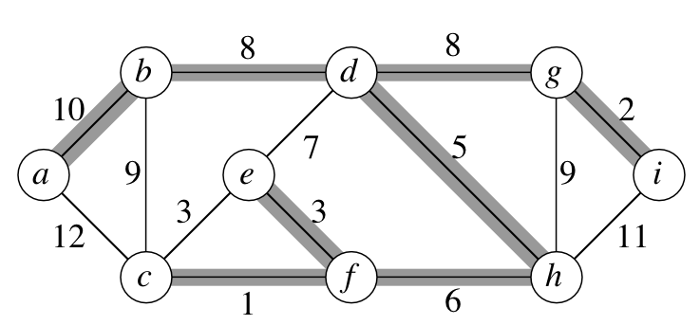
Example

Slide 57
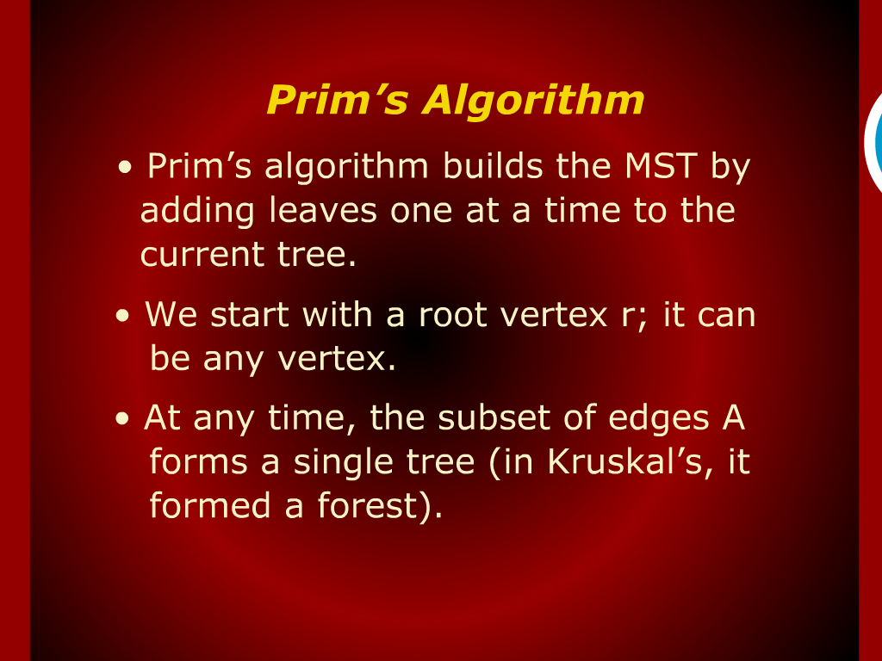
Prim’s Algorithm

Slide 58
Prim’s Algorithm
MST-Prim(G, w, r)
Q = V[G];
for each u ∈ Q
key[u] = ∞;
key[r] = 0;
p[r] = NULL;
while (Q not empty)
u = ExtractMin(Q);
for each v ∈ Adj[u]
if (v ∈ Q and w(u,v) < key[v])
p[v] = u;
key[v] = w(u,v);

Slide 59
Prim’s Algorithm
MST-Prim(G, w, r)
Q = V[G];
for each u ∈ Q
key[u] = ∞;
key[r] = 0;
p[r] = NULL;
while (Q not empty)
u = ExtractMin(Q);
for each v ∈ Adj[u]
if (v ∈ Q and w(u,v) < key[v])
p[v] = u;
key[v] = w(u,v);
6
4
5
9
14
2
10
15
3
8
Run on example graph

Slide 60
Prim’s Algorithm
∞
MST-Prim(G, w, r)
Q = V[G];
for each u ∈ Q
key[u] = ∞;
key[r] = 0;
p[r] = NULL;
while (Q not empty)
u = ExtractMin(Q);
for each v ∈ Adj[u]
if (v ∈ Q and w(u,v) < key[v])
p[v] = u;
key[v] = w(u,v);
6
4
5
9
∞
∞
∞
14
2
10
15
∞
∞
∞
3
∞
8
Run on example graph

Slide 61
Prim’s Algorithm
∞
MST-Prim(G, w, r)
Q = V[G];
for each u ∈ Q
key[u] = ∞;
key[r] = 0;
p[r] = NULL;
while (Q not empty)
u = ExtractMin(Q);
for each v ∈ Adj[u]
if (v ∈ Q and w(u,v) < key[v])
p[v] = u;
key[v] = w(u,v);
6
4
5
9
∞
∞
∞
14
2
10
15
r
0
∞
∞
3
∞
8
Pick a start vertex r

Slide 62
Prim’s Algorithm
∞
MST-Prim(G, w, r)
Q = V[G];
for each u ∈ Q
key[u] = ∞;
key[r] = 0;
p[r] = NULL;
while (Q not empty)
u = ExtractMin(Q);
for each v ∈ Adj[u]
if (v ∈ Q and w(u,v) < key[v])
p[v] = u;
key[v] = w(u,v);
6
4
5
9
∞
∞
∞
14
2
10
15
u
0
∞
∞
3
∞
8
Black vertices have been removed from Q

Slide 63
Prim’s Algorithm
∞
MST-Prim(G, w, r)
Q = V[G];
for each u ∈ Q
key[u] = ∞;
key[r] = 0;
p[r] = NULL;
while (Q not empty)
u = ExtractMin(Q);
for each v ∈ Adj[u]
if (v ∈ Q and w(u,v) < key[v])
p[v] = u;
key[v] = w(u,v);
6
4
5
9
∞
∞
∞
14
2
10
15
u
0
∞
∞
3
3
8
black arrows indicate parent pointers

Slide 64
Prim’s Algorithm
∞
MST-Prim(G, w, r)
Q = V[G];
for each u ∈ Q
key[u] = ∞;
key[r] = 0;
p[r] = NULL;
while (Q not empty)
u = ExtractMin(Q);
for each v ∈ Adj[u]
if (v ∈ Q and w(u,v) < key[v])
p[v] = u;
key[v] = w(u,v);
6
4
5
9
14
∞
∞
14
2
10
15
u
0
∞
∞
3
3
8

Slide 65
Prim’s Algorithm
∞
MST-Prim(G, w, r)
Q = V[G];
for each u ∈ Q
key[u] = ∞;
key[r] = 0;
p[r] = NULL;
while (Q not empty)
u = ExtractMin(Q);
for each v ∈ Adj[u]
if (v ∈ Q and w(u,v) < key[v])
p[v] = u;
key[v] = w(u,v);
6
4
5
9
14
∞
∞
14
2
10
15
0
∞
∞
3
3
8
u

Slide 66
Prim’s Algorithm
∞
MST-Prim(G, w, r)
Q = V[G];
for each u ∈ Q
key[u] = ∞;
key[r] = 0;
p[r] = NULL;
while (Q not empty)
u = ExtractMin(Q);
for each v ∈ Adj[u]
if (v ∈ Q and w(u,v) < key[v])
p[v] = u;
key[v] = w(u,v);
6
4
5
9
14
∞
∞
14
2
10
15
0
8
∞
3
3
8
u

Slide 67
Prim’s Algorithm
∞
MST-Prim(G, w, r)
Q = V[G];
for each u ∈ Q
key[u] = ∞;
key[r] = 0;
p[r] = NULL;
while (Q not empty)
u = ExtractMin(Q);
for each v ∈ Adj[u]
if (v ∈ Q and w(u,v) < key[v])
p[v] = u;
key[v] = w(u,v);
6
4
5
9
10
∞
∞
14
2
10
15
0
8
∞
3
3
8
u

Slide 68
Prim’s Algorithm
∞
MST-Prim(G, w, r)
Q = V[G];
for each u ∈ Q
key[u] = ∞;
key[r] = 0;
p[r] = NULL;
while (Q not empty)
u = ExtractMin(Q);
for each v ∈ Adj[u]
if (v ∈ Q and w(u,v) < key[v])
p[v] = u;
key[v] = w(u,v);
6
4
5
9
10
∞
∞
14
2
10
15
0
8
∞
3
3
8
u

Slide 69
Prim’s Algorithm
∞
MST-Prim(G, w, r)
Q = V[G];
for each u ∈ Q
key[u] = ∞;
key[r] = 0;
p[r] = NULL;
while (Q not empty)
u = ExtractMin(Q);
for each v ∈ Adj[u]
if (v ∈ Q and w(u,v) < key[v])
p[v] = u;
key[v] = w(u,v);
6
4
5
9
10
2
∞
14
2
10
15
0
8
∞
3
3
8
u

Slide 70
Prim’s Algorithm
∞
MST-Prim(G, w, r)
Q = V[G];
for each u ∈ Q
key[u] = ∞;
key[r] = 0;
p[r] = NULL;
while (Q not empty)
u = ExtractMin(Q);
for each v ∈ Adj[u]
if (v ∈ Q and w(u,v) < key[v])
p[v] = u;
key[v] = w(u,v);
6
4
5
9
10
2
∞
14
2
10
15
0
8
15
3
3
8
u

Slide 71
Prim’s Algorithm
∞
u
MST-Prim(G, w, r)
Q = V[G];
for each u ∈ Q
key[u] = ∞;
key[r] = 0;
p[r] = NULL;
while (Q not empty)
u = ExtractMin(Q);
for each v ∈ Adj[u]
if (v ∈ Q and w(u,v) < key[v])
p[v] = u;
key[v] = w(u,v);
6
4
5
9
10
2
∞
14
2
10
15
0
8
15
3
3
8

Slide 72
Prim’s Algorithm
∞
u
MST-Prim(G, w, r)
Q = V[G];
for each u ∈ Q
key[u] = ∞;
key[r] = 0;
p[r] = NULL;
while (Q not empty)
u = ExtractMin(Q);
for each v ∈ Adj[u]
if (v ∈ Q and w(u,v) < key[v])
p[v] = u;
key[v] = w(u,v);
6
4
5
9
10
2
9
14
2
10
15
0
8
15
3
3
8

Slide 73
Prim’s Algorithm
4
u
MST-Prim(G, w, r)
Q = V[G];
for each u ∈ Q
key[u] = ∞;
key[r] = 0;
p[r] = NULL;
while (Q not empty)
u = ExtractMin(Q);
for each v ∈ Adj[u]
if (v ∈ Q and w(u,v) < key[v])
p[v] = u;
key[v] = w(u,v);
6
4
5
9
10
2
9
14
2
10
15
0
8
15
3
3
8

Slide 74
Prim’s Algorithm
4
u
MST-Prim(G, w, r)
Q = V[G];
for each u ∈ Q
key[u] = ∞;
key[r] = 0;
p[r] = NULL;
while (Q not empty)
u = ExtractMin(Q);
for each v ∈ Adj[u]
if (v ∈ Q and w(u,v) < key[v])
p[v] = u;
key[v] = w(u,v);
6
4
5
9
5
2
9
14
2
10
15
0
8
15
3
3
8

Slide 75
Prim’s Algorithm
u
4
MST-Prim(G, w, r)
Q = V[G];
for each u ∈ Q
key[u] = ∞;
key[r] = 0;
p[r] = NULL;
while (Q not empty)
u = ExtractMin(Q);
for each v ∈ Adj[u]
if (v ∈ Q and w(u,v) < key[v])
p[v] = u;
key[v] = w(u,v);
6
4
5
9
5
2
9
14
2
10
15
0
8
15
3
3
8

Slide 76
Prim’s Algorithm
u
4
MST-Prim(G, w, r)
Q = V[G];
for each u ∈ Q
key[u] = ∞;
key[r] = 0;
p[r] = NULL;
while (Q not empty)
u = ExtractMin(Q);
for each v ∈ Adj[u]
if (v ∈ Q and w(u,v) < key[v])
p[v] = u;
key[v] = w(u,v);
6
4
5
9
5
2
9
14
2
10
15
0
8
15
3
3
8

Slide 77
Prim’s Algorithm
u
4
MST-Prim(G, w, r)
Q = V[G];
for each u ∈ Q
key[u] = ∞;
key[r] = 0;
p[r] = NULL;
while (Q not empty)
u = ExtractMin(Q);
for each v ∈ Adj[u]
if (v ∈ Q and w(u,v) < key[v])
p[v] = u;
key[v] = w(u,v);
6
4
5
9
5
2
9
14
2
10
15
0
8
15
3
3
8

Slide 78
Prim’s Algorithm
4
MST-Prim(G, w, r)
Q = V[G];
for each u ∈ Q
key[u] = ∞;
key[r] = 0;
p[r] = NULL;
while (Q not empty)
u = ExtractMin(Q);
for each v ∈ Adj[u]
if (v ∈ Q and w(u,v) < key[v])
p[v] = u;
key[v] = w(u,v);
6
4
5
9
5
2
9
14
2
u
10
15
0
8
15
3
3
8

Slide 79
Review: Prim’s Algorithm
MST-Prim(G, w, r)
Q = V[G];
for each u ∈ Q
key[u] = ∞;
key[r] = 0;
p[r] = NULL;
while (Q not empty)
u = ExtractMin(Q);
for each v ∈ Adj[u]
if (v ∈ Q and w(u,v) < key[v])
p[v] = u;
key[v] = w(u,v);

Slide 80
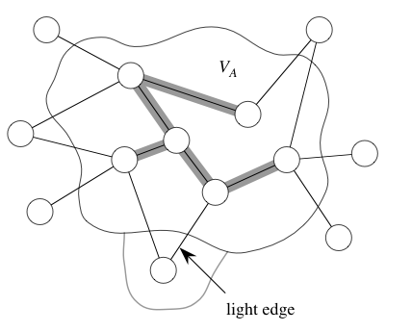
Prim’s Algorithm
Start with an arbitrary node from V
Instead of maintaining a forest, grow a MST
  At any time, maintain a MST for V’ ⊆ V
At any moment, find a light edge connecting V’ with (V-V’)
  I.e., the edge with smallest weight connecting some vertex in V’ with some vertex in V-V’ !

Slide 81
Prim’s Algorithm cont.
Use a priority queue !
Again two issues:
  Maintain the tree already build at any moment
    Easy: simply a tree rooted at r : the starting node
  Find the next light edge efficiently
    For v ∈ V - V’, define key(v) = the min distance between v and some node from V’
    At any moment, find the node with min key.

Slide 82
Example

Slide 83
Analysis
Using heap for priority queue:
  Each operation is O ( log |V| )
Total time complexity: O (|E| log |V|)

Slide 84
Summary
  Summary

Slide 85
  THANK YOU
  Q & A

