Slide 1

CUI Abbottabad
Department of Computer Science
Data Structures and Algorithms
Lecture No. 25
Graph Traversal

Slide 2
Agenda
Graph Traversal
  Depth First Search (DFS)
  Breadth First Search (BFS)

Slide 3
Graph Searching
Given: a graph G = (V, E), directed or undirected
Goal: methodically explore every vertex and every edge
Ultimately: build a tree on the graph
  Pick a vertex as the root
  Choose certain edges to produce a tree
  Note: might also build a forest if graph is not connected

Slide 4
Breadth-First Search
“Explore” a graph, turning it into a tree
  One vertex at a time
  Expand frontier of explored vertices across the breadth of the frontier
Builds a tree over the graph
  Pick a source vertex to be the root
  Find (“discover”) its children, then their children, etc.

Slide 5
Properties of A Tree
G = (V, E) is undirected graph, then it
  is a tree
  has no cycle, and connected
  has |V|-1 edges, and connected

Slide 6
Breadth-First Search
Will associate vertex “colors” to guide the algorithm
  White vertices have not been discovered
    All vertices start out white
  Grey vertices are discovered but not fully explored
    They may be adjacent to white vertices
  Black vertices are discovered and fully explored
    They are adjacent only to black and gray vertices
Explore vertices by scanning adjacency list of grey vertices

Slide 7
BFS
є
є

Slide 8
Breadth-First Search: Example
r
s
t
u
∞
∞
∞
∞
∞
∞
∞
∞
v
w
x
y

Slide 9
Breadth-First Search: Example
r
s
t
u
∞
0
∞
∞
∞
∞
∞
∞
v
w
x
y
Q:
s

Slide 10
Breadth-First Search: Example
r
s
t
u
1
0
∞
∞
∞
1
∞
∞
v
w
x
y
Q:
w
r

Slide 11
Breadth-First Search: Example
r
s
t
u
1
0
2
∞
∞
1
2
∞
v
w
x
y
Q:
r
t
x

Slide 12
Breadth-First Search: Example
r
s
t
u
1
0
2
∞
2
1
2
∞
v
w
x
y
Q:
t
x
v

Slide 13
Breadth-First Search: Example
r
s
t
u
1
0
2
3
2
1
2
∞
v
w
x
y
Q:
x
v
u

Slide 14
Breadth-First Search: Example
r
s
t
u
1
0
2
3
2
1
2
3
v
w
x
y
Q:
v
u
y

Slide 15
Breadth-First Search: Example
r
s
t
u
1
0
2
3
2
1
2
3
v
w
x
y
Q:
u
y

Slide 16
Breadth-First Search: Example
r
s
t
u
1
0
2
3
2
1
2
3
v
w
x
y
Q:
y

Slide 17
Breadth-First Search: Example
r
s
t
u
1
0
2
3
2
1
2
3
v
w
x
y
Q:
Ø

Slide 18
Breadth-First Search: Properties
BFS calculates the shortest-path distance to the source node
  Shortest-path distance δ(s,v) = minimum number of edges from s to v, or ∞ if v not reachable from s
  Proof given in the book (p. 472-5)
BFS builds breadth-first tree, in which paths to root represent shortest paths in G
  Thus can use BFS to calculate shortest path from one vertex to another in O(V+E) time

Slide 19
Depth-first Search
Breadth-first search:
  Go as broad as possible at each node

Slide 20
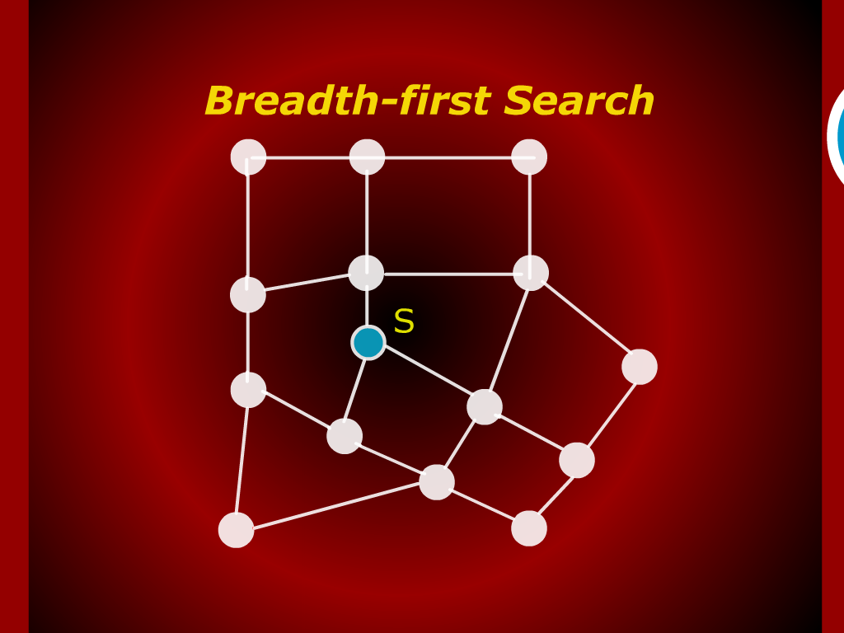
Breadth-first Search

Slide 21
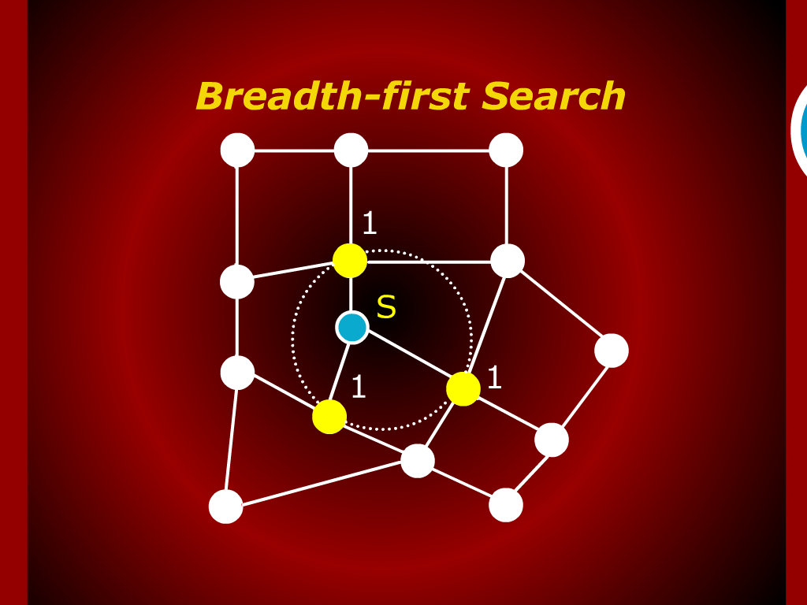
Breadth-first Search

Slide 22
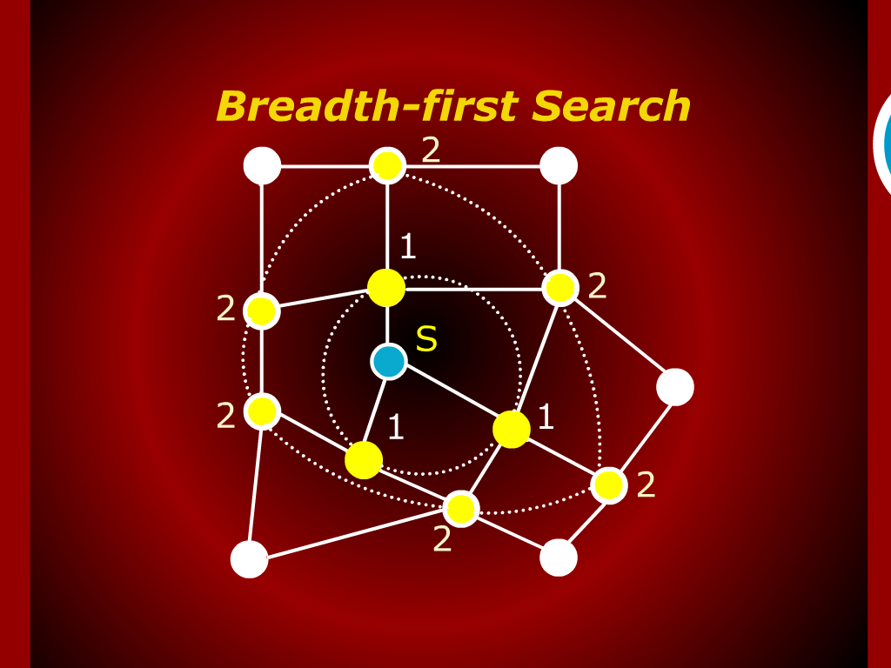
Breadth-first Search

Slide 23
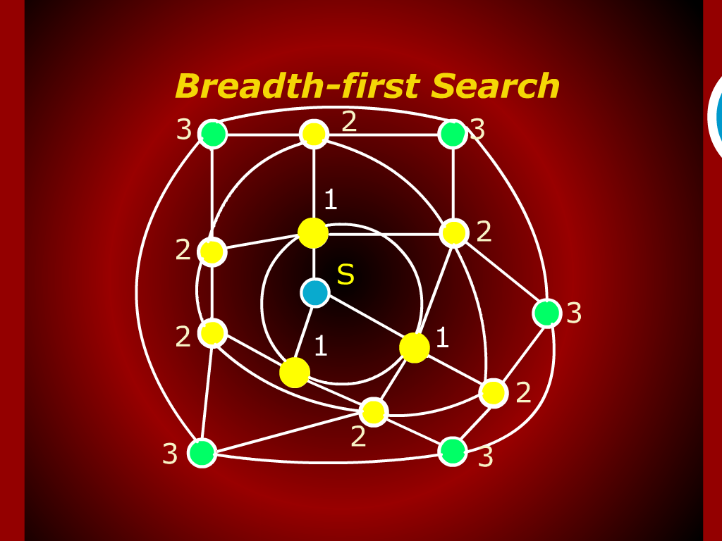
Breadth-first Search

Slide 24
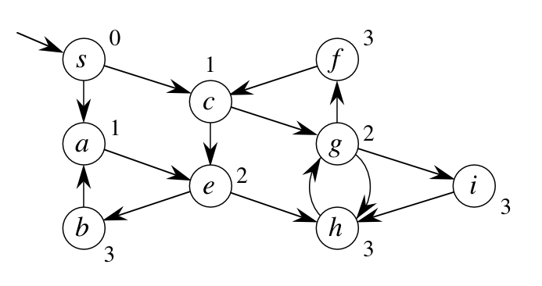
Depth-first Search
Breadth-first search:
  Go as broad as possible at each node
Depth-first search (a different strategy):
  Go as deep as possible first

Slide 25
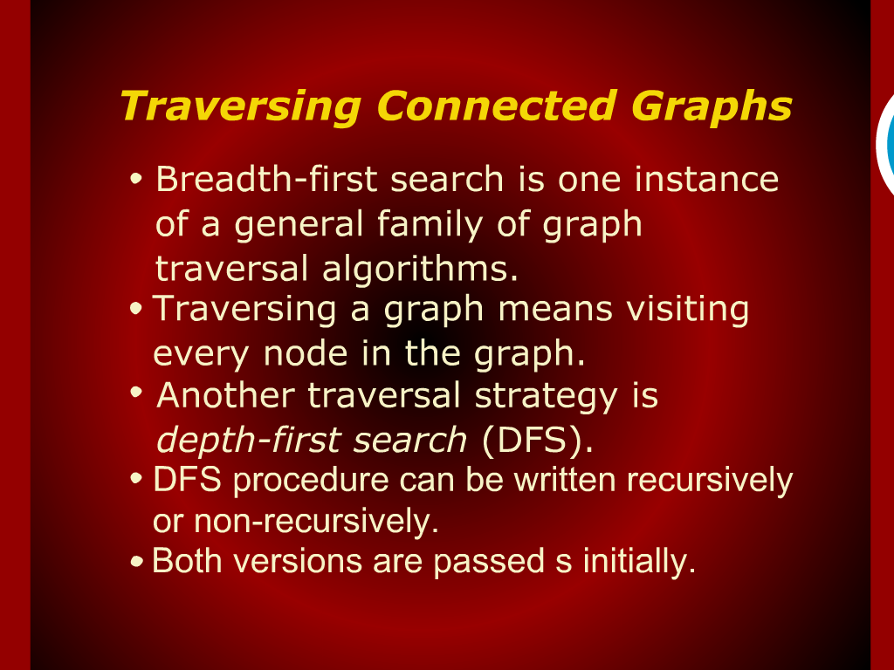
Traversing Connected Graphs

Slide 26
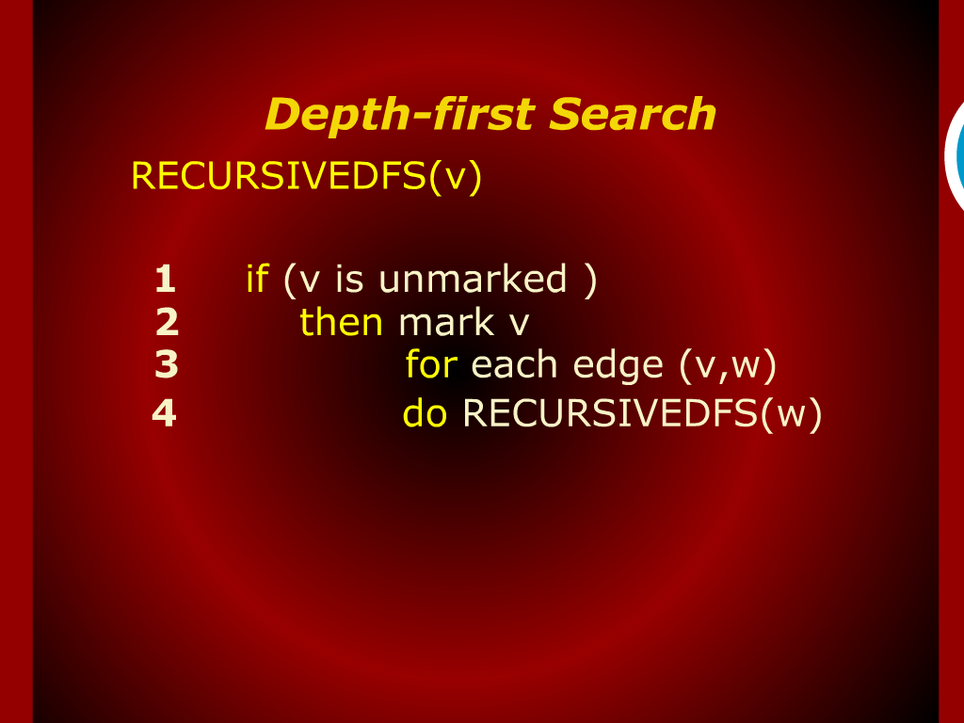
Depth-first Search

Slide 27
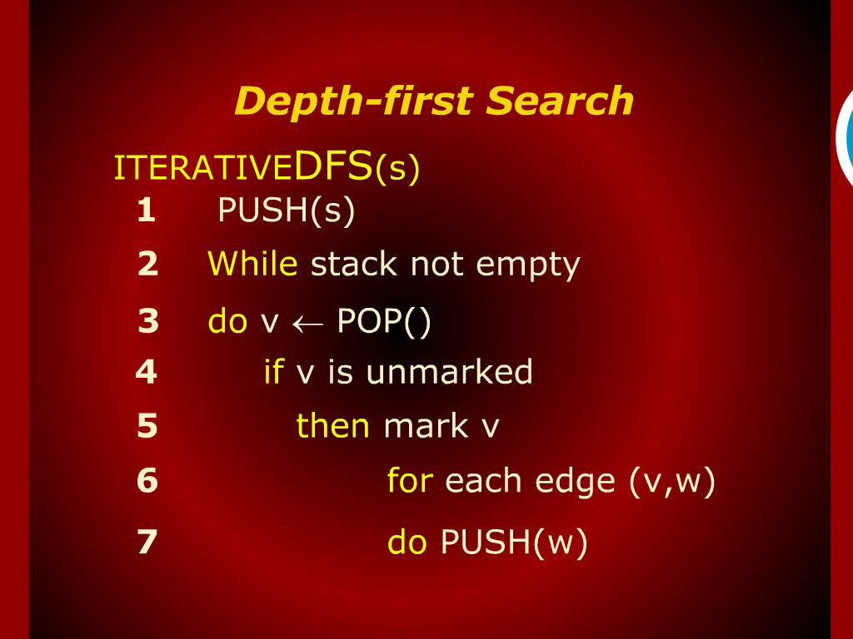
Depth-first Search

Slide 28
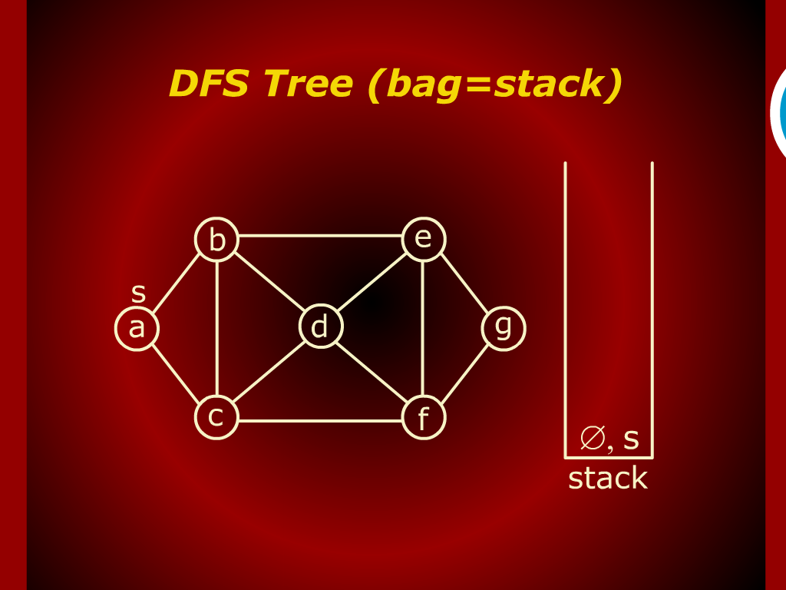
DFS Tree (bag=stack)

Slide 29
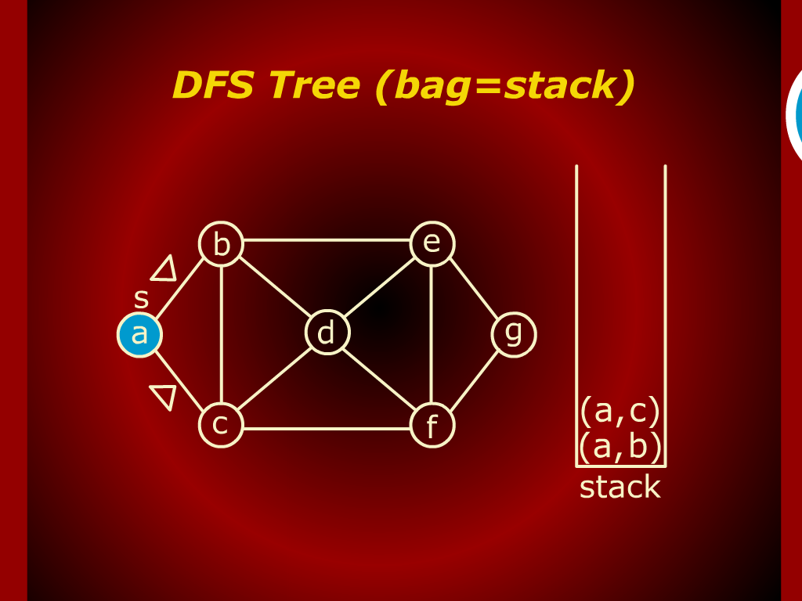
DFS Tree (bag=stack)

Slide 30
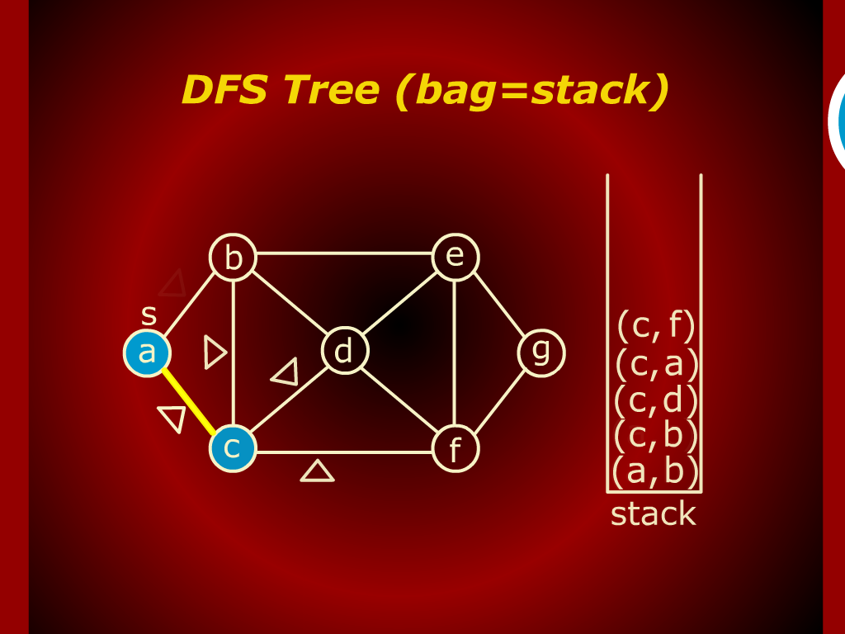
DFS Tree (bag=stack)

Slide 31
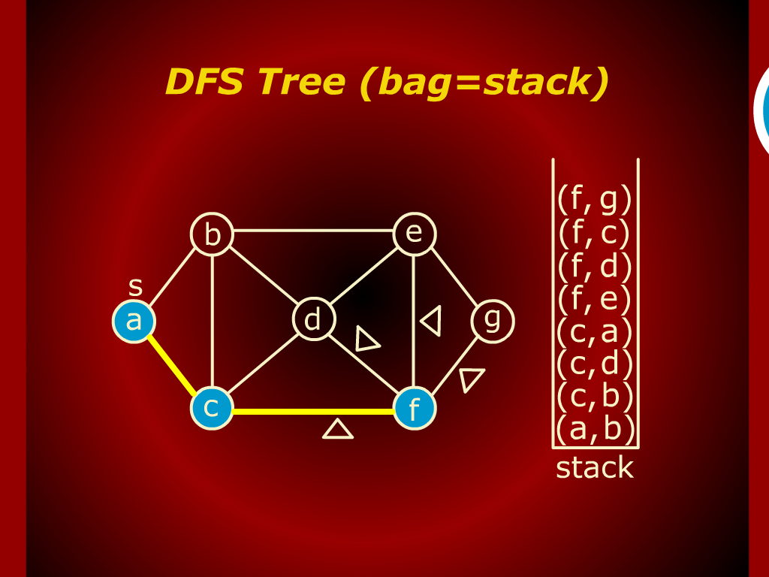
DFS Tree (bag=stack)

Slide 32
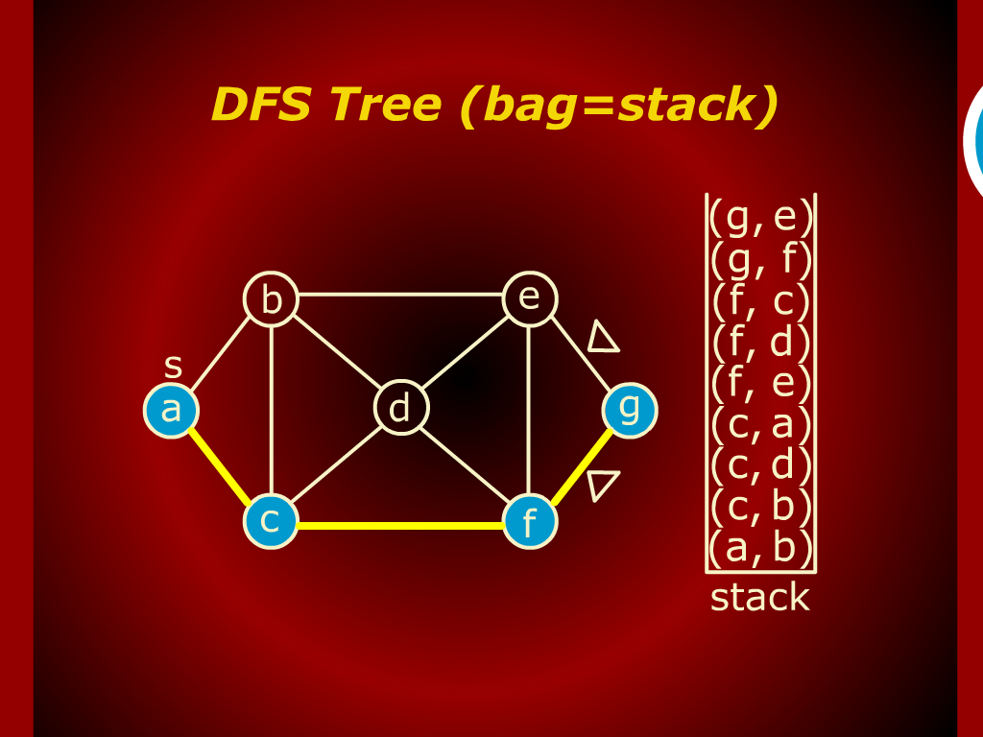
DFS Tree (bag=stack)

Slide 33
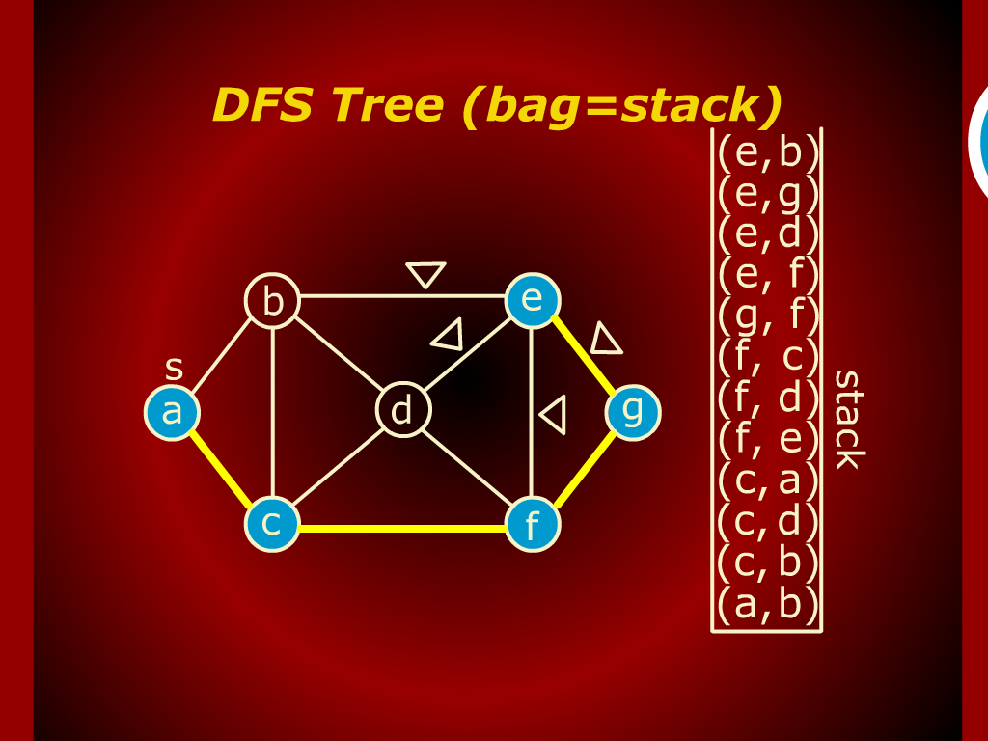
DFS Tree (bag=stack)

Slide 34
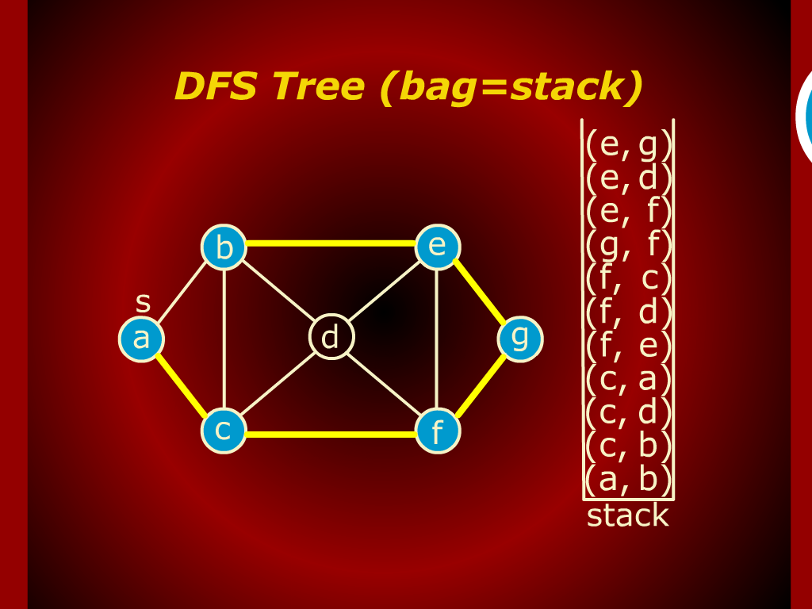
DFS Tree (bag=stack)

Slide 35
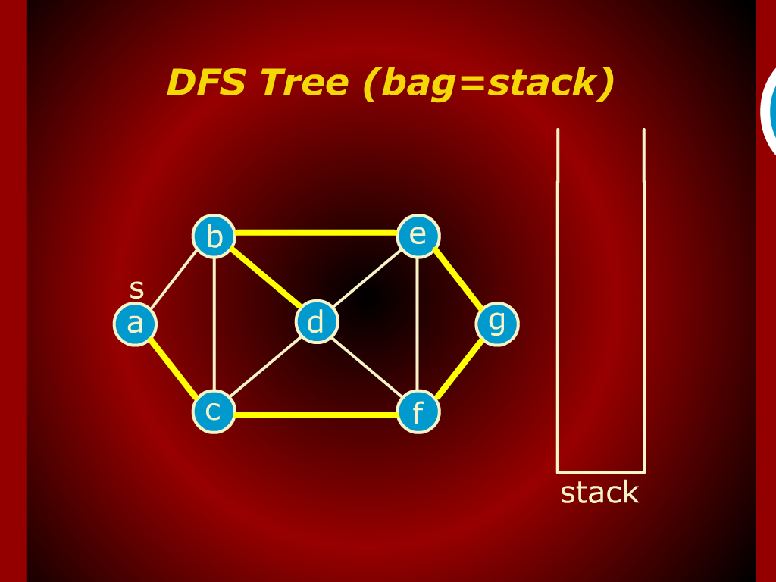
DFS Tree (bag=stack)

Slide 36
Depth-first Search
Depth-first search (a different strategy):
  Go as deep as possible first

Slide 37
More Formally
Again, a node
  white: unvisited
  gray: discovered but not finished
  black: finished (explored)
For every node v ∈ V
  d[v]: time v is discovered
  f[v]: time v is finished (all edges in v’s adjacency list are explored)
  f[v] - d[v] = time from grey to black

Slide 38
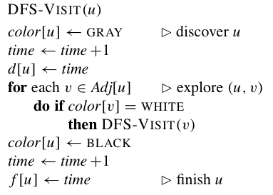
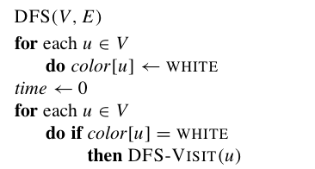
Pseudo-code
Time complexity

Slide 39
Depth-First Search: Example

Slide 40
Depth-First Search: Example

Slide 41
Depth-First Search: Example

Slide 42
Depth-First Search: Example

Slide 43
Depth-First Search: Example

Slide 44
Depth-First Search: Example

Slide 45
Depth-First Search: Example

Slide 46
Depth-First Search: Example

Slide 47
Depth-First Search: Example

Slide 48
Depth-First Search: Example

Slide 49
Depth-First Search: Example

Slide 50
Depth-First Search: Example

Slide 51
Depth-First Search: Example

Slide 52
Depth-First Search: Example

Slide 53
Depth-First Search: Example

Slide 54
Depth-First Search: Example

Slide 55
Depth-First Search: Example

Slide 56
Depth-First Search: Example

Slide 57
Depth-First Search: Example

Slide 58
Depth-First Search: Example

Slide 59
Depth-First Search: Example

Slide 60
Depth-First Search: Example

Slide 61
Depth-First Search: Example

Slide 62
Depth-First Search: Example

Slide 63
Depth-First Search: Example
DFS(G) terminated
Depth-first forest (DFF)

Slide 64
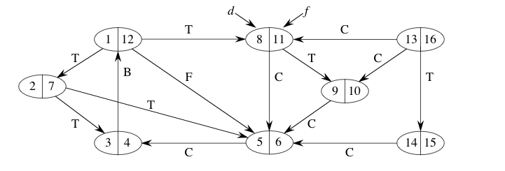
Example

Slide 65
Depth-first Forest
Consider all edges (p(u), u)
  When it happens: p(u) is grey, u is white
  A forest, called Depth-first forest
  Depends on the order of vertices
  Example from previous page
Property:
  Start (finish) time for each tree: same order as if we visit nodes in pre-order (post-order) tree walk

Slide 66
Properties of DFS
Parenthesis Theorem:
  Any two nodes u and v, one of the following 3 cases:
    (1) u is descendant of v, and d[v] < d[u] < f[u] < f[v]
    (2) v is descendant of u, and d[u] < d[v] < f[v] < f[u]
    (3) u is not descendant of v, neither is v a descendant of u, and
    d[u] < f[u] < d[v] < f[v] or d[v] < f[v] < d[u] < f[u]
  u is descendant of v iff d[v] < d[u] < f[u] < f[v]
White-path Theorem
  u is descendant of v iff at the time of d[v], there is a all white path from v to u.

Slide 67
Classification of Edges
Four types of an edge (u,v)
  Tree edge: Edge (u, v) is a tree edge if v was first discovered by exploring edge (u, v).
  Non-tree edges:
    Back edge: u is descendant of v – self-loops
    Forward edge: v is descendent of u
    Cross edge: others
  Distinguish by the color of v
    Other than cross & forward edges
Example
a
b
c
d
j
e
h
f
g
k

Slide 68
Classification of Edges
An edge (u, v) is
  a tree edge or forward edge if and only if d[u] < d[v] < f[v] < f[u],
  a back edge if and only if d[v] < d[u] < f[u] < f[v], and
  a cross edge if and only if d[v] < f[v] < d[u] < f[u].

Slide 69
Theorem
a
b
c
d
j
e
h
f
g
k
In a DFS of an undirected graph G, every edge of G is either a tree edge or a back edge.

Slide 70
Connected Components
Undirected graph
  DF forests represents the set of connected components
Directed graph
  Does the tree rooted at u include all nodes accessible from u ?

Slide 71
Summary of DFS
Work for both directed and undirected graphs
Produce a DFS forest
  Note that it is not unique!
  Two reachable nodes may not be in the same tree for a directed graph! (question: where can they be in?)
  Different types of edges
  Parenthesis property
Takes time O(|V| + |E|)

Slide 72
Directed Acyclic Graph
A directed graph G is a dag iff a DFS of G yields
no back edges.
How about an undirected acyclic graph?
DAG: directed acyclic graph
Determine whether a directed graph is DAG or not
  How?

Slide 73
Topological Sort
undershorts
socks
watch
pants
shoes
shirt
belt
tie
jacket
A topological sort of a dag G = (V, E)
  A linear ordering A of all vertices from V
  If edge (u,v) ∈ E => A[u] < A[v]
Notes:
73
Partial order, total order, what if we have cycles?

Slide 74
Topological Sort
Using DFS
Topological-Sort(G)
  Call DFS(G) to compute finishing times f[v] for each v
  Output vertices in descreasing order of finishing time
Time complexity
  O (|V| + |E|)

Slide 75
Example
17, 18
11, 16
undershorts
socks
watch
12, 15
pants
shoes
9, 10
13, 14
shirt
1, 8
6, 7
belt
tie
2, 5
jacket
3, 4
socks , undershots , pants , shoes , watch , shirt , belt , tie , jacket

Slide 76
Summary
  Summary

Slide 77
  THANK YOU
  Q & A

