Slide 1

CUI Abbottabad
Department of Computer Science
Data Structures and Algorithms
Lecture No. 24
Graph Theory

Slide 2
Agenda
Graph Theory
  Graph ADT
  Basic Terminologies
  Representation
  Adjacency Matrix
  Adjacency List
  Types of Graphs

Slide 3
Introduction to Graphs
Graph theory plays an important role in several areas of computer science such as:
  Switching theory and logical design
  Artificial intelligence
  Formal languages
  Computer graphics
  Operating systems
  Compiler writing
  Information organization and retrieval.

Slide 4
Graphs
A graph is a non-empty set of points called vertices and a set of line segments joining pairs of vertices called edges.
Formally, a graph G consists of two finite sets:
  A set V=V(G) of vertices (or points or nodes)
  A set E=E(G) of edges; where each edge corresponds to a pair of vertices.

Slide 5
Graph definitions
There are two kinds of graphs: directed graphs (sometimes called digraphs) and undirected graphs
start
60
Birmingham
Rugby
fill pan
with water
take egg
from fridge
150
190
100
140
Cambridge
London
190
120
add salt
to water
break egg
into pan
Bristol
110
Dover
boil
water
Southhampton
A directed graph
An undirected graph

Slide 6
Graph terminology I
A graph is a collection of nodes (or vertices, singular is vertex) and edges (or arcs)
  Each node contains an element
  Each edge connects two nodes together (or possibly the same node to itself) and may contain an edge attribute
A directed graph is one in which the edges have a direction
An undirected graph is one in which the edges do not have a direction
  Note: Whether a graph is directed or undirected is a logical distinction—it describes how we think about the graph
  Depending on the implementation, we may or may not be able to follow a directed edge in the “backwards” direction

Slide 7
Graph terminology II
The size of a graph is the number of nodes in it
The empty graph has size zero (no nodes)
If two nodes are connected by an edge, they are neighbors (and the nodes are adjacent to each other)
The degree of a node is the number of edges it has
For directed graphs,
  If a directed edge goes from node S to node D, we call S the source and D the destination of the edge
    The edge is an out-edge of S and an in-edge of D
    S is a predecessor of D, and D is a successor of S
  The in-degree of a node is the number of in-edges it has
  The out-degree of a node is the number of out-edges it has

Slide 8
Graph terminology III
An undirected graph is connected if there is a path from every node to every other node
A directed graph is strongly connected if there is a path from every node to every other node
A directed graph is weakly connected if the underlying undirected graph is connected
Node X is reachable from node Y if there is a path from Y to X
A subset of the nodes of the graph is a connected component (or just a component) if there is a path from every node in the subset to every other node in the subset

Slide 9
Graphs
Graph G = (V, E)
V: set of nodes
E: set of edges
a
b
c
d
e
f
Example:
  V ={ a, b, c, d, e, f }
  E ={(a, b), (a, d), (a, e), (b, c), (b, d), (b, e), (c, e), (e,f)}

Slide 10
More Terminologies
Directed / undirected graph
Weighted / unweighted graph
Special graphs
  Complete graph, planar graph, tree, path, cycle
Size of graph:
  |V|, |E|
Degree of a node
  indegree / outdegree
Node u and v are connected
  If there is a path from E connecting u and v

Slide 11
Graph Variations
Variations:
  A connected graph has a path from every vertex to every other
  In an undirected graph:
    Edge (u,v) = edge (v,u)
    No self-loops
  In a directed graph:
    Edge (u,v) goes from vertex u to vertex v, notated u→v

Slide 12
Graph Variations
More variations:
  A weighted graph associates weights with either the edges or the vertices
    E.g., a road map: edges might be weighted w/ distance
  A multigraph allows multiple edges between the same vertices
    E.g., the call graph in a program (a function can get called from multiple points in another function)

Slide 13
Definitions and Examples
Undirected graph
Directed graph
loop
G=(V,E)
isolated vertex
multiple
edges
adjacent
simple graph: an undirected graph without loop or multiple edges
degree of a vertex: number of edges connected
(indegree, outdegree)

Slide 14
Definitions and Examples
a
x
y
e
path: no vertex can be repeated
a-b-c-d-e
trail: no edge can be repeat
a-b-c-d-e-b-d
walk: no restriction
a-b-d-a-b-c
b
d
c
length: number of edges in
this (path,trail,walk)
closed if x=y
closed trail: circuit (a-b-c-d-b-e-d-a,
one draw without lifting pen)
closed path: cycle (a-b-c-d-a)

Slide 15
Definitions and Examples
remove any cycle on the repeated
vertices
a
x
b
Def 11.4 Let G=(V,E) be an undirected graph. We call G connected
if there is a path between any two distinct vertices of G.
a
e
a
e
b
b
disconnected with
two components
d
d
c
c

Slide 16
Definitions and Examples
Def. 11.6
multigraph of multiplicity 3
multigraphs

Slide 17
Definitions and Examples
a
a
e
a
b
e
b
e
b
d
d
c
c
d
d
induced subgraph
include all edges
of E in V₁
c
c
spanning subgraph
V₁=V

Slide 18
Graph Types
Complete Graph: K_{n}
A complete graph on n vertices is a simple graph in which each vertex is connected to every other vertex and is denoted by K_{n} (K_{n} means that there are n vertices).
a
e
b
K₅
d
c

Slide 19
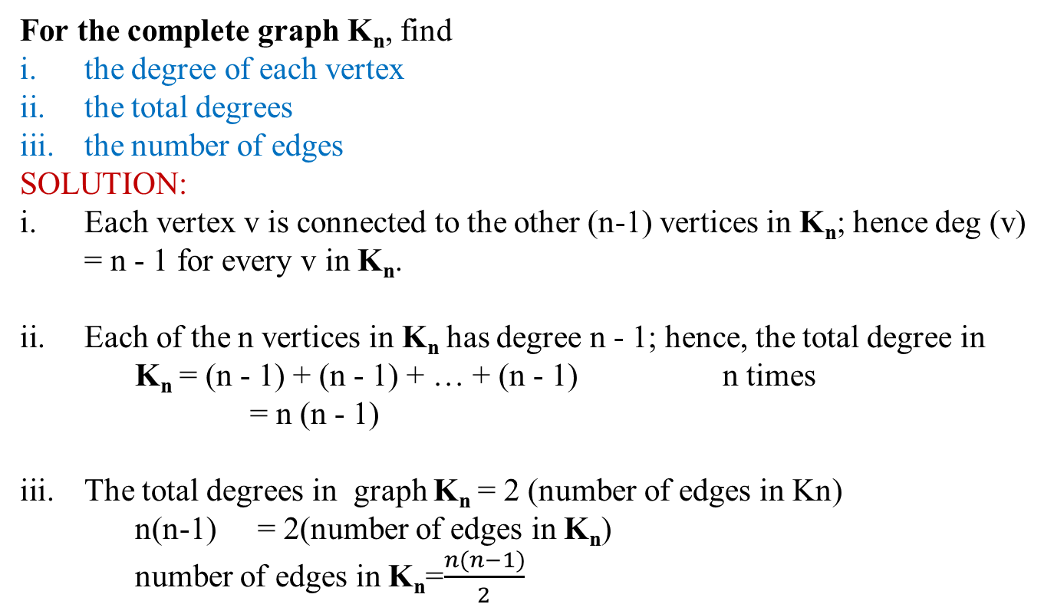
Complete Graph
For the complete graph K_{n}, find
the degree of each vertex
the total degrees
the number of edges
SOLUTION:
Each vertex v is connected to the other (n-1) vertices in K_{n}; hence deg (v) = n - 1 for every v in K_{n}.
Each of the n vertices in K_{n} has degree n - 1; hence, the total degree in
K_{n} = (n - 1) + (n - 1) + … + (n - 1) n times
= n (n - 1)
The total degrees in graph K_{n} = 2 (number of edges in Kn)
n(n-1) = 2(number of edges in K_{n})
number of edges in K_{n}=$\frac{n(n−1)}{2}$

Slide 20
REGULAR GRAPH:
A graph G is regular of degree k or k-regular if every vertex of G has degree k.
In other words, a graph is regular if every vertex has the same degree.
Following are some regular graphs.
REMARK: The complete graph Kn is (n-1) regular.

Slide 21
BIPARTITE GRAPH:
A bipartite graph G is a simple graph whose vertex set can be partitioned into two mutually disjoint non-empty subsets A and B such that the vertices in A may be connected to vertices in B, but no vertices in A are connected to vertices in A and no vertices in B are connected to vertices in B.
The following are bipartite graphs

Slide 22
COMPLETE BIPARTITE GRAPH:
A complete bipartite graph on (m+n) vertices denoted K_{m,n} is a simple graph whose vertex set can be partitioned into two mutually disjoint non-empty subsets A and B containing m and n vertices respectively, such that each vertex in set A is connected (adjacent) to every vertex in set B, but the vertices within a set are not connected.

Slide 23
DETERMINING BIPARTITE GRAPHS:
The following labeling procedure determines whether a graph is bipartite or not.
Label any vertex a
Label all vertices adjacent to a with the label b.
Label all vertices that are adjacent to a vertex just labeled b with label a.
Repeat steps 2 and 3 until all vertices got a distinct label (a bipartite graph) or there is a conflict i.e., a vertex is labeled with a and b (not a bipartite graph).

Slide 24
EXERCISE:
Find which of the following graphs are bipartite.
Redraw the bipartite graph so that its bipartite nature is evident.

Slide 25
SOLUTION:
(i)
The graph is not bipartite.
The graph is a bipartite.

Slide 26
SOLUTION:
By labeling procedure, each vertex gets a distinct label. Hence the graph is bipartite. To redraw the graph, we mark labels a’s as a₁, a₂ and b’s as b₁, b₂,
Redrawing graph with bipartite nature evident.

Slide 27
Complement of a Graph
a
G G
a
e
e
b
b
d
d
c
c

Slide 28
Representing Graphs
Assume V = {1, 2, …, n}
An adjacency matrix represents the graph as a n x n matrix A:
  A[i, j] = 1 if edge (i, j) ∈ E (or weight of edge)
  = 0 if edge (i, j) ∉ E

Slide 29
Graphs: Adjacency Matrix
Example:
A | 1 | 2 | 3 | 4
1
2
3 |  |  | ??
4
1
a
2
d
4
b
c
3

Slide 30
Graphs: Adjacency Matrix
Example:
A | 1 | 2 | 3 | 4
1 | 0 | 1 | 1 | 0
2 | 0 | 0 | 1 | 0
3 | 0 | 0 | 0 | 0
4 | 0 | 0 | 1 | 0
1
a
2
d
4
b
c
3

Slide 31
Graphs: Adjacency Matrix
The adjacency matrix is a dense representation
  Usually too much storage for large graphs
  But can be very efficient for small graphs
Most large interesting graphs are sparse
  E.g., planar graphs, in which no edges cross, have |E| = O(|V|) by Euler’s formula
  For this reason, the adjacency list is often a more appropriate representation

Slide 32
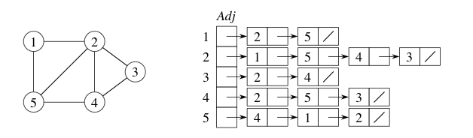
Representations of Graphs
Adjacency lists
  An array of |V| lists
  Each vertex u has a list, recording its neighbors
    I.e., all v’s such that (u, v) ∈ E

Slide 33
Representation of Graphs
Two standard ways.
  Adjacency Lists.
  Adjacency Matrix.
a
b
a
b
d
c
b
a
c
c
d
c
d
a
b
d
a
c
1
2
1 2 3 4
1 0 1 1 1
2 1 0 1 0
3 1 1 0 1
4 1 0 1 0
a
b
c
d
3
4

Slide 34
Adjacency Lists
Consists of an array Adj of |V| lists.
One list per vertex.
For u ∈ V, Adj[u] consists of all vertices adjacent to u.
a
b
a
b
d
c
b
c
If weighted, store weights also in adjacency lists.
c
d
c
d
d
a
b
a
b
d
c
b
a
c
c
d
c
d
a
b
d
a
c

Slide 35
Summary
  Summary

Slide 36
  THANK YOU
  Q & A

