Slide 1

CUI Abbottabad
Department of Computer Science
Data Structures and Algorithms
Lecture No. 23
Applications of Tree

Slide 2
Agenda
Applications of Tree
  Expression Tree
  Huffman Coding

Slide 3
Expression Trees
Expression trees, and the more general parse trees and abstract syntax trees are significant components of compilers.
Let us consider the expression tree.

Slide 4
Expression Tree
(a+b*c)+((d*e+f)*g)
+
+
*
a
*
+
g
b
c
*
f
d
e

Slide 5
Expression Tree
The inner nodes contain operators while leaf nodes contain operands.
+
+
*
a
*
+
g
b
c
*
f
d
e
Notes:
Start of lecture 25.

Slide 6
Expression Tree
The tree is binary because the operators are binary.
+
+
*
a
*
+
g
b
c
*
f
d
e

Slide 7
Expression Tree
This is not necessary. A unary operator (!, e.g.) will have only one subtree.
+
+
*
a
*
+
g
b
c
*
f
d
e

Slide 8
Expression Tree
Inorder traversal yields: a+b*c+d*e+f*g
+
+
*
a
*
+
g
b
c
*
f
d
e

Slide 9
Enforcing Parenthesis
/* inorder traversal routine using the parenthesis */
void inorder(TreeNode treeNode)
{
if( treeNode != NULL )
{
if(treeNode.left != NULL && treeNode.right != NULL) //if not leaf
system.out.print("(“);
inorder(treeNode.left);
system.out.print(treeNode.data+" “);
inorder(treeNode.right);
if(treeNode.left != NULL && treeNode.right!= NULL) //if not leaf
system.out.print(“)“); }
}

Slide 10
Expression Tree
Inorder : (a+(b*c))+(((d*e)+f)*g)
+
+
*
a
*
+
g
b
c
*
f
d
e

Slide 11
Expression Tree
Postorder traversal: a b c * + d e * f + g * +
which is the postfix form.
+
+
*
a
*
+
g
b
c
*
f
d
e

Slide 12
Constructing Expression Tree
Algorithm to convert postfix expression into an expression tree.
We already have an expression to convert an infix expression to postfix.
Read a symbol from the postfix expression.
If symbol is an operand, put it in a one node tree and push it on a stack.
If symbol is an operator, pop two trees from the stack, form a new tree with operator as the root and T₁ and T₂ as left and right subtrees and push this tree on the stack.

Slide 13
Constructing Expression Tree
a b + c d e + * *
stack

Slide 14
Constructing Expression Tree
a b + c d e + * *
top
If symbol is an operand, put it in a one node tree and push it on a stack.
a
b
Stack is growing left to right

Slide 15
Constructing Expression Tree
a b + c d e + * *
If symbol is an operator, pop two trees from the stack, form a new tree with operator as the root and T₁ and T₂ as left and right subtrees and push this tree on the stack.
+
a
b
Stack is growing left to right

Slide 16
Constructing Expression Tree
a b + c d e + * *
+
c
d
e
a
b

Slide 17
Constructing Expression Tree
a b + c d e + * *
+
c
+
a
b
d
e

Slide 18
Constructing Expression Tree
a b + c d e + * *
+
*
a
b
c
+
d
e

Slide 19
Constructing Expression Tree
a b + c d e + * *
*
+
*
a
b
c
+
d
e

Slide 20

Huffman coding

Slide 21
Huffman Encoding
Data compression plays a significant role in computer networks.
To transmit data to its destination faster, it is necessary to either increase the data rate of the transmission media or to simply send less data.
Improvements with regard to the transmission media has led to increase in the rate.
The other options is to send less data by means of data compression.
Compression methods are used for text, images, voice and other types of data (space probes).

Slide 22
Huffman Encoding
Huffman code is method for the compression for standard text documents.
It makes use of a binary tree to develop codes of varying lengths for the letters used in the original message.
Huffman code is also part of the JPEG image compression scheme.
The algorithm was introduced by David Huffman in 1952 as part of a course assignment at MIT.

Slide 23
Huffman Encoding
To understand Huffman encoding, it is best to use a simple example.
Encoding the 32-character phrase: "traversing threaded binary trees",
If we send the phrase as a message in a network using standard 8-bit ASCII codes, we would have to send 8*32= 256 bits.
Using the Huffman algorithm, we can send the message with only 116 bits.

Slide 24
Huffman Encoding
List all the letters used, including the "space" character, along with the frequency with which they occur in the message.
Consider each of these (character,frequency) pairs to be nodes; they are actually leaf nodes, as we will see.
Pick the two nodes with the lowest frequency, and if there is a tie, pick randomly amongst those with equal frequencies.
Notes:
Start of Lecture 26

Slide 25
Huffman Encoding
Make a new node out of these two, and make the two nodes its children.
This new node is assigned the sum of the frequencies of its children.
Continue the process of combining the two nodes of lowest frequency until only one node, the root, remains.

Slide 26
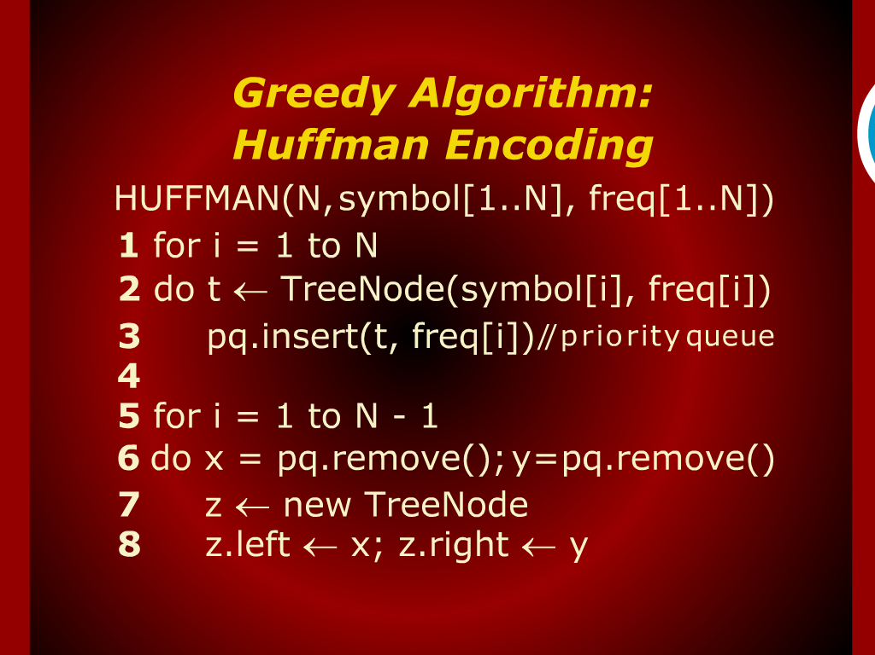
Greedy Algorithm: Huffman Encoding

Slide 27
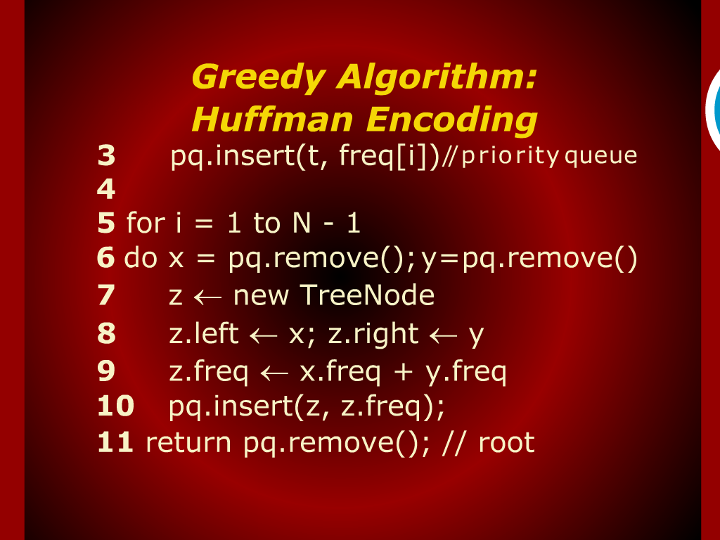
Greedy Algorithm: Huffman Encoding

Slide 28
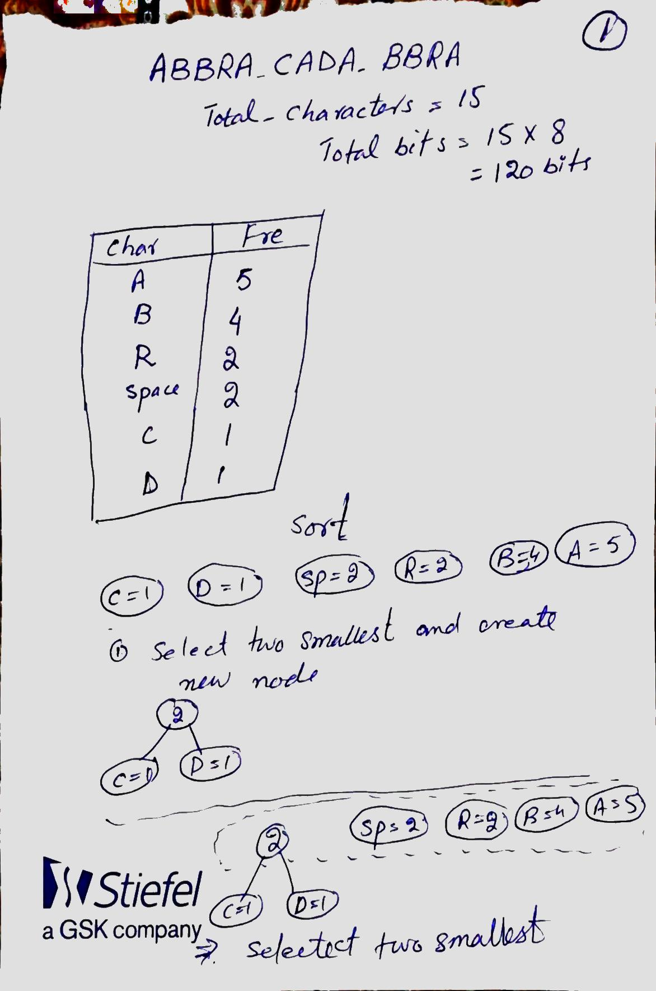
ABBRA CADA BBRA
Total bit=15 x 8=120 bits
ASCII
HC bit=?

Slide 29
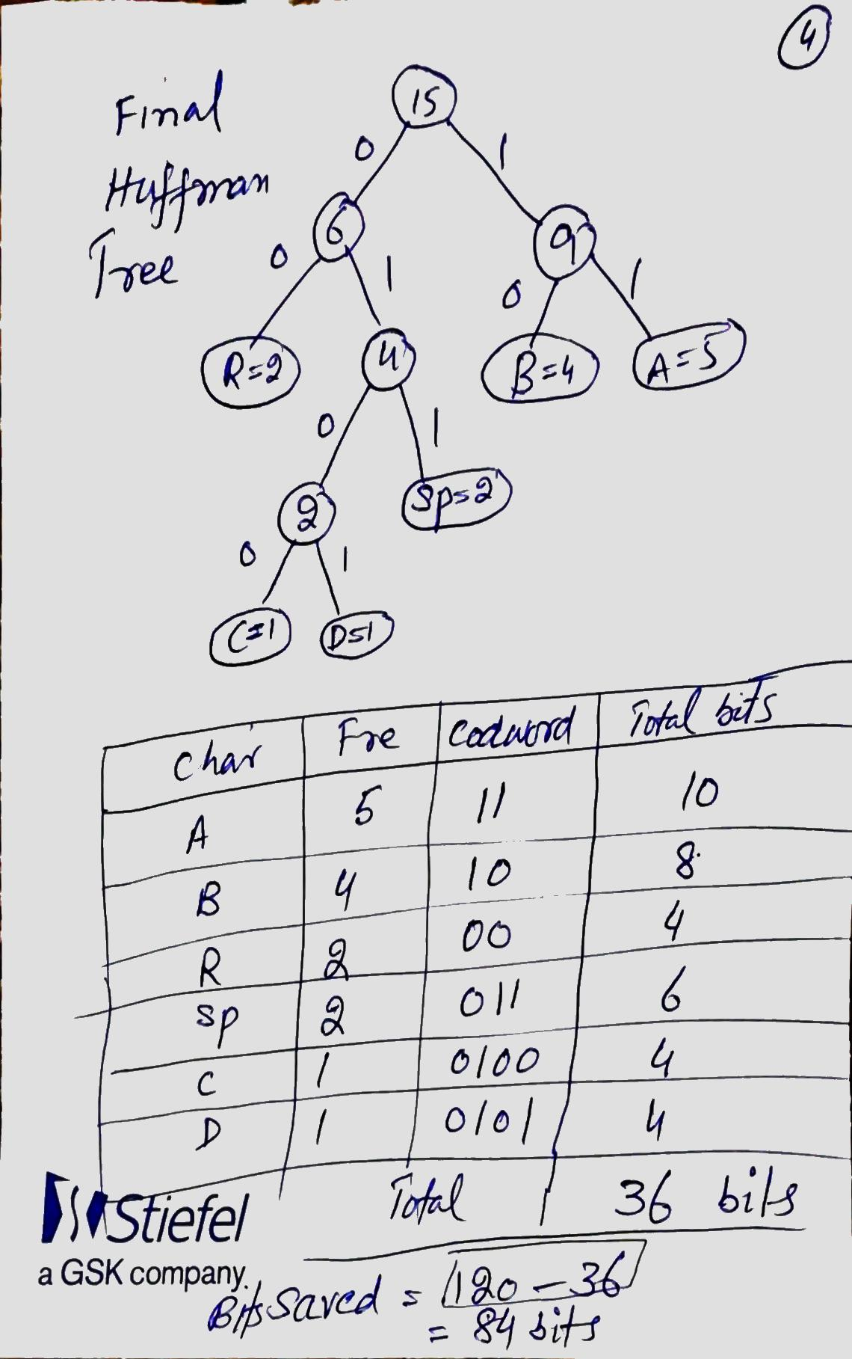

Slide 30
Huffman Code Problem
Left tree represents a fixed length encoding scheme
Right tree represents a Huffman encoding scheme
Notes:
30

Slide 31
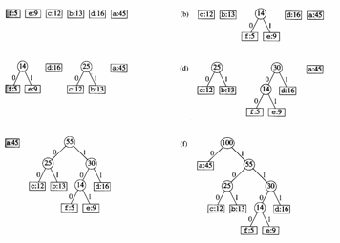
Example
Notes:
31

Slide 32
Huffman Encoding
Original text:
traversing threaded binary trees
size: 33 characters (space and newline)
  NL : 1
  SP : 3
  a : 3
  b : 1
  d : 2
  e : 5
  g : 1
  h : 1
  i : 2
  n : 2
  r : 5
  s : 2
  t : 3
  v : 1
  y : 1

Slide 33
Huffman Encoding
2 is equal to sum
of the frequencies of
the two children nodes.
a
3
e
5
r
5
t
3
d
2
i
2
n
2
s
2
2
SP
3
NL
1
b
1
g
1
h
1
v
1
y
1

Slide 34
Huffman Encoding
There a number of ways to combine nodes. We have chosen just one such way.
a
3
e
5
r
5
t
3
d
2
i
2
n
2
s
2
2
2
SP
3
NL
1
b
1
g
1
h
1
v
1
y
1

Slide 35
Huffman Encoding
a
3
e
5
r
5
t
3
d
2
i
2
n
2
s
2
2
2
2
SP
3
NL
1
b
1
g
1
h
1
v
1
y
1

Slide 36
Huffman Encoding
a
3
e
5
r
5
t
3
4
4
d
2
i
2
n
2
s
2
2
2
2
SP
3
NL
1
b
1
g
1
h
1
v
1
y
1

Slide 37
Huffman Encoding
6
a
3
4
e
5
r
5
5
t
3
4
4
d
2
i
2
n
2
s
2
2
2
2
SP
3
NL
1
b
1
g
1
h
1
v
1
y
1

Slide 38
Huffman Encoding
9
10
6
8
a
3
4
e
5
r
5
5
t
3
4
4
d
2
i
2
n
2
s
2
2
2
2
SP
3
NL
1
b
1
g
1
h
1
v
1
y
1

Slide 39
Huffman Encoding
14
19
9
10
6
8
a
3
4
e
5
r
5
5
t
3
4
4
d
2
i
2
n
2
s
2
2
2
2
SP
3
NL
1
b
1
g
1
h
1
v
1
y
1

Slide 40
Huffman Encoding
33
14
19
9
10
6
8
a
3
4
e
5
r
5
5
t
3
4
4
d
2
i
2
n
2
s
2
2
2
2
SP
3
NL
1
b
1
g
1
h
1
v
1
y
1
Notes:
End of lecture 25.

Slide 41
Huffman Encoding
Start at the root. Assign 0 to left branch and 1 to the right branch.
Repeat the process down the left and right subtrees.
To get the code for a character, traverse the tree from the root to the character leaf node and read off the 0 and 1 along the path.

Slide 42
Huffman Encoding
33
0
1
14
19
9
10
6
8
a
3
4
e
5
r
5
5
t
3
4
4
d
2
i
2
n
2
s
2
2
2
2
SP
3
NL
1
b
1
g
1
h
1
v
1
y
1

Slide 43
Huffman Encoding
33
0
1
14
19
0
1
0
1
9
10
6
8
a
3
4
e
5
r
5
5
t
3
4
4
d
2
i
2
n
2
s
2
2
2
2
SP
3
NL
1
b
1
g
1
h
1
v
1
y
1

Slide 44
Huffman Encoding
33
0
1
14
19
0
1
0
1
9
10
6
8
0
1
0
1
0
1
0
1
a
3
4
e
5
r
5
5
t
3
4
4
0
1
0
1
0
1
0
1
d
2
i
2
n
2
s
2
2
2
2
SP
3
NL
1
b
1
g
1
h
1
v
1
y
1

Slide 45
Huffman Encoding
33
0
1
14
19
0
1
0
1
9
10
6
8
0
1
0
1
0
1
0
1
a
3
4
e
5
r
5
5
t
3
4
4
0
1
0
1
0
1
0
1
d
2
i
2
n
2
s
2
2
2
2
SP
3
0
1
0
1
0
1
NL
1
b
1
g
1
h
1
v
1
y
1

Slide 46
Huffman Encoding
  Huffman character codes
  NL ⇨ 10000
  SP ⇨ 1111
  a ⇨ 000
  b ⇨ 10001
  d ⇨ 0100
  e ⇨ 101
  g ⇨ 10010
  h ⇨ 10011
  i ⇨ 0101
  n ⇨ 0110
  r ⇨ 110
  s ⇨ 0111
  t ⇨ 001
  v ⇨ 11100
  y ⇨ 11101
  Notice that the code is variable length.
  Letters with higher frequencies have shorter codes.
  The tree could have been built in a number of ways; each would yielded different codes but the code would still be minimal.

Slide 47
Huffman Encoding
Original: traversing threaded binary trees
Encoded:
001110000111001011100111010101101001011110011001111010100001001010100111110000101011000011011101111100111010110101110000

Slide 48
Huffman Encoding
Original: traversing threaded binary trees
With 8 bits per character, length is 264.
Encoded:
001110000111001011100111010101101001011110011001111010100001001010100111110000101011000011011101111100111010110101110000
Compressed into 122 bits, 54% reduction.

Slide 49
Summary
  Summary

Slide 50
  THANK YOU
  Q & A

