Slide 1
CUI Abbottabad
Department of Computer Science
Data Structures and Algorithms
Lecture No. 20
Binary Search Tree (BST)

Slide 2
Agenda
Binary Search Tree
Introduction
Realization
Insertion of a Nodes
Searching a Nodes
Deletion of a Nodes

Slide 3
Binary Search Tree
A Binary Search Tree (BST) is a tree in which all the nodes follow the below-mentioned properties:
The value of the key of the left sub-tree is less than the value of its parent (root) node's key.
The value of the key of the right sub-tree is greater than or equal to the value of its parent (root) node's key.

Slide 4
Binary Search Tree
Thus, BST divides all its sub-trees into two segments; the left sub-tree and the right subtree and can be defined as:
Left < parent ≤ right

Slide 5
Binary Search Tree
A binary tree with the property that items in the left subtree are smaller than the root and items are larger or equal in the right subtree is called a binary search tree (BST).
The tree we built for searching for duplicate numbers was a binary search tree.
BST and its variations play an important role in searching algorithms.

Slide 6
Basic Operations of BST
Following are the basic operations of a BST:
Search − Searches an element in a BST.
Insert − Inserts an element in a BST.
Delete – Deletes an element in a BST.
Traverse – Accessing all the elements in a BST

Slide 7
Basic Operations of BST
Search Operation:
Start searching from the root node
If the data is less than the key value, search for the element in the left subtree.
Otherwise, search for the element in the right subtree.
Insert Operation:
First locate its proper location. Start searching from the root node
If the data is less than the key value, search for the empty location in the left subtree and insert the data.
Otherwise, search for the empty location in the right subtree and insert the data.

Slide 8
Basic Operations of BST
Delete Operation:
As is common with many data structures, the hardest operation is deletion.
First locate the node to be deleted. Start searching from the root
If the node data is less than the key value, search for the key in the left subtree.
Otherwise, search in the right subtree.
After this there are three cases:
Target node is leaf node (No Child)
Target node has 1 child
Target node has 2 children

Slide 9
Basic Operations of BST
Delete Operation:
Target node is a leaf node (No Child)

Slide 10
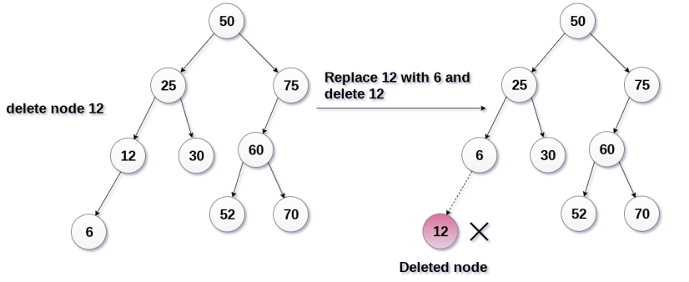
Basic Operations of BST
Delete Operation:
Target node has 1 child

Slide 11
Basic Operations of BST
Delete Operation:
Example
6
2
8
1
4
3

Slide 12
Basic Operations of BST
Delete Operation:
Example
6
↓
6
2
8
2
8
1
4
1
4
3
3

Slide 13
Basic Operations of BST
Delete Operation:
Example
6
↓
6
↓
6
2
8
2
8
2
8
1
4
1
4
1
3
3
3

Slide 14
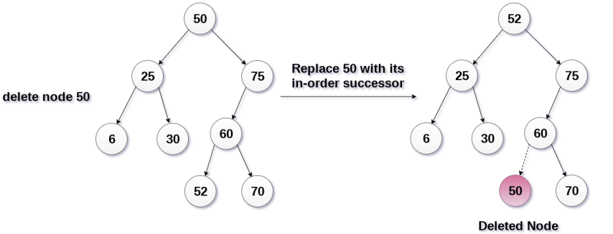
Basic Operations of BST
Delete Operation:
Target node has 2 children

Slide 15
Basic Operations of BST
Delete Operation:
Example
6
2
8
1
5
3
4
Inorder successor

Slide 16
Basic Operations of BST
Delete Operation:
Example
6
↓
6
2
8
3
8
1
5
1
5
3
3
4
4

Slide 17
Basic Operations of BST
Delete Operation:
Example
6
↓
6
↓
6
2
8
3
8
3
8
1
5
1
5
1
5
3
3
3
4
4
4

Slide 18
Basic Operations of BST
Delete Operation:
Example
↓
6
↓
6
3
8
3
8
1
5
1
5
3
4
4

Slide 19
code for delete
TreeNode remove(TreeNode tree, int info)
{
TreeNode t;
int cmp = info – tree.data;
if( cmp < 0 ){
t = remove(tree.left, info);
tree.left= t ;
}
else if( cmp > 0 ){
t = remove(tree.right, info);
tree.right=t ;
}

Slide 20
code for delete
//two children, replace with inorder successor
else if(tree.left != null
&& tree.right != null ){
TreeNode minNode;
minNode = findMin(tree.right);
tree.data=minNode.data;
t = remove(tree.right,
minNode.data);
tree.right=t ;
}

Slide 21
code for delete
else { // case 1
TreeNode nodeToDelete = tree;
if( tree.left == null ) //will handle 0 children
tree = tree.right;
else if( tree.right== null )
tree = tree.left;
else tree = null;
}
return tree;
}

Slide 22
code for delete
TreeNode findMin(TreeNode tree)
{
if( tree == null )
return null;
if( tree.left == null )
return tree; // this is it.
return findMin( tree.left);
}

Slide 23
Basic Operations of BST
Traverse Operation:
We discussed in previous lecture

Slide 24
Summary
Summary

Slide 25
THANK YOU
Q & A

