Slide 1
CUI Abbottabad
Department of Computer Science
Data Structures and Algorithms
Lecture No. 16
Binary Tree

Slide 2
Agenda
Binary Tree
Binary Trees ADT
Properties
Realization
Binary Tree implementation
Array
Linked List

Slide 3
Tree Data Structures
There are a number of applications where linear data structures are not appropriate.
Consider a genealogy tree of a family.
Mohammad Aslam Khan
Sohail Aslam
Javed Aslam
Yasmeen Aslam
Haaris
Saad
Qasim
Asim
Fahd
Ahmad
Sara
Omer

Slide 4
Tree Data Structure
A linear linked list will not be able to capture the tree-like relationship with ease.
Shortly, we will see that for applications that require searching, linear data structures are not suitable.
We will focus our attention on binary trees.

Slide 5
Binary Tree
A binary tree is a finite set of elements that is either empty or is partitioned into three disjoint subsets.
The first subset contains a single element called the root of the tree.
The other two subsets are themselves binary trees called the left and right subtrees.
Each element of a binary tree is called a node of the tree.

Slide 6
Binary Tree
A binary tree is a hierarchical data structure in which each node has at most two children generally referred as left child and right child.
Each node contains three components:
Data
Reference to left subtree
Reference to right subtree

Slide 7
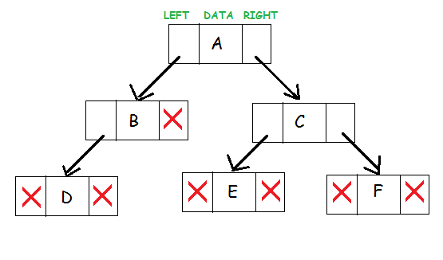
Binary Tree
The topmost node in the tree is called the root
An empty tree is represented by NULL pointer

Slide 8
Binary Tree
Binary tree with 9 nodes.
A
B
C
D
E
F
G
H
I

Slide 9
Binary Tree
root
A
B
C
D
E
F
G
H
I
Left subtree
Right subtree

Slide 10
Binary Tree
Recursive definition
A
Parent
B
C
D
E
F
Left subtree
G
H
I
Right subtree

Slide 11
Binary Tree
Recursive definition
A
B
C
Parent
D
E
F
G
H
I
Left subtree

Slide 12
Binary Tree
Recursive definition
A
B
C
D
E
F
Leaf
G
H
I

Slide 13
Binary Tree
Recursive definition
A
Parent
B
C
D
E
F
G
H
I
Right subtree

Slide 14
Binary Tree
Recursive definition
A
B
C
Parent
D
E
F
G
H
I
Left subtree
Right subtree

Slide 15
Not a Tree
Structures that are not trees.
A
B
C
D
E
F
G
H
I

Slide 16
Not a Tree
Structures that are not trees.
A
B
C
D
E
F
G
H
I

Slide 17
Not a Tree
Structures that are not trees.
A
B
C
D
E
F
G
H
I

Slide 18
Binary Tree: Terminology
parent
A
Left descendant
B
C
Right descendant
D
E
F
G
H
I
Leaf nodes
Leaf nodes

Slide 19
Binary Tree
If every non-leaf node in a binary tree has non-empty left and right subtrees, the tree is termed a strictly binary tree.
A
B
C
D
E
J
F
G
K
H
I

Slide 20
Level of a Binary Tree Node
The level of a node in a binary tree is defined as follows:
Root has level 0,
Level of any other node is one more than the level its parent (father).
The depth of a binary tree is the maximum level of any leaf in the tree.

Slide 21
Level of a Binary Tree Node
A
0
Level 0
B
1
C
1
Level 1
D
E
F
2
Level 2
2
2
G
H
3
I
3
Level 3
3

Slide 22
Types of Binary Tree
Based on Structure following types/variants of binary trees exists:
Full Binary Tree
Perfect Binary Tree
Complete Binary Tree
Degenerate Binary Tree
Balance Binary Tree

Slide 23
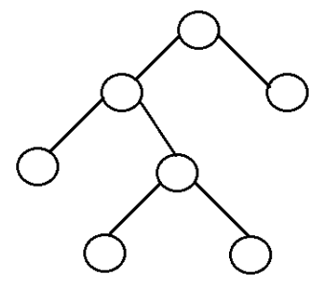
Full Binary Tree
It is a tree in which every node in the tree has either 0 or 2 children.
The number of nodes n is atleast n = 2^{h} – 1, and atmost n = 2^{h+1} – 1, where h is the height

Slide 24
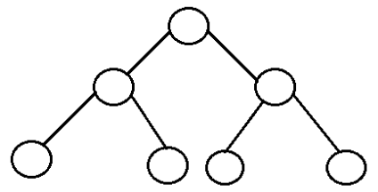
Perfect Binary Tree
All internal nodes have two children and all leaves have the same depth or same level.
A perfect binary tree with l leaves has n = 2l - 1 nodes where l is no. of leaf nodes.

Slide 25
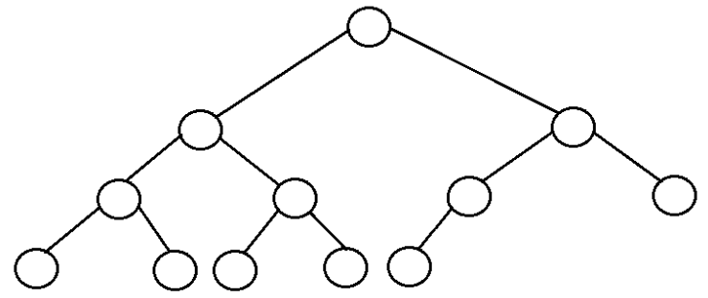
Complete Binary Tree
Binary tree in which every level, except possibly the last, is completely filled, and all nodes are as far left as possible.

Slide 26
Complete Binary Tree
A complete binary tree of depth d is the strictly binary all of whose leaves are at level d.
A
0
B
1
C
1
D
2
E
2
F
2
G
2
H
3
I
J
3
K
L
3
M
3
N
3
O
3

Slide 27
Complete Binary Tree
A
Level 0: 2⁰ nodes
B
C
Level 1: 2¹ nodes
D
E
F
G
Level 2: 2² nodes
H
I
J
K
L
M
N
O
Level 3: 2³ nodes

Slide 28
Complete Binary Tree
At level k, there are 2^{k} nodes.
Total number of nodes in the tree of depth d: 2⁰+ 2¹+ 2² + ………. + 2^{d} = ∑2^{j} = 2^{d+1} – 1
In a complete binary tree, there are 2^{d} leaf nodes and (2^{d} - 1) non-leaf (inner) nodes.
d
j=0

Slide 29
Complete Binary Tree
If the tree is built out of ‘n’ nodes then n = 2^{d+1} – 1 or log₂(n+1) = d+1 or d = log₂(n+1) – 1
I.e., the depth of the complete binary tree built using ‘n’ nodes will be log₂(n+1) – 1.
For example, for n=1,000,000, log₂(1000001) is less than 20; the tree would be 20 levels deep.

Slide 30
Degenerate Binary Tree
It is a tree is where each parent node has only one child node. It behaves like a linked list.

Slide 31
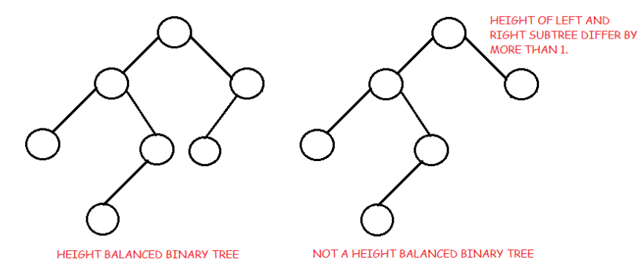
Balanced Binary Tree
A binary tree is height balanced if it satisfies these constraints:
The left and right subtrees' heights differ by at most one, AND
The left subtree is balanced, AND
The right subtree is balanced
The height of a balanced binary tree is O(log₂ n) where n is number of nodes.

Slide 32
Operations on Binary Tree
There are a number of operations that can be defined for a binary tree.
If p is pointing to a node in an existing tree then
left(p) returns pointer to the left subtree
right(p) returns pointer to right subtree
parent(p) returns the father of p
brother(p) returns brother of p.
info(p) returns content of the node.

Slide 33
Operations on Binary Tree
In order to construct a binary tree, the following can be useful:
setLeft(p,x) creates the left child node of p. The child node contains the info ‘x’.
setRight(p,x) creates the right child node of p. The child node contains the info ‘x’.

Slide 34
Applications of Binary Trees
A binary tree is a useful data structure when two-way decisions must be made at each point in a process.
For example, suppose we wanted to find all duplicates in a list of numbers: 14, 15, 4, 9, 7, 18, 3, 5, 16, 4, 20, 17, 9, 14, 5

Slide 35
Applications of Binary Trees
One way of finding duplicates is to compare each number with all those that precede it.
14, 15, 4, 9, 7, 18, 3, 5, 16, 4, 20, 17, 9, 14, 5
14, 15, 4, 9, 7, 18, 3, 5, 16, 4, 20, 17, 9, 14, 5

Slide 36
Searching for Duplicates
If the list of numbers is large and is growing, this procedure involves a large number of comparisons.
A linked list could handle the growth but the comparisons would still be large.
The number of comparisons can be drastically reduced by using a binary tree.
The tree grows dynamically like the linked list.

Slide 37
Searching for Duplicates
The binary tree is built in a special way.
The first number in the list is placed in a node that is designated as the root of a binary tree.
Initially, both left and right subtrees of the root are empty.
We take the next number and compare it with the number placed in the root.
If it is the same then we have a duplicate.

Slide 38
Searching for Duplicates
Otherwise, we create a new tree node and put the new number in it.
The new node is made the left child of the root node if the second number is less than the one in the root.
The new node is made the right child if the number is greater than the one in the root.

Slide 39
Searching for Duplicates
14, 15, 4, 9, 7, 18, 3, 5, 16, 4, 20, 17, 9, 14, 5
14

Slide 40
Searching for Duplicates
15, 4, 9, 7, 18, 3, 5, 16, 4, 20, 17, 9, 14, 5
15
14

Slide 41
Searching for Duplicates
15, 4, 9, 7, 18, 3, 5, 16, 4, 20, 17, 9, 14, 5
14
15

Slide 42
Searching for Duplicates
4, 9, 7, 18, 3, 5, 16, 4, 20, 17, 9, 14, 5
4
14
15

Slide 43
Searching for Duplicates
4, 9, 7, 18, 3, 5, 16, 4, 20, 17, 9, 14, 5
14
4
15

Slide 44
Searching for Duplicates
9, 7, 18, 3, 5, 16, 4, 20, 17, 9, 14, 5
9
14
4
15

Slide 45
Searching for Duplicates
9, 7, 18, 3, 5, 16, 4, 20, 17, 9, 14, 5
14
4
15
9

Slide 46
Searching for Duplicates
7, 18, 3, 5, 16, 4, 20, 17, 9, 14, 5
7
14
4
15
9

Slide 47
Searching for Duplicates
7, 18, 3, 5, 16, 4, 20, 17, 9, 14, 5
14
4
15
9
7

Slide 48
Searching for Duplicates
18, 3, 5, 16, 4, 20, 17, 9, 14, 5
18
14
4
15
9
7

Slide 49
Searching for Duplicates
18, 3, 5, 16, 4, 20, 17, 9, 14, 5
14
4
15
9
18
7

Slide 50
Searching for Duplicates
3, 5, 16, 4, 20, 17, 9, 14, 5
3
14
4
15
9
18
7

Slide 51
Searching for Duplicates
3, 5, 16, 4, 20, 17, 9, 14, 5
14
4
15
3
9
18
7

Slide 52
Searching for Duplicates
5, 16, 4, 20, 17, 9, 14, 5
5
14
4
15
3
9
18
7

Slide 53
Searching for Duplicates
5, 16, 4, 20, 17, 9, 14, 5
14
4
15
3
9
18
7
5

Slide 54
Searching for Duplicates
16, 4, 20, 17, 9, 14, 5
16
14
4
15
3
9
18
7
5

Slide 55
Searching for Duplicates
16, 4, 20, 17, 9, 14, 5
14
4
15
3
9
18
7
16
5

Slide 56
Searching for Duplicates
4, 20, 17, 9, 14, 5
4
14
4
15
3
9
18
7
16
5

Slide 57
Searching for Duplicates
20, 17, 9, 14, 5
20
14
4
15
3
9
18
7
16
5

Slide 58
Searching for Duplicates
20, 17, 9, 14, 5
14
4
15
3
9
18
7
16
20
5

Slide 59
Searching for Duplicates
17, 9, 14, 5
17
14
4
15
3
9
18
7
16
20
5

Slide 60
Searching for Duplicates
17, 9, 14, 5
14
4
15
3
9
18
7
16
20
5
17

Slide 61
Searching for Duplicates
9, 14, 5
14
4
15
3
9
18
7
16
20
5
17

Slide 62
Implementation
public class TreeNode {
int data;
TreeNode left;
TreeNode right;
TreeNode(int data) {
this.data = data;
left = null;
right = null;
}

Slide 63
Implementation
void insert(TreeNode root, int x) {
TreeNode n = new TreeNode(x);
TreeNode p, q;
p = q = root;
while (x != p.data && q != null) {
p = q;
if (x < p.data) {
q = p.left;
} else {
q = p.right;
}
}
if (x == p.data) {
System.out.print("duplicate" + x);
} else if (x < p.data) {
p.left = n;
} else {
p.right = n;
}
} // end of insert
} // end of class

Slide 64
Implementation
public static void main(String[] args) {
int x[] = { 14, 15, 4, 9, 7, 18, 3, 5, 16,4, 20, 17,
9, 14,5};
TreeNode root = new TreeNode(x[0]);
for(int i=0; i < x.length; i++ )
{
root.insert(root, x[i] );
}
}

Slide 65
Trace of insert
17, 9, 14, 5
p
17
q
14
4
15
3
9
18
7
16
20
5

Slide 66
Trace of insert
17, 9, 14, 5
p
17
14
4
q
15
3
9
18
7
16
20
5

Slide 67
Trace of insert
17, 9, 14, 5
17
14
4
p
15
q
3
9
18
7
16
20
5

Slide 68
Trace of insert
17, 9, 14, 5
17
14
4
p
15
3
9
q
18
7
16
20
5

Slide 69
Trace of insert
17, 9, 14, 5
17
14
4
15
3
9
p
18
q
7
16
20
5

Slide 70
Trace of insert
17, 9, 14, 5
17
14
4
15
3
9
p
18
7
q
16
20
5

Slide 71
Trace of insert
17, 9, 14, 5
17
14
4
15
3
9
18
p
7
q
16
20
5

Slide 72
Trace of insert
17, 9, 14, 5
17
14
4
15
3
9
18
p
7
16
20
q
5

Slide 73
Trace of insert
17, 9, 14, 5
14
4
15
3
9
18
7
p
16
20
5
node
17
p.right=node;
Notes:
End of lecture 12

Slide 74
Cost of Search
Given that a binary tree is level d deep. How long does it take to find out whether a number is already present?
Consider the insert(17) in the example tree.
Each time around the while loop, we did one comparison.
After the comparison, we moved a level down.

Slide 75
Cost of Search
With the binary tree in place, we can write a routine find(x) that returns true if the number x is present in the tree, false otherwise.
How many comparison are needed to find out if x is present in the tree?
We do one comparison at each level of the tree until either x is found or q becomes NULL.

Slide 76
Cost of Search
If the binary tree is built out of n numbers, how many comparisons are needed to find out if a number x is in the tree?
Recall that the depth of the complete binary tree built using ‘n’ nodes will be log₂(n+1) – 1.
For example, for n=100,000, log₂(100001) is less than 20; the tree would be 20 levels deep.

Slide 77
Cost of Search
If the tree is complete binary or nearly complete, searching through 100,000 numbers will require a maximum of 20 comparisons.
Or in general, approximately log₂(n).
Compare this with a linked list of 100,000 numbers. The comparisons required could be a maximum of n.

Slide 78
Summary
Summary

Slide 79
THANK YOU
Q & A

