Slide 1
CUI Abbottabad
Department of Computer Science
Data Structures and Algorithms
Lecture No. 15
Tree

Slide 2
Agenda
Tree
Introduction
Basic Terminologies
Types of Tree
Representation of Tree
Applications of a Tree

Slide 3
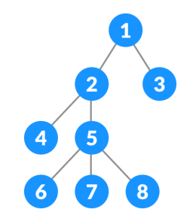
Tree
A tree is a nonlinear hierarchical data structure that consists of nodes connected by edges

Slide 4
Why Tree?
Other data structures such as arrays, linked list, stack, and queue are linear data structures that store data sequentially.
In order to perform any operation in a linear data structure, the time complexity increases with the increase in the data size.
It is not acceptable in today's computational world.

Slide 5
Why Tree?
Consider a search operation in a linear or sequential data structure what will be the cost of search operation?
Different tree data structures allow quicker and easier access to the data as it is a nonlinear data structure. (We will go into details of each one by one)

Slide 6
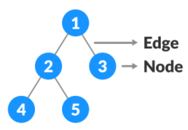
Basic Terminologies
Node:
It contains a key or value and pointers to its child nodes.
The last nodes of each path are called leaf nodes.
Leaf nodes do not contain any child nodes.
Edge:
It is the link between any two nodes.

Slide 7
Basic Terminologies
Root:
It is the topmost node of a tree from which the tree starts.
There is only one root per tree and one path from the root node to any node.
Parent:
Any node (except root) node has upward edge to a node called parent.
Child:
The node below a given node connected by an edge downward is called child node.
Leaf:
The node which does not have any child node is called the leaf node.

Slide 8
Basic Terminologies
Height of a Node
The height of a node is the number of edges from the node to the deepest leaf.
Depth of a Node
The depth of a node is the number of edges from the root to the node.
Levels
Level of a node represents the generation of a node. If the root node is at level 0, then its next child node is at level 1, its grandchild is at level 2, and so on.

Slide 9
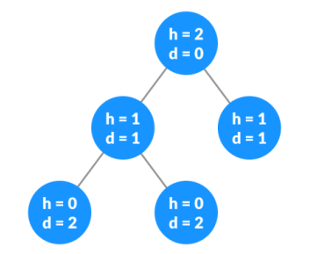
Basic Terminologies
Height of a Tree
The height of a tree is the number of edges from the deepest leaf to the root.
Depth of a Tree
The depth of a tree is the number of edges from the root to the deepest leaf.

Slide 10
Basic Terminologies
Degree of a Node
The degree of a node is the total number of children of that node.
Visiting
Visiting refers to checking the value of a node when control is on the node.
Tree Traversal
The tree traversal algorithm helps in visiting a required node in the tree. Traversal means passing through the nodes of a tree in a specific order.

Slide 11
Basic Terminologies
Key
Key represents a value of a node based on which a search operation is to be carried out.
Path
Path refers to the sequence of nodes along the edges of a tree.
Subtree
Subtree represents the descendants of a node.

Slide 12
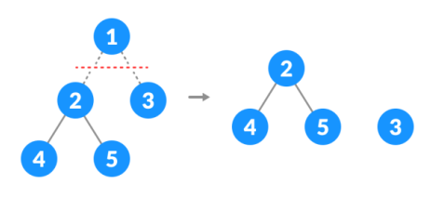
Basic Terminologies
Forest
A collection of disjoint trees is called a forest. You can create a forest by cutting the root of a tree.

Slide 13
Types of Tree
Types of tree included in this course
Binary Tree
Binary Search Tree
AVL Tree
Other types of trees
B-Tree
B+ Tree
Red Black Tree
T-Tree
Trie

Slide 14
Representation of Tree
Tree is represented as a linked list with two references to a child node and sometimes a reference to a parent node.
class Node <T> { T data; Node LeftChild; Node RightChild; }
Certain tree can also be represented using array which we will discuss later.

Slide 15
Applications of Tree
Trees are used to quickly check whether an element is present in a set or not.
Trees are used to do the data compression.
Trees are used for expression evaluation and representation.
Trees are used in decision making algorithms.
Heap is a kind of tree that is used for heap sort.
A modified version of a tree called Tries is used in modern routers to store routing information.
Most popular databases use B-Trees and T-Trees, which are variants of the tree.
Compilers use a syntax tree to validate the syntax of every program you write.

Slide 16
Summary
Summary

Slide 17
THANK YOU
Q & A

