Slide 1
CUI Abbottabad
Department of Computer Science
Data Structures and Algorithms
Lecture No. 14
Applications of Queues

Slide 2
Agenda
Applications of Queue
Job Scheduling in Operating System
Buffers in Computer Networks
Spoolers in Hardware Devices

Slide 3
Application of Queues
Implementation of a queue is also an important factor in IT sector.
Job scheduling of CPU in Operating Systems
Packets buffers in Networking.
Spooling in Printers
Resource allocation to customer services in industry.

Slide 4
Job Scheduling
Nowadays computer handles:
Multiuser environment
multiprogramming environment
time-sharing environment
In this environment a system handles several jobs at a time
Queue is used to handle these jobs.

Slide 5
Job Scheduling
It may happen that processes in the ready queue can be divided into different classes where each class has its own scheduling needs.
For example, a common division is:
Foreground (interactive) processes
Background (batch) processes
System processes
These classes have different scheduling needs. For this kind of situation Multilevel Queue Scheduling is used where priority is implemented

Slide 6
Job Scheduling
Now, let us see how it works:
Ready Queue is divided into separate queues for each class of processes.
For example, let us take three different types of process:
System processes
Interactive processes
Batch Processes
All three types of processes have their own queue.

Slide 7
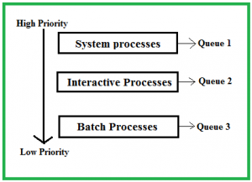
Job Scheduling
System Processes: The CPU itself has its own process to run which is generally termed as System Process.
Interactive Processes: An Interactive Process is a type of process in which there should be same type of interaction.
Batch Processes: Batch processing is generally a technique in the Operating system that collects the programs and data together in the form of the batch before the processing starts.

Slide 8
Network Device Buffers
A Buffer is a region of physical memory storage (queue) used to temporarily store data while it is being moved from one place to another.
Typically, the data is stored in a buffer it is retrieved from an input device (such as audio/video) or just before it is sent to an output device (such as speakers/screen).
However, a buffer may be used when moving data between processes within a computer.

Slide 9
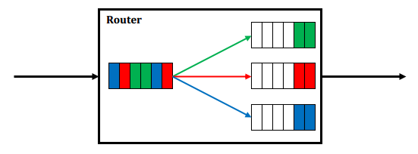
Network Device Buffers
This is comparable to buffers in telecommunication
where one systems sends data to other while the other systems receives and decode data it saves it in a temporary space based on queues.

Slide 10
Spooling
Spooling is a specialized form of queue for the purpose of temporary holding data between different devices.
It is usually used for mediating between a computer application and a slow peripheral, such as a printer.
Spooling allows programs to "hand off" work to be done by the peripheral and then proceed to other tasks.
Spooler, maintains an orderly sequence of jobs for the peripheral and feeds it data at its own rate.

Slide 11
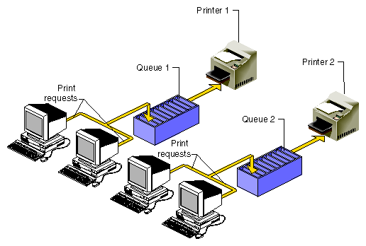
Spooling
There are many other uses of queues in computer sciences field that you will study in detail in other courses such as Operating Systems and Computer Networks and many others.

Slide 12
Summary
Summary

Slide 13
THANK YOU
Q & A

