Slide 1
CUI Abbottabad
Department of Computer Science
Data Structures and Algorithms
Lecture No. 03
Asymptotic Analysis

Slide 2
Agenda
Analysis of Algorithms
Complexity of Algorithms
Asymptotic Anlysis

Slide 3
Analysis of Algorithms
An algorithm is a finite set of precise instructions for performing a computation or for solving a problem.
What is the goal of analysis of algorithms?
To compare algorithms mainly in terms of running time but also in terms of other factors (e.g., memory requirements, programmer's effort etc.)
What do we mean by running time analysis?
Determine how running time increases as the size of the problem increases.

Slide 4
Example: Searching
Problem of searching an ordered list.
Given a list L of n elements that are sorted into a definite order (e.g., numeric, alphabetical),
And given a particular element x,
Determine whether x appears in the list, and if so, return its index (position) in the list.

Slide 5
Search alg. #1: Linear Search
procedure linear search (x: integer, a₁, a₂, …, a_{n}: distinct integers) i := 1 while (i ≤ n ∧ x ≠ ai) i := i + 1
End if i ≤ n then
location := i else
location := -1
End return location {index or -1 if not found}

Slide 6
Search alg. #2: Binary Search
Basic idea: On each step, look at the middle element of the remaining list to eliminate half of it, and quickly reach in on the desired element.
<x
<x
<x
>x

Slide 7
Search alg. #2: Binary Search
procedure binary search (x:integer, a₁, a₂, …, a_{n}: distinct integers) i := 1 {left endpoint of search interval} j := n {right endpoint of search interval}
location := -1 while i<j begin {while interval has >1 item} m := ⎣(i+j)/2⎦ {midpoint} if(x = a_{m})
location := m
else if(x < a_{m})
j:=m-1
else
i:=m+1
end return location (location=-1 not found)

Slide 8
Is Binary Search more efficient?
Number of iterations:
For a list of n elements, Binary Search can execute at most log₂ n times!!
Linear Search, on the other hand, can execute up to n times !!
Average Number of Iterations
Length | Linear Search | Binary Search
10 | 5.5 | 2.9
100 | 50.5 | 5.8
1,000 | 500.5 | 9.0
10,000 | 5000.5 | 12.0

Slide 9
Is Binary Search more efficient?
Number of computations per iteration:
Binary search does more computations than Linear Search per iteration.
Overall:
If the number of components is small (say, less than 20), then Linear Search is faster.
If the number of components is large, then Binary Search is faster.

Slide 10
How do we analyze algorithms?
We need to define a number of objective measures.
(1) Compare execution times?
Not good: times are specific to a particular computer !!
(2) Count the number of statements executed?
Not good: number of statements vary with the programming language as well as the style of the individual programmer.

Slide 11
Ideal Solution
Express running time as a function of the input size n (i.e., f(n)).
Compare different functions corresponding to running times.
Such an analysis is independent of machine time, programming style, etc.

Slide 12
Input Size
Input size (number of elements in the input)
size of an array
polynomial degree
# of elements in a matrix
# of bits in the binary representation of the input
vertices and edges in a graph

Slide 13
Types of Analysis
Worst case
Provides an upper bound on running time
An absolute guarantee that the algorithm would not run longer, no matter what the inputs are
Best case
Provides a lower bound on running time
Input is the one for which the algorithm runs the fastest
Average case
Provides a prediction about the running time
Assumes that the input is random

Slide 14
Example
Associate a "cost" with each statement.
Find the "total cost“ by finding the total number of times each statement is executed.
Algorithm 1 Algorithm 2
Cost Cost
arr[0] = 0; c₁ for(i=0; i<N; i++) c₂
arr[1] = 0; c₁ arr[i] = 0; c₁
arr[2] = 0; c₁
... ...
arr[N-1] = 0; c₁
----------- -------------
c₁+c₁+...+c₁ = c₁ x N (N+1) x c₂ + N x c₁ =
(c₂ + c₁) x N + c₂

Slide 15
Another Example
Algorithm 3 Cost
sum = 0; c₁
for(i=0; i<N; i++) c₂
for(j=0; j<N; j++) c₂
sum += arr[i][j]; c₃
------------
c₁ + c₂ x (N+1) + c₂ x N x (N+1) + c₃ x N²

Slide 16
Asymptotic Analysis
To compare two algorithms with running times f(n) and g(n), we need a rough measure that characterizes how fast each function grows.
Hint: use rate of growth
Compare functions in the limit, that is, asymptotically!
(i.e., for large values of n)

Slide 17
Rate of Growth ≡Asymptotic Analysis
Using rate of growth as a measure to compare different functions implies comparing them asymptotically.
If f(x) is faster growing than g(x), then f(x) always eventually becomes larger than g(x) in the limit (for large enough values of x).

Slide 18
Rate of Growth
We need to simplify the function to extract the most important part and cast aside the less important parts
Suppose that an algorithm, running on an input of size n, takes 6n² + 100n + 300
6n² becomes more larger than 100n + 300 for n large enough 20 in this case
We ignore the lower order terms to simply the calculation

Slide 19
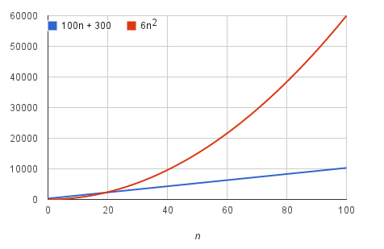
Rate of Growth

Slide 20
Rate of Growth
Consider the example of buying elephants and fish:
Cost: cost_of_elephants + cost_of_fish
Cost ~ cost_of_elephants (approximation)
The low order terms in a function are relatively insignificant for large n
n⁴ + 100n² + 10n + 50 ~ n⁴
i.e., we say that n⁴ + 100n² + 10n + 50 and n⁴ have the same rate of growth

Slide 21
Example
Suppose you are designing a web site to process user data (e.g., financial records).
Suppose program A takes f_{A}(n)=30n+8 microseconds to process any n records, while program B takes f_{B}(n)=n²+1 microseconds to process the n records.
Which program would you choose, knowing you’ll want to support millions of users?
A

Slide 22
Big-O Notation
We say f_{A}(n)=30n+8 is order n, or O(n). It is, at most, roughly proportional to n.
f_{B}(n)=n²+1 is order n², or O(n²). It is, at most, roughly proportional to n².
In general, an O(n²) algorithm will be slower than O(n) algorithm.
Warning: an O(n²) function will grow faster than an O(n) function.

Slide 23
Visualizing Orders of Growth
On a graph, as you go to the right, a faster growing function eventually becomes larger...
f_{A}(n)=30n+8
Value of function →
f_{B}(n)=n²+1
Increasing n →

Slide 24
Asymptotic Notation
By now you should have an intuitive feel for asymptotic (big-O) notation:
What does O(n) running time mean? O(n²)? O(n lg n)?
How does asymptotic running time relate to asymptotic memory usage?
Our first task is to define this notation more formally and completely

Slide 25
Big-O Notation
Read O as “Big-O” (you’ll also hear it as “order”)
In general, a function
f(n) is O(g(n)) if there exist positive constants c and n₀ such that f(n) ≤ c ⋅ g(n) for all n ≥ n₀
Formally
O(g(n)) = { f(n): ∃ positive constants c and n₀ such that
f(n) ≤ c ⋅ g(n) ∀ n ≥ n₀

Slide 26
Big-O Visualization
k

Slide 27
Big-O example, graphically
Note 30n+8 isn’t less than n anywhere (n>0).
It isn’t even less than 31n everywhere.
But it is less than 31n everywhere to the right of n=8.
cn = 31n
30n+8
30n+8 ∈O(n)
Value of function →
n
n>k=8 →
Increasing n →

Slide 28
Big-O Visualization
O(g(n)) is the set of functions with smaller or same order of growth as g(n)

Slide 29
Definition: Ω(g), at least order g
Let f,g be any function R→R.
We say that “f is at least order g”, written Ω(g), if
∃ c, k : f(x) ≥ cg(x), ∀ x > k
“Beyond some point k, function f is at least a constant c times g (i.e., proportional to g).”
Often, one deals only with positive functions and can ignore absolute value symbols.
“f is at least order g”, or “f is Ω(g)”, or “f= Ω(g)” all just mean that f∈ Ω(g).

Slide 30
Big- Ω Visualization

Slide 31
Definition: Θ(g), exactly order g
If f∈O(g) and g∈O(f) then we say “g and f are of the same order” or “f is (exactly) order g” and write f∈Θ(g).
Another equivalent definition:
∃ c₁c₂, k: c₁ g(x) ≤ f(x) ≤c₂ g(x), ∀x>k
“Everywhere beyond some point k, f(x) lies in between two multiples of g(x).”
Θ(g) ≡ O(g) ∩ Ω(g)
(i.e., f∈O(g) and f∈Ω(g) )

Slide 32
Big- Θ Visualization

Slide 33
Back to Our Example
Algorithm 1 Algorithm 2
Cost Cost
arr[0] = 0; c₁ for(i=0; i<N; i++) c₂
arr[1] = 0; c₁ arr[i] = 0; c₁
arr[2] = 0; c₁
...
arr[N-1] = 0; c₁
----------- -------------
c₁+c₁+...+c₁ = c₁ x N (N+1) x c₂ + N x c₁ =
(c₂ + c₁) x N + c₂
Both algorithms are of the same order: O(N)

Slide 34
Example (cont’d)
Algorithm 3 Cost
sum = 0; c₁
for(i=0; i<N; i++) c₂
for(j=0; j<N; j++) c₂
sum += arr[i][j]; c₃
------------
c₁ + c₂ x (N+1) + c₂ x N x (N+1) + c₃ x N² = O(N²)

Slide 35
General rules for analyzing algorithms
1. for loops: the running time of a for loop is at most
running time of statements in loop × number of loop iterations
for (int i = 0; i < N; i++) {
sum += nums[i];
}
2. nested loops: the running time of a statement in nested loops is
running time of statement in loop × product of sizes of the loops
for (int i = 0; i < N; i++) {
for (int j = 0; j < M; j++) {
nums1[i] += nums2[j] + i;
}
}

Slide 36
General rules for analyzing algorithms
3. Consecutive statements: the running time of consecutive statements is sum of their individual running times
int sum = 0;
for (int i = 0; i < N; i++) {
sum += nums[i];
}
double avg = (double)sum/N;
4. if-else: the running time of an if-else statement is at most
running time of the test + maximum running time of the if and else cases
if (isSorted(nums)) {
index = binarySearch(nums, desired);
}
else {
index = sequentialSearch(nums, desired);
}

Slide 37
Commonly Used Terminology for the Complexity of Algorithms.
Complexity Class | Terminology (Name)
1 | Constant Complexity
log n | Logarithmic Complexity
n | Linear Complexity
n log n | Linearithmic Complexity
n² | Quadratic
n³ | Cubic
n^{b} where b is constant | Polynomial Complexity
2^{n} | Exponential Complexity
n! | Factorial Complexity

Slide 38
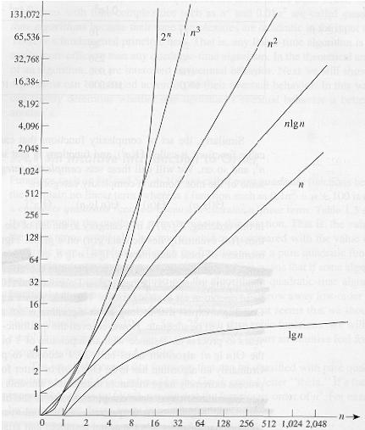
Common orders of magnitude

Slide 39
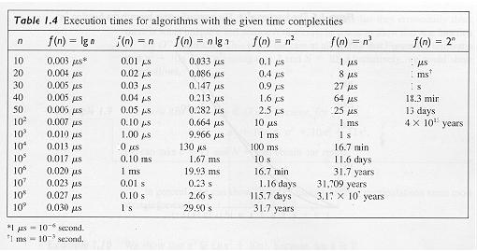
Common orders of magnitude

Slide 40
Summary
Summary

Slide 41
THANK YOU
Q & A

