Slide 1
CUI Abbottabad
Department of Computer Science
Data Structures and Algorithms
Lecture No. 02
Introduction to Algorithms

Slide 2
Agenda
Introduction
Algorithms
Relation among Data
Data Structures and Algorithms
Algorithm Analysis

Slide 3
Origin of Word: ALGORITHM
Abu Ja’fa Mohammad ibn Musa al-Khowarizmi

Slide 4
Origin of word: Algorithm
The word Algorithm comes from the name of the muslim author Abu Ja’far Mohammad ibn Musaal-Khowarizmi. He was born in the eighth century at Khwarizm (Kheva), a town south of river Oxus in present Uzbekistan. Uzbekistan, a Muslim country for over a thousand years, was taken over by the Russians in 1873.
Much of al-Khwarizmi’s work was written in a book titled al Kitab al-mukhatasar fi hisab al-jabrwa’l-muqabalah (The Compendious Book on Calculation by Completion and Balancing). It is from the titles of these writings and his name that the words algebra and algorithm are derived. As a result of his work, al-Khwarizmi is regarded as the most outstanding mathematician of his time

Slide 5
Origin of Word: ALGORITHM

Slide 6
Origin of Word: ALGORITHM
His year of birth is not known exactly.
Al-Khwarizmi parents migrated to a place south of Baghdad when he was a child.
It has been established from his contributions that flourished under khalifah Al-Mamun at Baghdad during 813 to 833 C.E.
Al-Khwarizmi died around 840 C.E.

Slide 7
Origin of Word: ALGORITHM
The Compendious Book on Calculation by Completion and Balancing

Slide 8
Origin of Word: ALGORITHM
It is from the titles of these writings and his name that the words algebra and algorithm are derived.
As a result of his work, al-Khwarizmi is regarded as the most outstanding mathematician of his time.

Slide 9
ALGORITHM: Informal Definition
Algorithm is a step-by-step process to solve a specific problem.
An algorithm is any well-defined computational procedure that takes some values, or set of values as input produces some values, or set of values as output.
An algorithm is thus a sequence of computational steps that transform the input into output.
Algorithm is not only the base of data structure but it is also the base of good programming.

Slide 10
ALGORITHM, programming
A good understanding of algorithms is essential for programming.
However, unlike a program, an algorithm is a mathematical entity.
Algorithm is independent of a specific programming language, machine, or computer.
Algorithm design is about mathematical theory behind the design of good programs.

Slide 11
What is an algorithm?
It's a set of well-defined rules (a recipe) for solving a computational problem. For example,
You have a bunch of numbers and you want to rearrange them in a sorted order.
You have a road map with an origin and a destination, and you want to compute the shortest path from that origin to that destination.
You face a number of different tasks that need to be completed by certain deadlines and you want to know the order you should accomplish the tasks so that you can complete them all by their respective deadlines.

Slide 12
Properties of Algorithms
Input: The inputs used in an algorithm must come from a specified set of elements, where the amount and type of inputs are specified.
Output: The algorithm must specify the output and how it is related to the input.
Definiteness: The steps in the algorithm must be clearly defined and detailed.
Effectiveness: The steps in the algorithm must be doable and effective.
Finiteness: The algorithm must come to an end after a specific number of steps.
Notes:
Each and every instruction must be cleared and simple, that can be understand by any body else. This phenomenon is called definiteness.

Slide 13
Why Study Algorithms?
The fact is that many of the courses in computer science deal with efficient algorithms and data structures.
They apply these to various applications:
Compilers,
Operating Systems,
Data Bases,
Artificial Intelligence,
Computer Graphics and Vision,
Networks, etc.

Slide 14
Why we study algorithms?
Understanding the basics of algorithms and the related field of data structures is essential for doing serious work in any branch of computer science. For example,
Routing and communication networks make use of classical shortest path algorithms
The effectiveness of public key cryptography relies on that of number-theoretic algorithms
Computer graphics needs the computational primitives supplied by geometric algorithms
Database indices rely on balanced search tree data structures
Computational biology uses dynamic programming algorithms to measure genome similarity.

Slide 15
Why Study?
A good understanding of algorithm design is a central element to a good understanding of computer science and computer programming.

Slide 16
Objectives
An algorithm is
a well-defined set of rules for transforming an input into an output
correct if for any valid input it produces the result required by the algorithm's specification. Incorrect algorithms can sometimes be useful, if we can control their error rate
efficient if it consumes minimum possible resources compared to other algorithms performing the same task
(a) Time or number of operations
(b) Memory utilization

Slide 17
Some well-known computational problems
Sorting
Searching
Shortest paths in a graph
Minimum spanning tree
Towers of Hanoi
Note: Some of these problems don't have efficient algorithms

Slide 18
Expressing algorithms
We can express algorithms
in English
graphically
using a programming language
using a pseudo code

Slide 19
Finding the maximum element in a sequence
We perform the following steps
Set the temporary maximum equal to the first integer in the sequence. (The temporary maximum will be the largest integer examined at any stage of the procedure)
Compare the next integer in the sequence to the temporary maximum, and if it is larger than the temporary maximum, set the temporary maximum equal to this integer
Repeat the previous step if there are more integers in the sequence
Stop when there are no integers left in the sequence. The temporary maximum at this point is the largest integer in the sequence

Slide 20
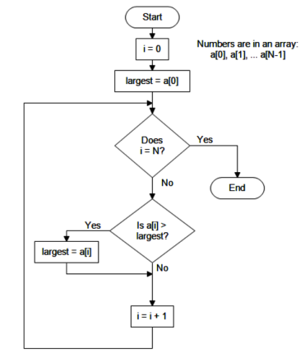
Finding the maximum element in a sequence(Flow Chart)

Slide 21
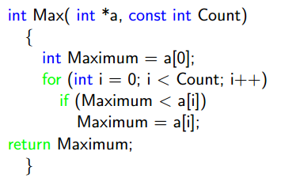
Finding the maximum element in a sequence (C code)

Slide 22
Finding the maximum element in a sequence (Pseudo Code)

Slide 23
Criteria for analyzing Algorithms
In order to design good algorithms, we must first agree on the criterion for measuring algorithms.
The emphasis is on the design of efficient algorithms.
We will measure algorithms in terms of the amount of computational resources that the algorithm requires:
Running time
Memory

Slide 24
Summary
Summary

Slide 25
THANK YOU
Q & A

