Slide 1
CUI Abbottabad
Department of Computer Science
Data Structures and Algorithms
Lecture No. 01
Introduction to Data Structures

Slide 2
Agenda
Introduction
Recommended and Textbook
Course Evaluation Details
Data and Data Structures
Types of Data Structures

Slide 3
Recommended Textbook
Textbook:
“Data Structures and Algorithm Analysis in Java” by Mark Allen Weiss, Addison-Wesley.
Reference Book:
“Data Structures & Algorithm in Java” by Robert Lafore.

Slide 4
Evaluation Criteria
Theory | Assessment Items | %age
S# | Assessment Type | Percentage
1 | Quizzes | 15
2 | Assignments | 10
3 | Midterm | 25
4 | Terminal Exam | 50
Total | Total | 100
Lab
S# | Assessment Type | Percentage
1 | Assignments | 25
2 | Midterm | 25
3 | Terminal Lab | 50
Total | Total | 100
Final Grade = (((Theory * 3)+(Lab * 1))/4)

Slide 5
Data Structures Goals
This course provides fundamental knowledge of data organization. The topics include: Overview of Data
Structures; Time Complexity of an Algorithm; Static & Dynamic List; Stack; Queue; Tree & its Algorithms; Graph & its Algorithms; Sorting; Searching; and Hashing.
Prepares the students for (and is a prerequisite for) the more advanced material students will encounter in later courses.
Cover well-known data structures such as dynamic arrays, linked lists, stacks, queues, tree and graphs.
Implement data structures in Java

Slide 6
Need for Data Structures
Data structures organize data ⇒ more efficient programs.
More powerful computers ⇒ more complex applications.
More complex applications demand more calculations.

Slide 7
Organizing Data
Any organization for a collection of records that can be searched, processed in any order, or modified.
The choice of data structure and algorithm can make the difference between a program running in a few seconds or many days.

Slide 8
Efficiency
A solution is said to be efficient if it solves the problem within its resource constraints.
Space
Time
The cost of a solution is the amount of resources that the solution consumes.

Slide 9
Selecting a Data Structure
Select a data structure as follows:
Analyze the problem to determine the resource constraints a solution must meet.
Determine the basic operations that must be supported. Quantify the resource constraints for each operation.
Select the data structure that best meets these requirements.

Slide 10
Some Questions to Ask
Are all data inserted into the data structure at the beginning, or are insertions spread with other operations?
Can data be deleted?
Are all data processed in some well-defined order, or is random access allowed?

Slide 11
Data Structure Philosophy
Each data structure has costs and benefits.
Rarely is one data structure better than another in all situations.
A data structure requires:
Space for each data item it stores,
Time to perform each basic operation,
Programming effort.

Slide 12
Goals of this Course
Reinforce the concept that costs, and benefits exist for every data structure.
Learn the commonly used data structures.
These form a programmer's basic data structure “toolkit.”
Understand how to measure the cost of a data structure or program.
These techniques also allow you to judge the merits of new data structures that you or others might invent.

Slide 13
Definition: Data Structures
A data structure is systematic way of organizing and accessing data with a specific relationship between the elements.
Why data structures?
Ultimate goal -- to write efficient programs. In order to do that, one needs to organize the data in such a way that it can be accessed and manipulated efficiently.

Slide 14
Definition: Data Structures (Cont…)
A data structure is a way of arranging data in a computer's memory or other disk storage.
A data structure is a collection of data, organized so that items can be stored and retrieved by some fixed techniques.
Example: Suppose you are hired to create a database of names with all company's management and employees.

Slide 15
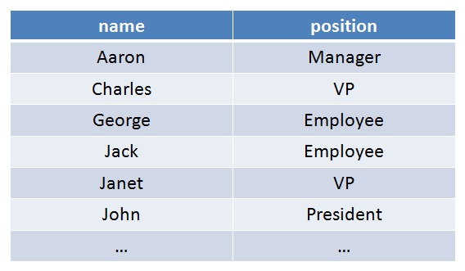
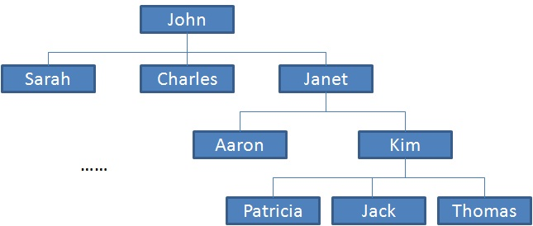
Example: Data Structures
You can make a list. You can also make a tree.

Slide 16
Data Structures Types
There are several common data structures: arrays, linked lists, queues, stacks, binary trees, hash tables, etc.
These data structures can be classified as either linear or nonlinear data structures, based on how the data is conceptually organized or aggregated.

Slide 17
Linear Vs Non-Linear Data Structures
Linear Structures | Non-Linear Structures
The array, list, queue, and stack belong to this category. Each of them is a collection that stores its entries in a linear sequence, and in which entries may be added or removed at will. They differ in the restrictions they place on how these entries may be added, removed, or accessed. The common restrictions include FIFO and LIFO. | Trees and graphs are classical non-linear structures. Data entries are not arranged in a sequence, but with different rules.

Slide 18
Dynamic and Static data structures
There are two approaches to creating a data structure.
STATIC DATA STRUCTURE
With a static data structure, the size of the structure is fixed.
Static data structures are very good for storing a well-defined number of data items.
For example, a programmer might be coding an 'Undo' function where the last 10 user actions are kept in case, they want to undo their actions. In this case the maximum allowed is 10 steps and so he decides to form a 10-item data structure.

Slide 19
Dynamic and Static data structures
2. DYNAMIC DATA STRUCTURE
There are many situations where the number of items to be stored is not known before hand.
In this case the programmer will consider using a dynamic data structure. This means the data structure is allowed to grow and shrink as the demand for storage arises. The programmer should also set a maximum size to help avoid memory collisions.
For example, a programmer coding a print spooler will have to maintain a data structure to store print jobs, but he cannot know before hand how many jobs there will be.

Slide 20
Dynamic and Static data structures
DYNAMIC | STATIC
Memory is allocated to the data structure dynamically i.e. as the program executes. | Memory is allocated at compile time. Fixed size.
Disadvantage: Because the memory allocation is dynamic, it is possible for the structure to 'overflow' should it exceed its allowed limit. It can also 'underflow' should it become empty. | Advantage: The memory allocation is fixed and so there will be no problem with adding and removing data items.
Advantage: Makes the most efficient use of memory as the data structure only uses as much memory as it needs | Disadvantage: Can be very inefficient as the memory for the data structure has been set aside regardless of whether it is needed or not whilst the program is executing.
Disadvantage: Harder to program as the software needs to keep track of its size and data item locations at all times | Advantage: Easier to program as there is no need to check on data structure size at any point.

Slide 21
Data Structure Operations
The data appearing in our data structures are processed by means of certain operations. The following four operations play a major role :
Traversing: Accessing each record exactly once so that certain items in the record may be processed.
Searching: Finding the location of the record with a given key value, or finding the locations of all records which satisfy one or more conditions.
Inserting: Adding a new record to the structure.
Deleting : Removing a record from the structure.

Slide 22
Data Structure Operations (Cont…)
Sometimes two or more of the operations may be used in given situations; e.g. we may want to delete the record with a given key, which may mean we first need to search for the location of the record.
The following two operations , which are used in special situations, will be considered:
Sorting: Arranging record in some logical order (ascending/ descending)
Merging: Combining the records in two different sorted files into a single sorted file.

Slide 23
Primitive and Non-Primitive
As we discussed above, anything that can store data can be called as a data structure, hence Integer, Float, Boolean, Char etc, all are data structures. They are known as Primitive Data Structures.
Then we also have some complex Data Structures, which are used to store large and connected data. Some examples of Non-Primitive (Abstract Data Structure) are:
Linked List
Tree
Graph
Stack, Queue etc.
All these data structures allow us to perform different operations on data. We select these data structures based on which type of operation is required.

Slide 24
Abstract Data Types (ADT)
Abstraction
The first thing that we need to consider when writing programs is the problem. However, the problems that we asked to solve in real life are often complicated. Thus, we need to describe these parts in a simple, precise language. This process is called abstraction.
As an example, consider a program that manages the student records. The head of the Computer Science Department comes to you and asks you to create a program which allows to administer the students in a class. Well, this is too vague a problem. We need to think about, for example, what student information is needed for the record? What tasks should be allowed?

Slide 25
Example of Abstraction
The abstract view of a television:
Ability to change channels, adjust the volume
TV displays the show we want to watch
Don't care: who made the TV, or how circuit inside was constructed.

Slide 26
Abstract Data Type
An ADT is a mathematical model of a data structure that specifies the type of data stored, the operations supported on them, and the types of parameters of the operations.
An ADT specifies what each operation does, but not how it does it.
Typically, an ADT can be implemented using one of many different data structures. A useful first step in deciding what data structure to use in a program is to specify an ADT for the program.

Slide 27
List ADT
Component
Item
Operations
Insertion
Deletion
Search
Display

Slide 28
Summary
Summary

Slide 29
THANK YOU
Q & A

