Slide 1
CSC271 Database Systems
Lecture # 9

Slide 2
Summary: Previous Lecture
Cartesian product
Join
Theta join, equijoin, natural join
Outer join (left, right, full)
Semijoin

Slide 3
Division
R ÷ S
Assume relation R is deﬁned over the attribute set A and relation S is deﬁned over the attribute set B such that B⊆ A (B is a subset of A)
Let C= A− B, that is, C is the set of attributes of R that are not attributes of S
Division operation defines a relation over the attributes C that consists of set of tuples from R that match combination of every tuple in S

Slide 4
Division
Division operation can be expressed in terms of basic operations:
T1←Π_{C}(R)
T2←Π_{C}((T1× S) − R)
T ← T1− T2

Slide 5
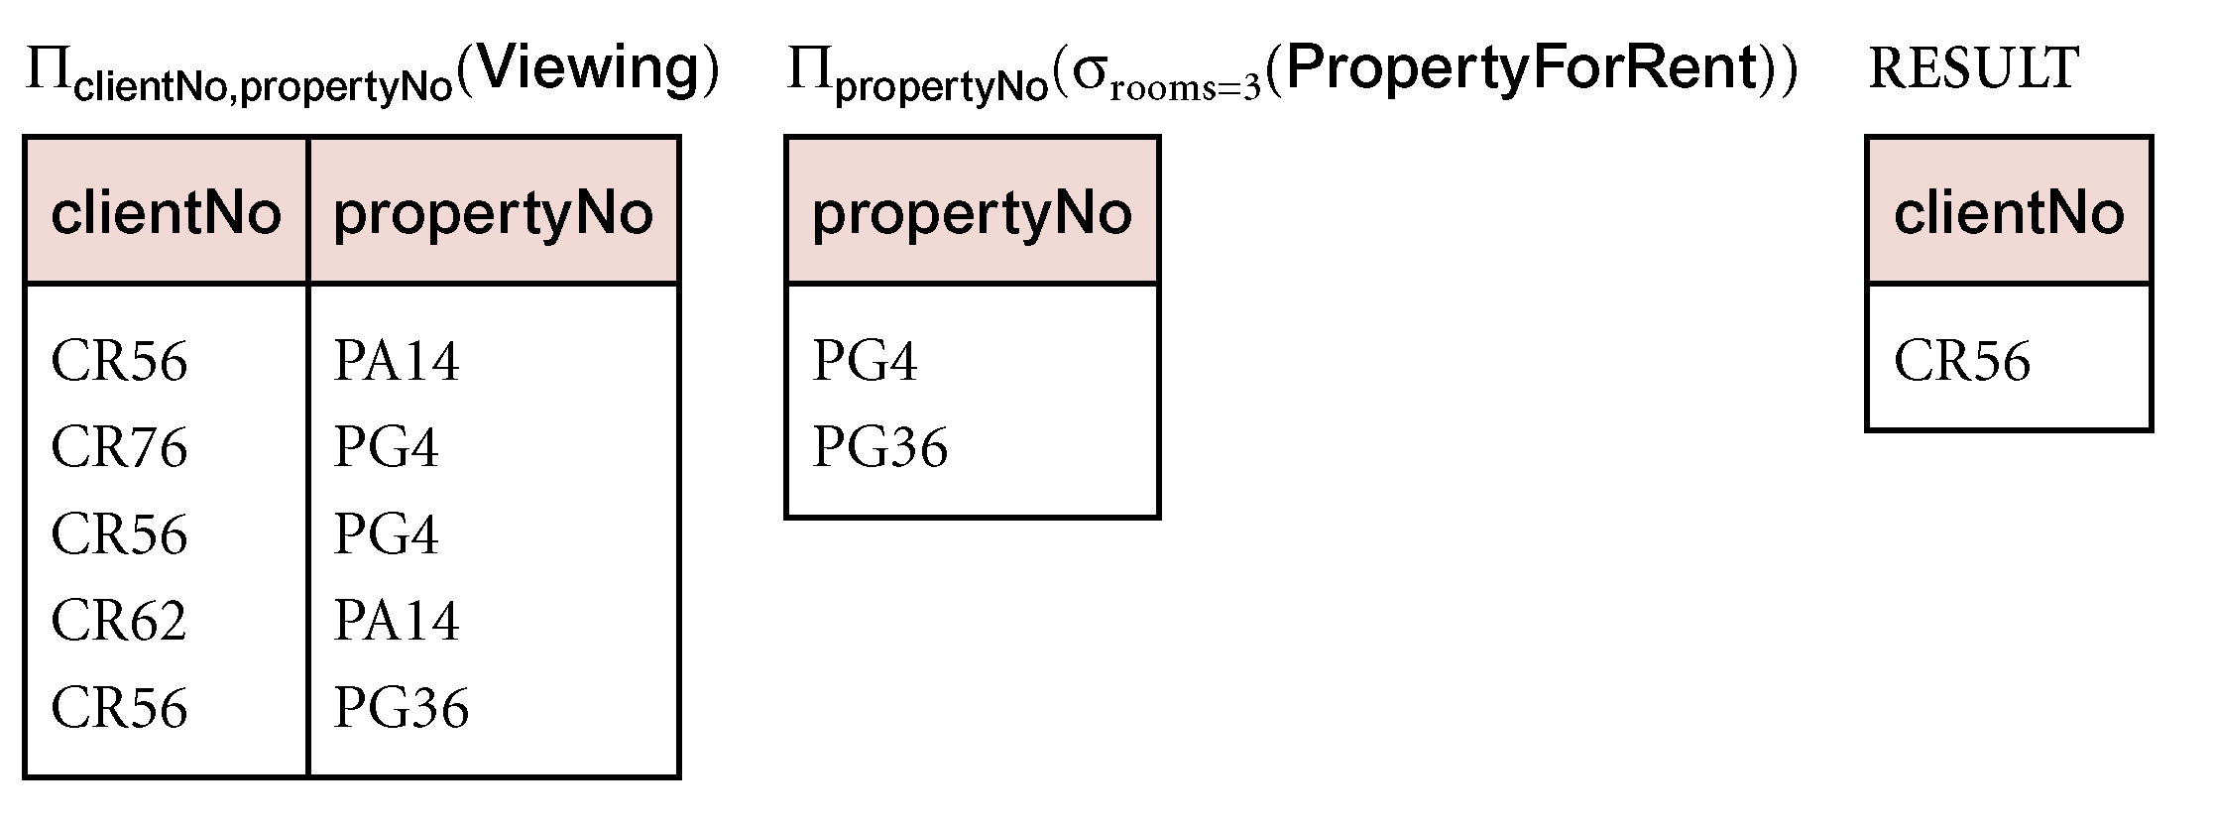
Example: Division
Identify all clients who have viewed all properties with three rooms
(Π_{clientNo, propertyNo}(Viewing)) ÷
(Π_{propertyNo}(σ_{rooms = 3}(PropertyForRent)))

Slide 6
Aggregate Operation
ℑ_{AL}(R)
Applies aggregate function list, AL, to R to define a relation over the aggregate list
AL contains one or more (<aggregate_function>, <attribute>) pairs
Main aggregate functions are:
COUNT, SUM, AVG, MIN, and MAX

Slide 7
Example: Aggregate Operation
How many properties cost more than £350 per month to rent?
ρ_{R}(myCount) ℑ _{COUNT propertyNo} (σ_{rent >350} (PropertyForRent))
Find the minimum, maximum, and average staff salary
ρ_{R}(myMin, myMax, myAverage) ℑ MIN salary, MAX salary, AVERAGE salary (Staff)

Slide 8
Grouping Operation
_{GA}ℑ_{AL}(R)
Groups the tuples of relation R by the grouping attributes, GA, and then applies the aggregate function list AL to deﬁne a new relation
AL contains one or more (<aggregate_function>, <attribute>) pairs
The resulting relation contains the grouping attributes, GA, along with the results of each of the aggregate functions

Slide 9
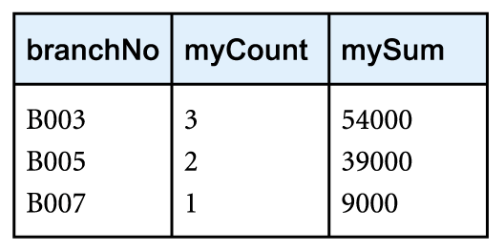
Example: Grouping Operation
Find the number of staff working in each branch and the sum of their salaries
ρ_{R}(branchNo, myCount, mySum)_{branchNo} ℑ_{COUNT staffNo, SUM salary}(Staff)

Slide 10
The Relational Calculus
Relational calculus
Query specifies what is to be retrieved rather than how to retrieve it
Predicate
In first-order logic (or predicate calculus), predicate is a truth-valued function with arguments e.g. is a member of staff
Proposition
When we substitute values for the arguments, function yields an expression, called a proposition, which can be either true or false e.g. John White is a member of staff

Slide 11
The Relational Calculus..
Range
If predicate contains a variable (e.g. ‘x is a member of staff’), there must be a range for x (set of all people)
When we substitute some values of this range for x, proposition may be true (John White); for other values, it may be false (Peter Norton)
If P is a predicate, then we can write the set of all x such that P is true for x, as:
{x |P(x)}
Logical connectives ∧ (AND), ∨ (OR), and ~ (NOT) to form compound predicates

Slide 12
Forms of Relational Calculus
Tuple relational calculus
We use variables that range over tuples in a relation
Domain relational calculus
We also use variables but in this case the variables take their values from domains of attributes rather than tuples of relations

Slide 13
Tuple Relational Calculus
Interested in finding tuples for which a predicate is true
Based on use of tuple variables
Tuple variable is a variable that ‘ranges over’ a named relation: i.e., variable whose only permitted values are tuples of the relation
Specify range of a tuple variable S as the Staff relation as:
Staff(S)
To find set of all tuples S such that P(S) is true:
{S | P(S)}

Slide 14
Example: Tuple Relational Calculus
To find details of all staff earning more than £10,000
{S | Staff(S) ∧ S.salary > 10000}
To find a particular attribute, such as salary, write:
{S.salary | Staff(S) ∧ S.salary > 10000}

Slide 15
Quantifiers
Two quantifiers to tell how many instances the predicate applies to:
Existential quantifier ∃ (‘there exists’)
Universal quantifier ∀ (‘for all’)
Bound and free variables
Tuple variables qualified by ∃ or ∀ are called bound variables, otherwise called free variables

Slide 16
Existential Quantifier (∃)
The existential quantiﬁer ∃ (‘there exists’) is used in formulae that must be true for at least one instance, such as:
Staff(S) ∧ (∃B) (Branch(B) ∧ (B.branchNo = S.branchNo) ∧ B.city = ‘London’)
This means, ‘There exists a Branch tuple that has the same branchNo as the branchNo of the current Staff tuple, S, and is located in London’

Slide 17
Universal Quantifier (∀)
The universal quantiﬁer ∀ (‘for all’) is used in statements about every instance, such as:
(∀B) (B.city ≠ ‘Paris’)
This means, ‘For all Branch tuples, the address is not in Paris’
Above formula can be re-written as:
~(∃B) (B.city = ‘Paris’)
Which means, ‘There are no branches with an address in Paris’

Slide 18
Expressions and Formulae
Formulae should be unambiguous and make sense
An expression in the tuple relational calculus has the following general form:
{S1.a1, S2.a2,..., Sn.an | F(S1, S2,..., Sm)} m ≥n
Where S1, S2,..., Sn,..., Sm are tuple variables, each ai is an attribute of the relation over which Si ranges, and F is a formula

Slide 19
Well-Formed Formula
A (well-formed) formula is made out of one or more atoms, where an atom has one of the following forms:
R(Si), where Si is a tuple variable and R is a relation
Si.a1 θ Sj.a2
Si.a1 θ c

Slide 20
Building Up Formulae
Can recursively build up formulae from atoms:
An atom is a formula
If F1 and F2 are formulae, so are their conjunction F1 ∧ F2, their disjunction F1 ∨ F2, and the negation ~F1
If F is a formula with free variable X, then (∃X)(F) and (∀X)(F) are also formulae

Slide 21
Examples: Tuple Relational Calculus
List the names of all managers who earn more than £25,000
{S.fName, S.lName | Staff(S) ∧ S.position = ‘Manager’ ∧ S.salary > 25000}
List the staff who manage properties for rent in Glasgow
{S | Staff(S) ∧ (∃P) (PropertyForRent(P) ∧
(P.staffNo = S.staffNo) ∧ P.city = ‘Glasgow’)}

Slide 22
Examples: Tuple Relational Calculus
List the names of staff who currently do not manage any properties
{S.fName, S.lName | Staff(S) ∧ (~(∃P) (PropertyForRent(P) ∧ (S.staffNo = P.staffNo)))}
Or
{S.fName, S.lName | Staff(S) ∧ ((∀P) (~PropertyForRent(P) ∨ ~(S.staffNo = P.staffNo)))}

Slide 23
Examples: Tuple Relational Calculus
List the names of clients who have viewed a property for rent in Glasgow
{C.fName, C.lName | Client(C) ∧ ( (∃V) (∃P)
(Viewing(V) ∧ PropertyForRent(P) ∧
(C.clientNo = V.clientNo) ∧
(V.propertyNo = P.propertyNo) ∧
P.city = ‘Glasgow’))}

Slide 24
Examples: Tuple Relational Calculus
List all the cities where there is a branch ofﬁce but no properties for rent
{B.city | Branch(B) ∧ ( ~(∃P) (PropertyForRent(P) ∧
B.city = P.city))}
List all the cities where there is both a branch ofﬁce and at least one property for rent
{B.city | Branch(B) ∧ ((∃P) (PropertyForRent(P) ∧
B.city = P.city))}

Slide 25
Safety of Expressions
Expressions can generate an infinite set e.g.
{S | ~Staff(S)}
Set of all tuples that are not in the Staff relation
To avoid this, add restriction that all values in result must be values in the domain of the expression

Slide 26
Domain Relational Calculus
Uses variables that take values from domains instead of tuples of relations
An expression in the domain relational calculus has the following general form:
{d1, d2,..., dn | F(d1, d2,..., dm)} m ≥ n
Where F(d1, d2, . . . , dn) represents a formula composed of atoms and d1, d2, . . . , dn represent domain variables

Slide 27
Well-Formed Formula
A formula is made out of one or more atoms, where an atom has one of the following forms:
R(d1, d2,...,dn), where R is a relation of degree n and each di is a domain variable
di θ dj, where di and dj are domain variables and θ is one of the comparison operators (<, ≤, >, ≥, =, ≠); the domains di and dj must have members that can be compared by θ
di θ c, where di is a domain variable, c is a constant from the domain of di, and θ is one of the comparison operators

Slide 28
Building Up Formulae
Can recursively build up formulae from atoms:
An atom is a formula
If F1 and F2 are formulae, so are their conjunction F1 ∧ F2, their disjunction F1 ∨ F2, and the negation ~F1
If F is a formula with domain variable X, then (∃X)(F) and (∀X)(F) are also formulae

Slide 29
Examples: Domain Relational Calculus
Shorthand notation will be used:
(∃d1, d2,..., dn) in place of (∃d1), (∃d2),..., (∃dn)
Find the names of all managers who earn more than £25,000
{fN, lN | (∃sN, posn, sex, DOB, sal, bN) (Staff(sN, fN, lN, posn, sex, DOB, sal, bN) ∧ posn = ‘Manager’ ∧ sal > 25000)}

Slide 30
Examples: Domain Relational Calculus
List the staff who manage properties for rent in Glasgow.
{sN, fN, lN, posn, sex, DOB, sal, bN | (∃sN1, cty)
(Staff(sN, fN, lN, posn, sex, DOB, sal, bN) ∧
PropertyForRent(pN, st, cty, pc, typ, rms, rnt, oN, sN1, bN1)
∧ (sN = sN1) ∧ cty = ‘Glasgow’)}

Slide 31
Examples: Domain Relational Calculus
List the names of staff who currently do not manage any properties for rent
{fN, lN | (∃sN) (Staff(sN, fN, lN, posn, sex, DOB, sal, bN) ∧
(~(∃sN1) (PropertyForRent(pN, st, cty, pc, typ, rms, rnt, oN, sN1, bN1) ∧ (sN = sN1))))}

Slide 32
Examples: Domain Relational Calculus
List the names of clients who have viewed a property for rent in Glasgow
{fN, lN | (∃cN, cN1, pN, pN1, cty) (
Client(cN, fN, lN, tel, pT, mR) ∧
Viewing(cN1, pN1, dt, cmt) ∧
PropertyForRent(pN, st, cty, pc, typ, rms, rnt, oN, sN, bN) ∧
(cN = cN1) ∧ (pN = pN1) ∧ cty = ‘Glasgow’)}

Slide 33
Examples: Domain Relational Calculus
List all the cities where there is a branch ofﬁce but no properties for rent
{cty | (Branch(bN, st, cty, pc) ∧
(~(∃cty1)
(PropertyForRent(pN, st1, cty1, pc1, typ, rms, rnt, oN, sN, bN1) ∧ (cty =cty1))))}

Slide 34
Other Languages
Transform-oriented languages are non-procedural languages that use relations to transform input data into required outputs (e.g. SQL)
Graphical languages provide user with picture of the structure of the relation, User fills in example of what is wanted and system returns required data in that format (e.g. QBE)

Slide 35
Other Languages
4GLs can create complete customized application using limited set of commands in a user-friendly, often menu-driven environment
Some systems accept a form of natural language, sometimes called a 5GL, although this development is still at an early stage

Slide 36
Summary
Relation algebra operations
Division
Aggregation and grouping
The relational calculus
Tuple relational calculus
Domain relational calculus

Slide 37
References
All the material (slides, diagrams etc.) presented in this lecture is taken (with modifications) from the Pearson Education website :
http://www.booksites.net/connbegg

