Slide 1
CSC271 Database Systems
Lecture # 8

Slide 2
Summary: Previous Lecture
Relation algebra and operations
Selection (Restriction), projection
Union, set difference, intersection

Slide 3
Cartesian Product
R X S
Defines a relation that is the concatenation of every tuple of relation R with every tuple of relation S
For example, if relation R has I tuples and N attributes and the relation S has J tuples and M attributes, the Cartesian product relation will contain (I * J) tuples with (N+M) attributes
For the attributes with the same name, the attribute names are preﬁxed with the relation name to maintain the uniqueness of attribute names within a relation

Slide 4
Example: Cartesian Product
List the names and comments of all clients who have viewed a property for rent
We need to combine two relations (Client, Viewing)
Π_{clinetNo, fName, lName}(Client) X Π_{clientNo, propertyNo, comment}(Viewing)

Slide 5
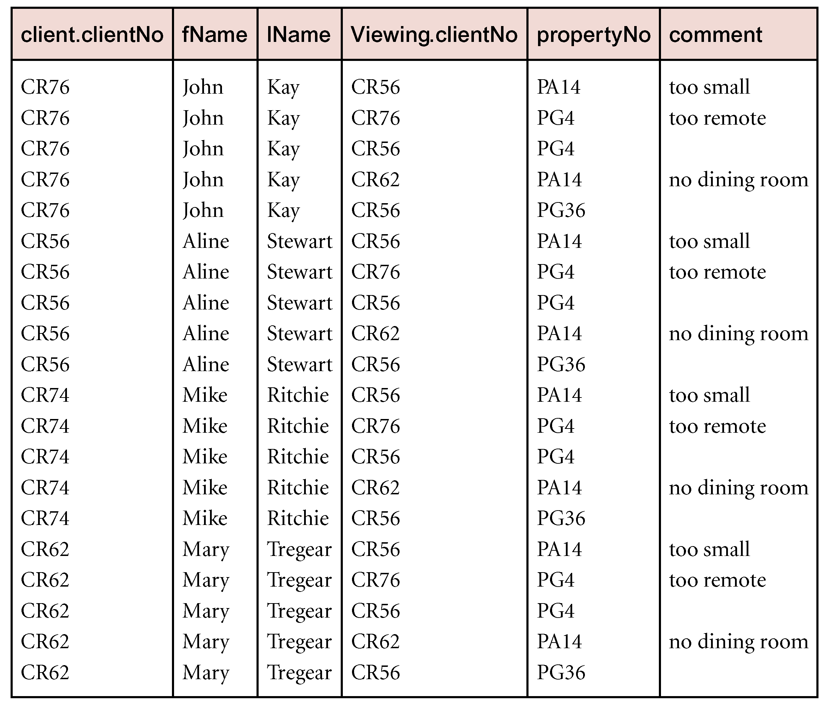
Example: Cartesian Product

Slide 6
Example: Cartesian Product
Resultant relation contains more information than we require
To obtain the required list, we need to carry out a Selection operation on this relation to extract those tuples where Client.clientNo= Viewing.clientNo
σClient.clientNo= Viewing.clientNo
((Π_{clientNo, fName, lName}(Client)) × (Π_{clientNo, propertyNo, comment}(Viewing)))

Slide 7
Example: Cartesian Product

Slide 8
Decomposing Complex Operations
The relational algebra operations can be of arbitrary complexity
We can decompose such operations into a series of smaller relational algebra operations and give a name to the results of intermediate expressions
We use the assignment operation, denoted by ←, to name the results of a relational algebra operation

Slide 9
Example: Decomposition
Previous example of Cartesian Product
Decomposition could be as follows:
TempV(clientNo, propertyNo, comment) ← Π_{clientNo, propertyNo, comment} (Viewing)
TempC(clientNo, fName, lName) ← Π_{clientNo, fName, lName} (Client)
Comment(clientNo, fName, lName, vclientNo, propertyNo, comment) ← TempC × TempV
Result ← σ_{clientNo= vclientNo} (Comment)

Slide 10
Rename Operation
ρ_{S}(E) or ρ_{S(a1, a2,..., an)} (E)
The Rename operation provides a new name S for the expression E, and optionally names the attributes as a1, a2,..., an
Examples:
ρ_{R} (Client) ← Π_{clientNo, fName, lName} (Client))
ρ_{R(CNo,} _{FirstName, LastName)}(Client)← Π_{clientNo, fName, lName} (Client)

Slide 11
Join Operations
Join is a derivative of Cartesian Product
Equivalent to performing a Selection, using join predicate as selection formula, over Cartesian product of the two operand relations
One of the most difficult operations to implement efficiently in an RDBMS and one reason why RDBMSs have intrinsic performance problems

Slide 12
Join Operations
Various forms of join operation
Theta join
Equijoin (a particular type of Theta join)
Natural join
Outer join
Semijoin

Slide 13
Theta join (θ-join)
R _{F} S
Defines a relation that contains tuples satisfying the predicate F from the Cartesian product of R and S
The predicate F is of the form R.ai θ S.bi where θ may be one of the comparison operators (<, <, >, >, =, ≠)
We can rewrite the Theta join in terms of the basic Selection and Cartesian product operations:
R _{F} S = σ_{F} (R × S)
As with Cartesian product, the degree of a Theta join is the sum of the degrees of the operand relations R and S

Slide 14
Equijoin
R _{F(=)} S
Defines a relation that contains tuples satisfying the predicate F from the Cartesian product of R and S
The predicate F is of the form R.ai θ S.bi where θ may be assigned only equality ( = ) operator

Slide 15
Example: Equijoin
List the names and comments of all clients who have viewed a property for rent
Same example/result but now using Equijoin instead of Cartesian product and Selection
(Π_{clientNo, fName, lName}(Client))
Client.clientNo= Viewing.clientNo
(Π_{clientNo, propertyNo, comment}(Viewing))
or
Result ← TempC TempC.clientNo = TempV.clientNoTempV

Slide 16
Example: Equijoin

Slide 17
Natural Join
R S
An Equijoin of the two relations R and S over all common attributes x
One occurrence of each common attribute is eliminated from the result
The Natural join operation performs an Equijoin over all the attributes in the two relations that have the same name
The degree of a Natural join is the sum of the degrees of the relations R and S less the number of attributes in x

Slide 18
Example: Natural Join
List the names and comments of all clients who have viewed a property for rent
Same example using Natural join but produces a relation with one occurrence of clientNo attribute
(Π_{clientNo, fName, lName}(Client)) (Π_{clientNo, propertyNo, comment}(Viewing))
Or
Result ← TempC TempV

Slide 19
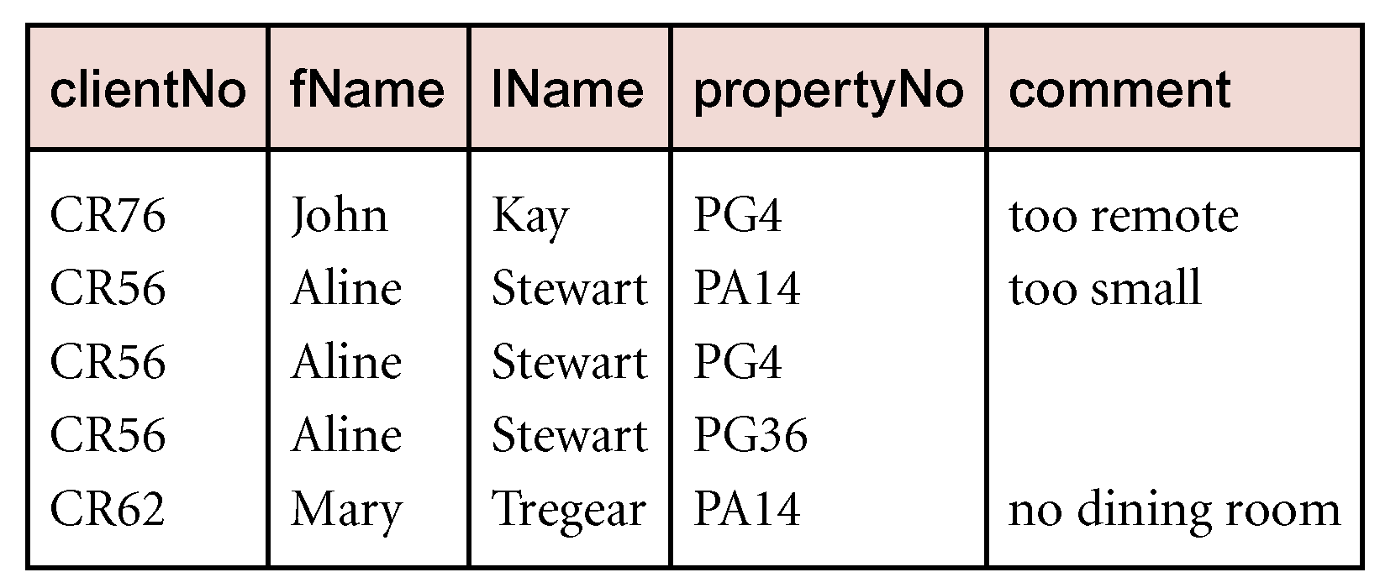
Example: Natural Join

Slide 20
Outer Join
We may want tuples from one of the relations to appear in the result even when there are no matching values in the other relation
This may be accomplished using the Outer join

Slide 21
Types of Outer Join
Types of outer join
Left outer join ( )
Keeps every tuple in the left-hand relation in the result
Right outer join ( )
Keeps every tuple in the right-hand relation in the result
Full outer join ( )
Keeps all tuples in both relations, padding tuples with nulls when no matching tuples are found

Slide 22
Left Outer Join
R S
(Left) outer join is join in which tuples from R that do not have matching values in common attributes of S are also included in result relation
Missing values in the second relation are set to null
To display rows in the result that do not have matching values in the join attributes

Slide 23
Example: Left Outer Join
Produce a status report on property viewings
We will produce a relation consisting of the properties that have been viewed with comments and those that have not been viewed using left outer join:
(Π_{propertyNo, street, city} (PropertyForRent)) Viewing

Slide 24
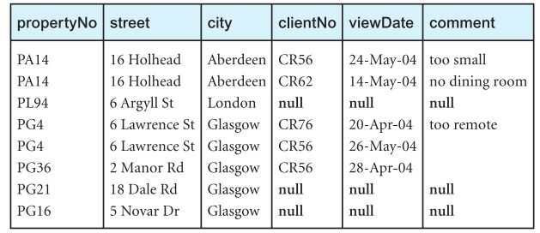
Example: Left Outer Join

Slide 25
Semijoin
R _{F} S
Defines a relation that contains the tuples of R that participate in the join of R with S
The Semijoin operation performs a join of the two relations and then projects over the attributes of the ﬁrst operand
Useful for computing joins in distributed systems
We can rewrite the Semijoin using the Projection and Join operations:
R _{F} S = Π_{A} (R _{F} S)
Where A is the set of all attributes for R

Slide 26
Example: Semijoin
List complete details of all staff who work at the branch in Glasgow
Staff Staff.branchNo = Branch.branchNo (σ_{city= ‘Glasgow’} (Branch))

Slide 27
Division
R ÷ S
Assume relation R is deﬁned over the attribute set A and relation S is deﬁned over the attribute set B such that B⊆ A (B is a subset of A)
Let C= A− B, that is, C is the set of attributes of R that are not attributes of S
Division operation defines a relation over the attributes C that consists of set of tuples from R that match combination of every tuple in S

Slide 28
Division
Division operation can be expressed in terms of basic operations:
T1←Π_{C}(R)
T2←Π_{C}((T1× S) − R)
T ← T1− T2

Slide 29
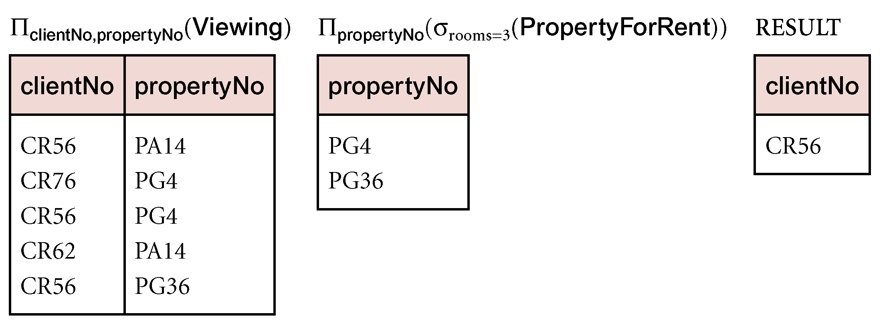
Example: Division
Identify all clients who have viewed all properties with three rooms
(Π_{clientNo, propertyNo}(Viewing)) ÷
(Π_{propertyNo}(σ_{rooms = 3}(PropertyForRent)))

Slide 30
Aggregate Operation
ℑ_{AL}(R)
Applies aggregate function list, AL, to R to define a relation over the aggregate list
AL contains one or more (<aggregate_function>, <attribute>) pairs
Main aggregate functions are:
COUNT, SUM, AVG, MIN, and MAX

Slide 31
Example: Aggregate Operation
How many properties cost more than £350 per month to rent?
ρ_{R}(myCount) ℑ _{COUNT propertyNo} (σ_{rent >350} (PropertyForRent))
Find the minimum, maximum, and average staff salary
ρ_{R}(myMin, myMax, myAverage) ℑ MIN salary, MAX salary, AVERAGE salary (Staff)

Slide 32
Grouping Operation
_{GA}ℑ_{AL}(R)
Groups the tuples of relation R by the grouping attributes, GA, and then applies the aggregate function list AL to deﬁne a new relation
AL contains one or more (<aggregate_function>, <attribute>) pairs
The resulting relation contains the grouping attributes, GA, along with the results of each of the aggregate functions

Slide 33
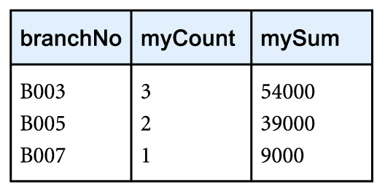
Example: Grouping Operation
Find the number of staff working in each branch and the sum of their salaries
ρ_{R}(branchNo, myCount, mySum)_{branchNo} ℑ_{COUNT staffNo, SUM salary}(Staff)

Slide 34
Summary
Cartesian product
Join
Theta join, equijoin, natural join
Outer join (left, right, full)
Semijoin
Division
Aggregate and grouping operations

Slide 35
References
All the material (slides, diagrams etc.) presented in this lecture is taken (with modifications) from the Pearson Education website :
http://www.booksites.net/connbegg

