Slide 1
CSC271 Database Systems
Lecture # 7

Slide 2
Summary: Previous Lecture
Relational keys
Integrity constraints
Views

Slide 3
The Relational Algebra and Relational Calculus
Chapter 4

Slide 4
Introduction
Relational algebra and relational calculus are formal languages associated with the relational model
Informally, relational algebra is a (high-level) procedural language and relational calculus a non-procedural language
However, formally both are equivalent to one another
A language that produces a relation that can be derived using relational calculus is said to be relationally complete

Slide 5
Relational Algebra
Relational algebra operations work on one or more relations to define another relation without changing the original relations
Both operands and results are relations, so output from one operation can become input to another operation
Allows expressions to be nested, just as in arithmetic is called closure property

Slide 6
Relational Algebra Operations
Five basic operations in relational algebra:
Selection, Projection, Cartesian product, Union, and Set Difference
These perform most of the data retrieval operations needed
Also have Join, Intersection, and Division operations, which can be expressed in terms of five basic operations
Unary vs. binary operations

Slide 7
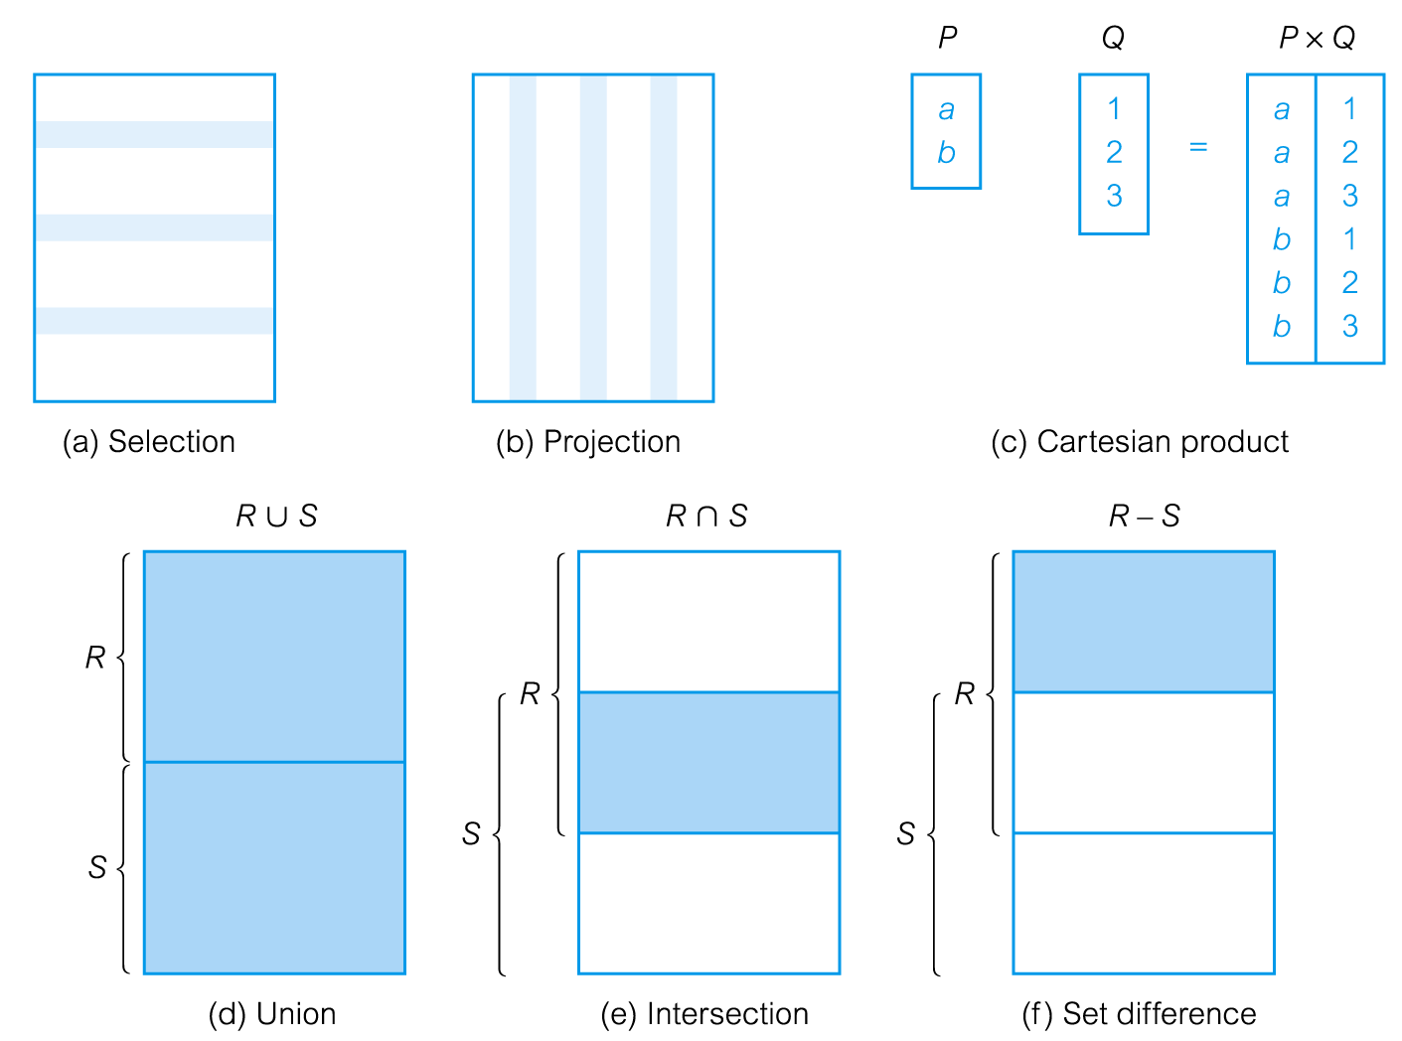
Relational Algebra Operations..

Slide 8
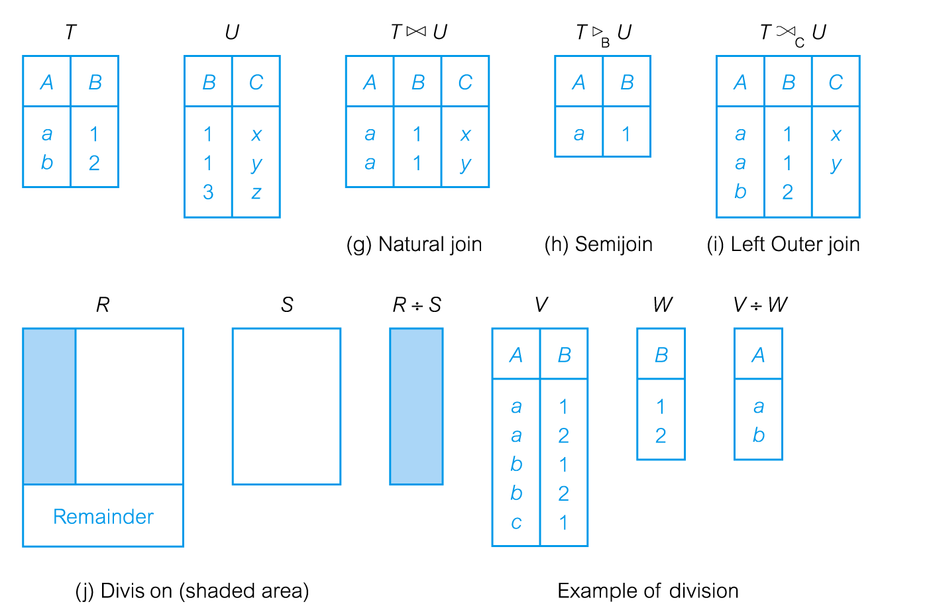
Relational Algebra Operations..

Slide 9
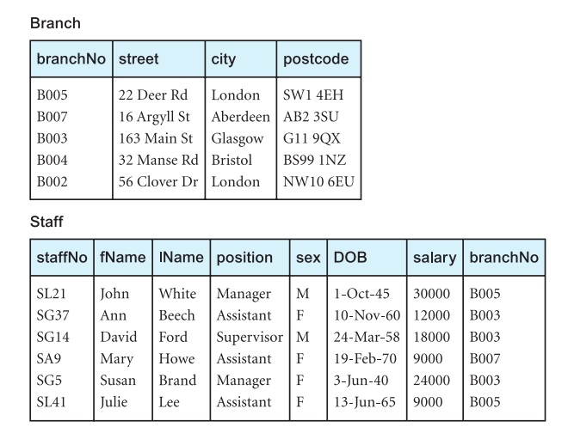
Instance of Sample Database

Slide 10
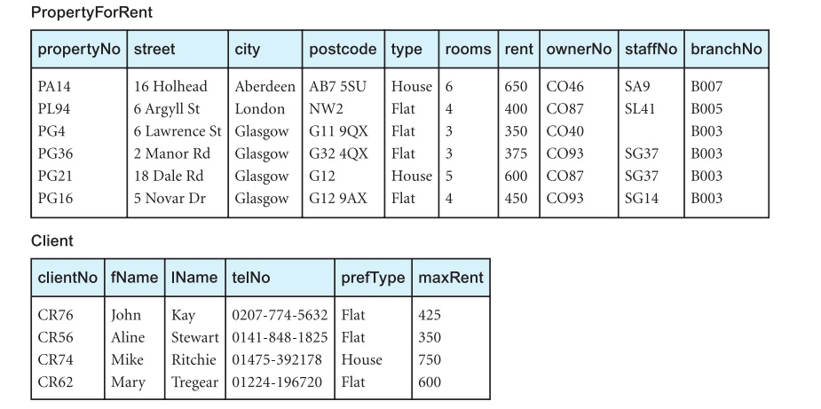
Instance of Sample Database

Slide 11
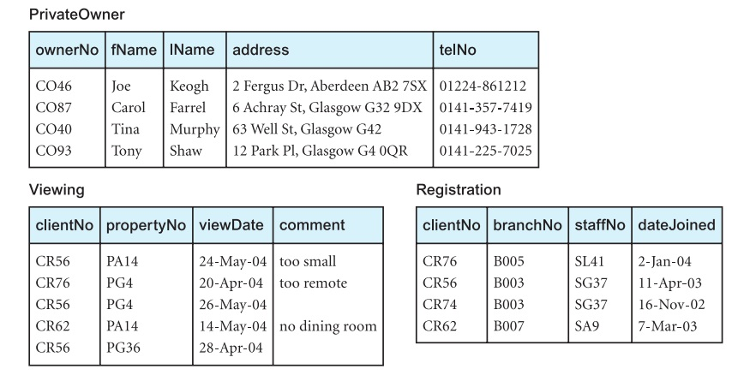
Instance of Sample Database

Slide 12
Selection (Restriction)
σ_{predicate} (R)
Works on a single relation R and defines a relation that contains only those tuples (rows) of R that satisfy the specified condition (predicate)
More complex predicate can be generated using the logical operators ∧ (AND),∨ (OR) and ~ (NOT)

Slide 13
Example: Selection (Restriction)
List all staff with a salary greater than £10,000
σ_{salary > 10000} (Staff)

Slide 14
Projection
Π_{a1, a2. . . , an}(R)
Works on a single relation R and defines a relation that contains a vertical subset of R, extracting the values of specified attributes and eliminating duplicates

Slide 15
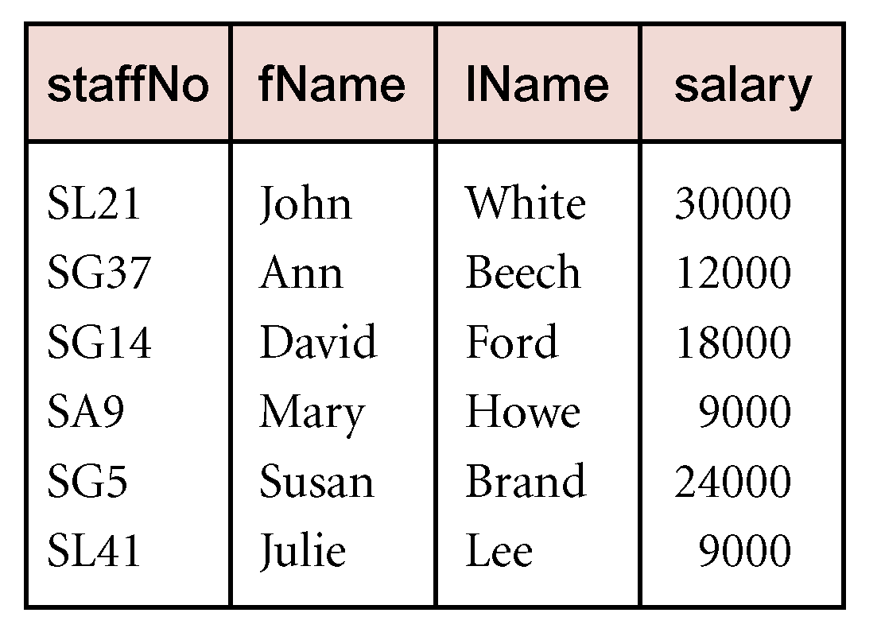
Example: Projection
Produce a list of salaries for all staff, showing only staffNo, fName, lName, and salary details
ΠstaffNo, fName, lName, salary(Staff)

Slide 16
Union
R ∪ S
Union of two relations R and S defines a relation that contains all the tuples of R, or S, or both R and S, duplicate tuples being eliminated
R and S must be union-compatible
If R and S have I and J tuples, respectively, union is obtained by concatenating them into one relation with a maximum of (I + J) tuples

Slide 17
Example: Union
List all cities where there is either a branch ofﬁce or a property for rent
Π_{city}(Branch) ∪ Π_{city}(PropertyForRent)

Slide 18
Set Difference
R – S
Defines a relation consisting of the tuples that are in relation R, but not in S
R and S must be union-compatible

Slide 19
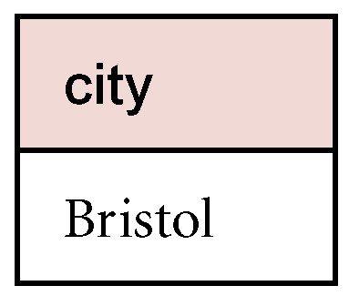
Example: Set Difference
List all cities where there is a branch ofﬁce but no properties for rent
Π_{city}(Branch) - Π_{city}(PropertyForRent)

Slide 20
Intersection
R ∩ S
Defines a relation consisting of the set of all tuples that are in both R and S
R and S must be union-compatible
Expressed using basic operations:
R ∩ S = R – (R – S)

Slide 21
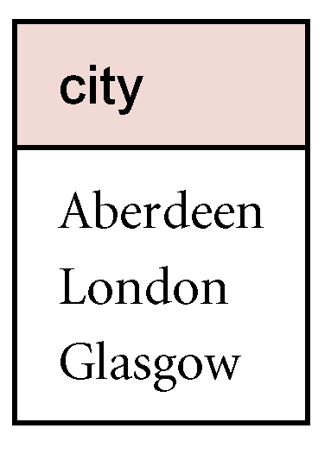
Example: Intersection
List all cities where there is both a branch office and at least one property for rent
Π_{city}(Branch) ∩ Π_{city}(PropertyForRent)

Slide 22
Summary
Relation algebra and operations
Selection (Restriction), projection
Union, set difference, intersection

Slide 23
References
All the material (slides, diagrams etc.) presented in this lecture is taken (with modifications) from the Pearson Education website :
http://www.booksites.net/connbegg

