Slide 1
CSC271 Database Systems
Lecture # 6

Slide 2
Summary: Previous Lecture
Relational model terminology
Mathematical relations
Database relations
Properties of a relation

Slide 3
Relational Keys
Superkey
Candidate key
Primary key
Alternate key
Foreign key

Slide 4
Superkey
An attribute, or set of attributes, that uniquely identifies a tuple within a relation
A super key may contain additional attributes that are not necessary for unique identiﬁcation
Consider Branch relation:
{branchNo, street, city, postcode}
{branchNo, street, city}
{branchNo, city} or {branchNo, postcode}

Slide 5
Candidate Key
Superkey (K) such that no proper subset is a superkey within the relation
In each tuple of R, values of K uniquely identify that tuple (uniqueness)
No proper subset of K has the uniqueness property (irreducibility)
In simple words, superkey with minimal attributes
Simple key or composite key
Instance of a relation cannot be used to prove uniqueness
Consider Branch relation
branchNo or postcode

Slide 6
Primary Key
Candidate key selected to identify tuples uniquely within relation
Consider Branch relation
Primary key: branchNo

Slide 7
Alternate Keys
Candidate keys that are not selected to be primary key
Consider Branch relation
Alternate key: postcode

Slide 8
Foreign Key
Attribute, or set of attributes, within one relation that matches candidate key of some (possibly same) relation
Used to represent relationship
In the Branch relation, branchNo is the primary key
However, in the Staff relation the branchNo attribute exists to match staff to the branch ofﬁce they work in
In the Staff relation, branchNo is a foreign key
branchNo in the Staff relation targets the primary key attribute branchNo in the home relation, Branch

Slide 9
Representing Relational Database Schemas
Conceptual schema or conceptual model
Branch (branchNo, street, city, postcode)
Staff (staffNo, Name, position, sex, DOB, salary, branchNo)

Slide 10
Integrity Constraints
We need to understand Nulls before starting discussion on integrity constraints
Null
Represents value for an attribute that is currently unknown or not applicable for tuple
Deals with incomplete or exceptional data
Represents the absence of a value and is not the same as zero or spaces, which are values

Slide 11
Types of Integrity Constraints
Entity integrity constraint
Referential integrity constraint

Slide 12
Entity Integrity Constraint
In a base relation, no attribute of a primary key can be null

Slide 13
Referential Integrity Constraint
If foreign key exists in a relation, either foreign key value must match a candidate key value of some tuple in its home relation or foreign key value must be wholly null

Slide 14
Example: Referential Integrity
For Example: branchNo in Staff relation is foreign key from Branch relation
It should not be allowed to create Staff record with branch number B025, unless there exists a record for branch number B025 in Branch relation
However, we should be able to create new Staff record with null branch number (new Staff has joined the company but not assigned to particular branch yet)

Slide 15
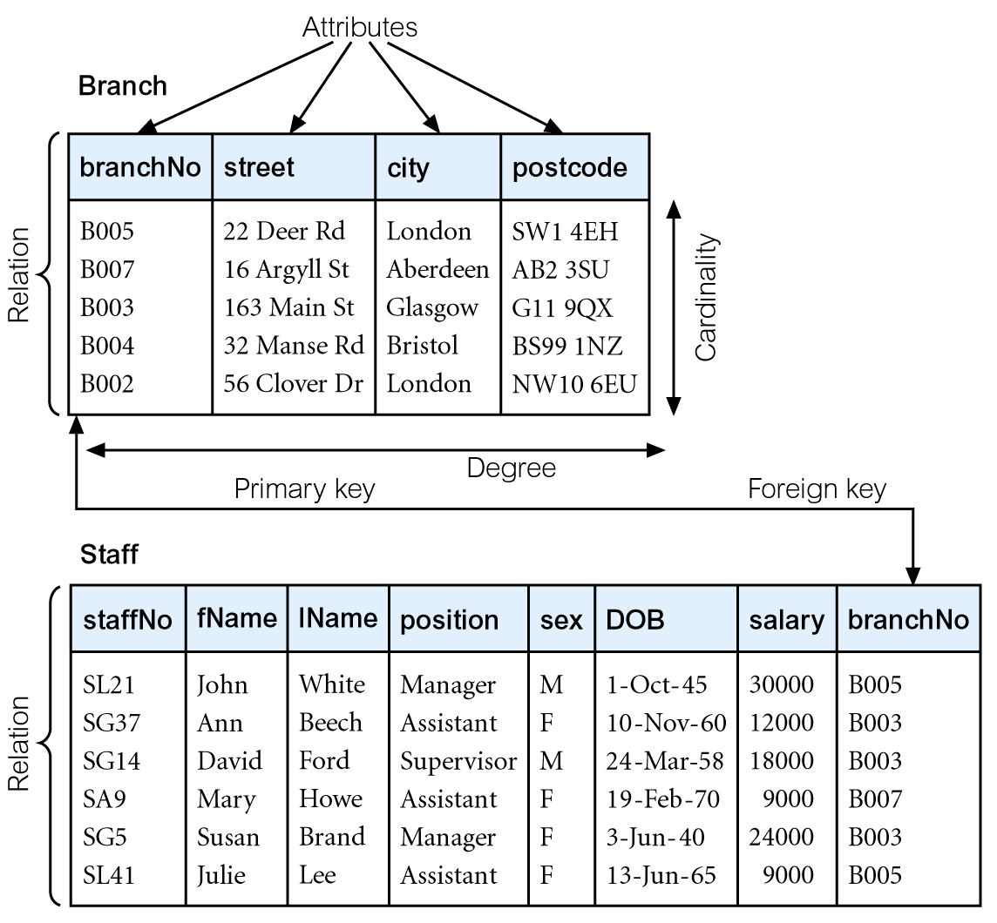
Violation of Referential Integrity
B025

Slide 16
General Constraints
Additional rules specified by users or database administrators that define or constrain some aspect of the enterprise
For example, If upper limit of 20 exists for number of Staff that may work at a branch office
DBMS should enforce it
Level of support for general constraints varies from system to system

Slide 17
Views in Relational Model
Base Relation
Named relation corresponding to an entity in conceptual schema, whose tuples are physically stored in database
View
The dynamic result of one or more relational operations operating on the base relations to produce another relation
A view is a virtual relation that does not necessarily exist in the database but can be produced upon request by a particular user, at the time of request

Slide 18
Views
A virtual relation that does not necessarily actually exist in the database but is produced upon request, at time of request
Contents of a view are defined as a query on one or more base relations
Views are dynamic, meaning that changes made to base relations that affect view attributes are immediately reflected in the view

Slide 19
Purpose of Views
Provides powerful and flexible security mechanism by hiding parts of database from certain users
Permits users to access data in a customized way, so that same data can be seen by different users in different ways, at same time
Can simplify complex operations on base relations

Slide 20
Views Supporting External Model
For example
A user might need Branch tuples along with names of managers
Some members of staff should see Staff tuples without the salary attribute
Attributes may be renamed or the order of attributes changed e.g. branchNo attribute of branches is represented by Branch Number

Slide 21
Views & Logical Data Independence
Views allow a more signiﬁcant type of logical data independence that supports the reorganization of the conceptual schema
For example, if a new attribute is added to a relation, existing users can be unaware of its existence if their views are deﬁned to exclude it
If an existing relation is rearranged or split up, a view may be deﬁned so that users can continue to see their original views

Slide 22
Updating Views
All updates to a base relation should be immediately reflected in all views that reference that base relation
If view is updated, underlying base relation should reflect change

Slide 23
Updating Views..
There are restrictions on types of modifications that can be made through views:
Updates are allowed if query involves a single base relation and contains a candidate key of base relation
Updates are not allowed involving multiple base relations
Updates are not allowed involving aggregation or grouping operations

Slide 24
Summary
Relational keys
Integrity constraints
Views

Slide 25
References
All the material (slides, diagrams etc.) presented in this lecture is taken (with modifications) from the Pearson Education website :
http://www.booksites.net/connbegg

