Slide 1
CSC271 Database Systems
Lecture # 5

Slide 2
Summary: Previous Lecture
Database languages
Functions of a DBMS
DBMS environment
Data models and their categories

Slide 3
The Relational Model
Chapter 3

Slide 4
History of Relational Model
Proposed by E.F. Codd in 1970
“ A relational model of data for large shared data banks”
Objectives of relational model
High degree of data independence
Dealing with issues e.g. data semantics, consistencies, and redundancy
To enable the expansion of set-oriented data manipulation languages

Slide 5
Examples of RDBMSs
Oracle
Microsoft SQLServer
Microsoft Access
Visual FoxPro
InterBase
JDataStore
R:Base

Slide 6
Relational Model
Based on mathematical concept of a relation
Which is physically represented as a table
Codd, a trained mathematician, used terminology taken from mathematics, principally set theory and predicate logic

Slide 7
Relational Model Terminology
A relation is a table with columns and rows
Only applies to logical structure of the database (external and conceptual level of ANSI-SPARC architecture), not the physical structure
Attribute is a named column of a relation
Domain is the set of allowable values for one or more attributes

Slide 8
Relational Model Terminology..
Tuple is a row of a relation
Degree is the number of attributes in a relation
Cardinality is the number of tuples in a relation
Relational Database is a collection of normalized relations with distinct relation names

Slide 9
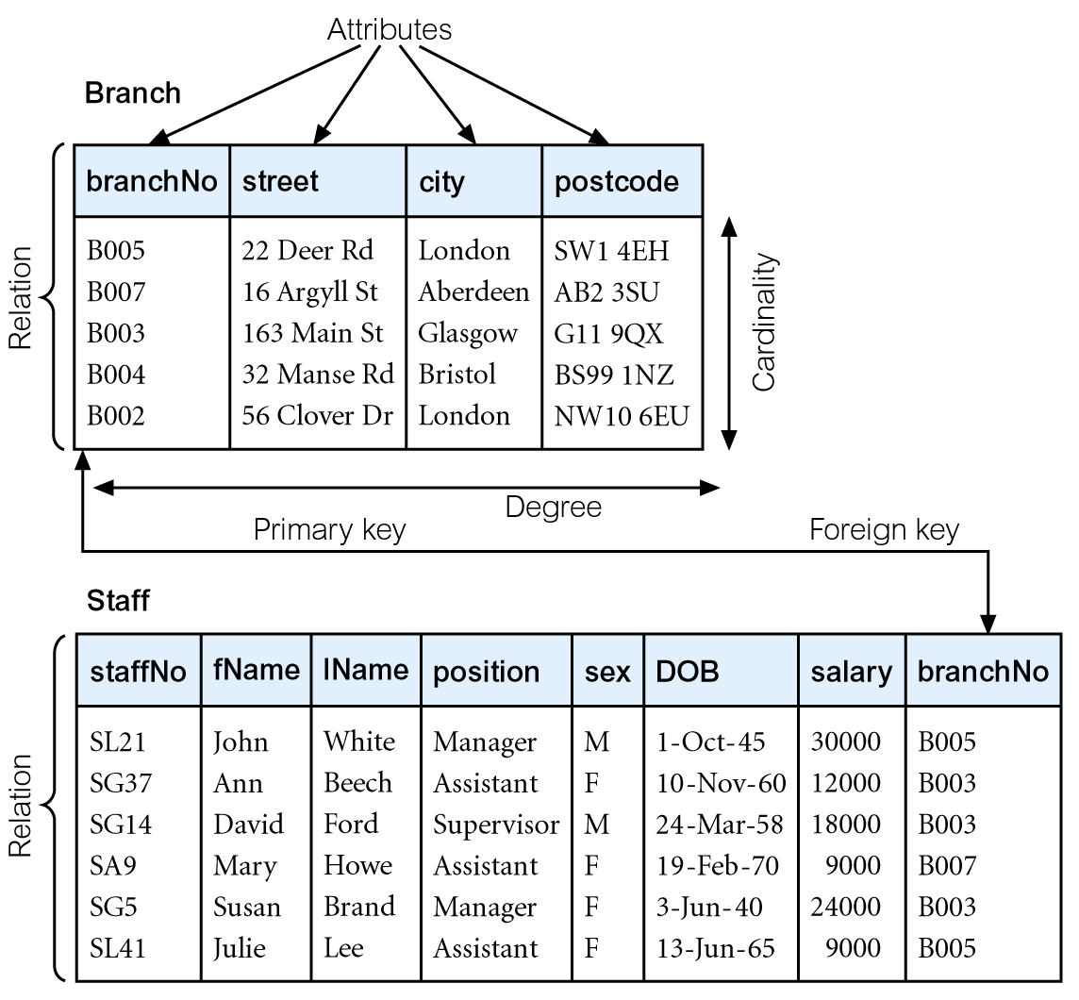
Instances of Sample Relations

Slide 10
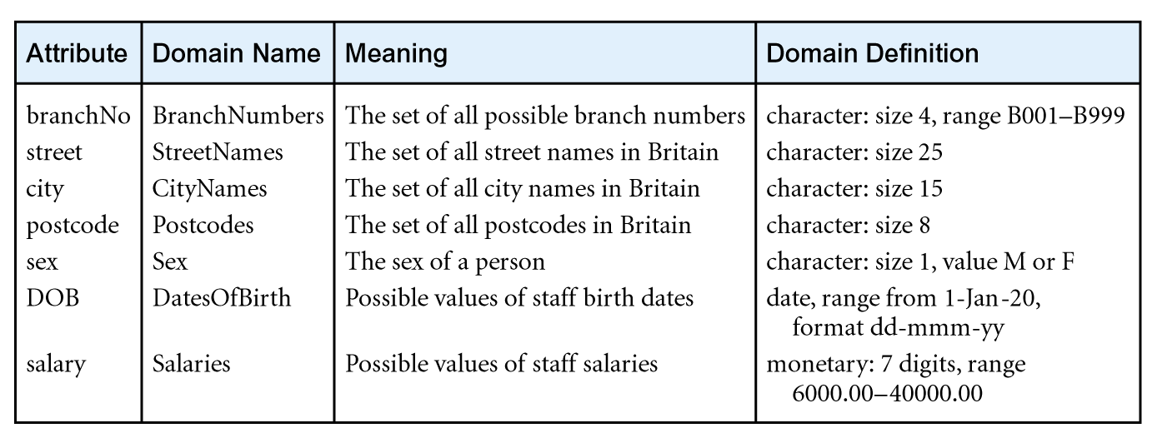
Examples of Attribute Domains

Slide 11
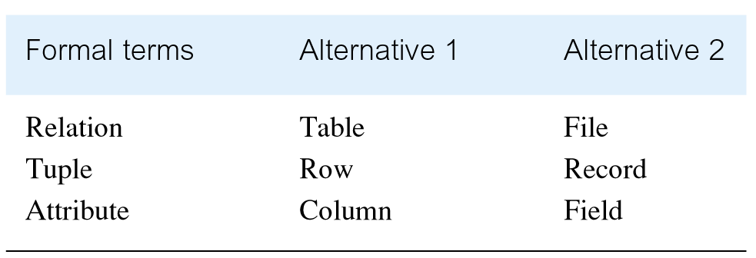
Alternative Terminology

Slide 12
Mathematical Relations
Consider two sets, D1 & D2,
Where D1 = {2, 4} and D2 = {1, 3, 5}
Cartesian product, D1 x D2 is,
Set of all ordered pairs, where first element is member of D1 and second element is member of D2
D1 x D2 = {(2, 1), (2, 3), (2, 5), (4, 1), (4, 3), (4, 5)}
Alternative way is to find all combinations of elements with first from D1 and second from D2

Slide 13
Mathematical Relations..
Any subset of Cartesian product is a relation; e.g.
R = {(2, 1), (4, 1)}
May specify which pairs are in relation using some condition for selection; e.g.
Second element is 1:
R = {(x, y) | x ∈ D1, y ∈ D2, and y = 1}
First element is always twice the second:
S = {(x, y) | x ∈ D1, y ∈ D2, and x = 2y}

Slide 14
Mathematical Relations..
Relating with database relations
Consider Branch relation in the example where
branchNo = {B002,B003} city = {London, Glasgow}
Cartesian product, branchNo x city is,
{(B002, London), (B002, Glasgow), (B003, London), (B003, Glasgow)}
Any subset of Cartesian product is a relation

Slide 15
Mathematical Relations..
Consider three sets D1, D2, D3 with Cartesian Product D1 x D2 x D3, e.g.
D1 = {1, 3} D2 = {2, 4} D3 = {5, 6}
D1 x D2 x D3 =
{(1,2,5), (1,2,6), (1,4,5), (1,4,6), (3,2,5), (3,2,6), (3,4,5), (3,4,6)}
Any subset of these ordered triples is a relation

Slide 16
Mathematical Relations..
Cartesian product of n sets (D1, D2,…, Dn) is:
D1 x D2 x . . . x Dn = {(d1, d2, . . . , dn) | d1 ∈ D1, d2 ∈ D2, . . . , dn ∈ Dn}
Usually written as:
n
XDi
i = 1
Any set of n-tuples from this Cartesian product is a relation on the n sets

Slide 17
Database Relations
Relation schema
Named relation defined by a set of attribute and domain name pairs
Let A1, A2,...,An be attributes with domains D1, D2,..., Dn
Then the set {A1:D1, A2:D2, ... , An:Dn} is a relation schema
A relation R deﬁned by a relation schema S is a set of mappings from the attribute names to their corresponding domains. Thus, relation R is a set of n-tuples:
(A1:d1, A2:d2,..., An:dn) such that
d1∈D1, d2∈D2,..., dn∈Dn

Slide 18
Database Relations
Relation schema
Named relation defined by a set of attribute and domain name pairs
Let A1, A2,...,An be attributes with domains D1, D2,..., Dn
Then the set {A1:D1, A2:D2, ... , An:Dn} is a relation schema
A relation R deﬁned by a relation schema S is a set of mappings from the attribute names to their corresponding domains. Thus, relation R is a set of n-tuples:
(A1:d1, A2:d2,..., An:dn) such that
d1∈D1, d2∈D2,..., dn∈Dn

Slide 19
Database Relations..
Branch relation schema
Branch =
{branchNo:BranchNumbers, street: StreetNames, city: CityNames, postcode:PostCodes}
Tuple of a Branch relation
{branchNo:B005, street: 22 Deer Rd, city: London, postcode:SW1 4EH}

Slide 20
Relational Database Schema
If R1, R2,..., Rn are a set of relation schemas, then we can write the relational database schema, or simply relational schema, R, as:
R= {R1, R2,..., Rn}

Slide 21
Properties of Relations
Relation name is distinct from all other relation names in relational schema
Each cell of relation contains exactly one atomic (single) value
Each attribute has a distinct name
Values of an attribute are all from the same domain

Slide 22
Properties of Relations..
Each tuple is distinct; there are no duplicate tuples
Order of attributes has no significance
Order of tuples has no significance, theoretically

Slide 23
Summary
Relational model terminology
Mathematical relations
Database relations
Properties of a relation

Slide 24
References
All the material (slides, diagrams etc.) presented in this lecture is taken (with modifications) from the Pearson Education website :
http://www.booksites.net/connbegg

