Slide 1
CSC271 Database Systems
Lecture # 4

Slide 2
Summary: Previous Lecture
ANSI-SPARC three-level architecture
Schemas, mappings, and instances
Data independence

Slide 3
Database Languages
Data sublanguage consist of two parts:
DDL (Data Definition Language)
DML (Data Manipulation Language)
Data sublanguage
Does not include constructs for all computing needs such as iterations or conditional statements
Many DBMSs provide embedding the sublanguage in a high level programming language e.g. C, C++, Java etc.
In this case , these high level languages are called host languages

Slide 4
Data Definition Language (DDL)
Allows the DBA or user to describe and name entities, attributes, and relationships required for the application
Plus any associated integrity and security constraints
System catalog (data dictionary, data directory)
Metadata (data about data, data description, data definitions)

Slide 5
Data Manipulation Language (DML)
Provides basic data manipulation operations on data held in the database
Procedural DML
Non-Procedural DML

Slide 6
Procedural DML
Allows user to tell system exactly how to manipulate data
Operate on records individually
Typically, embedded in a high level language
Network or hierarchical DMLs
More work is done by user (programmer)

Slide 7
Non-Procedural DML
Allows user to state what data is needed rather than how it is to be retrieved
Operate on set of records
Relational DBMS include e.g. SQL, QBE etc.
Easy to understand and learn than procedural DML
More work is done by DBMS than user
Provides considerable degree of data independence
Also called declarative languages

Slide 8
Fourth Generation Languages (4GLs)
No clear consensus
Forms generators
Report generators
Graphics generators
Application generators
Examples : SQL and QBE

Slide 9
Functions of a DBMS
Data storage, retrieval, and update
A user-accessible catalog
Transaction support
Concurrency control services
Recovery services

Slide 10
Functions of a DBMS..
Authorization services
Support for data communication
Integrity service
Services to promote data independence
Utility services

Slide 11
DBMS Environment
Single user
Multi-user
Teleprocessing
File-Server Architecture
Client-Server Architecture

Slide 12
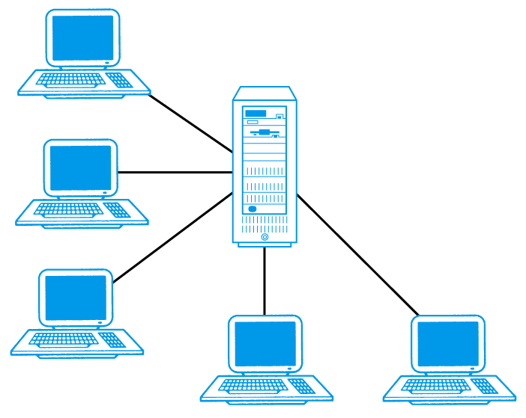
Teleprocessing

Slide 13
Teleprocessing
Traditional architecture
Single mainframe with a number of terminals attached
Trend is now towards downsizing

Slide 14
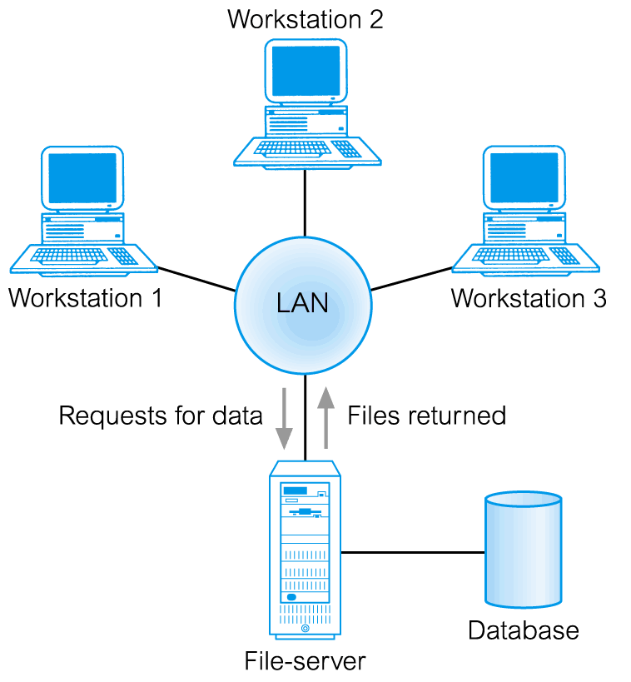
File-Server Architecture

Slide 15
File-Server Architecture
DBMS and applications run on each workstation
Disadvantages include:
Significant network traffic
Copy of DBMS on each workstation
Concurrency, recovery and integrity control more complex because multiple DBMSs accessing same files

Slide 16
Client-Server Architecture

Slide 17
Client-Server Architecture
Client (tier 1) manages user interface and runs applications
Server (tier 2) holds database and DBMS
Advantages include:
Wider access to existing databases
Increased performance
Possible reduction in hardware costs
Reduction in communication costs
Increased consistency

Slide 18
Two-Tier Client-Server

Slide 19
Three-Tier Client-Server
Client side issues in two-tier client/server model preventing true scalability:
‘Fat’ client, requiring considerable resources on client’s computer to run effectively
Significant client side administration overhead
By 1995, three layers proposed, each potentially running on a different platform

Slide 20
Three-Tier Client-Server

Slide 21
Three-Tier Client-Server
Advantages:
‘Thin’ client, requiring less expensive hardware
Application maintenance centralized
Easier to modify or replace one tier without affecting others
Separating business logic from database functions makes it easier to implement load balancing
Maps quite naturally to Web environment

Slide 22
Data Model
Integrated collection of concepts for describing data, relationships between data, and constraints on the data in an organization

Slide 23
Purpose of Data Model
To represent data in an understandable way
Represents the organization itself
Helps in unambiguous and accurate communication between between database designers and end-users about their understanding of the organizational data

Slide 24
Components of a Data Model
A data model comprises:
A structural part
A manipulative part
Possibly a set of integrity rules
ANSI-SPARC architecture related models
External data model (Universe of Discourse)
Conceptual data model (DBMS independent)
Internal data model

Slide 25
Categories of Data Models
Categories of data models include:
Object-based
Entity-Relationship
Semantic
Functional
Object-Oriented
Record-based
Relational Data Model
Network Data Model
Hierarchical Data Model
Physical

Slide 26
Relational Data Model

Slide 27
Network Data Model

Slide 28
Hierarchical Data Model

Slide 29
Conceptual Modeling
Conceptual modeling is process of developing a model of information use in an enterprise that is independent of implementation details
Should be complete and accurate representation of an organization’s data requirements
Conceptual schema is the core of a system supporting all user views
Conceptual vs. logical data model

Slide 30
Summary
Database languages
Functions of a DBMS
DBMS environment
Data models and their categories

Slide 31
References
All the material (slides, diagrams etc.) presented in this lecture is taken (with modifications) from the Pearson Education website given below
http://www.booksites.net/connbegg

