Slide 1
CSC271 Database Systems
Lecture # 32

Slide 2
Summary: Previous Lecture
Database security
Countermeasure: computer-based controls
DBMSs and web security
Transaction management
Transaction
Properties of transaction

Slide 3
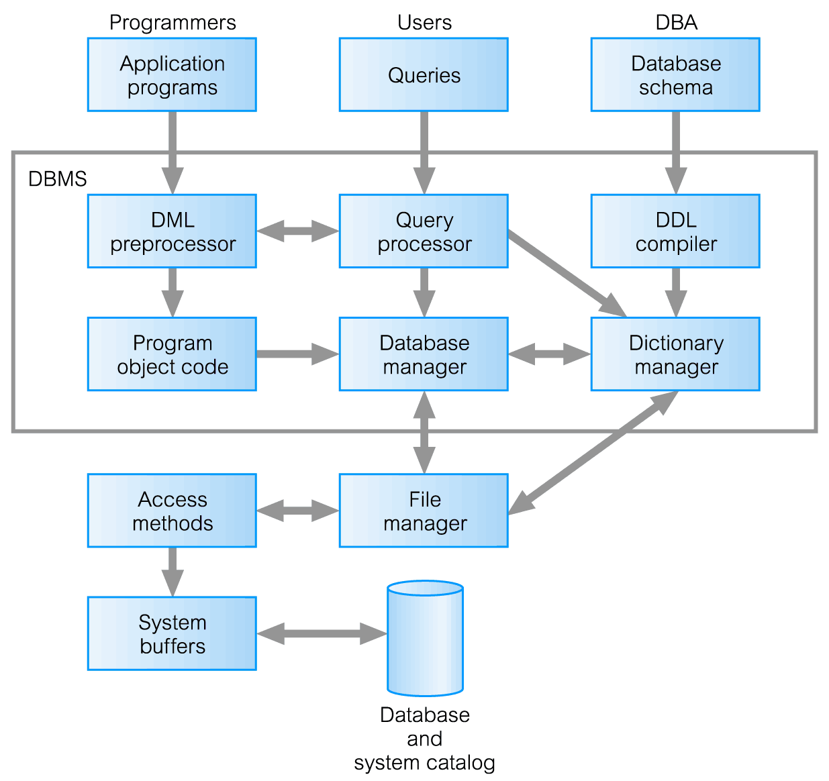
Components of DBMS

Slide 4
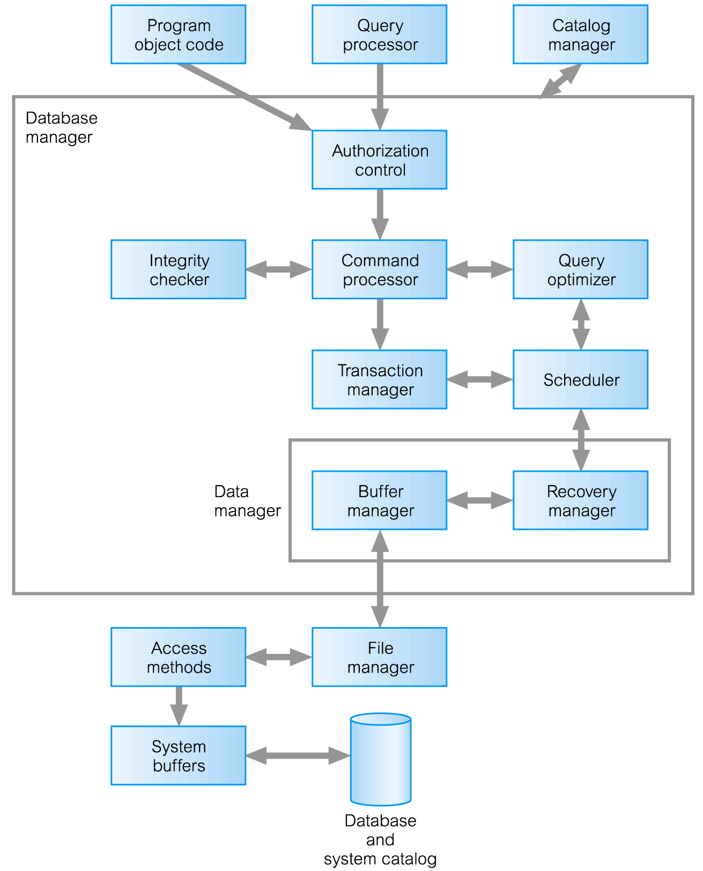
Components of Database Manager

Slide 5
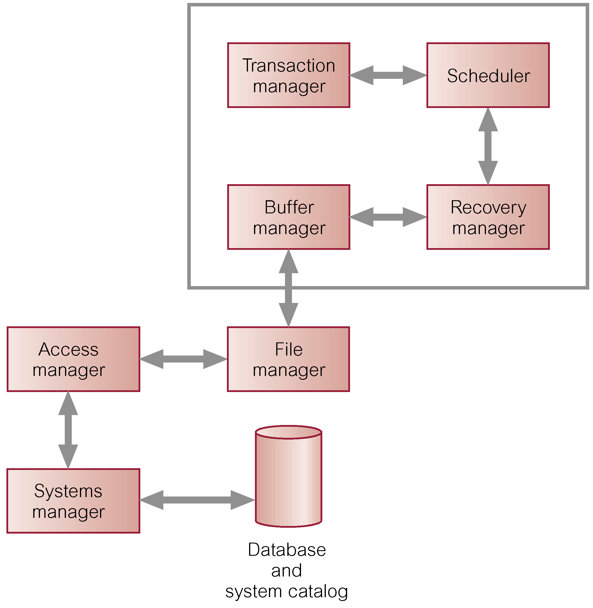
DBMS Transaction Subsystem

Slide 6
Objective of Database
A major objective in developing a database is to enable many users to access shared data concurrently
Concurrent access is relatively easy if all users are only reading data, as there is no way that they can interfere with one another
However, when two or more users are accessing the database simultaneously and at least one is updating data, there may be interference that can result in inconsistencies

Slide 7
Concurrency Control
The process of managing simultaneous operations on the database without having them interfere with one another
Prevents interference when two or more users are accessing database simultaneously and at least one is updating data
Although two transactions may be correct in themselves, interleaving of operations may produce an incorrect result

Slide 8
Need for Concurrency Control
Three examples of potential problems caused by concurrency:
Lost update problem
Uncommitted dependency problem
Inconsistent analysis problem

Slide 9
Lost Update Problem
Successfully completed update is overridden by another user
T1 withdrawing £10 from an account with bal_{x}, initially £100
T2 depositing £100 into same account
Serially, final balance would be £190

Slide 10
Lost Update Problem
The loss of T2’s update is avoided by preventing T1 from reading the value of bal_{x} until after T2’s update has been completed

Slide 11
Uncommitted Dependency Problem
Also called dirty read problem
This problem occurs when one transaction can see intermediate results of another transaction before it has committed
T4 updates bal_{x} to £200 but it aborts, so bal_{x} should be back at original value of £100
T3 has read new value of bal_{x} (£200) and uses value as basis of £10 reduction, giving a new balance of £190, instead of £90

Slide 12
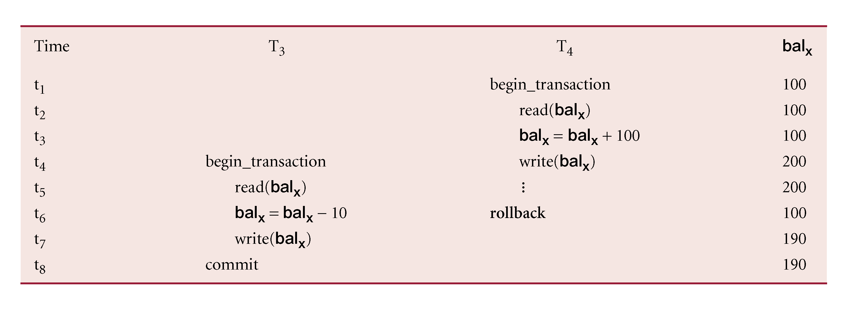
Uncommitted Dependency Problem

Slide 13
Uncommitted Dependency Problem
The uncommitted dependency (dirty read) problem is avoided by preventing T3 from reading balx until after the decision has been made to either commit or abort T4’s effects
The two problems in these examples concentrate on transactions that are updating the database and their interference may corrupt the database
However, transactions that only read the database can also produce inaccurate results if they are allowed to read partial results of incomplete transactions that are simultaneously updating the database

Slide 14
Inconsistent Analysis Problem
Occurs when transaction reads several values but second transaction updates some of them during execution of first
T6 is totaling balances of account x (£100), account y (£50), and account z (£25)
Meantime, T5 has transferred £10 from bal_{x} to bal_{z}, so T6 now has wrong result (£10 too high)

Slide 15
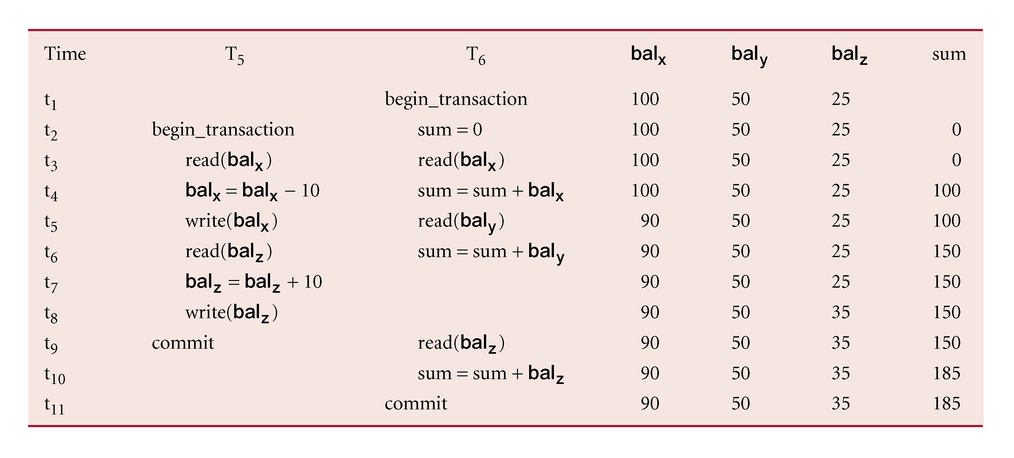
Inconsistent Analysis Problem

Slide 16
Inconsistent Analysis Problem
This problem is avoided by preventing transaction T6 from reading bal_{x} and bal_{z} until after T5 has completed its updates

Slide 17
Some Other Problems
Non-repeatable (or fuzzy) Read
When a transaction T rereads a data item it has previously read but, in between, another transaction has modiﬁed it. Thus, T receives two different values for the same data item
Phantom Read
Transaction T executes a query that retrieves a set of tuples from a relation satisfying a certain predicate, re-executes the query at a later time but ﬁnds that the retrieved set contains an additional (phantom) tuple that has been inserted by another transaction in the meantime

Slide 18
Serializability
Objective of a concurrency control protocol is to schedule transactions in such a way as to avoid any interference
Could run transactions serially, but this limits degree of concurrency or parallelism in system
Serializability identifies those executions of transactions guaranteed to ensure consistency

Slide 19
Serializability
Schedule
Sequence of reads/writes by set of concurrent transactions
Serial Schedule
Schedule where operations of each transaction are executed consecutively without any interleaved operations from other transactions
No guarantee that results of all serial executions of a given set of transactions will be identical

Slide 20
Serializability
Non-serial Schedule
Schedule where operations from set of concurrent transactions are interleaved
Objective of serializability is to find non-serial schedules that allow transactions to execute concurrently without interfering with one another, and thereby produce a database state that could be produced by a serial execution

Slide 21
Serializability
If a set of transactions executes concurrently, we say that the (non-serial) schedule is correct if it produces the same results as some serial execution
Such a schedule is called serializable

Slide 22
Serializability
In serializability, the ordering of read and write operations is important:
If two transactions only read a data item, they do not conﬂict and order is not important
If two transactions either read or write completely separate data items, they do not conﬂict and order is not important
If one transaction writes a data item and another either reads or writes the same data item, the order of execution is important

Slide 23
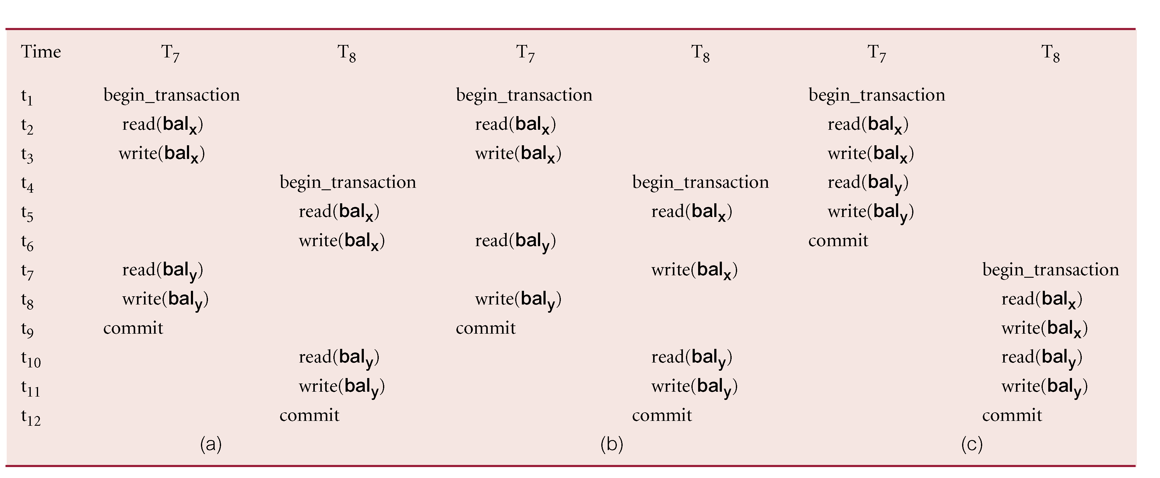
Conflict Serializability

Slide 24
Conflict Serializability
A conﬂict serializable schedule orders any conﬂicting operations in the same way as some serial execution

Slide 25
Concurrency Control Techniques
Conservative (or pessimistic) Methods
They cause transactions to be delayed in case they conﬂict with other transactions at some time in the future e.g. locking, timestamping etc.
Optimistic Methods
Based on the premise that conﬂict is rare so they allow transactions to proceed unsynchronized and only check for conﬂicts at the end, when a transaction commits

Slide 26
Concurrency Control Techniques
Locking
A procedure used to control concurrent access to data
When one transaction is accessing the database, a lock may deny access to other transactions to prevent incorrect results
Most widely used approach to ensure serializability
Generally, a transaction must claim a shared (read) or exclusive (write) lock on a data item before the corresponding database read or write operation

Slide 27
Concurrency Control Techniques
If a transaction has a shared lock on a data item, it can read the item but not update it
If a transaction has an exclusive lock on a data item, it can both read and update the item
Since read operations cannot conﬂict, it is permissible for more than one transaction to hold shared locks simultaneously on the same item
On the other hand, an exclusive lock gives a transaction exclusive access to that item
Some systems allow transaction to upgrade read lock to an exclusive lock, or downgrade exclusive lock to a shared lock

Slide 28
Concurrency Control Techniques
Locks are used in the following way:
Any transaction that needs to access a data item must ﬁrst lock the item, shared or an exclusive lock
If the item is not already locked, the lock will be granted
If the item is currently locked (shared), shared lock request will be granted; otherwise, the transaction must wait until the existing lock is released
A transaction continues to hold a lock until it explicitly releases it either during execution or when it terminates (aborts or commits)
It is only when the exclusive lock has been released that the effects of the write operation will be made visible to other transactions

Slide 29
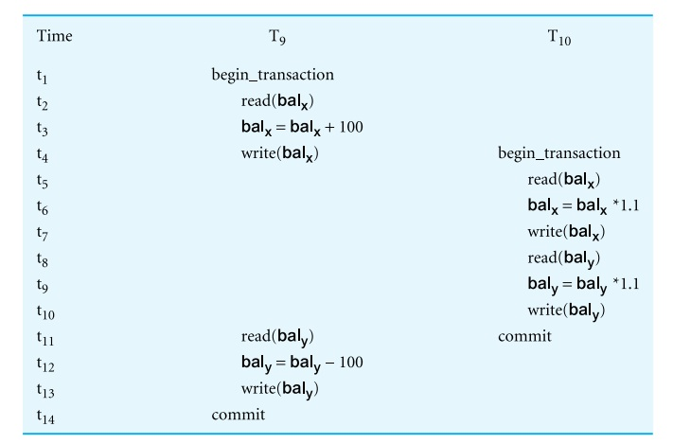
Concurrency Control Techniques

Slide 30
Example: Incorrect Locking Schedule
Using locks in transactions, does not guarantee serializability of schedules by themselves
For two transactions (T9, T10), a valid schedule using these rules is:
S = {write_lock(T9, balx), read(T9, balx), write(T9, balx), unlock(T9, balx), write_lock(T10, balx), read(T10, balx), write(T10, balx), unlock(T10, balx), write_lock(T10, baly), read(T10, baly), write(T10, baly), unlock(T10, baly), commit(T10), write_lock(T9, baly), read(T9, baly), write(T9, baly), unlock(T9, baly), commit(T9) }

Slide 31
Example: Incorrect Locking Schedule
If at start, balx = 100, baly = 400, result should be:
balx = 220, baly = 330, if T9 executes before T10, or
balx = 210, baly = 340, if T10 executes before T9
However, result gives balx = 220 and baly = 340
S is not a serializable schedule

Slide 32
Example: Incorrect Locking Schedule
Problem is that transactions release locks too soon, resulting in loss of total isolation and atomicity
To guarantee serializability, need an additional protocol concerning the positioning of lock and unlock operations in every transaction

Slide 33
Two-Phase Locking (2PL)
Transaction follows 2PL protocol if all locking operations precede first unlock operation in the transaction
Two phases for transaction:
Growing phase: acquires all locks but cannot release any locks
Shrinking phase: releases locks but cannot acquire any new locks

Slide 34
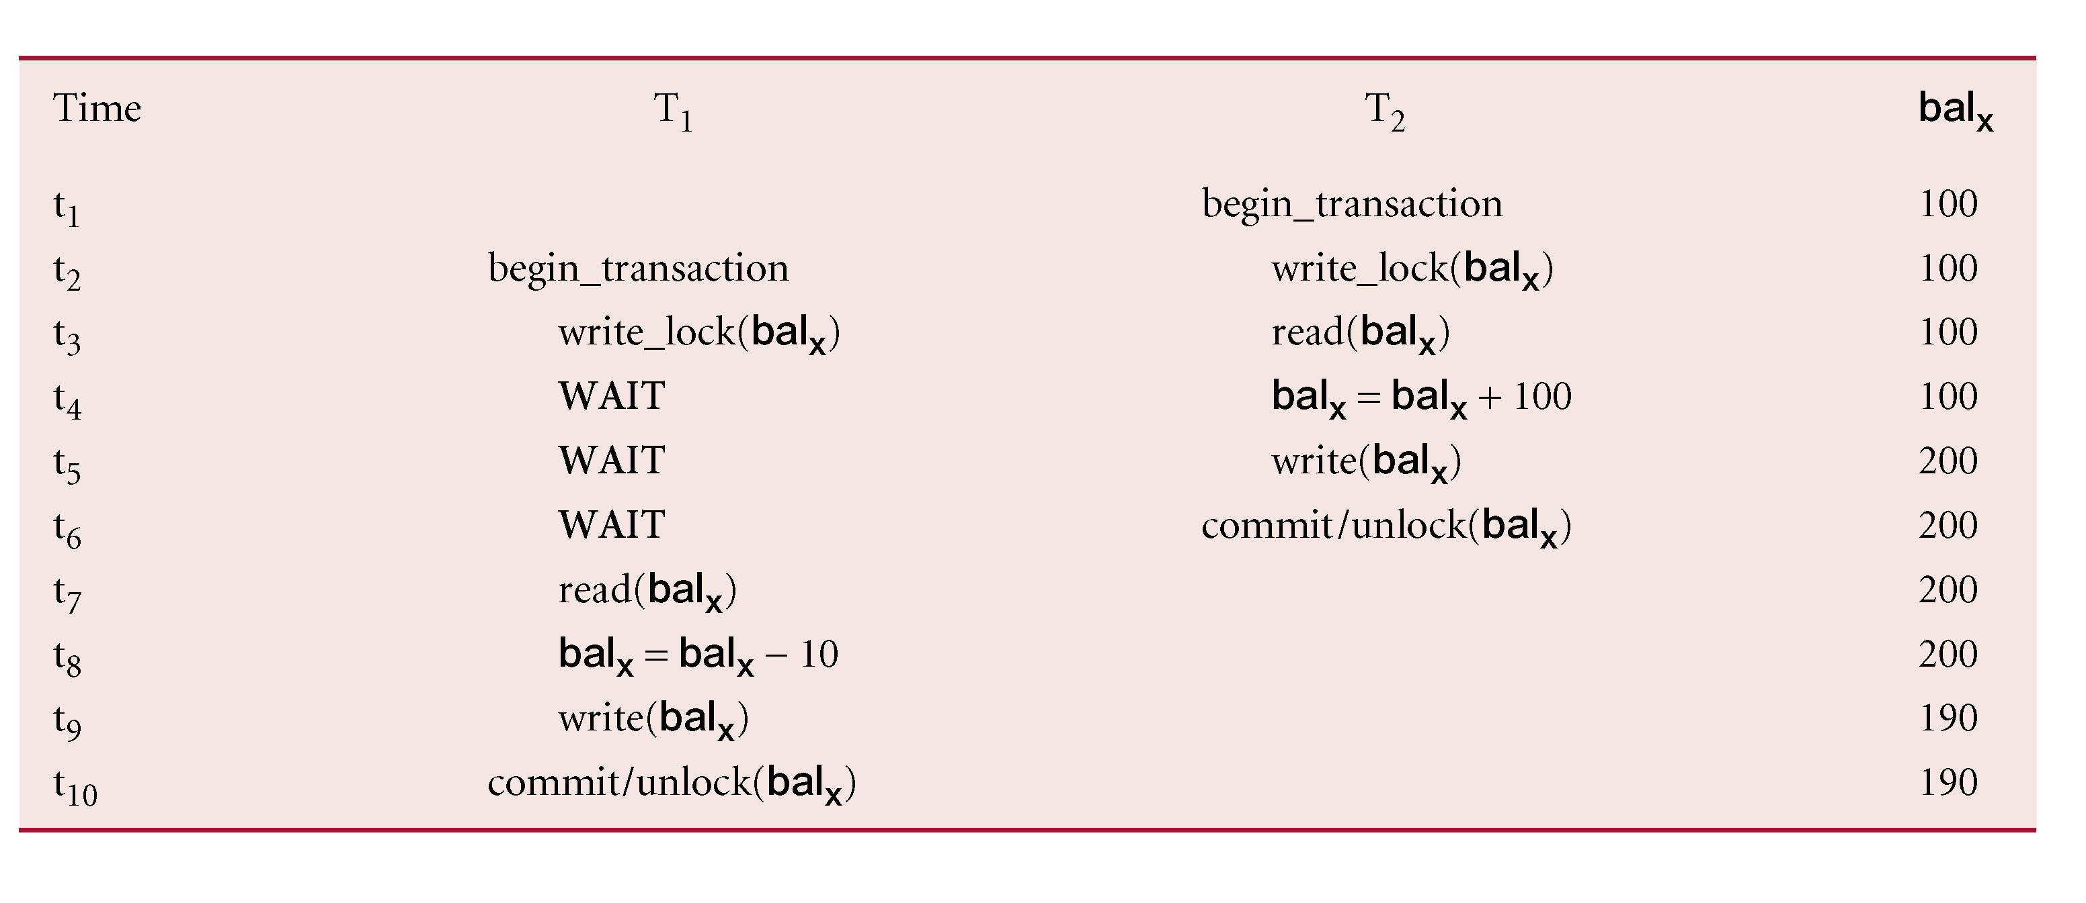
Preventing Lost Update Problem using 2PL

Slide 35
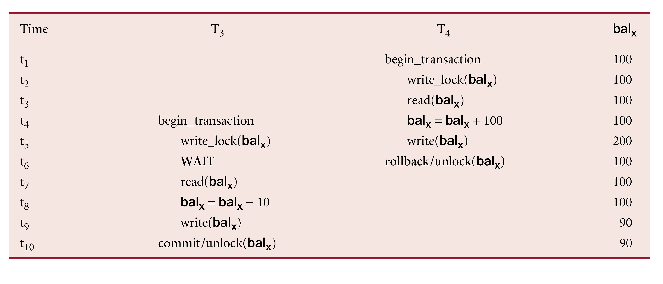
Preventing Uncommitted Dependency Problem using 2PL

Slide 36
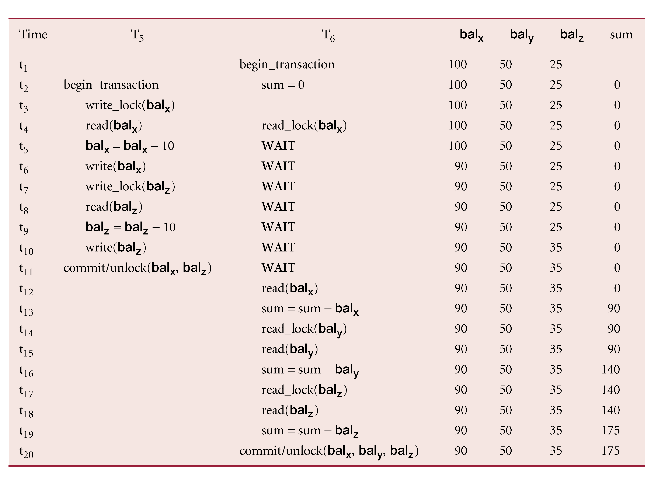
Preventing Inconsistent Analysis Problem using 2PL

Slide 37
Deadlock
An impasse that may result when two (or more) transactions are each waiting for locks held by the other to be released
Only one way to break deadlock, abort one or more of the transactions
Deadlock should be transparent to user, so DBMS should restart transaction(s)
Three general techniques for handling deadlock:
Timeouts
Deadlock prevention
Deadlock detection and recovery

Slide 38
Timestamping
A concurrency control protocol that orders transactions in such a way that older transactions, transactions with smaller timestamps, get priority in the event of conﬂict
Conflict is resolved by rolling back and restarting transaction
No locks so no deadlock

Slide 39
Database Recovery
The process of restoring the database to a correct state in the event of a failure
Need for Recovery Control
Two types of storage: volatile (main memory) and nonvolatile
Volatile storage does not survive system crashes
Stable storage represents information that has been replicated in several nonvolatile storage media with independent failure modes

Slide 40
Types of Failures
System crashes due to hardware or software errors, resulting in loss of main memory
Media failures, such as head crashes or unreadable media, resulting in the loss of parts of secondary storage
Application software errors, such as logical errors in the program that is accessing the database, which cause one or more transactions to fail
Natural physical disasters, such as ﬁres, ﬂoods, earthquakes, or power failures
Carelessness or unintentional destruction of data or facilities by operators or users
Sabotage, or intentional corruption or destruction of data, hardware, or software facilities

Slide 41
Recovery Facilities
A DBMS should provide the following facilities to assist with recovery:
A backup mechanism, which makes periodic backup copies of the database
Logging facilities, which keep track of the current state of transactions and database changes
A checkpoint facility, which enables updates to the database that are in progress to be made permanent
A recovery manager, which allows the system to restore the database to a consistent state following a failure

Slide 42
Main Recovery Techniques
Three main recovery techniques:
Deferred Update
Immediate Update
Shadow Paging

Slide 43
Summary
Concurrency control
Database recovery

Slide 44
References
All the material (slides, diagrams etc.) presented in this lecture is taken (with modifications) from the Pearson Education website :
http://www.booksites.net/connbegg

