Slide 1
CSC271 Database Systems
Lecture # 31

Slide 2
Summary: Previous Lecture
Remaining steps/activities in
Physical database design methodology
Monitoring and performance tuning

Slide 3
Security
Chapter 19

Slide 4
Database Security
Data is a valuable resource that must be strictly controlled and managed, as with any corporate resource
Part or all of the corporate data may have strategic importance and therefore needs to be kept secure and confidential
Mechanisms that protect the database against intentional or accidental threats

Slide 5
Database Security
Security considerations do not only apply to the data held in a database: breaches of security may affect other parts of the system, which may in turn affect the database
Database security encompasses
Hardware
Software
People
Data

Slide 6
Database Security
Database security involves measures to avoid:
Theft and fraud
Loss of confidentiality (secrecy)
Loss of privacy
Loss of integrity
Loss of availability

Slide 7
Database Security
Threat
Any situation or event, whether intentional or unintentional, that will adversely affect a system and consequently an organization

Slide 8
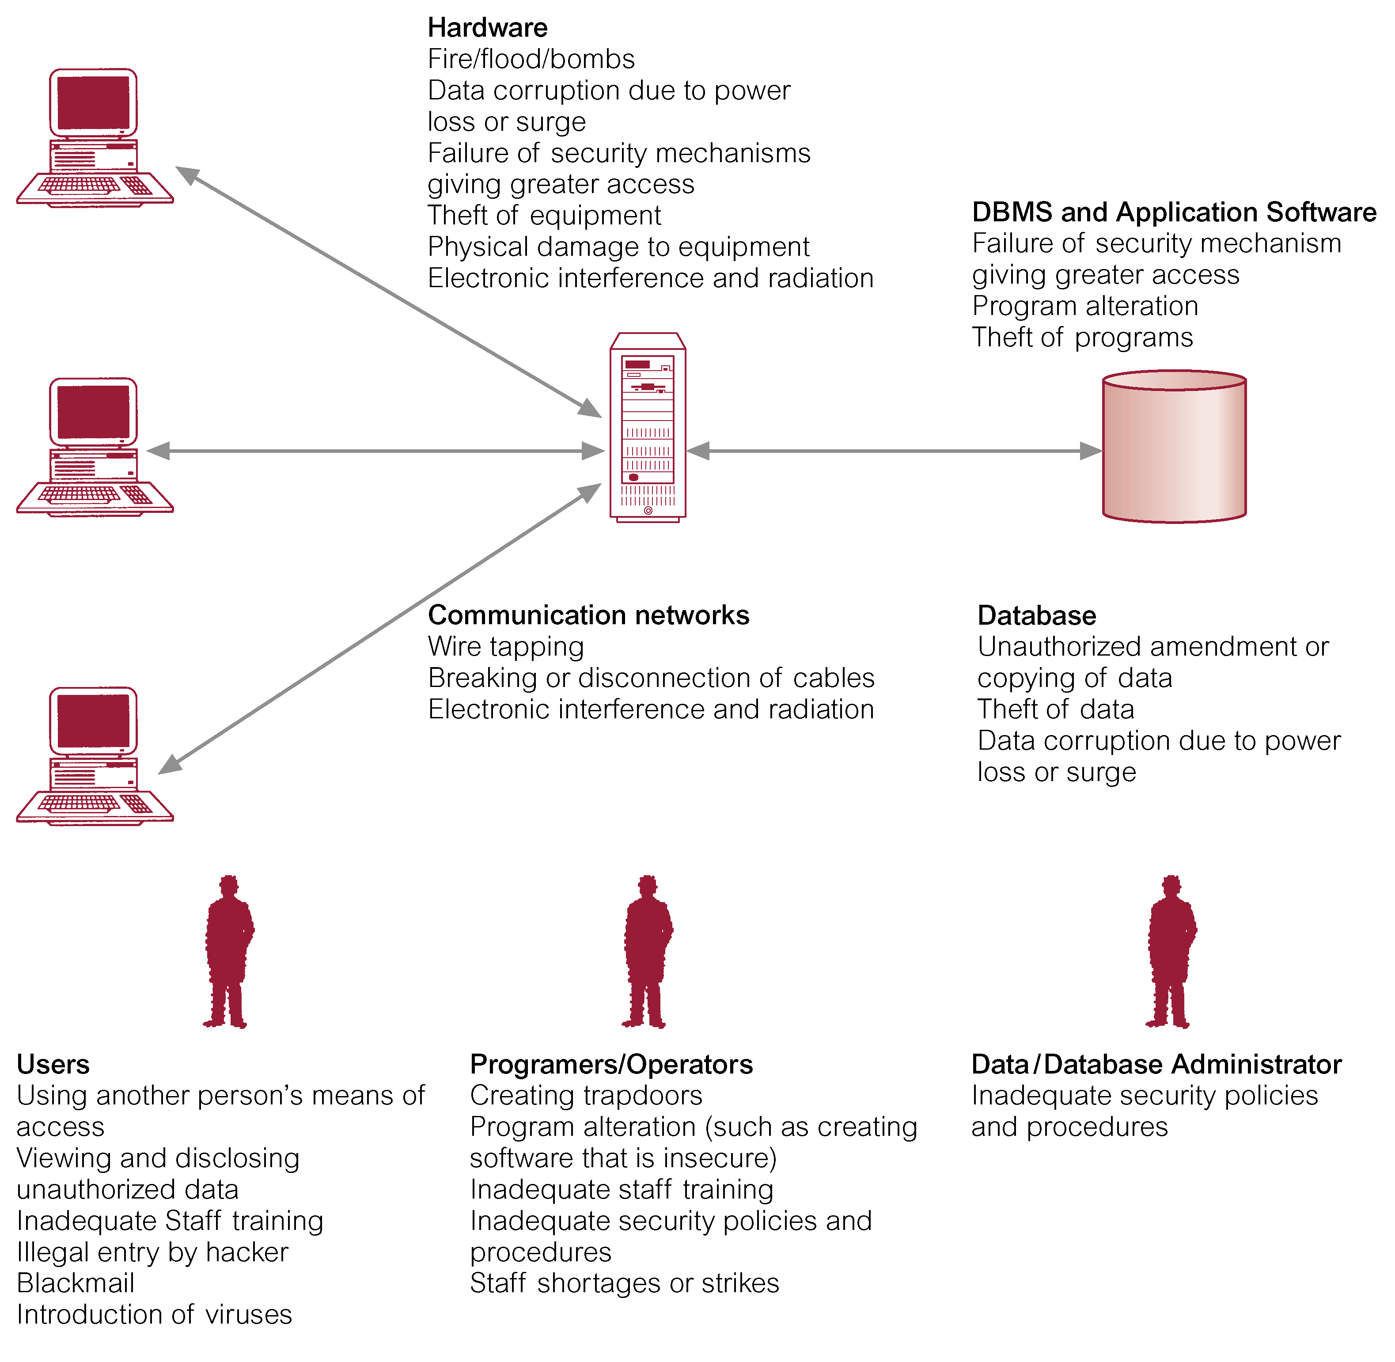
Threats to Computer Systems

Slide 9
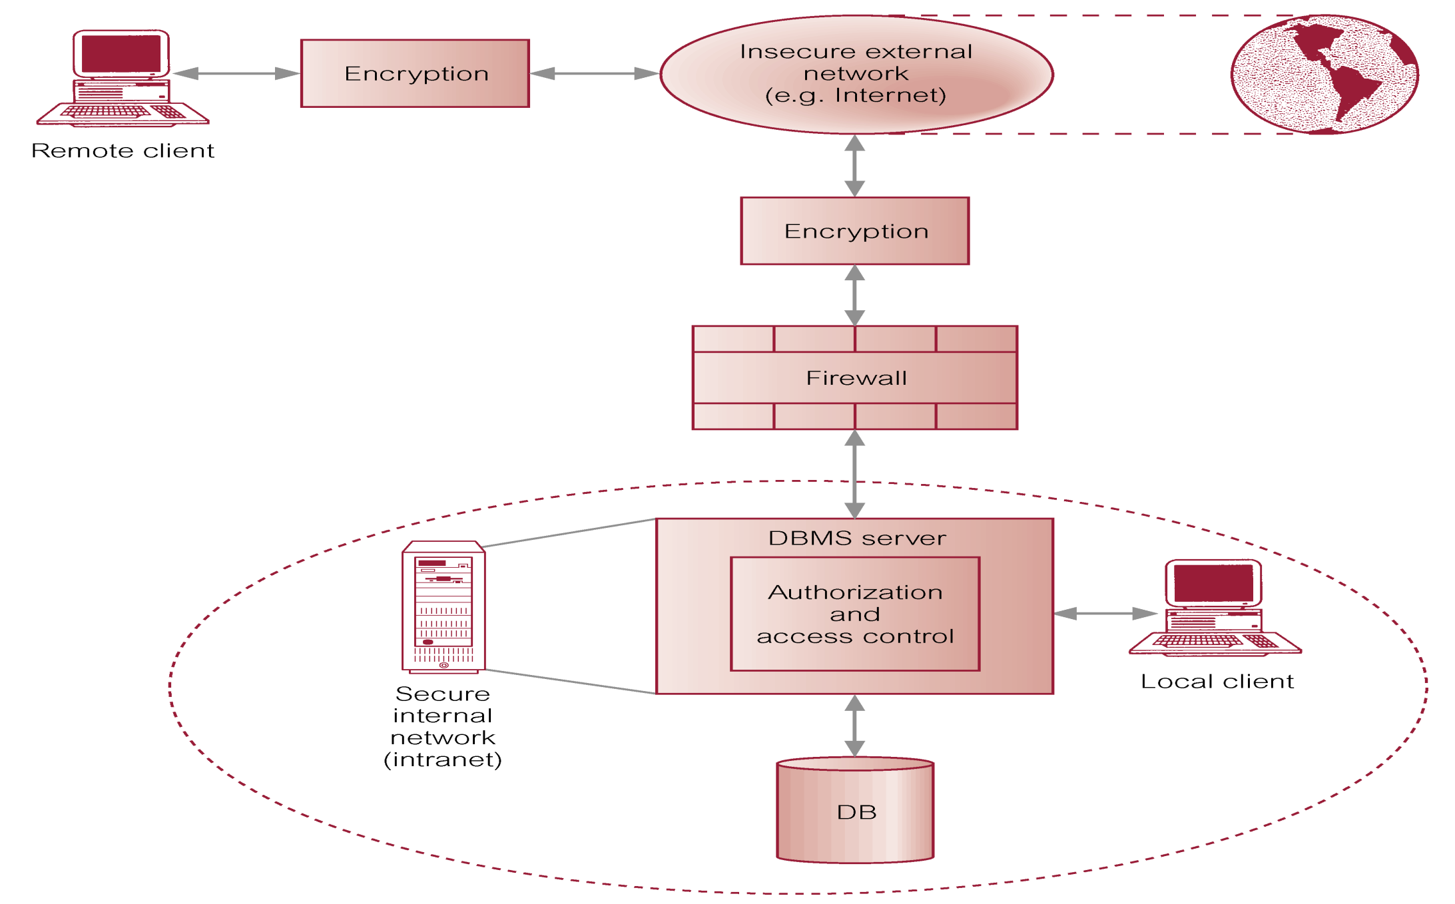
Typical Multi-user Computer Environment

Slide 10
Countermeasures: Computer-Based Controls
Concerned with physical controls to administrative procedures and includes:
Authorization
Access controls
Views
Backup and recovery
Integrity
Encryption
RAID technology

Slide 11
Countermeasures: Computer-Based Controls
Authorization
The granting of a right or privilege that enables a subject to have legitimate access to a system or a system’s object
Authentication
A mechanism that determines whether a user is who he or she claims to be

Slide 12
Countermeasures: Computer-Based Controls
Access controls
Based on the granting and revoking of privileges
Privilege
A privilege allows a user to create or access (that is read, write, or modify) some database object (such as a relation, view, and index) or to run certain DBMS utilities
Approaches used by DBMS
Discretionary Access Control (DAC)
Mandatory Access Control (MAC)

Slide 13
Countermeasures: Computer-Based Controls
Discretionary Access Control (DAC)
Provided by most DBMSs
SQL standard supports through GRANT/REVOKE
Certain weaknesses
Mandatory Access Control (MAC)
System-wide policies that cannot be changed by individual users
Each database object is assigned a security class and each user is assigned a clearance for a security class, and rules are imposed on reading and writing of database objects by users
The SQL standard does not include support for MAC
Popular Bell-LaPudula model based on MAC

Slide 14
Countermeasures: Computer-Based Controls
Views
A view is the dynamic result of one or more relational operations operating on the base relations to produce another relation
A view is a virtual relation that does not actually exist in the database, but is produced upon request by a particular user, at the time of request
Powerful and flexible security mechanism by hiding parts of the data from certain users
Access to views, not to base relations

Slide 15
Countermeasures: Computer-Based Controls
Backup and Recovery
The process of periodically taking a copy of the database and log ﬁle (and possibly programs) on to ofﬂine storage media
Journaling
The process of keeping and maintaining a log ﬁle (or journal) of all changes made to the database to enable recovery to be undertaken effectively in the event of a failure

Slide 16
Countermeasures: Computer-Based Controls
Integrity
Prevents data from becoming invalid, and hence giving misleading or incorrect results
Encryption
The encoding of the data by a special algorithm that renders the data unreadable by any program without the decryption key
Symmetric encryption
Same key, DES, PGP etc.
Asymmetric encryption
Different keys, RSA etc.

Slide 17
Countermeasures: Computer-Based Controls
RAID (Redundant Array of Independent Disks) Technology
Hardware that the DBMS is running on must be fault-tolerant, meaning that the DBMS should continue to operate even if one of the hardware components fails
The main hardware components that should be fault-tolerant include disk drives, disk controllers, CPU, power supplies, and cooling fans
Disk drives are the most vulnerable components with the shortest times between failure of any of the hardware components

Slide 18
Countermeasures: Computer-Based Controls
RAID (Redundant Array of Independent Disks) Technology
One solution is to provide a large disk array comprising an arrangement of several independent disks that are organized to improve reliability (through mirror and error-correction scheme) and at the same time increase performance (through data stripping)

Slide 19
DBMSs and Web Security
Internet communication relies on TCP/IP as the underlying protocol
However, TCP/IP and HTTP were not designed with security in mind
Without special software, all Internet traffic travels ‘in the clear’ and anyone who monitors traffic can read it

Slide 20
DBMSs and Web Security
The challenge is to transmit and receive information over the Internet while ensuring that:
It is inaccessible to anyone but the sender and receiver (privacy)
It has not been changed during transmission (integrity)
The receiver can be sure it came from the sender (authenticity)
The sender can be sure the receiver is genuine (non-fabrication)
The sender cannot deny he or she sent it (non-repudiation)

Slide 21
DBMSs and Web Security
Measures include:
Proxy servers
Firewalls
Message digest algorithms and digital signatures
Digital certificates
Kerberos
Secure sockets layer (SSL) and Secure HTTP (S-HTTP)
Secure Electronic Transactions (SET) and Secure Transaction Technology (SST)
Java security
ActiveX security

Slide 22
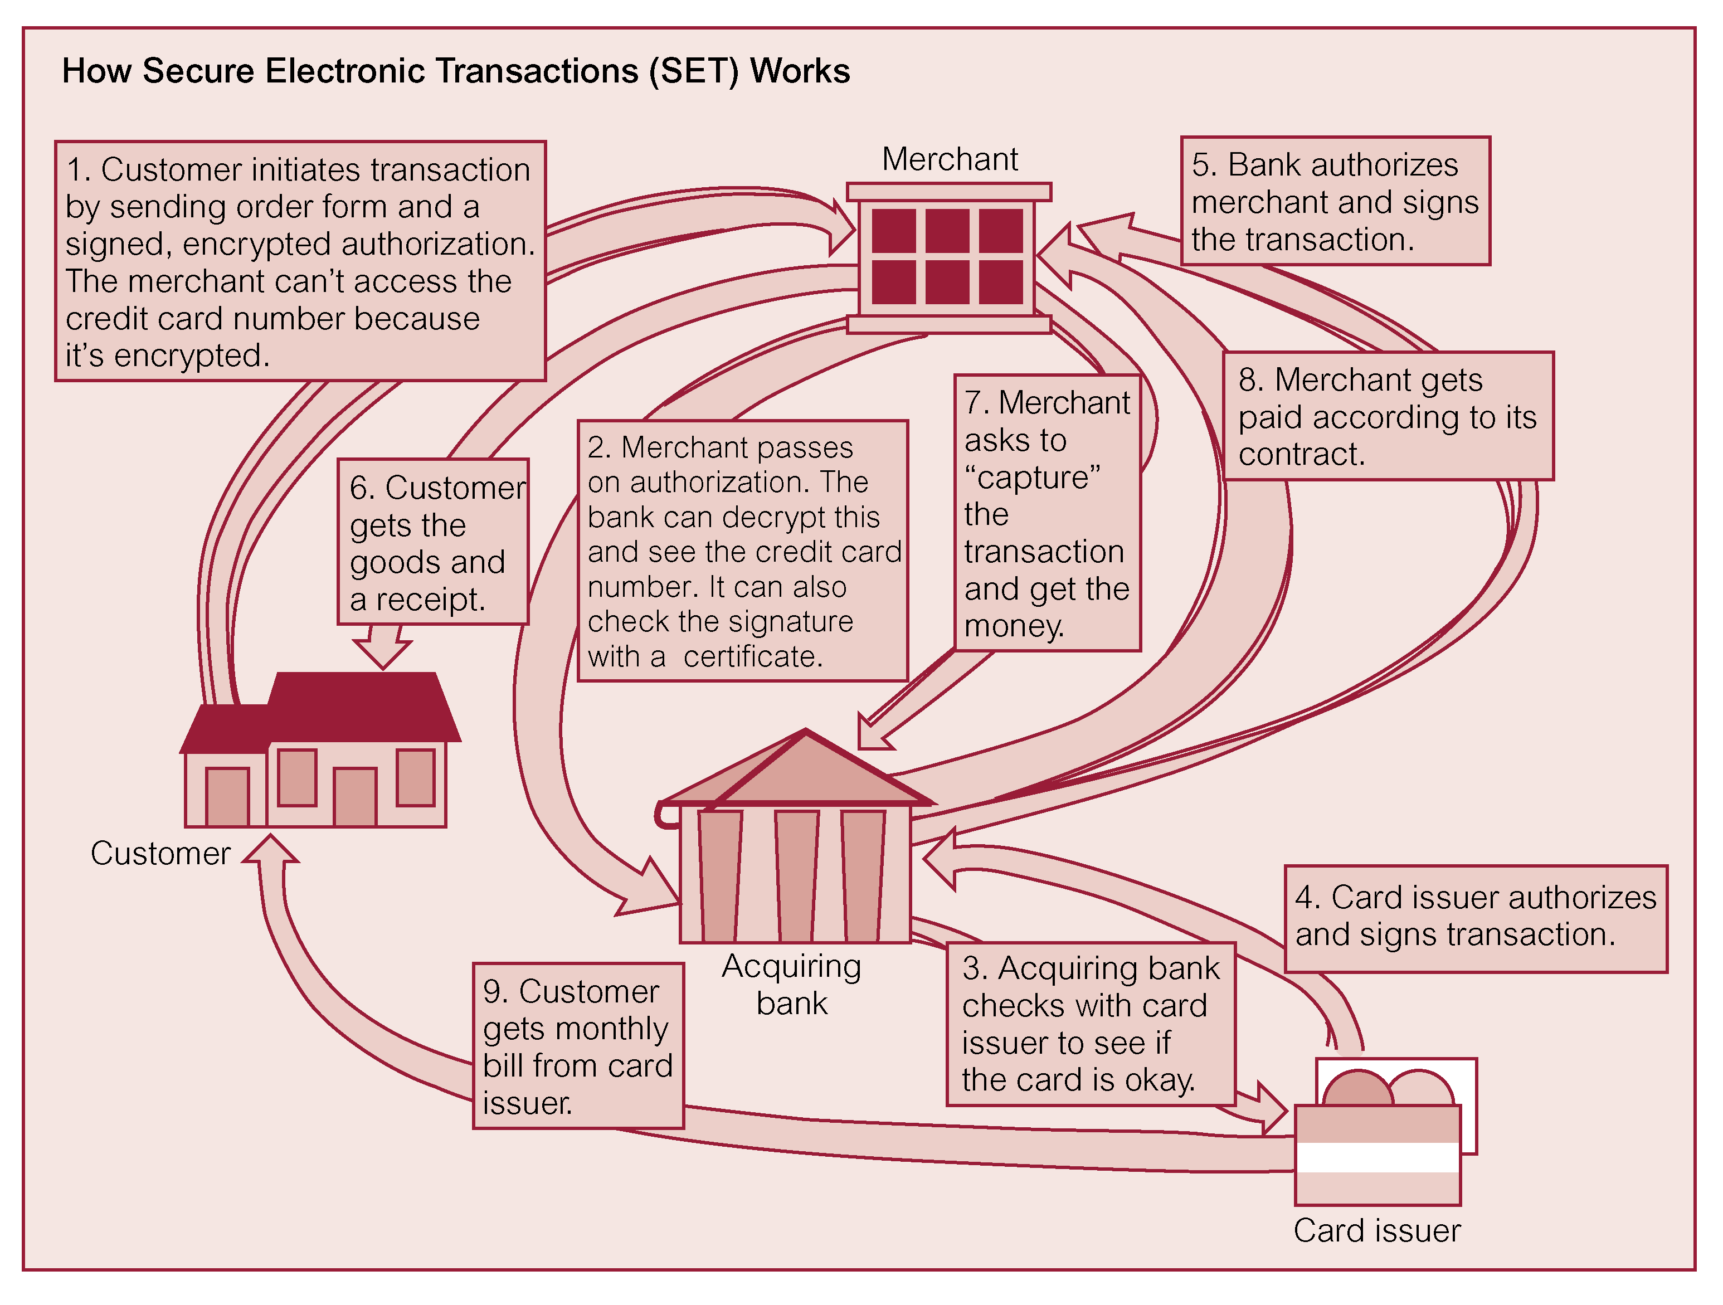
A SET Transaction

Slide 23
Transaction Management
Chapter 20

Slide 24
DBMS Functions
DBMS functions (transaction support, concurrency control services, recovery services) ensure:
Database is reliable and remains in a consistent state even in the presence of failures of both hardware and software components, and when multiple users are accessing the database
Both concurrency control and recovery are mutually dependent, and required to protect database from data inconsistencies and data loss

Slide 25
Transaction
An action, or series of actions, carried out by a single user or application program, which reads or updates the contents of the database
A transaction is a logical unit of work on the database
It may be an entire program, a part of a program, or a single command (e.g. the SQL command INSERT or UPDATE), and it may involve any number of operations on the database
In the database context, the execution of an application program can be thought of as one or more transactions with non-database processing taking place in between

Slide 26
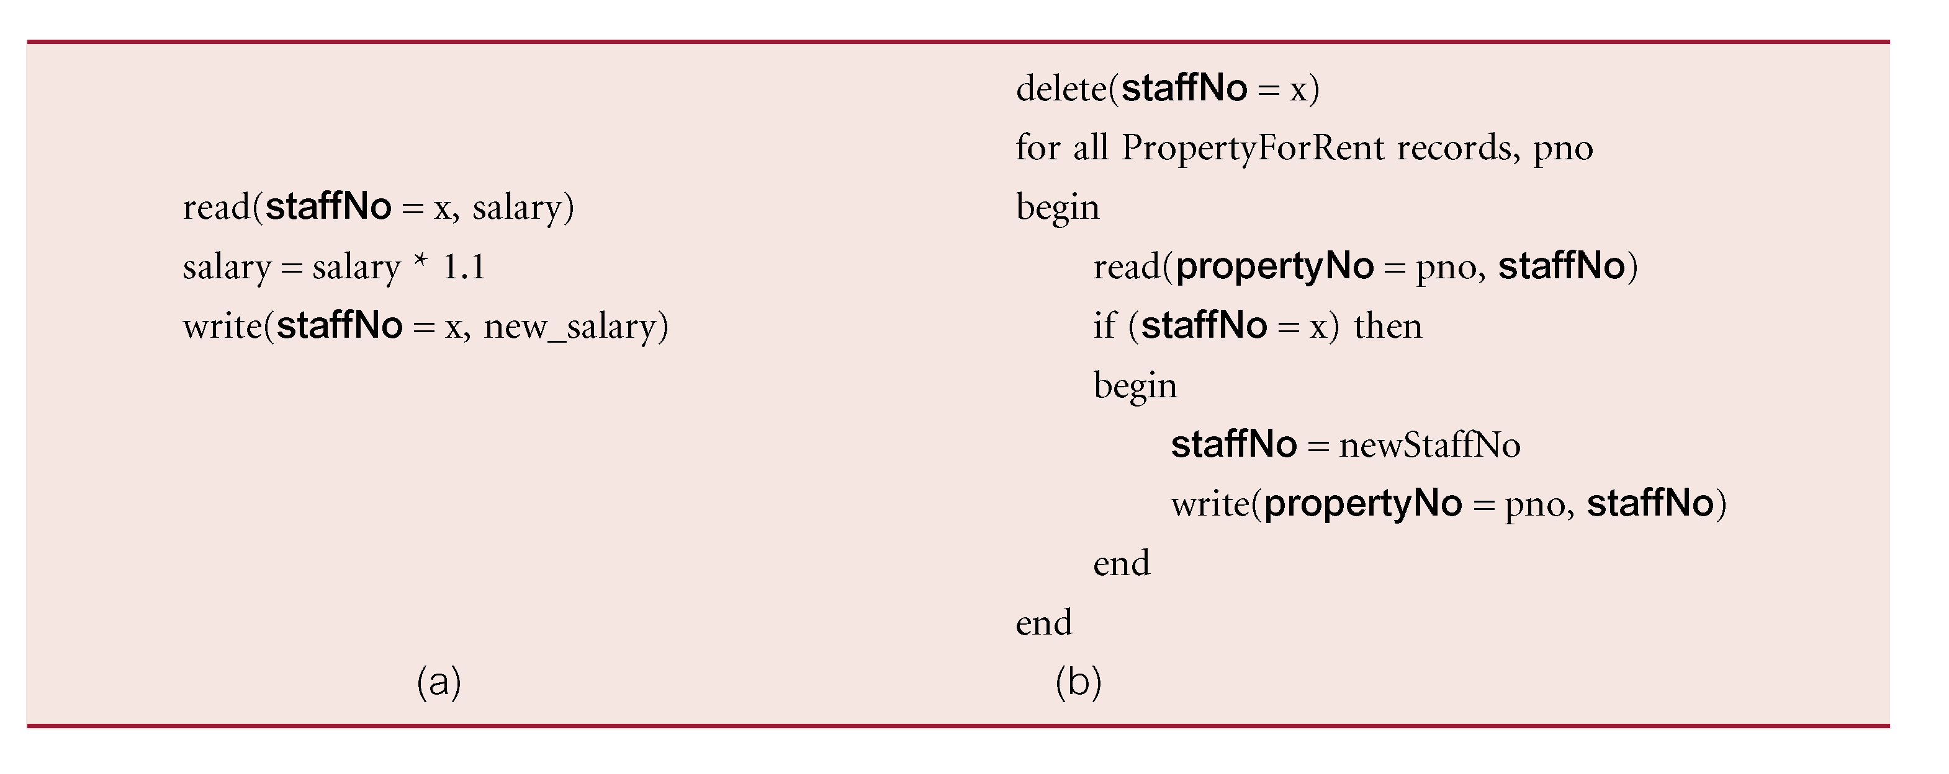
Transaction

Slide 27
Transaction
A transaction should always transform the database from one consistent state to another, although we accept that consistency may be violated while the transaction is in progress
For example, there may be some moment when one tuple of PropertyForRent contains the new newStaffNo value and another still contains the old one, x
However, at the end of the transaction, all necessary tuples should have the new newStaffNo value

Slide 28
Transaction
A transaction can have one of two outcomes
If the transaction completes successfully, the transaction is said to have committed and the database reaches a new consistent state
A committed transaction cannot be aborted
If we decide that the committed transaction was a mistake, we must perform another compensating transaction to reverse its effects e.g. increasing the salary of a staff member etc.

Slide 29
Transaction
If the transaction does not execute successfully, the transaction is aborted
If a transaction is aborted, the database must be restored to the consistent state it was in before the transaction started
Such a transaction is rolled back or undone
However, an aborted transaction that is rolled back can be restarted later and, depending on the cause of the failure, may successfully execute and commit at that time

Slide 30
Transaction
The DBMS has no inherent way of knowing which updates are grouped together to form a single logical transaction
DBMS must therefore provide a method to allow the user to indicate the boundaries of a transaction
The keywords BEGIN TRANSACTION, COMMIT, and ROLLBACK (or their equivalent) are available in many data manipulation languages to delimit transactions
If these delimiters are not used, the entire program is usually regarded as a single transaction, with the DBMS automatically performing a COMMIT when the program terminates correctly and a ROLLBACK if it does not

Slide 31
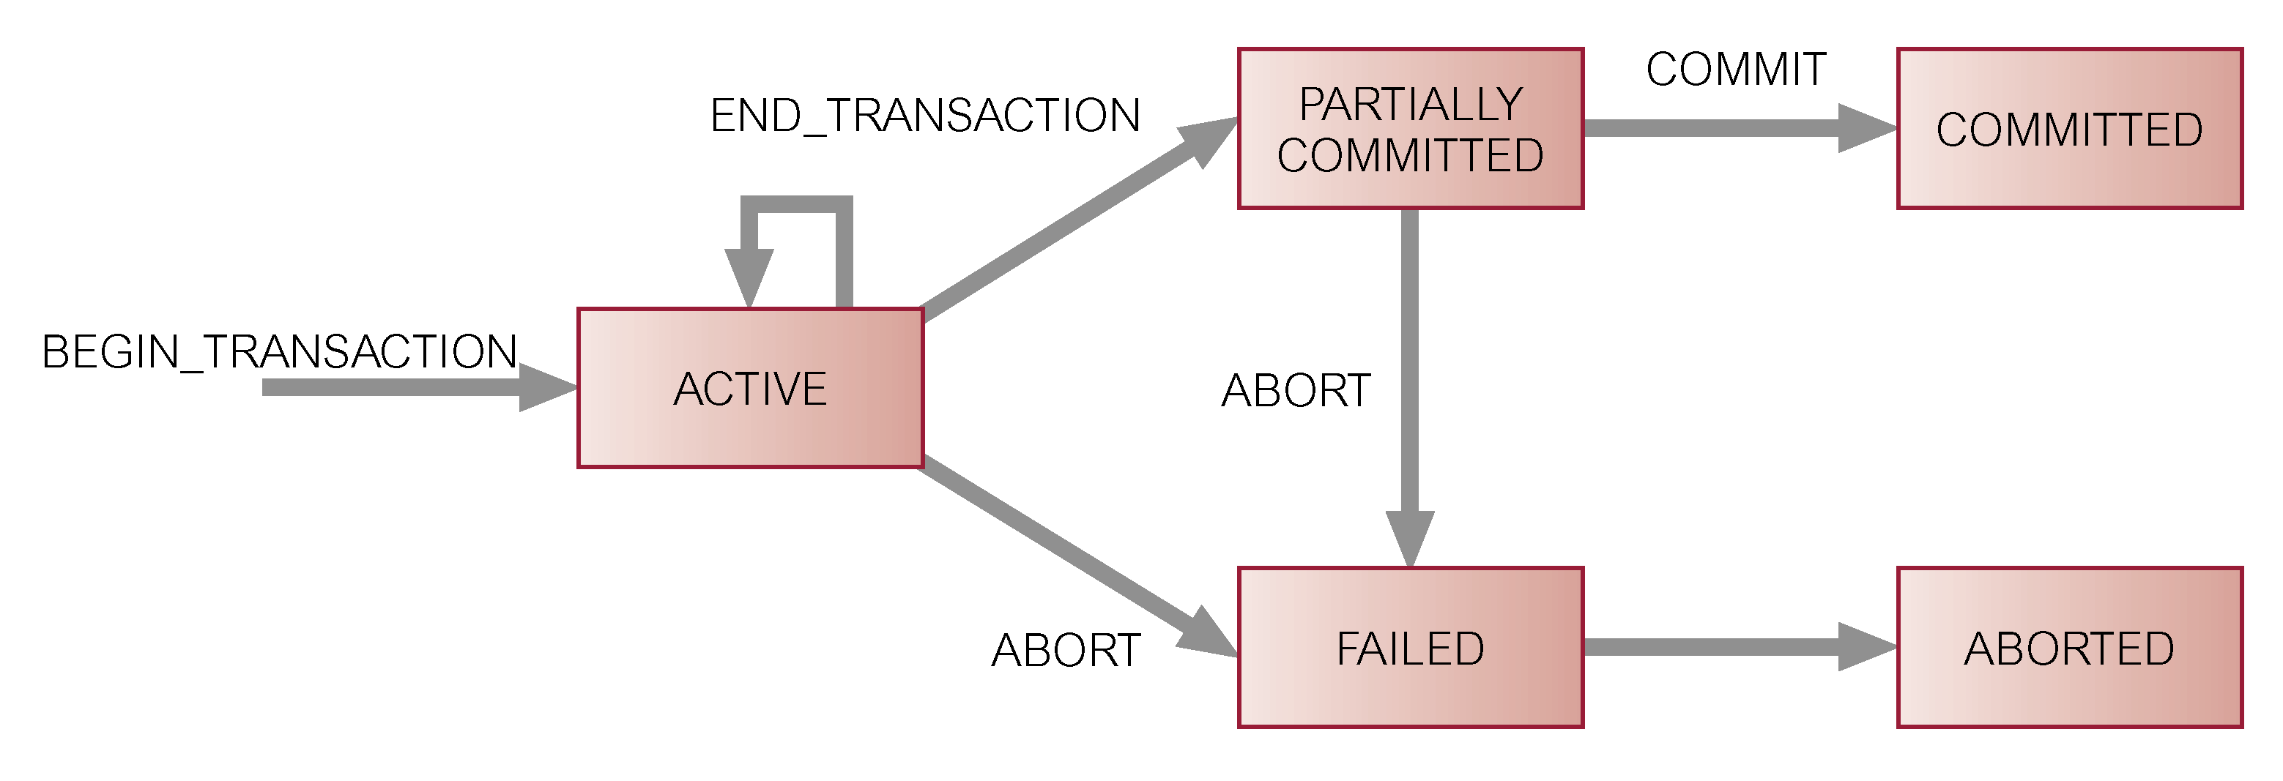
Transaction

Slide 32
Properties of Transaction
The four basic, or so-called ACID, properties of a transaction are:
Atomicity
‘All or nothing’ property
A transaction is an indivisible unit that is either performed in its entirety or is not performed at all
Responsibility of recovery subsystem of DBMS
Consistency
A transaction must transform the database from one consistent state to another consistent state
Responsibility of both DBMS and application developers

Slide 33
Properties of Transaction
The four basic, or so-called ACID, properties of a transaction are:
Isolation
Transactions execute independently of one another
In other words, the partial effects of incomplete transactions should not be visible to other transactions
Responsibility of the concurrency control subsystem
Durability
The effects of a successfully completed (committed) transaction are permanently recorded in the database and must not be lost because of a subsequent failure
Responsibility of the recovery subsystem

Slide 34
Summary
Database security
Countermeasure: computer-based controls
DBMSs and web security
Transaction management
Transaction
Properties of transaction

Slide 35
References
All the material (slides, diagrams etc.) presented in this lecture is taken (with modifications) from the Pearson Education website :
http://www.booksites.net/connbegg

