Slide 1
CSC271 Database Systems
Lecture # 30

Slide 2
Summary: Previous Lecture
Normalization summary/example
Remaining steps/activities in building logical data model
Physical database design
Translate logical data model for target DBMS

Slide 3
Physical Database Design Methodology
Translate logical data model for target DBMS
Design base relations
Design representation of derived data
Design general constraints
Design ﬁle organizations and indexes
Analyze transactions
Choose ﬁle organizations
Choose indexes
Estimate disk space requirements
Design user views
Design security mechanisms
Consider the introduction of controlled redundancy
Monitor and tune the operational system

Slide 4
Physical Database Design Methodology
Design ﬁle organizations and indexes
To determine optimal file organizations to store the base relations and the indexes that are required to achieve acceptable performance; that is, the way in which relations and tuples will be held on secondary storage
The types of ﬁle organization available are dependent on the target DBMS
The DB designer must understand the typical workload that database must support

Slide 5
Physical Database Design Methodology
Analyze transactions
To understand the functionality of the transactions that will run on the database and to analyze the important transactions
Attempt to identify performance criteria, such as:
Transactions that run frequently and will have a significant impact on performance
Transactions that are critical to the business
Times during the day/week when there will be a high demand made on the database (called the peak load)

Slide 6
Physical Database Design Methodology
Analyze transactions
Use this information to identify the parts of the database that may cause performance problems
Also need to know high-level functionality of the transactions, such as:
Attributes that are updated
Search criteria used in a query
Use this information to select appropriate file organization

Slide 7
Physical Database Design Methodology
Analyze transactions
Difficult to estimate all transactions, most important
The most active 20% of user queries account for 80% of the total data access
Use of
Transaction/relation cross-reference matrix, showing relations that each transaction accesses
Transaction usage map, indicating which relations are potentially heavily used
To focus on areas that may be problematic:
Map all transaction paths to relations
Most frequently accessed relations by transactions
Data usage of selected transactions involving relations

Slide 8
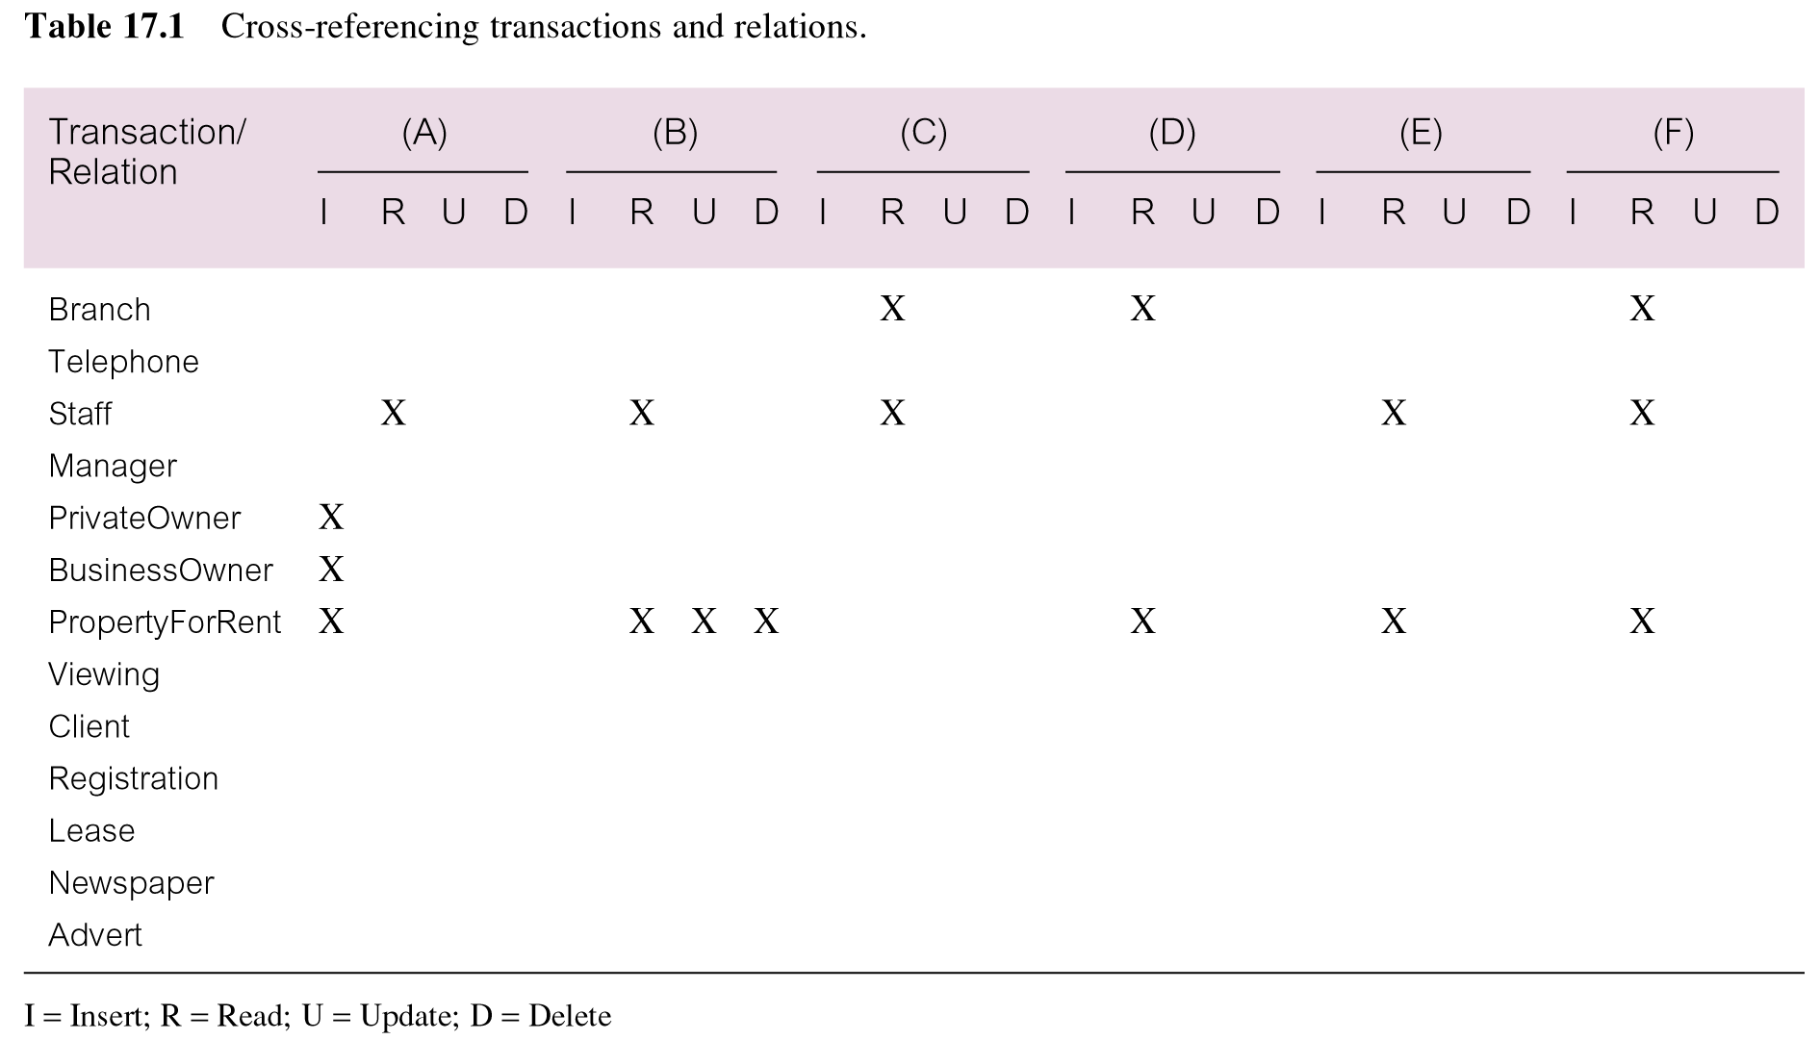
Cross-Referencing Transactions/Relations

Slide 9
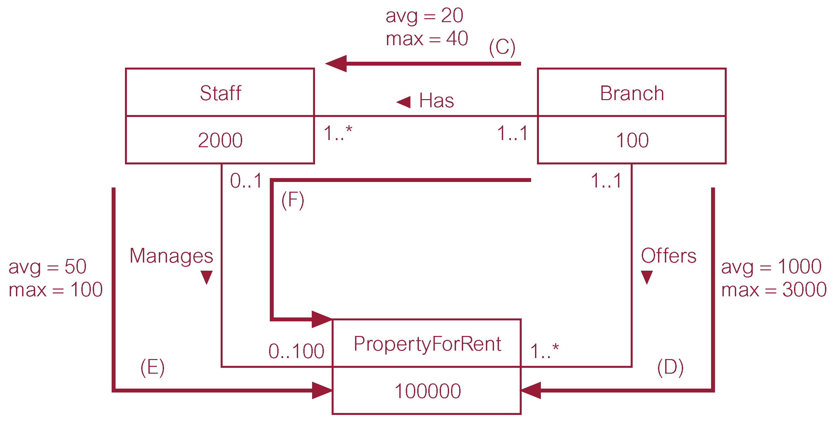
Transaction Usage Map

Slide 10
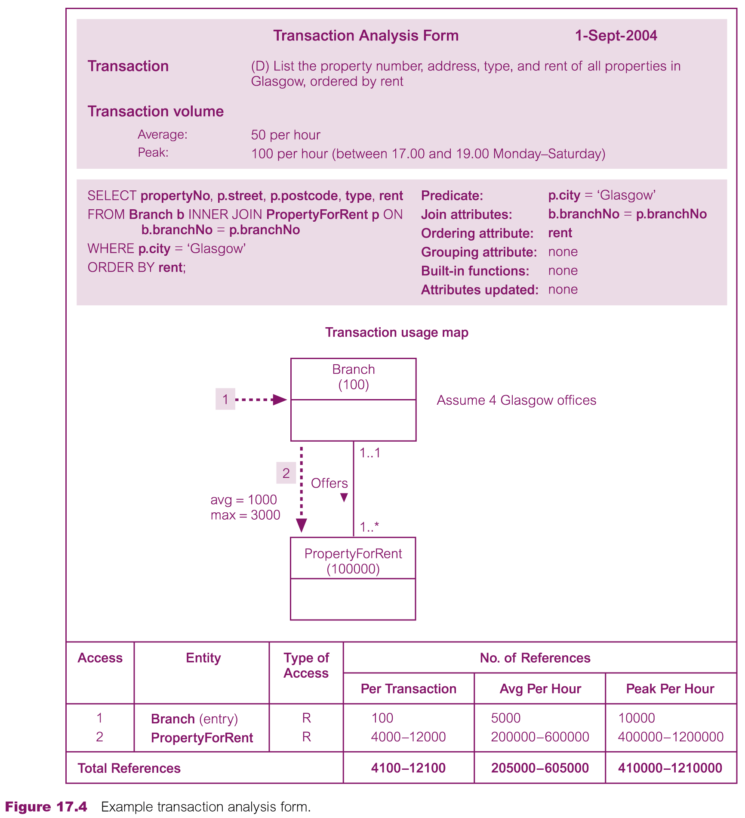
Transaction Analysis Form

Slide 11
Physical Database Design Methodology
Design ﬁle organizations and indexes
Choose ﬁle organizations
To determine an efficient file organization for each base relation
File organizations include Heap, Hash, Indexed Sequential Access Method (ISAM), B+-Tree, and Clusters
Some DBMSs may not allow selection of file organizations

Slide 12
Physical Database Design Methodology
Design ﬁle organizations and indexes
Choose indexes
To determine whether adding indexes will improve the performance of the system
Primary/Secondary/Clustering index
One approach is to keep tuples unordered and create as many secondary indexes as necessary
Another approach is to order tuples in the relation by specifying a primary or clustering index
For more details follow the guidelines

Slide 13
Physical Database Design Methodology
Design ﬁle organizations and indexes
Estimate disk space requirements
To estimate the amount of disk space that will be required by the database

Slide 14
Physical Database Design Methodology
Design user views
To design the user views that were identified during the ‘Requirements Collection and Analysis’ stage of the database system development lifecycle

Slide 15
Physical Database Design Methodology
Design security mechanisms
To design the security mechanisms for the database as speciﬁed by the users during the ‘Requirements Collection and Analysis’ stage of the database system development lifecycle
Depends upon the underlying DBMS
System security covers access and use of the database at the system level, such as a user name and password
Data security covers access and use of database objects (such as relations and views) and the actions that users can have on the objects e.g. GRANT/REVOKE etc.

Slide 16
Monitoring and Tuning the Operational System
Chapter 18

Slide 17
Physical Database Design Methodology
Consider the introduction of controlled redundancy
To determine whether introducing redundancy in a controlled manner by relaxing normalization rules will improve the performance of the system

Slide 18
Physical Database Design Methodology
Consider the introduction of controlled redundancy
Result of normalization is a design that is structurally consistent with minimal redundancy
However, sometimes a normalized database does not provide maximum processing efficiency
May be necessary to accept loss of some benefits of a fully normalized design in favor of performance

Slide 19
Physical Database Design Methodology
Consider the introduction of controlled redundancy
Also consider that denormalization:
Makes implementation more complex
Often sacrifices flexibility
May speed up retrievals but it slows down updates
Example of denormalization:
Branch (branchNo, street, city, postcode, mgrStaffNo) 2NF
Branch (branchNo, street, postcode, mgrStaffNo) 3NF
Postcode (postcode, city) 3NF

Slide 20
Physical Database Design Methodology
Consider denormalization in the following situations, speciﬁcally to speed up frequent or critical transactions:
Combining one-to-one (1:1) relationships
Duplicating non-key attributes in one-to-many (1:*) relationships to reduce joins
Duplicating foreign key attributes in one-to-many (1:*) relationships to reduce joins
Duplicating attributes in many-to-many (*:*) relationships to reduce joins
Introducing repeating groups
Creating extract tables
Partitioning relations

Slide 21
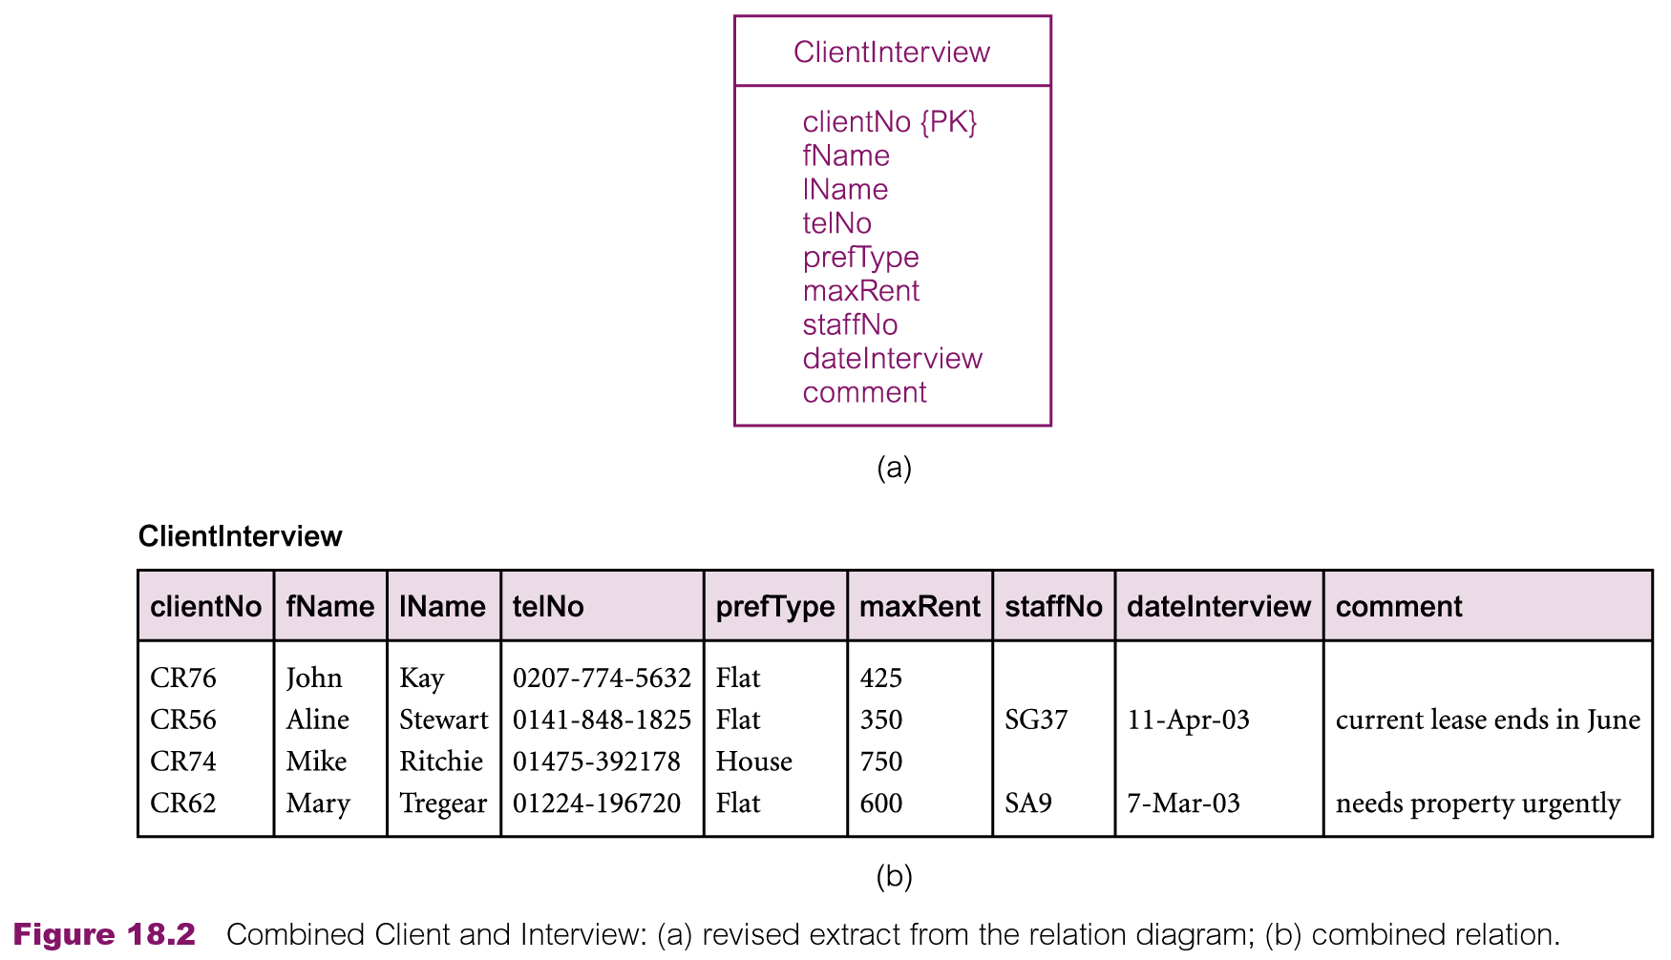
Physical Database Design Methodology
Combining one-to-one (1:1) relationships

Slide 22
Physical Database Design Methodology
Duplicating non-key attributes in one-to-many (1:*) relationships to reduce joins

Slide 23
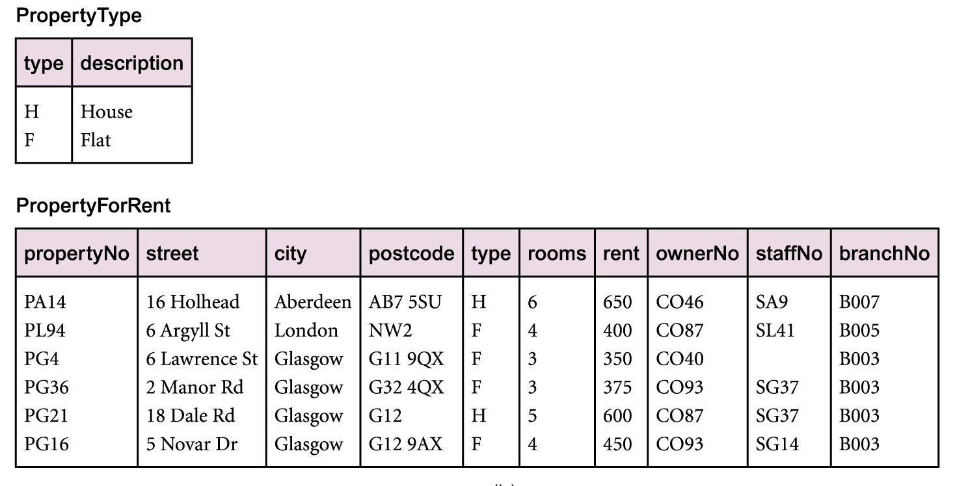
Physical Database Design Methodology
Duplicating non-key attributes in one-to-many (1:*) relationships to reduce joins (Lookup tables)

Slide 24
Physical Database Design Methodology
Duplicating non-key attributes in one-to-many (1:*) relationships to reduce joins (Lookup tables)

Slide 25
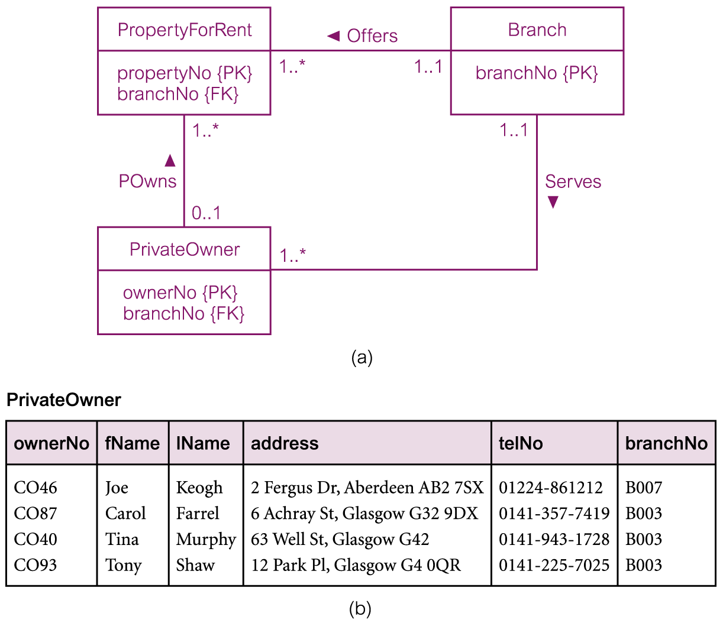
Physical Database Design Methodology
Duplicating foreign key attributes in one-to-many (1:*) relationships to reduce joins

Slide 26
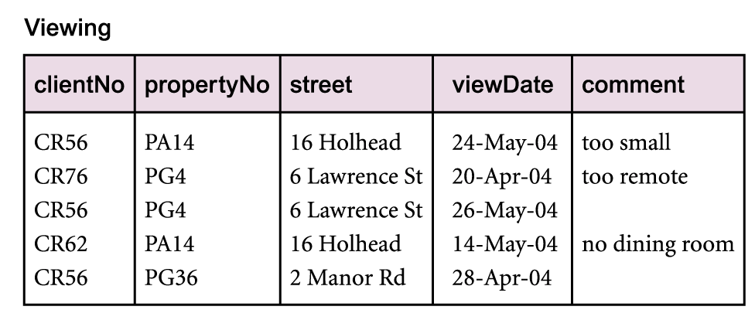
Physical Database Design Methodology
Duplicating attributes in many-to-many (*:*) relationships to reduce joins

Slide 27
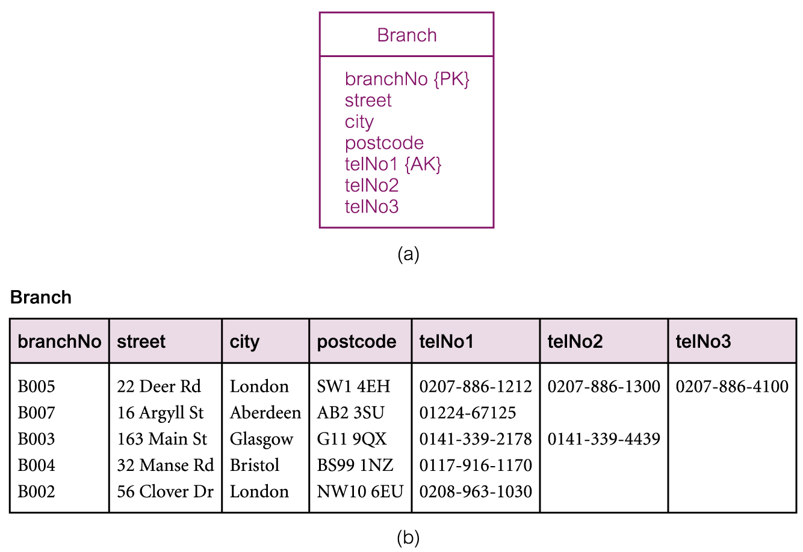
Physical Database Design Methodology
Introducing repeating groups

Slide 28
Physical Database Design Methodology
Creating extract tables
Reports can access derived data and perform multi-relation joins on same set of base relations
However, data the report is based on may be relatively static or may not have to be current
Possible to create a single, highly denormalized extract table based on relations required by reports, and allow users to access extract table directly instead of base relations

Slide 29
Physical Database Design Methodology
Partitioning relations
Rather than combining relations together, alternative approach is to decompose them into a number of smaller and more manageable partitions
Two main types of partitioning:
Horizontal Partitioning: Distributing the tuples of a relation across a number of (smaller) relations
Vertical Partitioning: Distributing the attributes of a relation across a number of (smaller) relations (the primary key is duplicated to allow the original relation to be reconstructed)
Other types include hash, range, list etc.

Slide 30
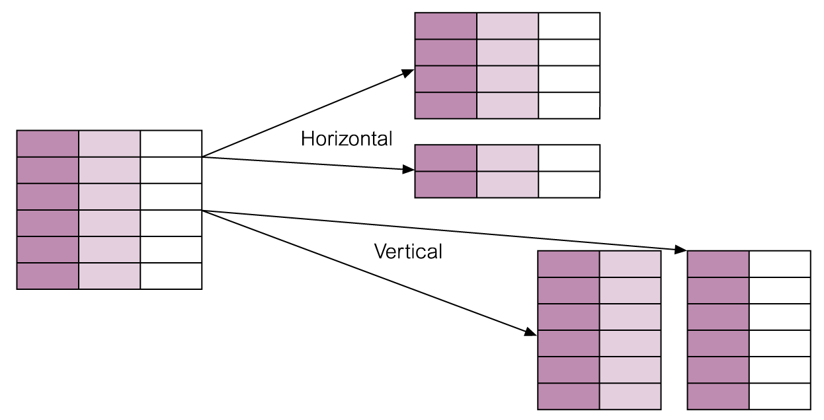
Physical Database Design Methodology
Partitioning relations

Slide 31
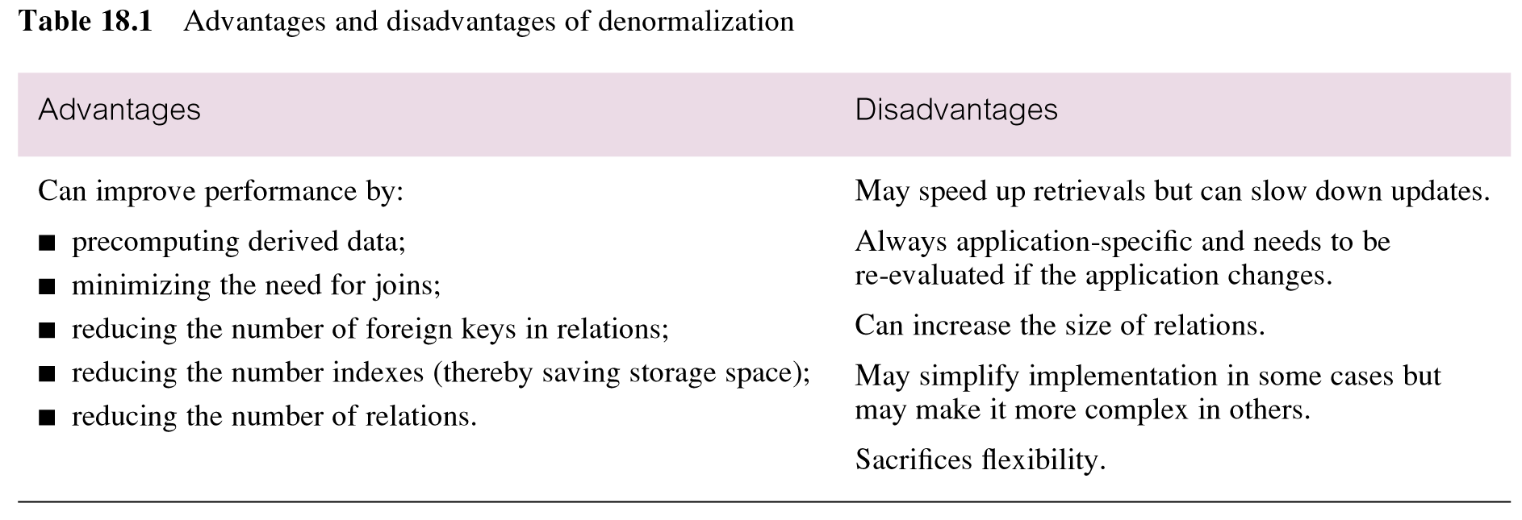
Physical Database Design Methodology

Slide 32
Physical Database Design Methodology
Monitor and tune the operational system
To monitor operational system and improve performance of system to correct inappropriate design decisions or reflect changing requirements

Slide 33
Physical Database Design Methodology
Monitor and tune the operational system
Number of factors may be used to measure efficiency:
Transaction Throughput: Number of transactions processed in given time interval
Response Time: Elapsed time for completion of a single transaction
Disk Storage: Amount of disk space required to store database files
No one factor is always correct
Need to understand how the various hardware components interact and affect database performance

Slide 34
Summary
Remaining steps/activities in
Physical database design methodology
Monitoring and performance tuning

Slide 35
References
All the material (slides, diagrams etc.) presented in this lecture is taken (with modifications) from the Pearson Education website :
http://www.booksites.net/connbegg

