Slide 1
CSC271 Database Systems
Lecture # 3

Slide 2
Database Environment
Chapter 2

Slide 3
Objectives of Three-Level Architecture
All users should be able to access same data but have a different customized view
A user’s view is immune to changes made in other views
Users should not need to know physical database storage details

Slide 4
Objectives of Three-Level Architecture..
DBA should be able to change database storage structures without affecting the users’ views
Internal structure of database should be unaffected by changes to physical aspects of storage
DBA should be able to change conceptual structure of database without affecting all users

Slide 5
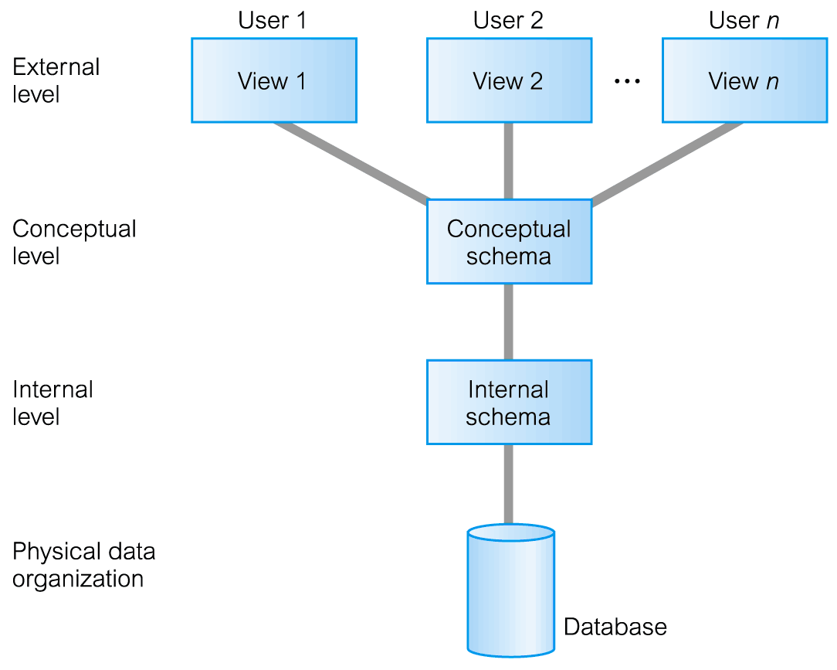
ANSI-SPARC Three-Level Architecture

Slide 6
ANSI-SPARC Three-Level Architecture..
External Level
  Users’ view of the database
  Describes that part of database that is relevant to a particular user
  Different views may have different representation of same data (e.g. different date formats, age derived from DOB etc.)

Slide 7
ANSI-SPARC Three-Level Architecture..
Conceptual Level
  Community view of the database
  Describes what data is stored in database and relationships among the data
  Along with any constraints on data
  Independent of any storage considerations

Slide 8
ANSI-SPARC Three-Level Architecture..
Internal Level
  Physical representation of the database on the computer
  Describes how the data is stored in the database
  physical implementation of the database to achieve optimal runtime performance and storage space utilization
  Data structures and ﬁle organizations used to store data on storage devices
  Interfaces with the operating system access methods to place the data on the storage devices, build the indexes, retrieve the data, and so on

Slide 9
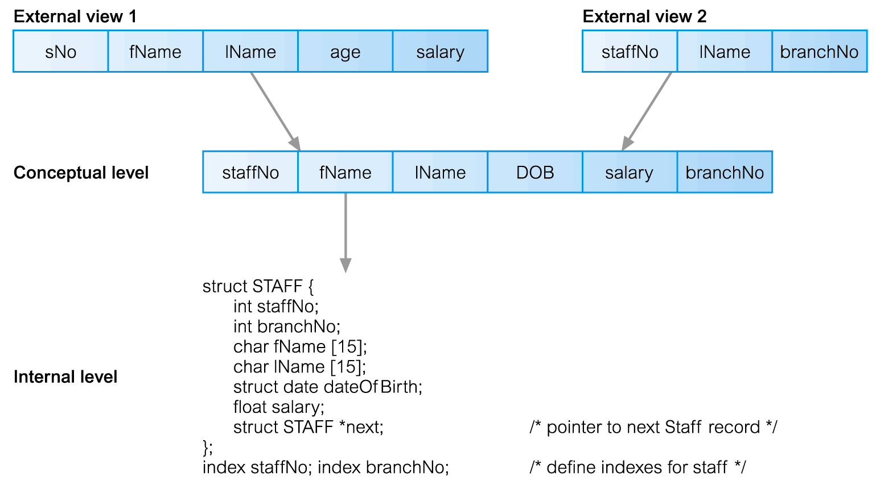
Differences between Three Levels of ANSI-SPARC Architecture

Slide 10
Schemas
External Schemas
  Also called subschemas
  Multiple schemas per database
  Corresponds to different views of data
Conceptual Schema
  Describes all the entities, attributes, and relationships together with integrity constraints
  Only one schema per database

Slide 11
Schemas..
Internal Schema
  A complete description of the internal model, containing the deﬁnitions of stored records, the methods of representation, the data ﬁelds, and the indexes and storage structures used
  Only one schema per database

Slide 12
Mappings
The DBMS is responsible for mapping between these three types of schema:
  The DBMS must check that each external schema is derivable from the conceptual schema, and it must use the information in the conceptual schema to map between each external schema and the internal schema
Types of mappings
  Conceptual/Internal mapping
  External/Conceptual mapping

Slide 13
Conceptual/Internal Mapping
Enables the DBMS to
  Find the actual record or combination of records in physical storage that constitute a logical record in the conceptual schema,
  Together with any constraints to be enforced on the operations for that logical record
  It also allows any differences in entity names, attribute names, attribute order, data types, and so on, to be resolved

Slide 14
External/Conceptual Mapping
Enables the DBMS to
  Map names in the user’s view on to the relevant part of the conceptual schema

Slide 15
Instances
Database Schema
  Description of database (also called intension)
  Specified during design phase
  Remain almost static
Database Instance
  Data in the database at any particular point in time
  Dynamic (changes with the time)
  Also called an extension (or state) of database

Slide 16
Data Independence
Logical Data Independence
  Refers to immunity of external schemas to changes in conceptual schema
  Conceptual schema changes (e.g. addition/removal of entities)
  Should not require changes to external schema or rewrites of application programs

Slide 17
Data Independence
Physical Data Independence
  Refers to immunity of conceptual schema to changes in the internal schema
  Internal schema changes (e.g. using different file organizations, storage structures, storage devices etc.)
  Should not require change to conceptual or external schemas

Slide 18
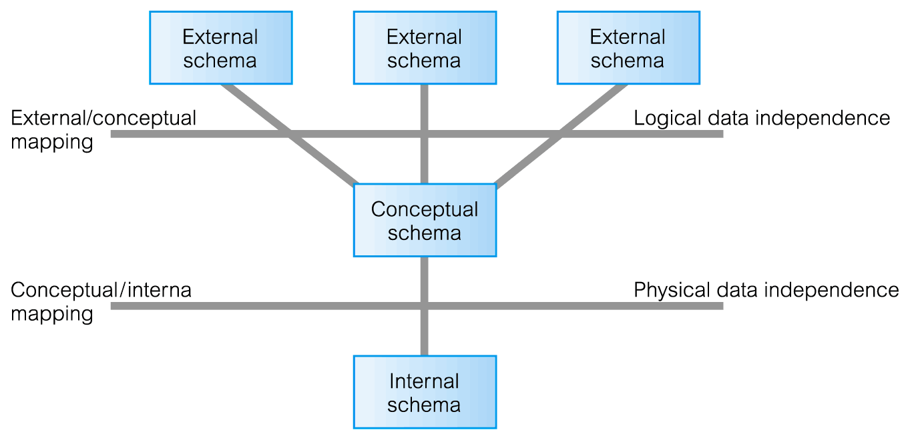
Data Independence and the ANSI-SPARC Three-Level Architecture

Slide 19
Summary
Components of the DBMS environment
Roles in the DB environment
History of DBMS
Advantages/Disadvantages of DBMSs
ANSI-SPARC three-level architecture
Schemas, mappings, and instances
Data independence

