Slide 1
CSC271 Database Systems
Lecture # 29

Slide 2
Summary: Previous Lecture
The normalization process
1NF, 2NF, 3NF
Inference rules for FDs
BCNF

Slide 3
Summary: Normalization
First normal form (1NF)
A relation in which the intersection of each row and column contains one and only one value
Second normal form (2NF)
A relation that is in 1NF and every non-PK attribute is fully functionally dependent on the primary key (CKs)
Third normal form (3NF)
A relation that is in 1NF and 2NF and in which no non-primary-key attribute is transitively dependent on the primary key (CKs)
Boyce–Codd normal form (BCNF)
A relation is in BCNF if and only if every determinant is a candidate key

Slide 4
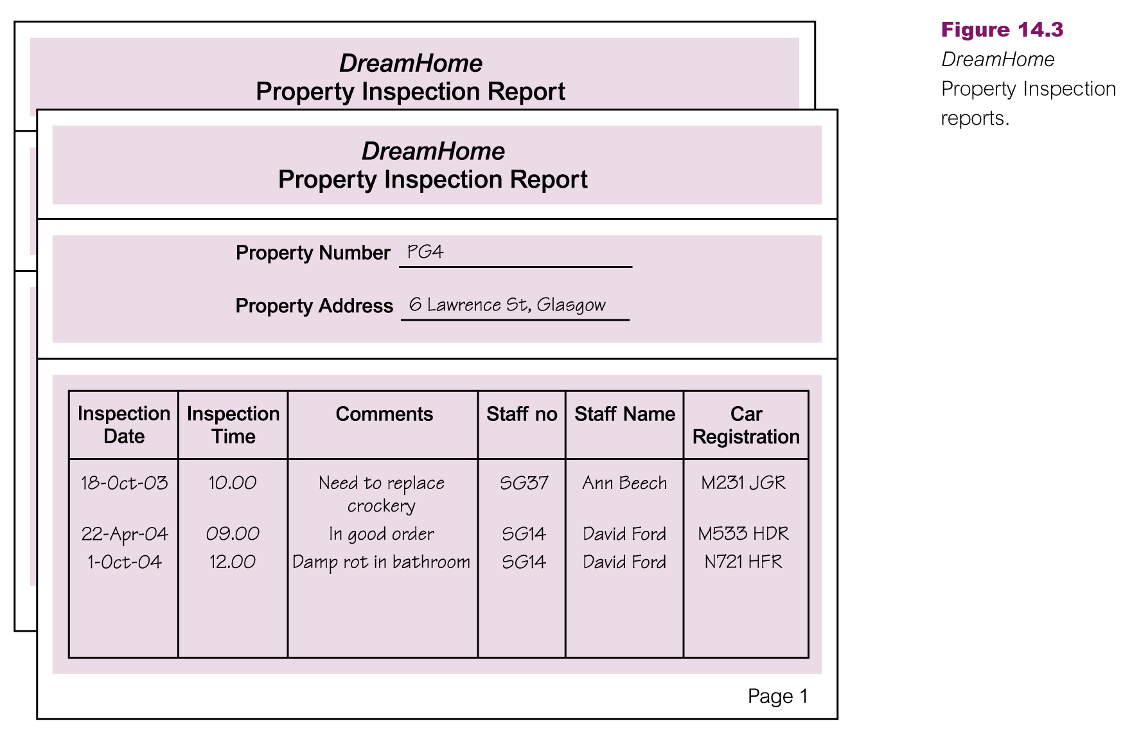
Example: Normalization

Slide 5
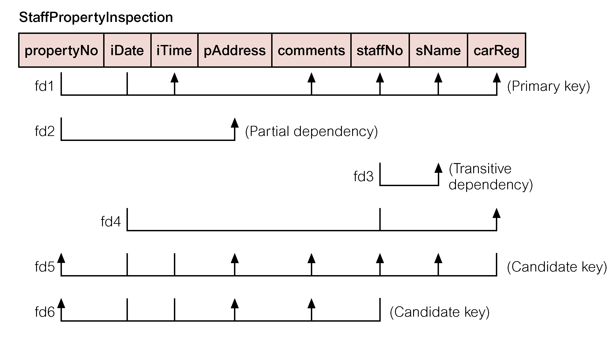
Example: Normalization
FDs

Slide 6
Example: Normalization
fd1 propertyNo, iDate → iTime, comments, staffNo, sName, carReg (Primary key)
fd2 propertyNo→ pAddress (Partial dependency)
fd3 staffNo→ sName (Transitive dependency)
fd4 staffNo, iDate→ carReg
fd5 carReg, iDate, iTime→ propertyNo, pAddress, comments, staffNo, sName (Candidate key)
fd6 staffNo, iDate, iTime→ propertyNo, pAddress, comments (Candidate key)

Slide 7
Example: Normalization
INF to 2NF
Property (propertyNo, pAddress)
PropertyInspection (propertyNo, iDate, iTime, comments, staffNo, sName, carReg)

Slide 8
Example: Normalization
Property
fd2 propertyNo → pAddress
PropertyInspection
fd1 propertyNo, iDate → iTime, comments, staffNo, sName, carReg
fd3 staffNo → sName
fd4 staffNo, iDate → carReg
fd5′ carReg, iDate, iTime → propertyNo, comments, staffNo, sName
fd6′ staffNo, iDate, iTime → propertyNo, comments

Slide 9
Example: Normalization
2NF to 3NF
Property (propertyNo, pAddress)
Staff (staffNo, sName)
PropertyInspect (propertyNo, iDate, iTime, comments, staffNo, carReg)

Slide 10
Example: Normalization
Property
fd2 propertyNo → pAddress
Staff
fd3 staffNo → sName
PropertyInspect
fd1′ propertyNo, iDate → iTime, comments, staffNo, carReg
fd4 staffNo, iDate → carReg
fd5′ carReg, iDate, iTime → propertyNo, comments, staffNo
fd6′ staffNo, iDate, iTime → propertyNo, comments

Slide 11
Example: Normalization
3NF to BCNF
Property (propertyNo, pAddress)
Staff (staffNo, sName)
Inspection (propertyNo, iDate, iTime, comments, staffNo)
StaffCar (staffNo, iDate, carReg)

Slide 12
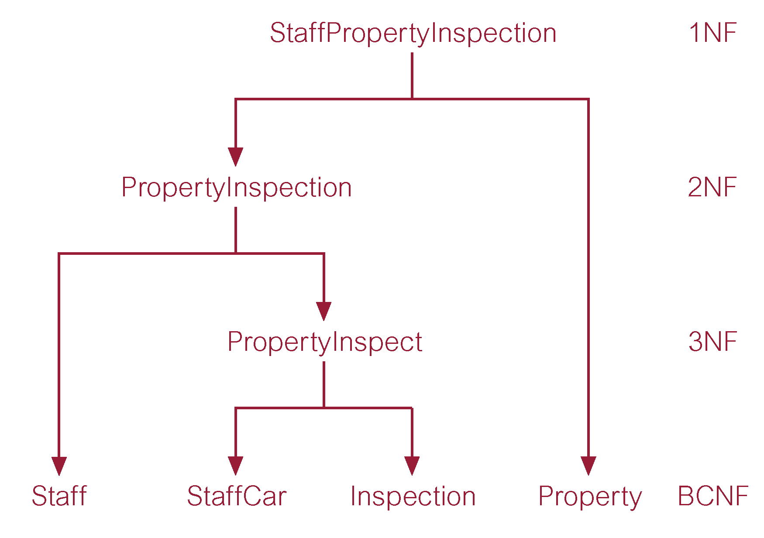
Example: Normalization

Slide 13
Building Logical Data Model
Activities included in building logical data model are:
Derive relations for logical data model
Validate relations using normalization
Validate relations against user transactions
Check integrity constraints
Review logical data model with user
Merge logical data models into global model (optional)
Check for future growth

Slide 14
Validate Relations Using Normalization
The logical design may not be the ﬁnal design, the physical design may be different due to speciﬁc performance requirements
A normalized design is robust and free of the update anomalies
Modern computers are powerful (processing overhead acceptable for normalized design)
Normalization produces a ﬂexible/scalable database design

Slide 15
Validate Relations Against User Transactions
To ensure that the relations in the logical data model support the required transactions

Slide 16
Check Integrity Constraints
To check integrity constraints are represented in the logical data model. This includes identifying:
Required data
Attribute domain constraints
Multiplicity
Entity integrity
Referential integrity
General constraints

Slide 17
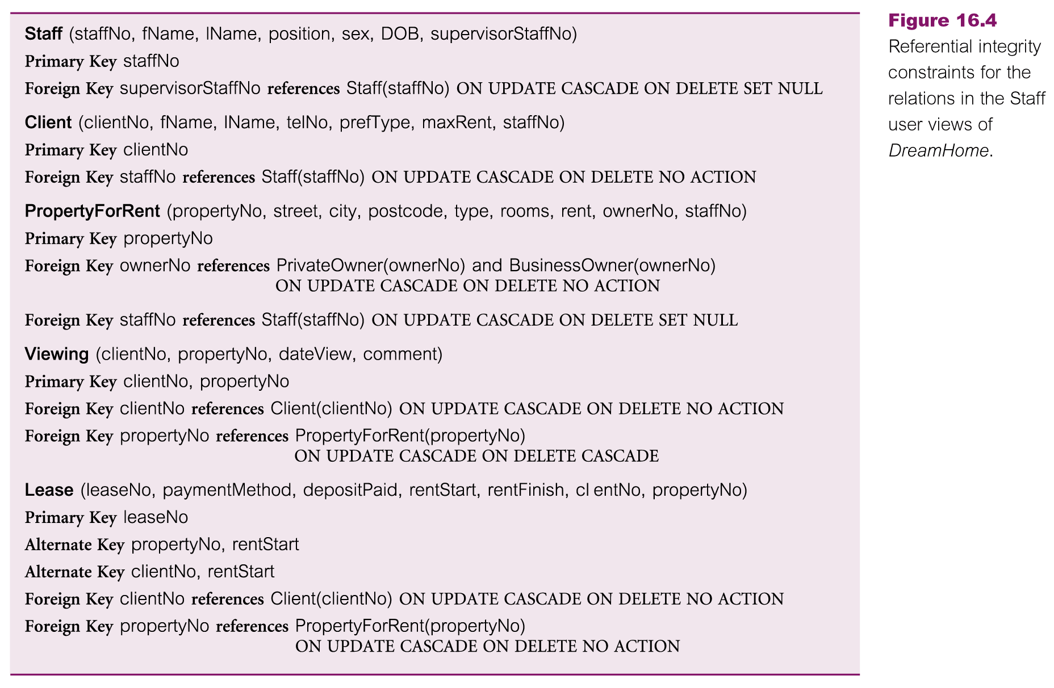
Check Integrity Constraints

Slide 18
Review Logical DM With User
To review the logical data model with the users to ensure that they consider the model to be a true representation of the data requirements of the enterprise
Use logical data modeling and data flow diagrams to model the users’ requirements specification in an effective manner

Slide 19
Merge LDM into GLDM
To merge logical data models into a single global logical data model that represents all user views of a database
Database with multiple user views
This step might include:
Merge local logical data models into global model
Validate global logical data model
Review global logical data model with users

Slide 20
Merge LDM into GLDM
Merge local logical data models into global model
Review the names and contents of entities/relations and their CKs
Review the names and contents of relationships/foreign keys
Merge entities/relations from the local data models
Include (without merging) entities/relations unique to each LDM
Merge relationships/foreign keys from the local data models
Include (without merging) relationships/foreign keys unique to each LDM
Check for missing entities/relations and relationships/foreign keys
Check foreign keys
Check integrity constraints
Draw the global ER/relation diagram
Update the documentation

Slide 21
Merge LDM into GLDM
Validate global logical data model
To validate the relations created from the global logical data model using the technique of normalization and to ensure they support the required transactions, if necessary
Review global logical data model with users
To review the global logical data model with the users to ensure that they consider the model to be a true representation of the data requirements of an enterprise

Slide 22
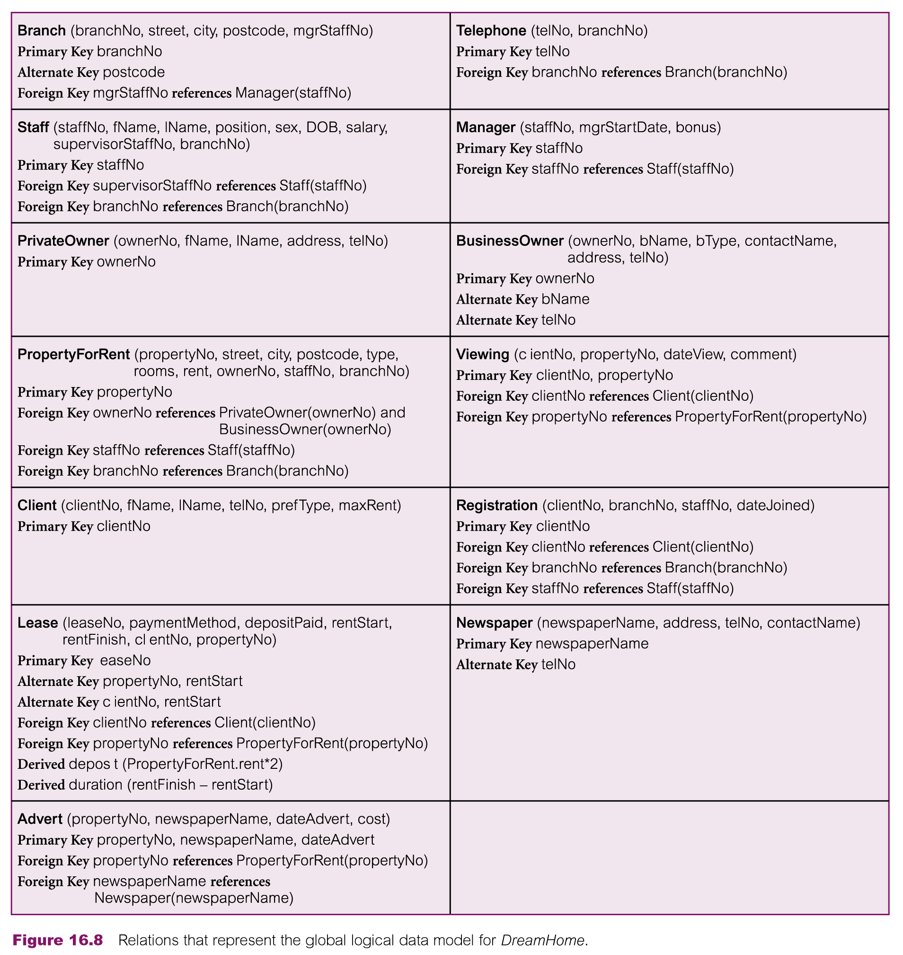
Relations in GLDM

Slide 23
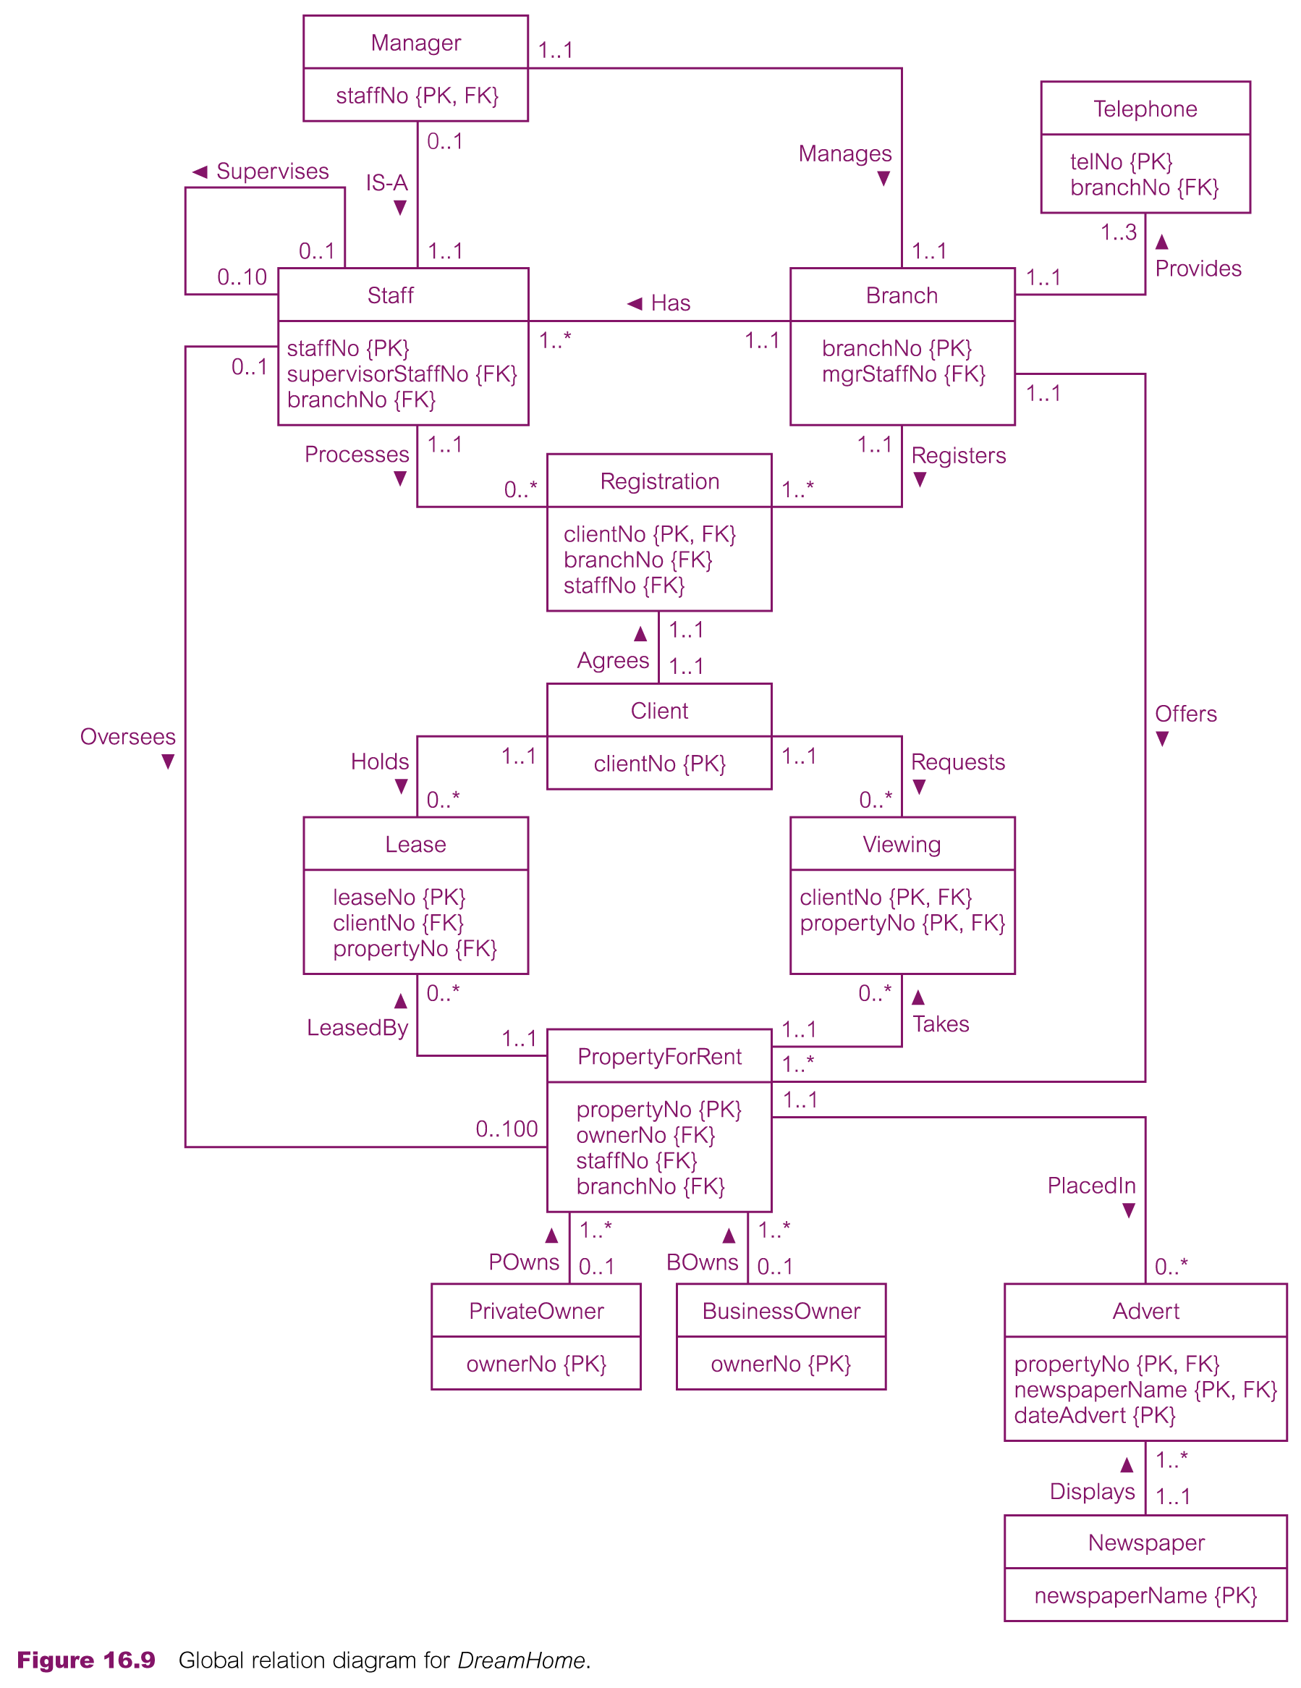
ER Diagram of GLDM

Slide 24
Check for Future Growth
Check for scalability/extensibility
Life is short if the model can sustain current requirements only, signiﬁcant reworking may be necessary to accommodate new requirements
Quite difﬁcult to achieve, as the enterprise may not know its future plans, even this is not the case, it may be prohibitively expensive both in time/money
However, it is not necessary to incorporate any changes into the data model unless requested by the user

Slide 25
Physical Database Design for Relational Databases
Chapter 17

Slide 26
Logical Vs. Physical Database Design
Sources of information for physical design process includes logical data model and documentation that describes model
Logical database design is concerned with the what, physical database design is concerned with the how

Slide 27
Physical Database Design
Process of producing a description of the implementation of the database on secondary storage
It describes the base relations, file organizations, and indexes used to achieve efficient access to the data, and any associated integrity constraints and security measures

Slide 28
Physical Database Design
Objective of physical database design
Store and access data in an efficient way

Slide 29
Physical Database Design Methodology
Translate logical data model for target DBMS
Design base relations
Design representation of derived data
Design general constraints
Design ﬁle organizations and indexes
Analyze transactions
Choose ﬁle organizations
Choose indexes
Estimate disk space requirements
Design user views
Design security mechanisms
Consider the introduction of controlled redundancy
Monitor and tune the operational system

Slide 30
Physical Database Design Methodology
Translate logical data model for target DBMS
Design base relations
To decide how to represent base relations identified in logical model in target DBMS
Design representation of derived data
To decide how to represent any derived data present in logical data model in target DBMS
Stored vs. calculated each time
Design general constraints
DBMS vs. general constraints

Slide 31
Summary
Normalization summary/example
Remaining steps/activities in building logical data model
Physical database design
Translate logical data model for target DBMS

Slide 32
References
All the material (slides, diagrams etc.) presented in this lecture is taken (with modifications) from the Pearson Education website :
http://www.booksites.net/connbegg

