Slide 1
CSC271 Database Systems
Lecture # 28

Slide 2
Summary: Previous Lecture
Purpose of normalization
Data redundancy and update anomalies
Functional Dependencies
Partial, full, transitive
Identifying functional dependencies
Identifying primary keys using functional dependencies

Slide 3
The Process of Normalization
Normalization is a formal technique for analyzing relations based on their PK (or CKs) and functional dependencies
The technique involves a series of rules that can be used to test individual relations so that a database can be normalized to any degree
When a requirement is not met, the relation violating the requirement must be decomposed into relations that individually meet the requirements of normalization
Types of normal forms are 1NF, 2NF, 3NF, BCNF, 4NF, 5NF
All normal forms are based on FDs except 1NF
Normal forms 4NF, 5NF deal with the situations that are very rare

Slide 4
The Process of Normalization
Normalization is often executed as a series of steps, each step corresponds to a speciﬁc normal form that has known properties
As normalization proceeds, the relations become progressively more restricted (stronger) in format and also less vulnerable to update anomalies
For the relational data model, it is important to recognize that it is only First Normal Form (1NF) that is critical in creating relations; all subsequent normal forms are optional
However, to avoid the update anomalies, it is generally recommended that we proceed to at least Third Normal Form (3NF)

Slide 5
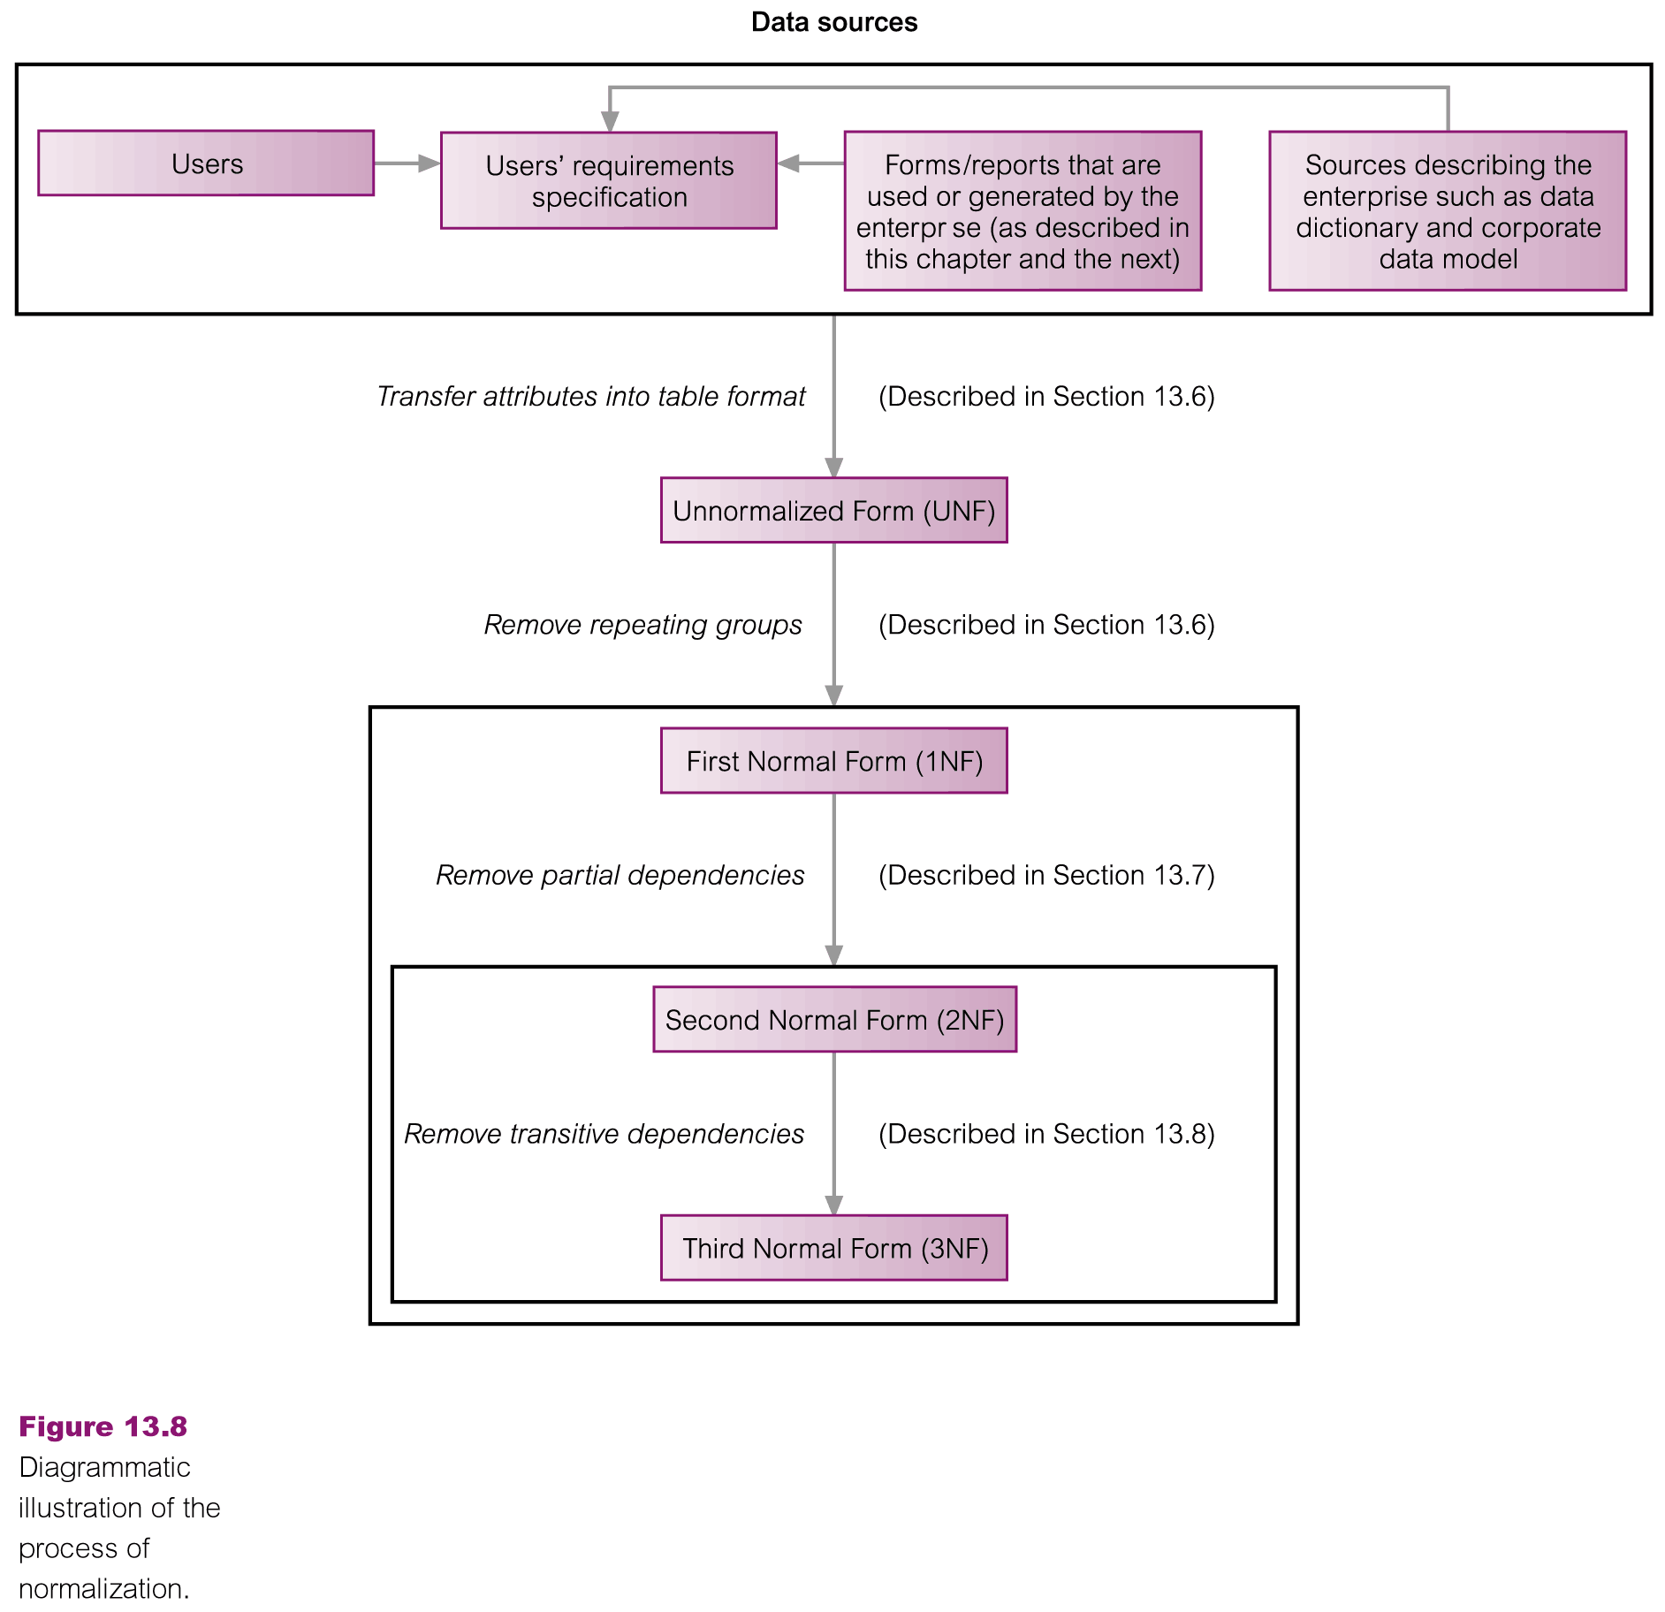
The Process of Normalization

Slide 6
Unnormalized Form (UNF)
A table that contains one or more repeating groups
To create an unnormalized table
Transform the data from the information source (e.g. form) into table format with columns and rows

Slide 7
Lease Forms: DreamHome

Slide 8
Transformation into UNF Table

Slide 9
First Normal Form (1NF)
A relation in which the intersection of each row and column contains one and only one value

Slide 10
UNF to 1NF
Nominate an attribute or group of attributes to act as the key for the unnormalized table
Identify the repeating group(s) in the unnormalized table which repeats for the key attribute(s)

Slide 11
UNF to 1NF
Remove the repeating groups by
Entering appropriate data into the empty columns of rows containing the repeating data (‘flattening’ the table)
By Placing the repeating data along with a copy of the original key attribute(s) into a separate relation

Slide 12
UNF to 1NF
For both approaches, the resulting tables are now referred to as 1NF relations containing atomic (or single) values at the intersection of each row and column
Although both approaches are correct, approach 1 introduces more redundancy into the original UNF table as part of the ‘ﬂattening’ process, whereas approach 2 creates two or more relations with less redundancy than in the original UNF table

Slide 13
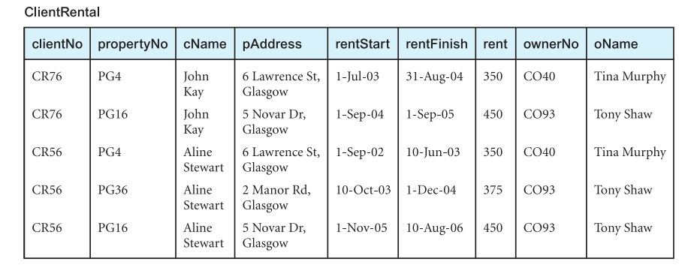
Approach 1 (1NF)

Slide 14
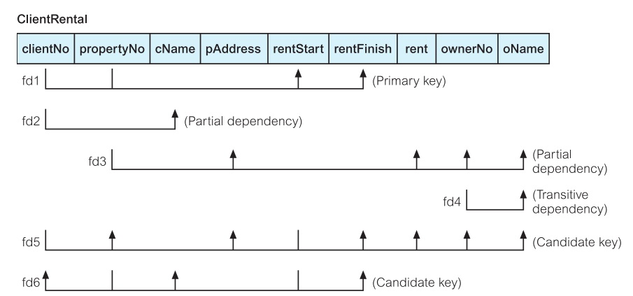
FDs of ClientRental Relation

Slide 15
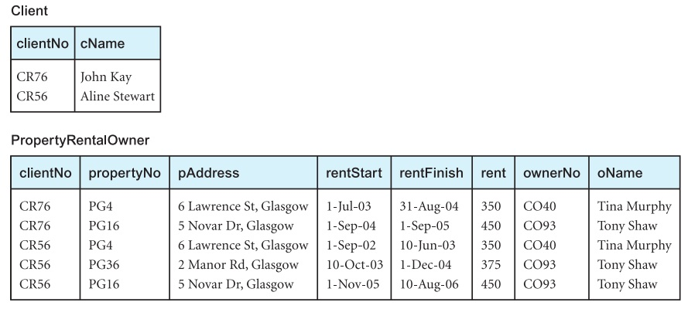
Approach 2 (1NF)

Slide 16
Second Normal Form (2NF)
2NF is based on the concept of full FD
2NF applies to relations with composite keys, means a relation with a simple PK is automatically in at least 2NF
A relation that is not in 2NF may suffer from the update anomalies e.g. change the rent of property number PG4 etc.

Slide 17
Second Normal Form (2NF)
A relation that is in 1NF and every non-PK attribute is fully functionally dependent on the primary key
The normalization of 1NF relations to 2NF involves the removal of partial dependencies
If a partial dependency exists, we remove the partially dependent attribute(s) from the relation by placing them in a new relation along with a copy of their determinant

Slide 18
FDs of ClientRental Relation
fd1 clientNo, propertyNo→ rentStart, rentFinish (PK)
fd2 clientNo→ cName (Partial dependency)
fd3 propertyNo→ pAddress, rent, ownerNo, oName (Partial dependency)
fd4 ownerNo→ oName (Transitive dependency)
fd5 clientNo, rentStart→ propertyNo, pAddress, rentFinish, rent, ownerNo, oName (Candidate key)
fd6 propertyNo, rentStart→ clientNo, cName, rentFinish (Candidate key)

Slide 19
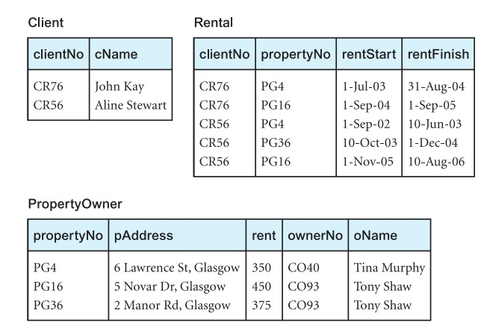
1NF to 2NF
By removing partial functional dependencies

Slide 20
Third Normal Form (3NF)
Although 2NF relations have less redundancy than those in 1NF, they may still suffer from update anomalies e.g. if we want to update the name of an owner, such as Tony Shaw (ownerNo CO93) etc.

Slide 21
Third Normal Form (3NF)
A relation that is in 1NF and 2NF and in which no non-primary-key attribute is transitively dependent on the primary key
The normalization of 2NF relations to 3NF involves the removal of transitive dependencies
If a transitive dependency exists, we remove the transitively dependent attribute(s) from the relation by placing the attribute(s) in a new relation along with a copy of the determinant

Slide 22
FDs of 2NF Relations
Client
fd2 clientNo → cName (Primary key)
Rental
fd1 clientNo, propertyNo → rentStart, rentFinish (PK)
fd5′ clientNo, rentStart → propertyNo, rentFinish (CK)
fd6′ propertyNo, rentStart → clientNo, rentFinish (CK)
PropertyOwner
fd3 propertyNo → pAddress, rent, ownerNo, oName (PK)
fd4 ownerNo → oName (Transitive dependency)

Slide 23
2NF to 3NF
By removing transitive dependency

Slide 24
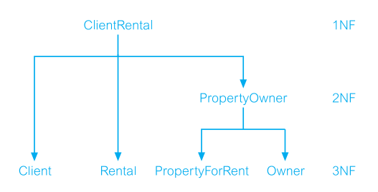
Decomposition
The decomposition of ClientRental 1NF relation into 3NF relations

Slide 25
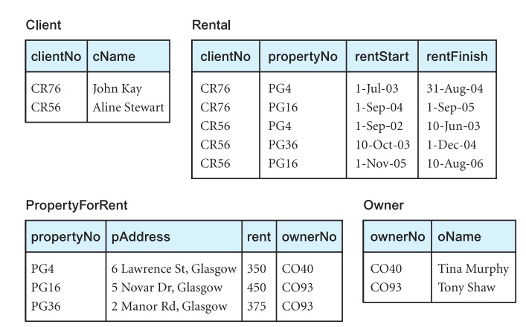
3NF Relations

Slide 26
General Definitions of 2NF and 3NF
Second normal form (2NF)
A relation that is in first normal form and every non-primary-key attribute is fully functionally dependent on any candidate key
Third normal form (3NF)
A relation that is in first and second normal form and in which no non-primary-key attribute is transitively dependent on any candidate key

Slide 27
Using General Def. of 2NF and 3NF
When using the general deﬁnitions of 2NF and 3NF
Look for partial and transitive dependencies on all candidate keys and not just the primary key
Makes the process of normalization more complex
However, the general deﬁnitions place additional constraints on the relations and may identify hidden redundancy in relations that could be missed

Slide 28
Using General Def. of 2NF and 3NF
The tradeoff between
Keeping the process of normalization simpler
Increase the opportunity to identify missed redundancy
In fact, it is often the case that whether we use the deﬁnitions based on primary keys or the general deﬁnitions of 2NF and 3NF, the decomposition of relations is the same
For verification apply general definitions of 2NF and 3NF to ClientRental relation

Slide 29
Advanced Normalization
Chapter 14

Slide 30
Inference Rules for FDs
The complete set of functional dependencies for a given relation can be very large
Important to find an approach that can reduce the set to a manageable size
Need to identify a set of functional dependencies (represented as X) for a relation that is smaller than the complete set of functional dependencies (represented as Y) for that relation and has the property that every functional dependency in Y is implied by the functional dependencies in X

Slide 31
Inference Rules for FDs
The set of all functional dependencies that are implied by a given set of functional dependencies X is called the closure of X, written X+
A set of inference rules, called Armstrong’s axioms, specifies how new functional dependencies can be inferred from given ones

Slide 32
Inference Rules for FDs
Let A, B, and C be subsets of the attributes of the relation R. Armstrong’s axioms are as follows:
Reflexivity
If B is a subset of A, then A → B
Augmentation
If A → B, then A,C → B,C
Transitivity
If A → B and B → C, then A → C

Slide 33
Inference Rules for FDs
Further rules can be derived from the first three rules that simplify the practical task of computing X+. Let D be another subset of the attributes of relation R, then:
Self-determination
A → A
Decomposition
If A → B,C, then A → B and A → C
Union
If A → B and A → C, then A → B,C
Composition
If A → B and C → D then A,C → B,D

Slide 34
Boyce–Codd Normal Form (BCNF)
BCNF is based on functional dependencies that take into account all candidate keys in a relation, however BCNF also has additional constraints compared with the general definition of 3NF
Boyce–Codd normal form (BCNF)
A relation is in BCNF if and only if every determinant is a candidate key

Slide 35
Boyce–Codd Normal Form (BCNF)
Difference between 3NF and BCNF is that for a functional dependency A → B,
3NF allows this dependency in a relation if B is a primary-key attribute and A is not a candidate key
Whereas, BCNF insists that for this dependency to remain in a relation, A must be a candidate key
Every relation in BCNF is also in 3NF
However, a relation in 3NF is not necessarily in BCNF

Slide 36
Boyce–Codd Normal Form (BCNF)
Violation of BCNF is quite rare
The potential to violate BCNF may occur in a relation that:
Contains two (or more) composite candidate keys
The candidate keys overlap, that is have at least one attribute in common

Slide 37
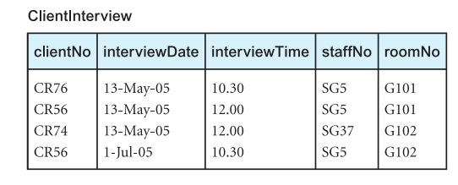
Example: (BCNF)
fd1 clientNo, interviewDate → interviewTime, staffNo, roomNo (PK)
fd2 staffNo, interviewDate, interviewTime → clientNo (CK)
fd3 roomNo, interviewDate, interviewTime → staffNo, clientNo (CK)
fd4 staffNo, interviewDate → roomNo

Slide 38
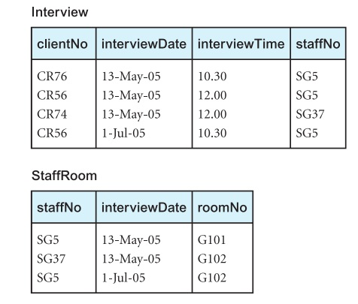
Example: (BCNF)

Slide 39
3NF or BCNF
May not always be desirable to transform a relation into BCNF e.g. if there is a FD that is not preserved when we perform the decomposition (i.e. the determinant and the attributes it determines are placed in different relations)
Loss of fd3 when ClientInterview relation was transformed to BCNF
Decision about to stop at 3NF or progress to BCNF is dependent on the amount of redundancy resulting from the presence of fd4 and the signiﬁcance of the ‘loss’ of fd3

Slide 40
Higher Normal Forms
4NF
A relation that is in Boyce-Codd Normal Form and contains no nontrivial multi-valued dependencies
5NF
A relation that has no join dependency

Slide 41
Summary
The normalization process
1NF, 2NF, 3NF
Inference rules for FDs
BCNF

Slide 42
References
All the material (slides, diagrams etc.) presented in this lecture is taken (with modifications) from the Pearson Education website :
http://www.booksites.net/connbegg

