Slide 1
CSC271 Database Systems
Lecture # 25

Slide 2
Summary: Previous Lecture
Structural constraints
Multiplicity
Cardinality
Participation
Connection traps
Fan traps
Chasm traps

Slide 3
Enhanced Entity-Relationship Modeling
Chapter 12

Slide 4
Enhanced Entity-Relationship Model
Since 1980s there has been an increase in emergence of new database applications with more demanding requirements
Basic concepts of ER modeling are not sufficient to represent requirements of newer, more complex applications
Response is development of additional ‘semantic’ modeling concepts

Slide 5
Enhanced Entity-Relationship Model..
The ER model supported with additional semantic concepts is called the Enhanced Entity–Relationship (EER) model
Examples of additional concepts of the EER model, namely specialization/generalization, aggregation, and composition

Slide 6
Specialization/Generalization
Superclass
An entity type that includes one or more distinct subgroupings of its occurrences, which require to be represented in a data model
Subclass
A distinct subgrouping of occurrences of an entity type, which require to be represented in a data model
For example, the Staff superclass may have subclasses as Manager, SalesPersonnel, and Secretary etc.

Slide 7
Specialization/Generalization..
Each member of a subclass is also a member of the superclass
In other words, the entity in the subclass is the same entity in the superclass, but has a distinct role e.g. Manager/Supervisor is also a Staff etc.
The relationship between a superclass and a subclass is one-to-one (1:1) and is called a superclass/subclass relationship

Slide 8
Specialization/Generalization..
Some superclasses may contain overlapping subclasses, e.g. a member of staff who is both a Manager and a member of Sales Personnel
Not every member of a superclass need be a member of a subclass, e.g. members of staff without a distinct job role such as a Manager or a member of Sales Personnel

Slide 9
Specialization/Generalization..
Superclasses and subclasses are used to avoid describing different types of staff with possibly different attributes within a single entity
For example, Sales Personnel may have special attributes such as salesArea and carAllowance
By using a single entity will result in a lot of nulls
Similarly some relationships are only associated with particular types of staff (subclasses), e.g. SalesPersonnel Uses Car etc.

Slide 10
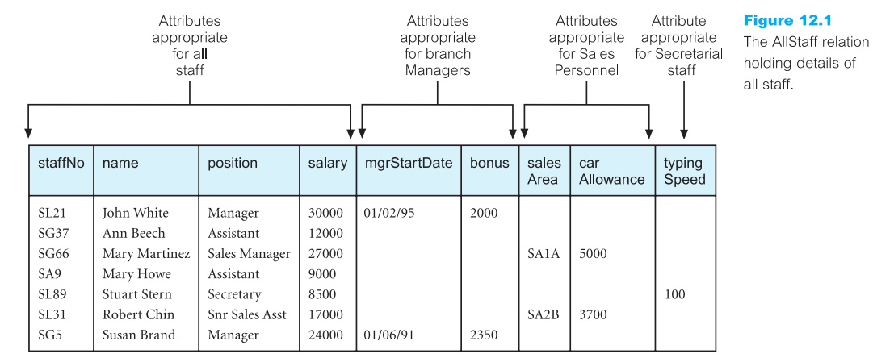
Specialization/Generalization..

Slide 11
Specialization/Generalization..
There are two important reasons for introducing the concepts of superclasses and subclasses into an ER model
Firstly, it avoids describing similar concepts more than once, thereby saving time for the designer and making the ER diagram more readable
Secondly, it adds more semantic information to the design in a form that is familiar to many people e.g. the assertions that ‘Manager IS-A member of staff’ and ‘ﬂat IS-A type of property’, communicates signiﬁcant semantic content in a concise form

Slide 12
Specialization/Generalization..
There are two important reasons for introducing the concepts of superclasses and subclasses into an ER model
Firstly, it avoids describing similar concepts more than once, thereby saving time for the designer and making the ER diagram more readable
Secondly, it adds more semantic information to the design in a form that is familiar to many people e.g. the assertions that ‘Manager IS-A member of staff’ and ‘ﬂat IS-A type of property’, communicates signiﬁcant semantic content in a concise form

Slide 13
Specialization/Generalization..
Attribute Inheritance
An entity in a subclass represents the same ‘real world’ object as in the superclass, and may possess subclass-speciﬁc attributes, as well as those associated with the superclass
A subclass is an entity in its own right and so it may also have one or more subclasses

Slide 14
Specialization/Generalization..
Attribute Inheritance
An entity and its subclasses and their subclasses, and so on, is called a type hierarchy
Type hierarchies are known by a variety of names including:
Specialization hierarchy
Generalization hierarchy
IS-A hierarchy
A subclass with more than one superclass is called a shared subclass (multiple inheritance)

Slide 15
Specialization/Generalization..
Specialization
The process of maximizing differences between members of an entity by identifying their distinguishing characteristics
Specialization is a top-down approach to deﬁning a set of superclasses and their related subclasses
The set of subclasses is deﬁned on the basis of some distinguishing characteristics of the entities in the superclass

Slide 16
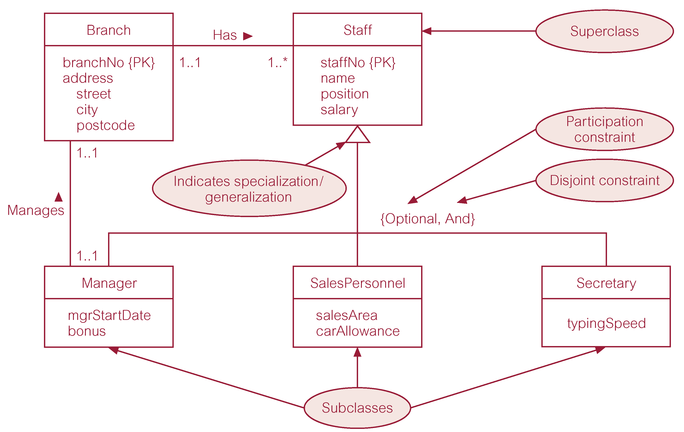
Specialization/Generalization..

Slide 17
Diagrammatic Representation
The subclasses are attached by lines to a triangle that points toward the superclass
The label below the specialization/generalization triangle, shown as {Optional, And}, describes the constraints on the relationship between the superclass and its subclasses
Attributes that are speciﬁc to a given subclass are listed in the lower section of the rectangle representing that subclass
Attributes that are common to all subclasses are listed in the lower section of the rectangle representing the superclass

Slide 18
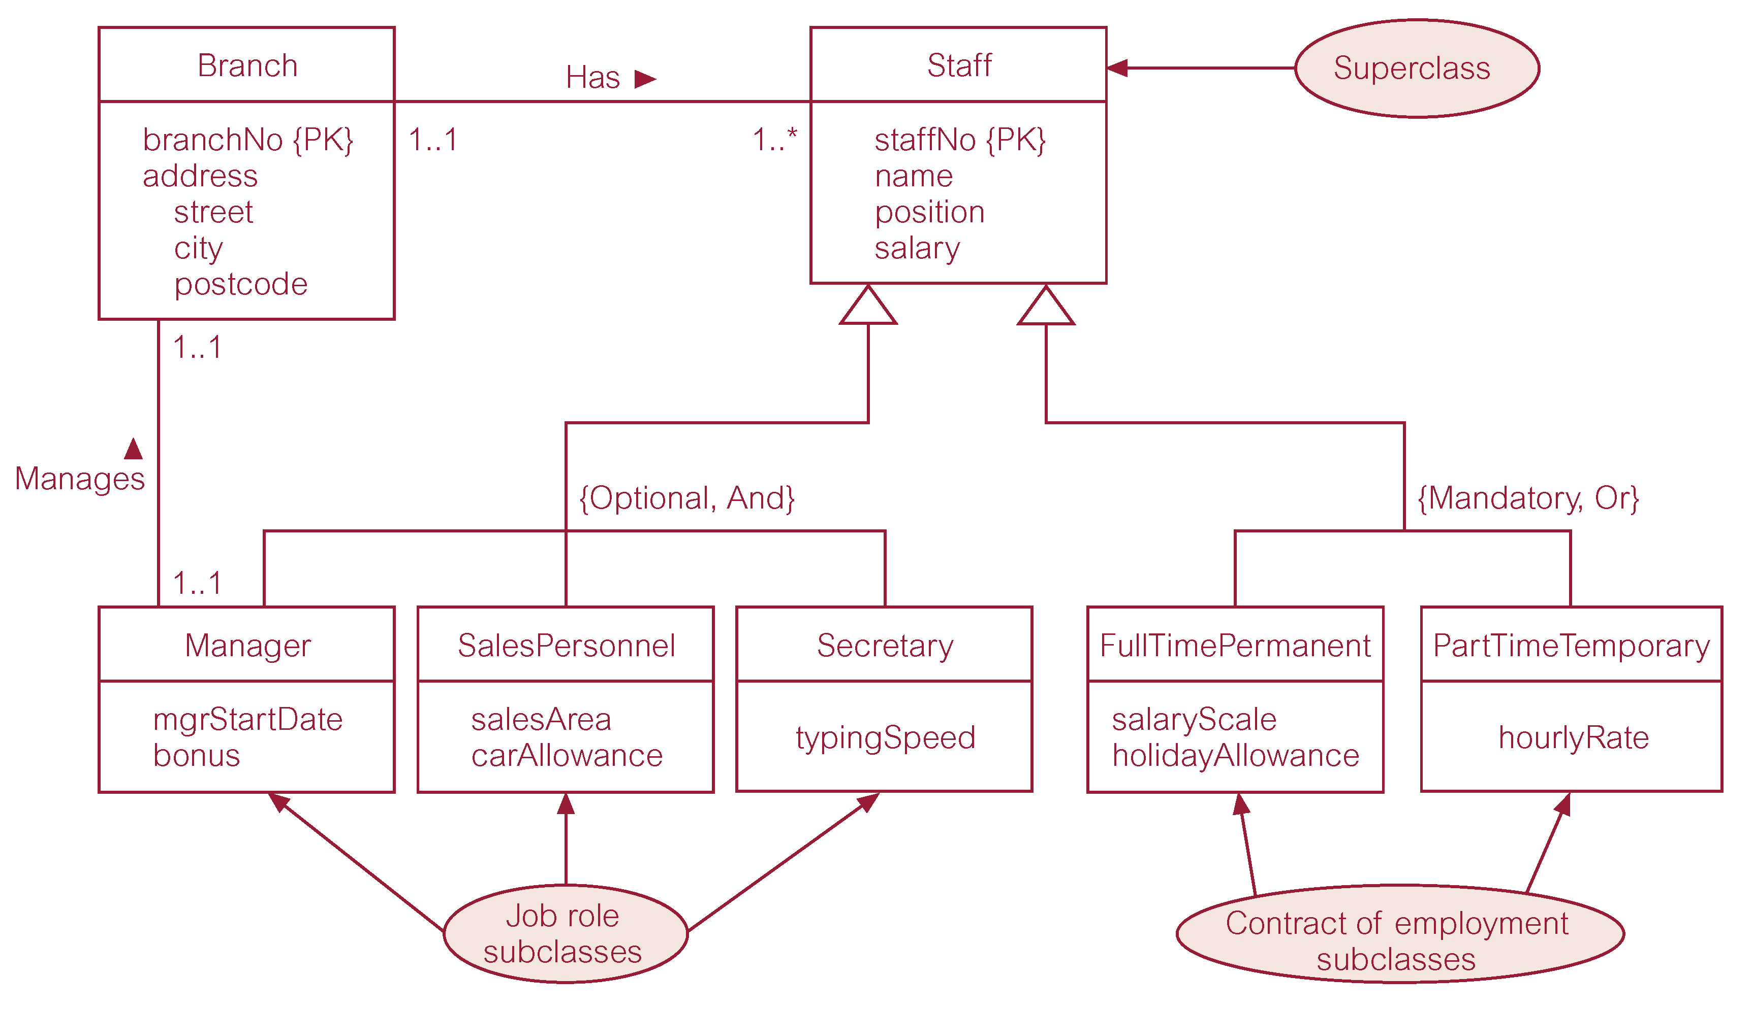
Specialization/Generalization..

Slide 19
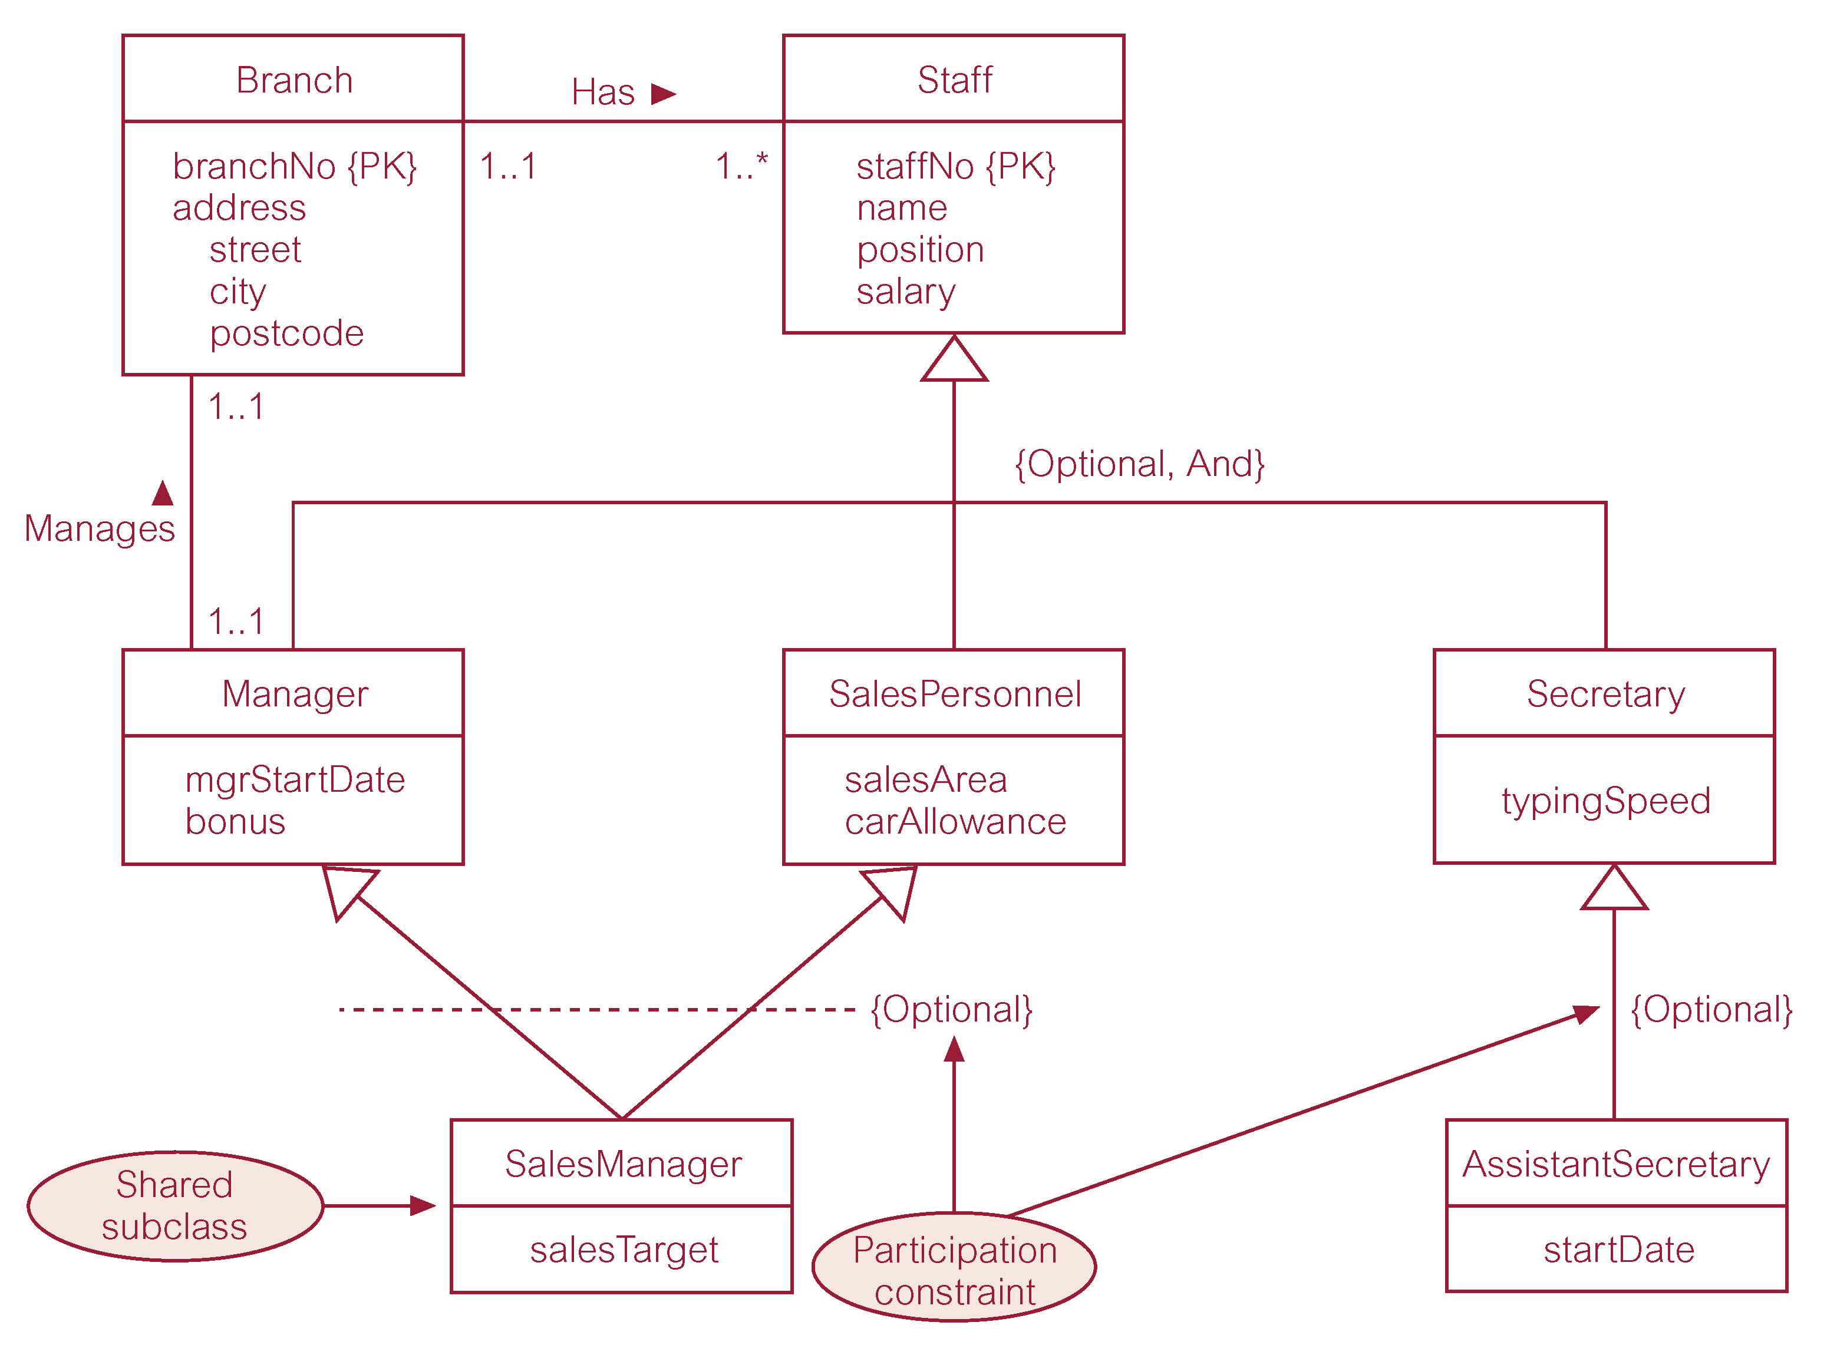
Specialization/Generalization..

Slide 20
Constraints: Specialization/Generalization
Participation constraint
Determines whether every member in the superclass must participate as a member of a subclass
May be mandatory or optional
A superclass/subclass relationship with mandatory participation speciﬁes that every member in the superclass must also be a member of a subclass e.g. contract of employment
A superclass/subclass relationship with optional participation speciﬁes that a member of a superclass need not belong to any of its subclasses e.g. job role

Slide 21
Constraints: Specialization/Generalization
Disjoint constraint
Describes the relationship between members of the subclasses and indicates whether it is possible for a member of a superclass to be a member of one, or more than one, subclass
The disjoint constraint only applies when a superclass has more than one subclass
If the subclasses are disjoint, then an entity occurrence can be a member of only one of the subclasses

Slide 22
Constraints: Specialization/Generalization
Disjoint constraint
To represent a disjoint superclass/subclass relationship, ‘Or’ is placed next to the participation constraint within the curly brackets e.g. contract of employment specialization/generalization is disjoint, which means that a member of staff must have a full-time permanent or a part-time temporary contract, but not both

Slide 23
Constraints: Specialization/Generalization
Disjoint constraint
If subclasses of a specialization/generalization are not disjoint (called nondisjoint), then an entity occurrence may be a member of more than one subclass
To represent a nondisjoint superclass/subclass relationship, ‘And’ is placed next to the participation constraint within the curly brackets
For example, the job role specialization/ generalization is nondisjoint, which means that an entity occurrence can be a member of both the Manager, and SalesPersonnel subclasses (shared subclass SalesManager)

Slide 24
Constraints: Specialization/Generalization
Disjoint constraint
Note that it is not necessary to include the disjoint constraint for hierarchies that have a single subclass at a given level and for this reason only the participation constraint is shown for the SalesManager and AssistantSecretary subclasses

Slide 25
Categories: Disjoint/Participation
The disjoint and participation constraints of specialization and generalization are distinct, giving rise to four categories:
Mandatory and disjoint (Or)
Optional and disjoint (Or)
Mandatory and nondisjoint (And)
Optional and nondisjoint (And)

Slide 26
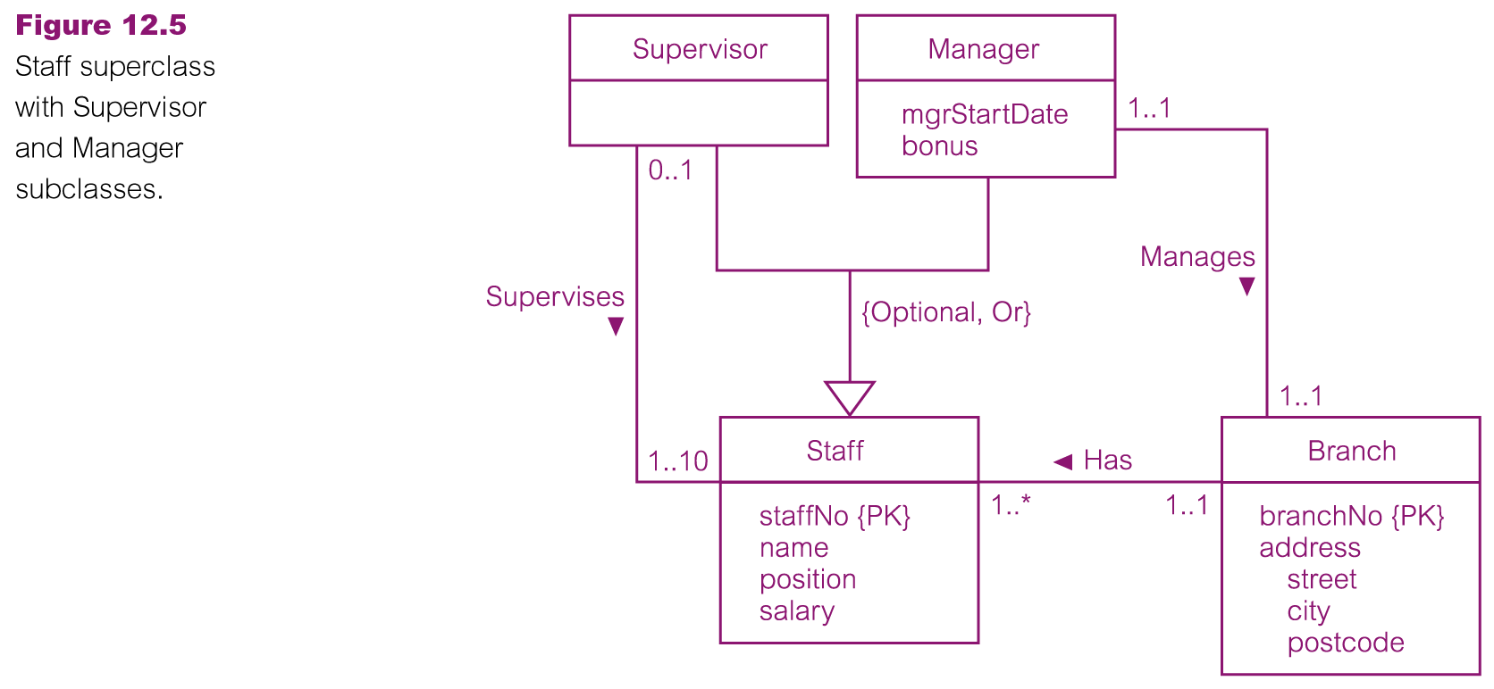
DreamHome Branch View

Slide 27
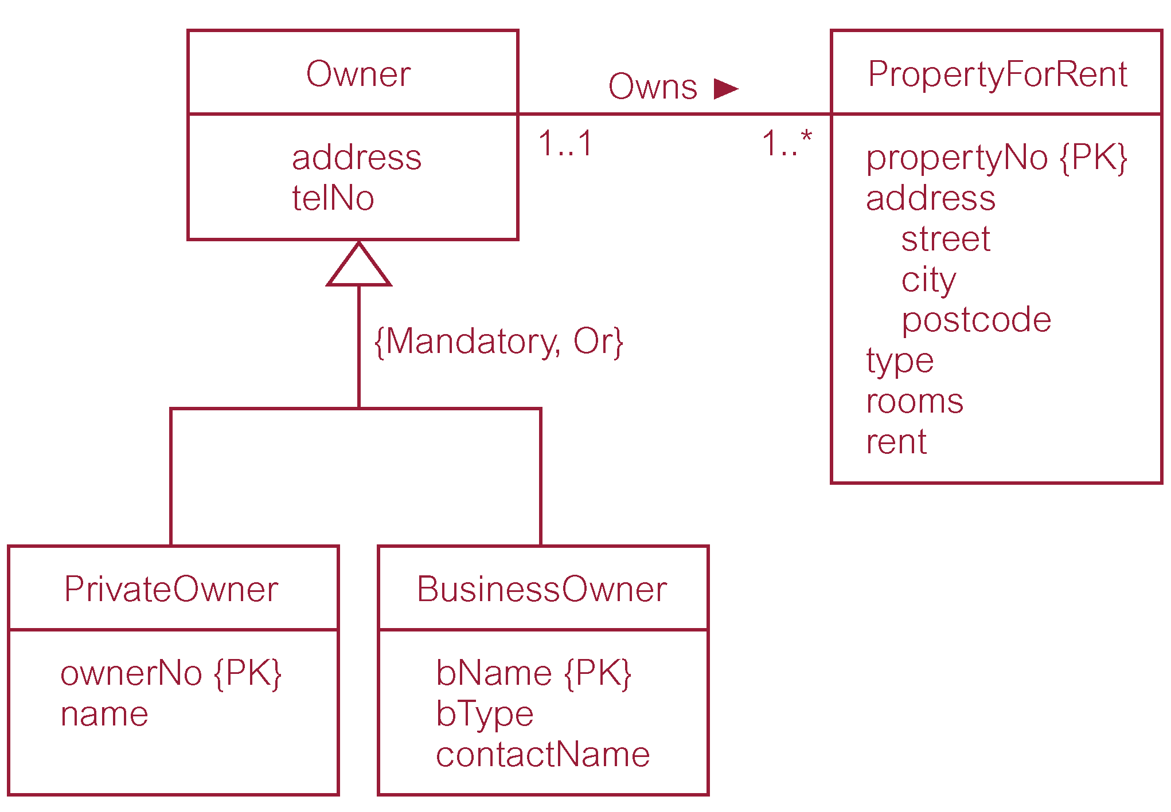
DreamHome Branch View

Slide 28
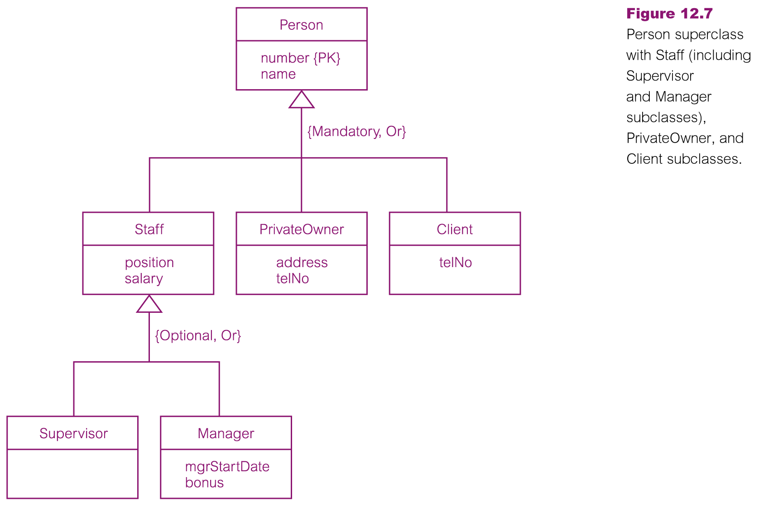
DreamHome Branch View

Slide 29
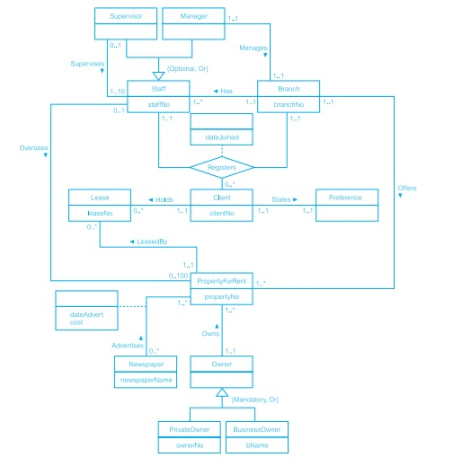
DreamHome Branch View

Slide 30
Aggregation
Represents a ‘has-a’ or ‘is-part-of’ relationship between entity types, where one represents the ‘whole’ and the other the ‘part’
A relationship represents an association between two entity types that are conceptually at the same level
One entity represents a larger entity (the ‘whole’), consisting of smaller entities (the ‘parts’)
Aggregation does not change the meaning of navigation across the relationship between the whole and its parts, nor does it link the lifetimes of the whole and its parts e.g. the Has relationship, which relates the Branch entity (the ‘whole’) to the Staff entity (the ‘part’)

Slide 31
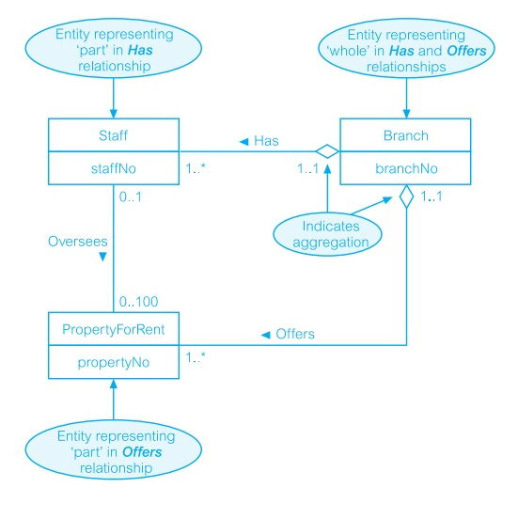
Aggregation

Slide 32
Composition
A speciﬁc form of aggregation that represents an association between entities, where there is a strong ownership and coincidental lifetime between the ‘whole’ and the ‘part’
The ‘whole’ is responsible for the disposition of the ‘parts’, which means that the composition must manage the creation and destruction of its ‘parts’
In other words, an object may only be part of one composite at a time

Slide 33
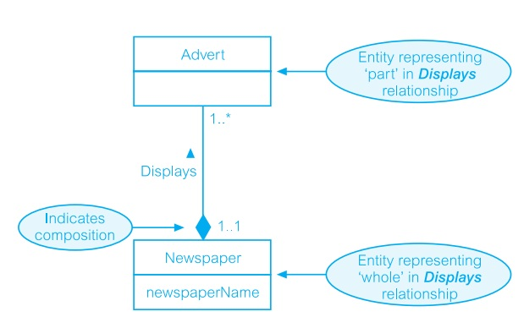
Composition

Slide 34
Important
If we remember that the major aim of a data model is to unambiguously and accurately communicate an understanding of the enterprise data
We should only use the additional concepts of aggregation and composition when the enterprise data is too complex to easily represent using only the basic concepts of the ER model

Slide 35
Summary
Enhanced Entity-Relationship (EER) model
Specialization/Generalization
Specialization/Generalization constraints
Aggregation
Composition
Application of EER concepts to DreamHome

Slide 36
References
All the material (slides, diagrams etc.) presented in this lecture is taken (with modifications) from the Pearson Education website :
http://www.booksites.net/connbegg

