Slide 1
CSC271 Database Systems
Lecture # 24

Slide 2
Summary: Previous Lecture
Classification of entities
Attributes on relationships
Structural constraints
Multiplicity
Binary/Complex relationships

Slide 3
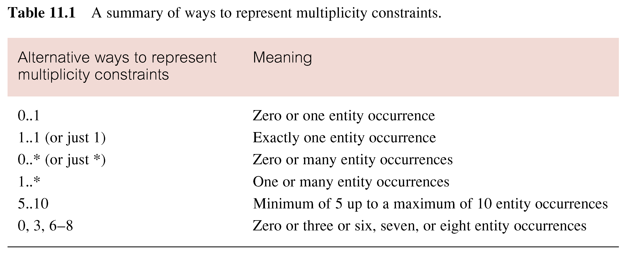
Summary of Multiplicity Constraints

Slide 4
Structural Constraints
Multiplicity actually consists of two separate constraints known as
Cardinality
Participation

Slide 5
Cardinality
Describes maximum number of possible relationship occurrences for an entity participating in a given relationship type
The cardinality of a binary relationship is what we previously referred to as a one-to-one (1:1), one-to-many (1:*), and many-to-many (*:*)
The cardinality of a relationship appears as the maximum values for the multiplicity ranges on either side of the relationship

Slide 6
Participation
Determines whether all or only some entity occurrences participate in a relationship
The participation constraint represents whether all entity occurrences are involved in a particular relationship (referred to as mandatory participation) or only some (referred to as optional participation)
The participation of entities in a relationship appears as the minimum values for the multiplicity ranges on either side of the relationship
Optional participation is represented as a minimum value of 0 while mandatory participation is shown as a minimum value of 1

Slide 7
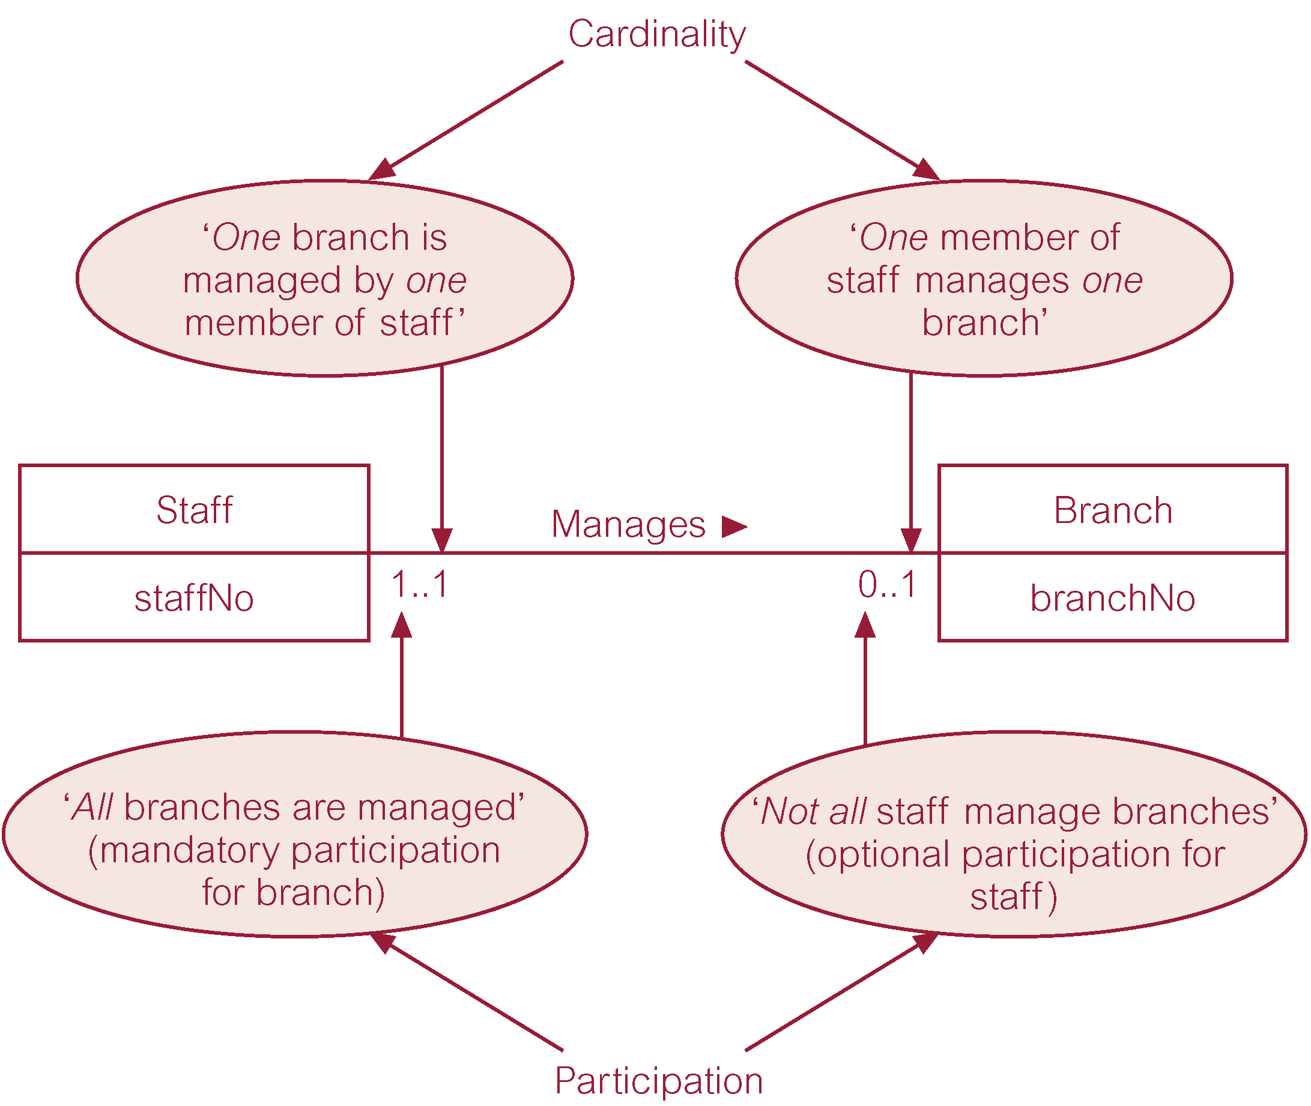
Cardinality and Participation

Slide 8
Problems with ER Models
Problems may arise when designing a conceptual data (creating an ER) model called connection traps
Normally occur due to a misinterpretation of the meaning of certain relationships
Two main types of connection traps are:
Fan traps
Chasm traps

Slide 9
Connection Traps
In general, to identify connection traps we must ensure that the meaning of a relationship is fully understood and clearly deﬁned
If we do not understand the relationships we may create a model that is not a true representation of the ‘real world’

Slide 10
Fan Traps
Where a model represents a relationship between entity types, but pathway between certain entity occurrences is ambiguous
A fan trap may exist where two or more 1:* relationships fan out from the same entity as shown in the following example

Slide 11
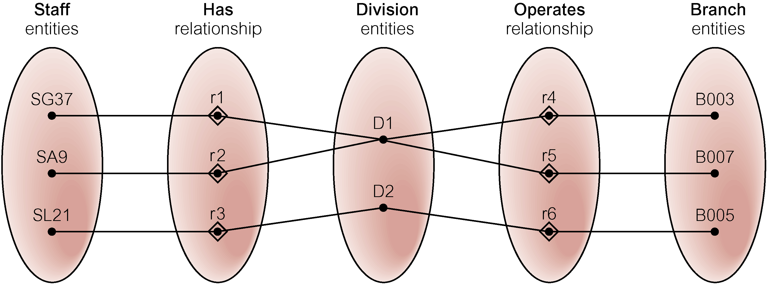
Fan Traps..
At which branch office does staff number SG37 work?

Slide 12
Resolving Fan Trap
Reconstruction of the original ER model to represent the correct association between these entities

Slide 13
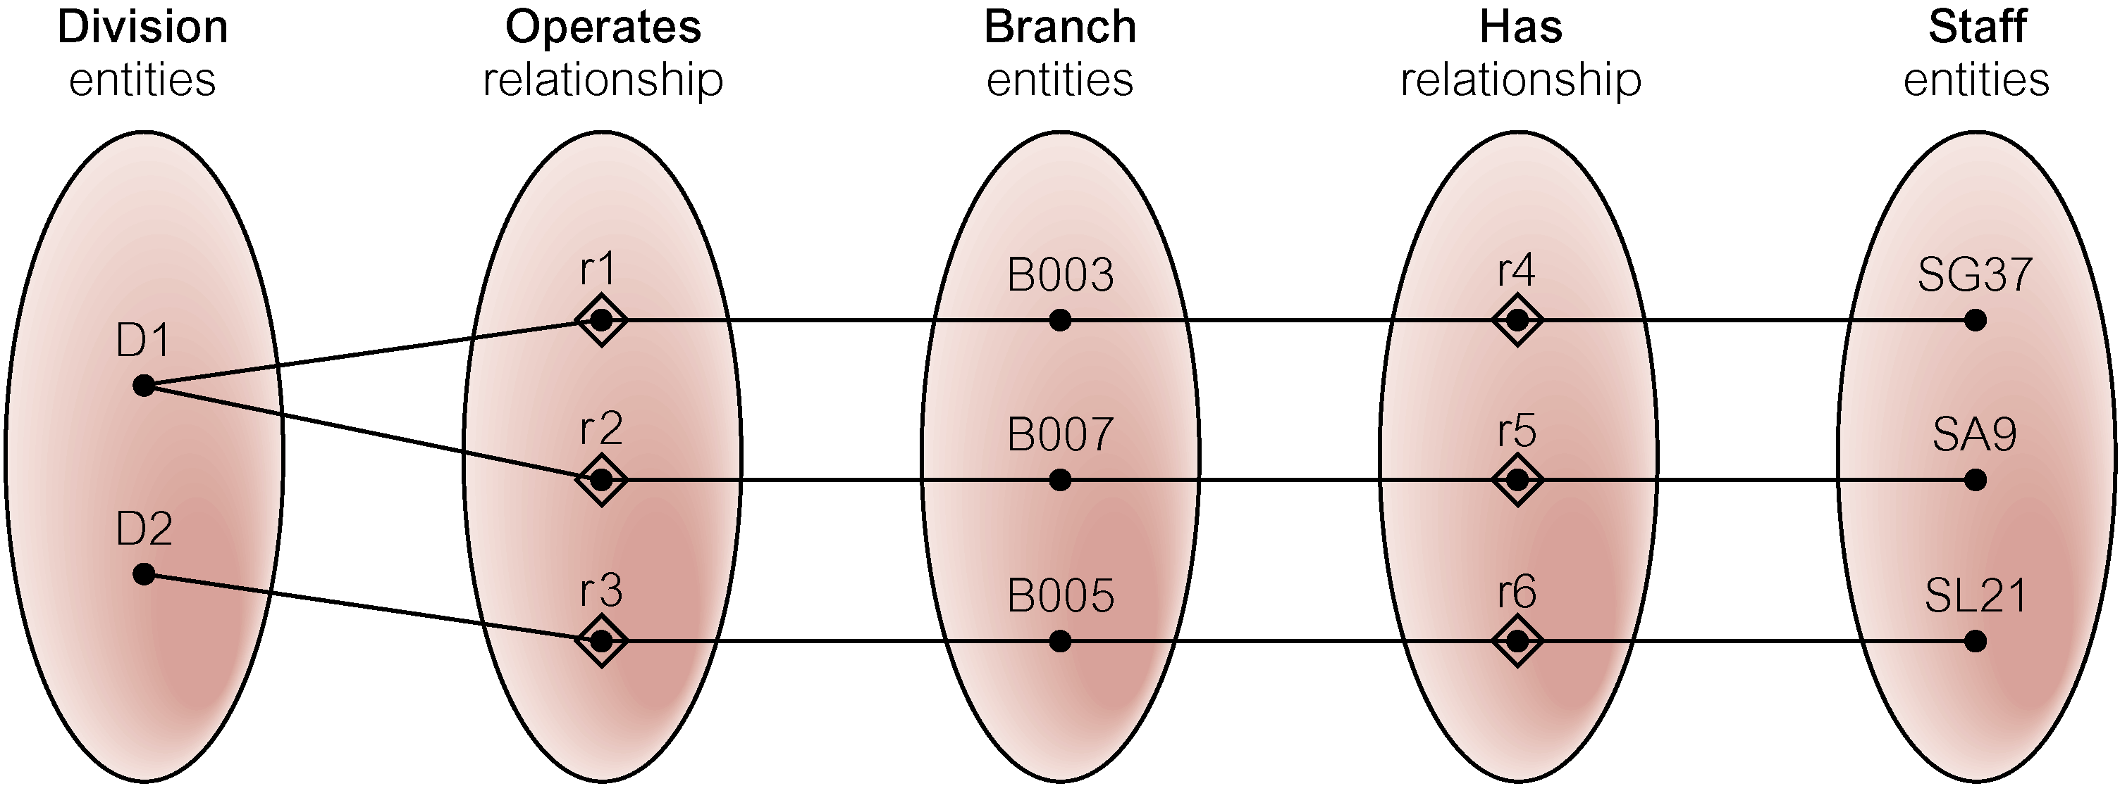
Fan Trap Resolved?
At which branch office does staff number SG37 work, same question again?

Slide 14
Chasm Traps
Where a model suggests the existence of a relationship between entity types, but pathway does not exist between certain entity occurrences
A chasm trap may occur where there are one or more relationships with a minimum multiplicity of zero (that is optional participation) forming part of the pathway between related entities

Slide 15
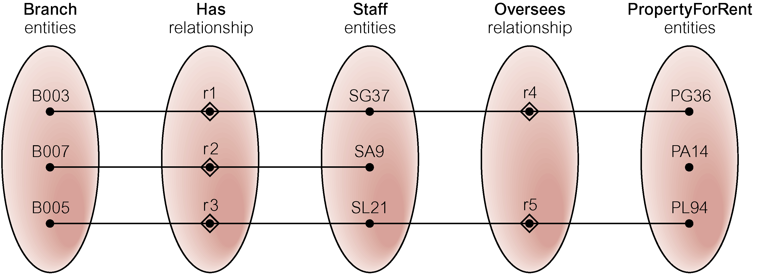
Chasm Traps..
At which branch office is property PA14 available?

Slide 16
Resolving Chasm Trap
Identify the missing relationship that represents the true association between entities

Slide 17
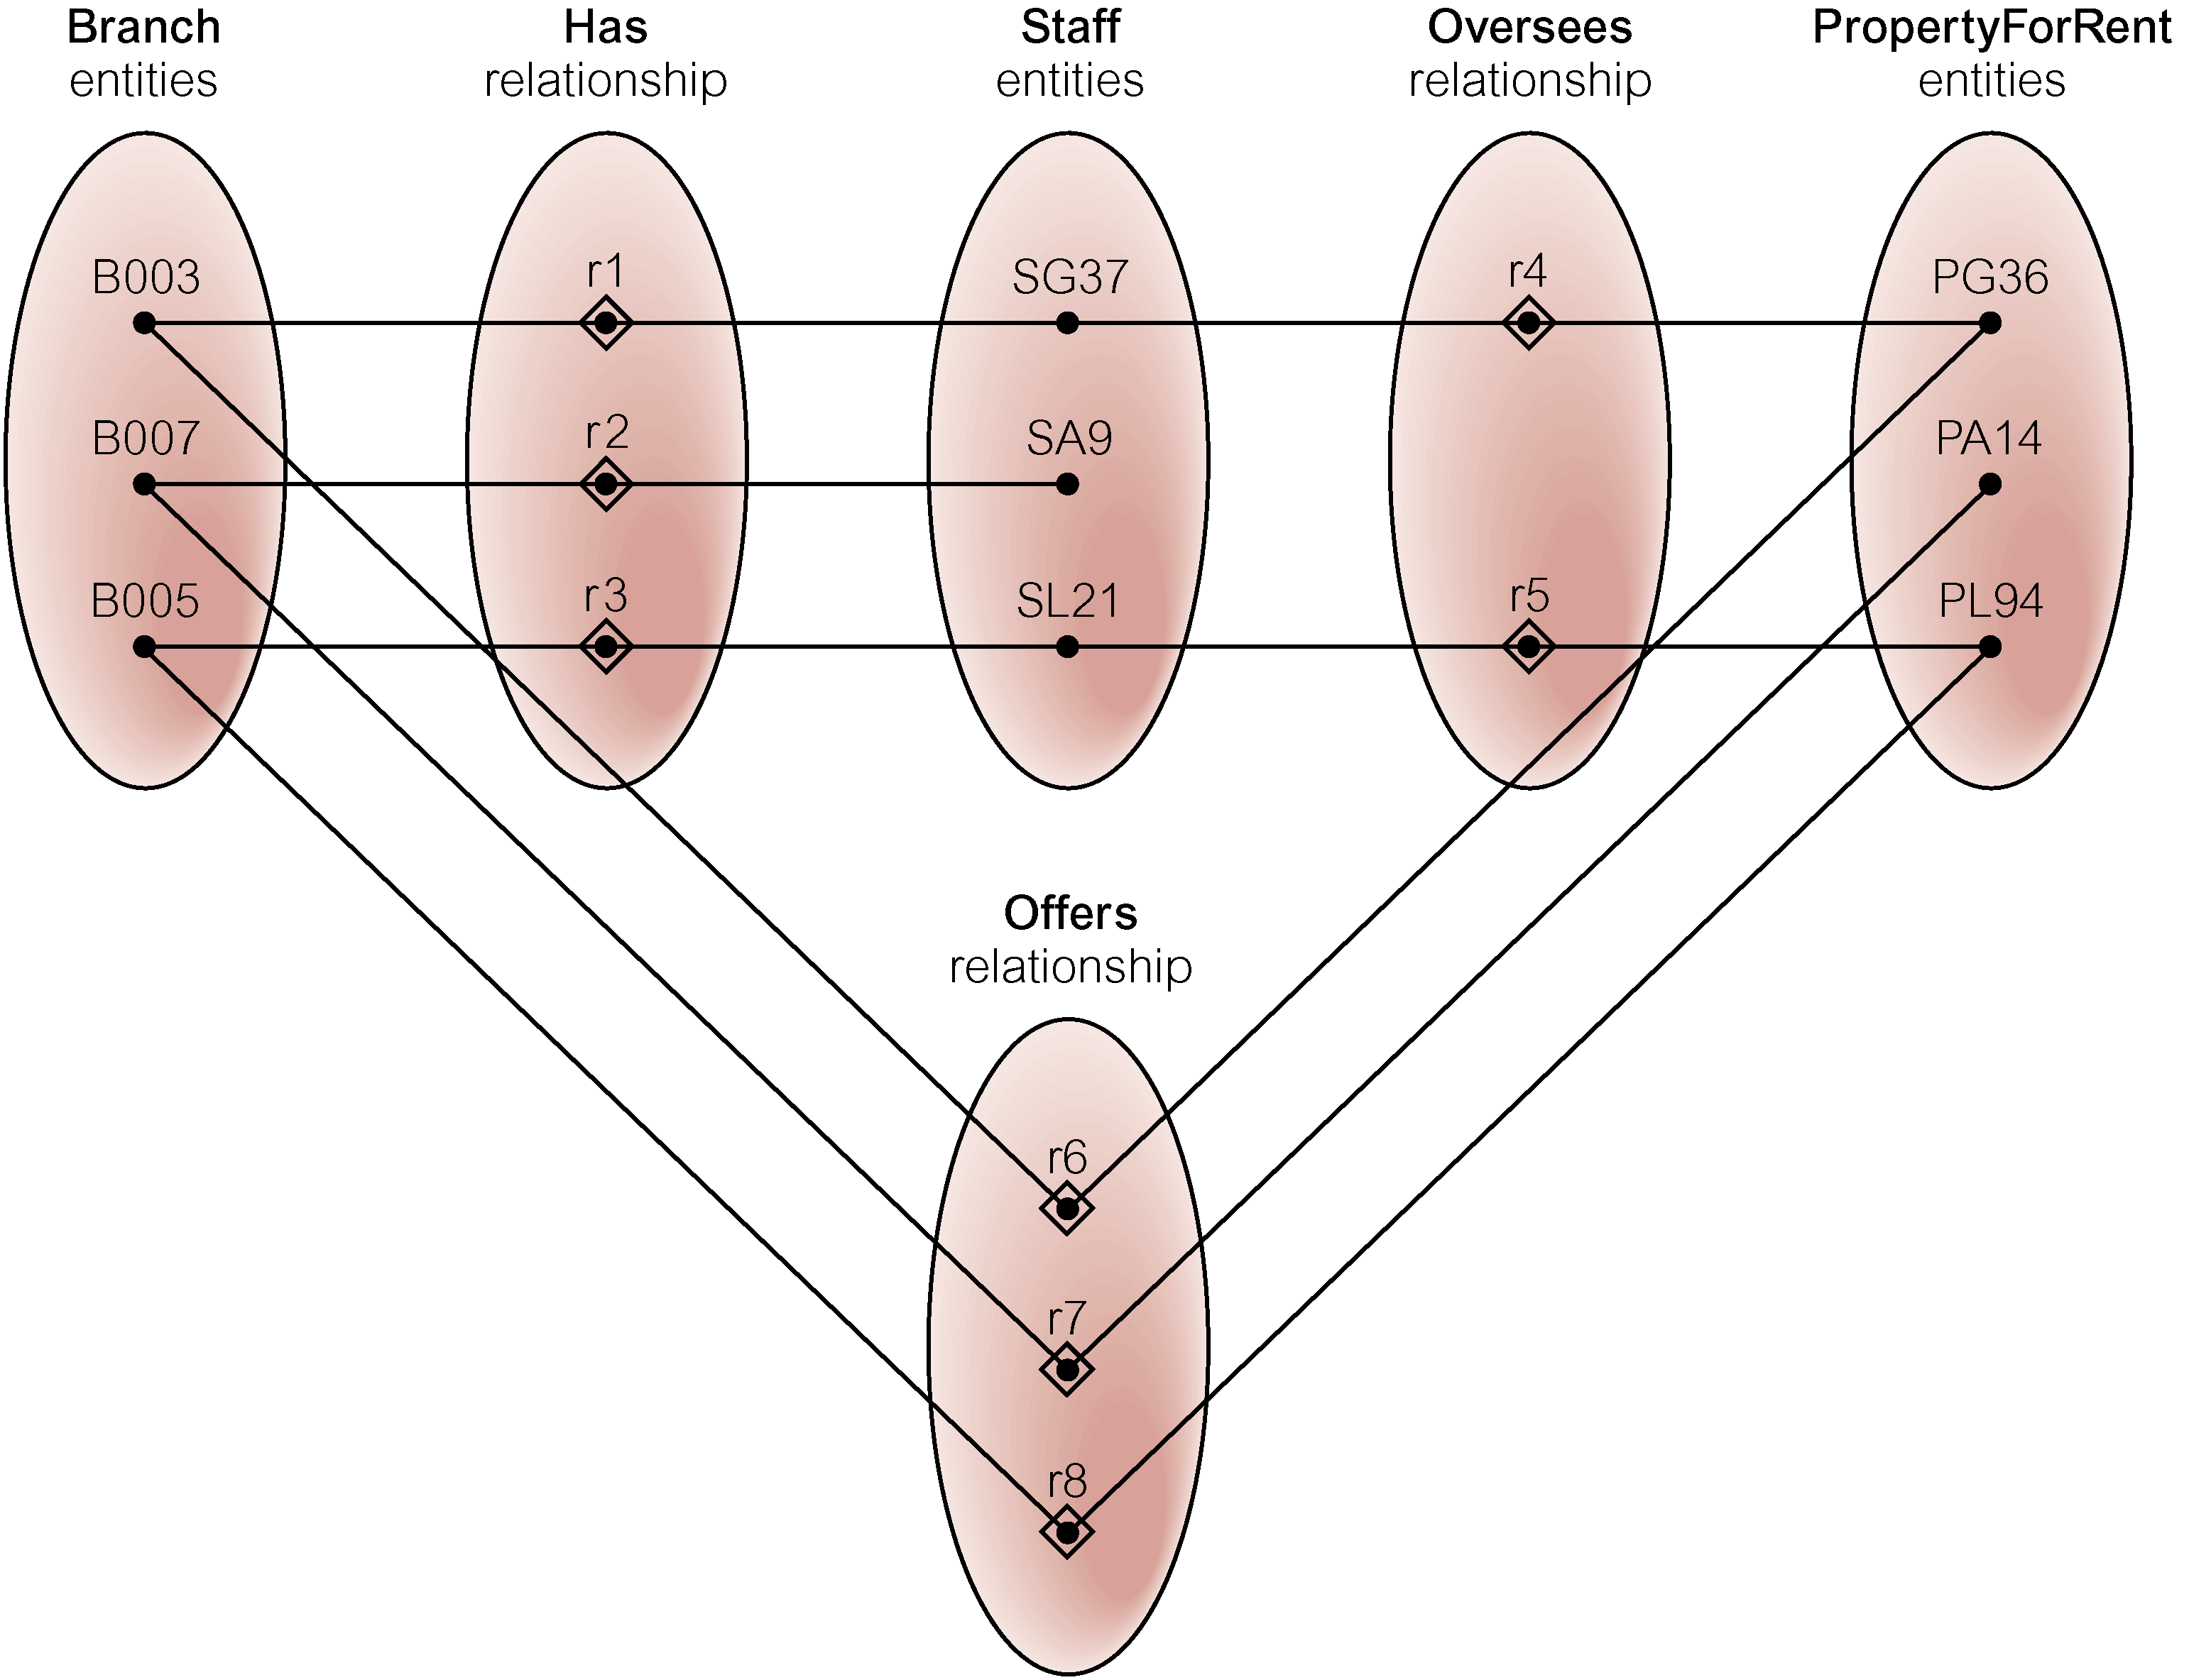
Chasm Trap Resolved?
At which branch office is property PA14 available, same question again?

Slide 18
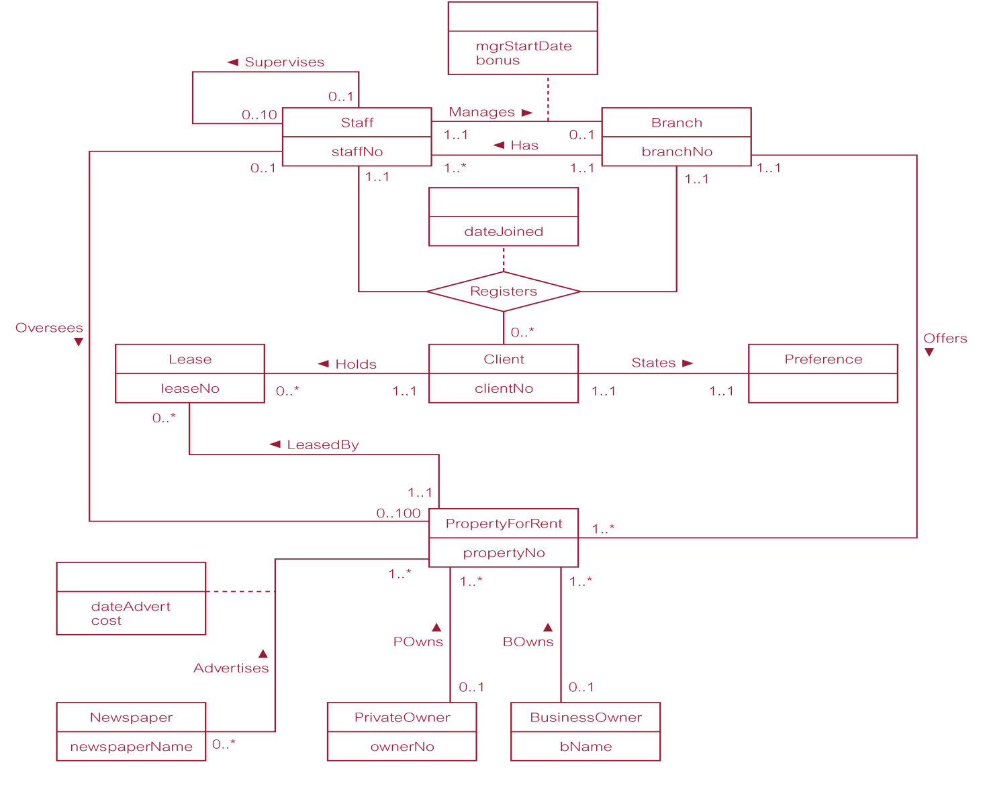
Sample ER-Diagram

Slide 19
Summary
Structural constraints
Multiplicity
Cardinality/Participation
Connection traps
Fan/Chasm traps

Slide 20
References
All the material (slides, diagrams etc.) presented in this lecture is taken (with modifications) from the Pearson Education website :
http://www.booksites.net/connbegg

