Slide 1
CSC271 Database Systems
Lecture # 23

Slide 2
Summary: Previous Lecture
Database design using ER modeling
Concepts of ER model
Entities
Relationships
Attributes

Slide 3
Classification of Entity Types
The entity types can classified into
Strong entity type
Weak entity type

Slide 4
Strong Entity Type
Strong entity type
An entity type that is not existence-dependent on some other entity type e.g. Staff, Branch, PropertyForRent, Client etc.
A characteristic of a strong entity type is that each entity occurrence is uniquely identiﬁable using the primary key attribute(s) of that entity type
For example, we can uniquely identify each member of staff using the staffNo attribute, which is the primary key for the Staff entity type
Sometimes referred to as parent, owner, or dominant entities

Slide 5
Weak Entity Type
Weak entity type
An entity type that is existence-dependent on some other entity type e.g. Preference etc.
A characteristic of a weak entity is that each entity occurrence cannot be uniquely identiﬁed using only the attributes associated with that entity type
For example, note that there is no primary key for the Preference entity, means that we cannot identify each occurrence of the Preference entity type using only the attributes of this entity
Sometimes referred to as child, dependent, or subordinate entities

Slide 6
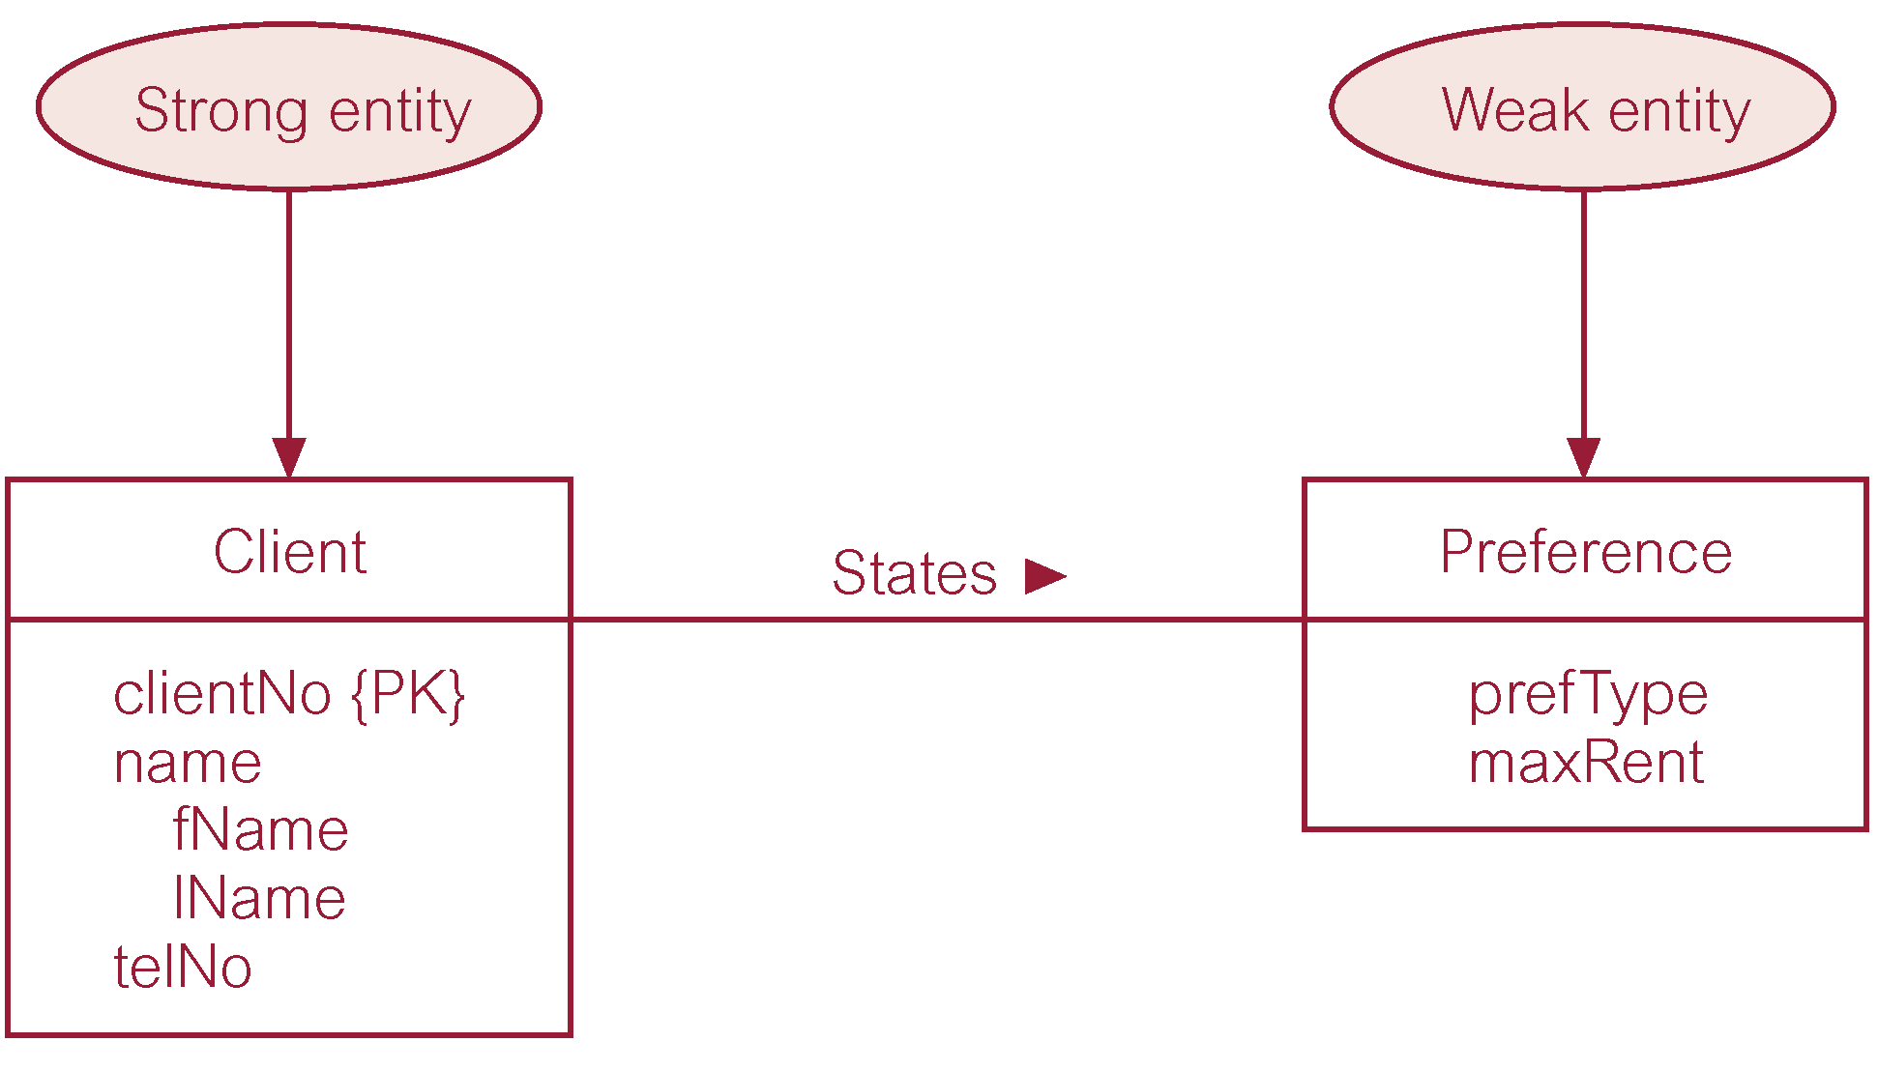
Example: Strong/Weak Entities

Slide 7
Attributes on Relationships
Attributes can also be assigned to relationships
For example, consider the relationship Advertises, which associates the Newspaper and PropertyForRent entity types
To record the date the property was advertised and the cost, we associate this information with the Advertises relationship as attributes called dateAdvert and cost, rather than with the Newspaper or the PropertyForRent entities

Slide 8
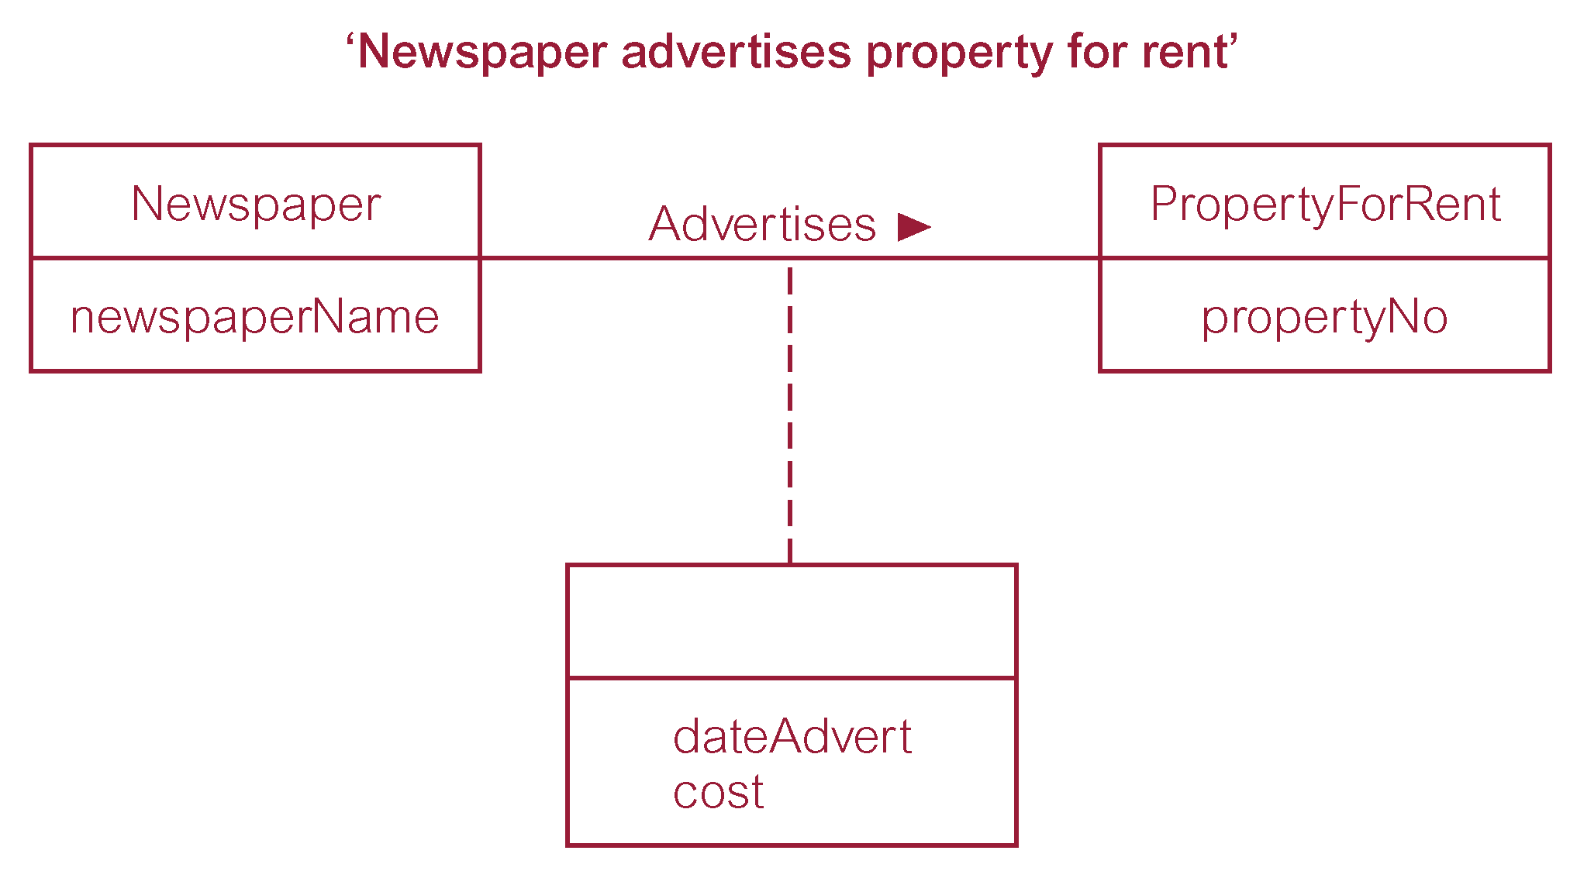
Attributes on Relationships..

Slide 9
Diagrammatic Representation
Attributes on relationship
We represent attributes associated with a relationship type using the same symbol as an entity type
However, to distinguish between a relationship with an attribute and an entity, the rectangle representing the attribute(s) is associated with the relationship using a dashed line
The presence of one or more attributes assigned to a relationship may indicate that the relationship conceals an unidentiﬁed entity type e.g. the presence of an entity called Advert

Slide 10
Structural Constraints
We now examine the constraints that may be placed on entity types that participate in a relationship
The constraints should reﬂect the restrictions on the relationships as perceived in the ‘real world’
Examples of such constraints include the requirements that a property for rent must have an owner and each branch must have staff
The main type of constraint on relationships is called multiplicity

Slide 11
Multiplicity
The number (or range) of possible occurrences of an entity type that may relate to a single occurrence of an associated entity type through a particular relationship
Multiplicity constrains the way that entities are related
It is a representation of the policies (or business rules) established by the user or enterprise
We must ensure that all appropriate enterprise constraints are identiﬁed and represented in an ER model

Slide 12
Structural Constraints..
The most common degree for relationships is binary, binary relationships are generally referred to as being:
One-to-One (1:1)
A member of staff manages a branch (1:1)
One-to-Many (1:*)
A member of staff oversees properties for rent (1:*)
Many-to-Many (*:*)
A newspapers advertise properties for rent (*:*)

Slide 13
Structural Constraints..
It is important to note that not all integrity constraints can be easily represented in an ER model
For example, the requirement that a member of staff receives an additional day’s holiday for every year of employment with the enterprise may be difﬁcult to represent in an ER model

Slide 14
Determining the Multiplicity
Determining the multiplicity normally requires examining the precise relationships between the data given in a enterprise constraint using sample data
The sample data may be obtained by examining ﬁlled-in forms or reports and, if possible, from discussion with users
However, it is important to stress that to reach the right conclusions about a constraint requires that the sample data examined or discussed is a true representation of all the data being modeled

Slide 15
One-to-One (1:1) Relationships..
Determining the multiplicity
Consider the relationship Manages, which relates the Staff and Branch entity types
A semantic net can be used displays sample occurrences of the Manages relationship type

Slide 16
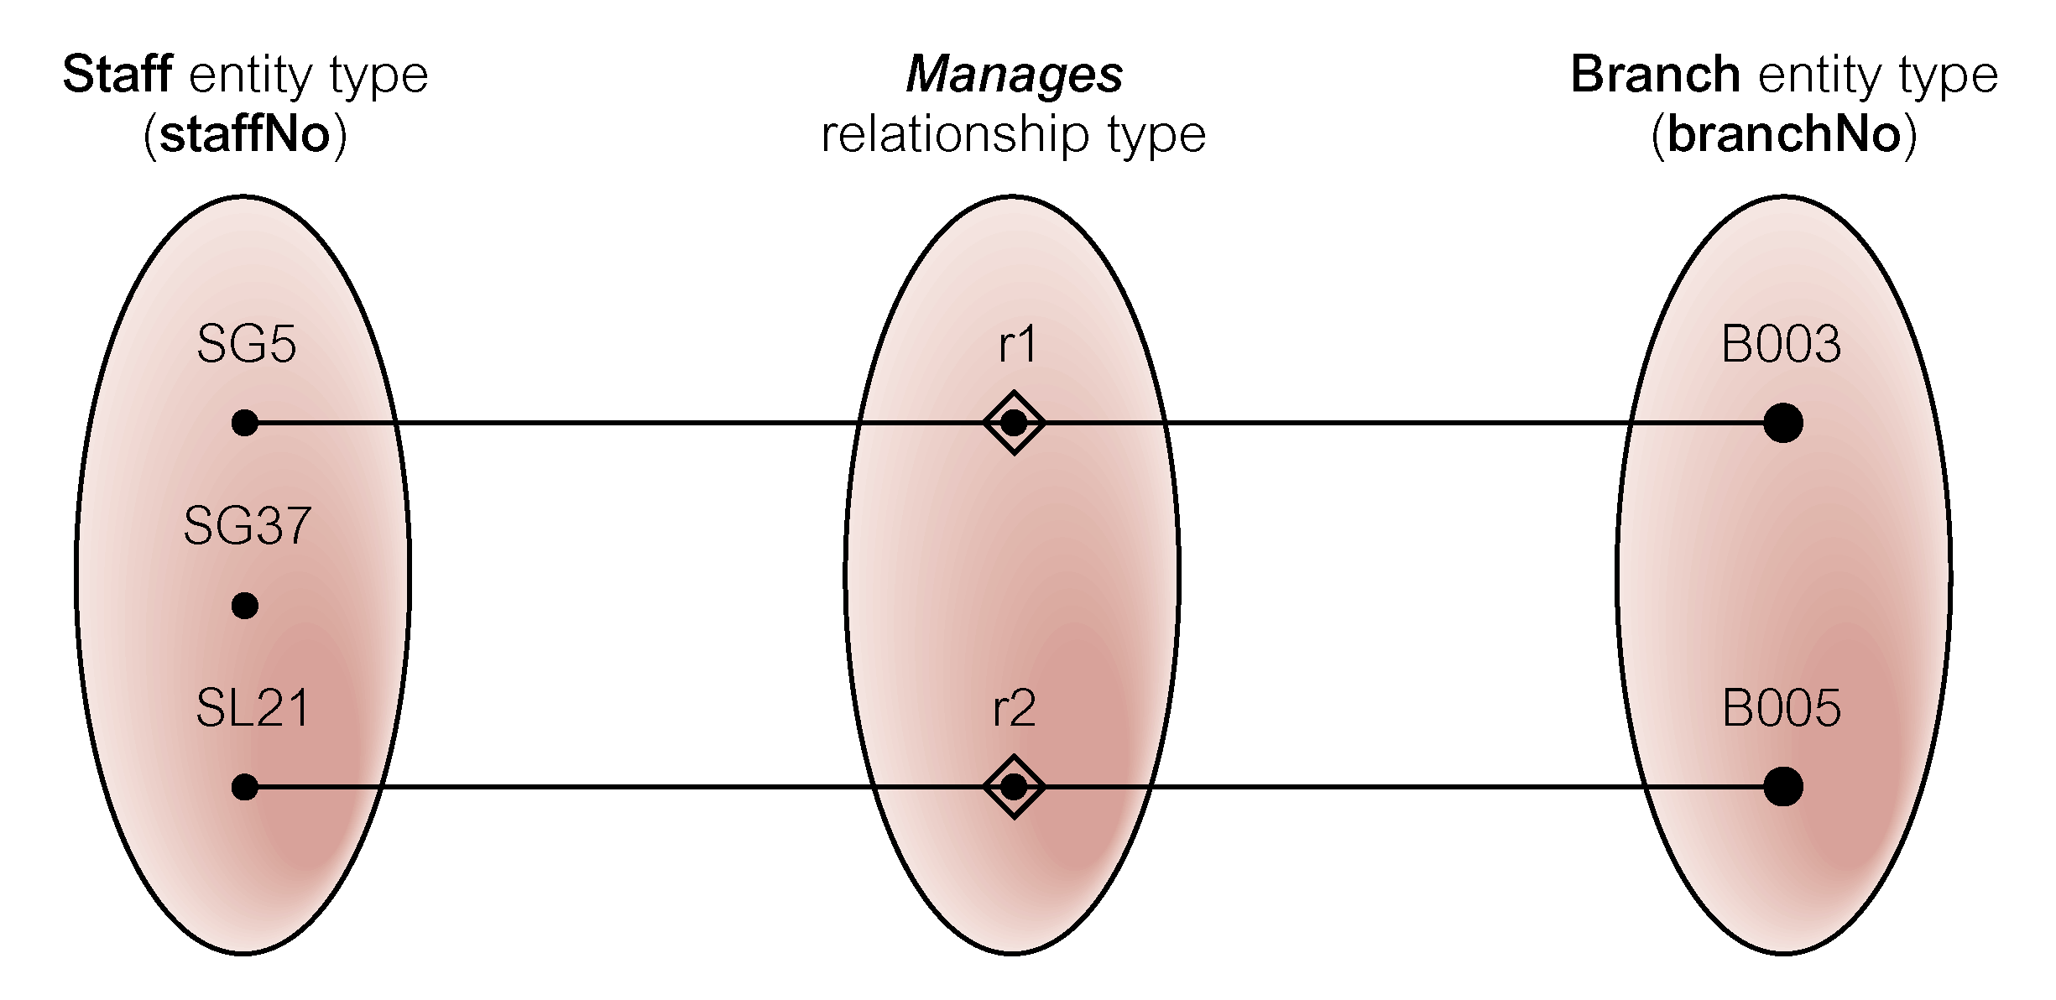
One-to-One (1:1) Relationships..

Slide 17
One-to-One (1:1) Relationships..
By analyzing the semantic net, we can conclude as follows:
The staffNo SG5 manages branchNo B003 and staffNo SL21 manages branchNo B005, but staffNo SG37 does not manage any branch
In other words, a member of staff can manage zero or one branch and each branch is managed by one member of staff
As there is a maximum of one branch for each member of staff involved in this relationship and a maximum of one member of staff for each branch, we refer to this type of relationship as one-to-one

Slide 18
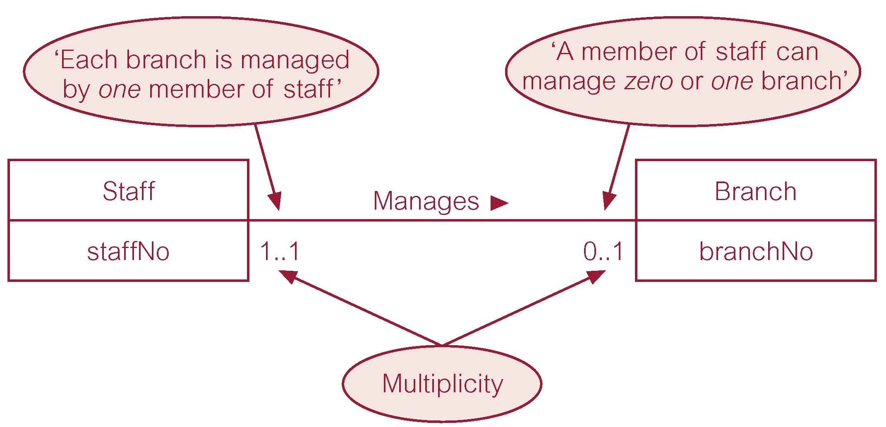
One-to-One (1:1) Relationships..

Slide 19
One-to-Many (1:*) Relationships
Determining the multiplicity
Consider the relationship Oversees, which relates the Staff and PropertyForRent entity types
A semantic net can be used displays sample occurrences of the Oversees relationship type

Slide 20
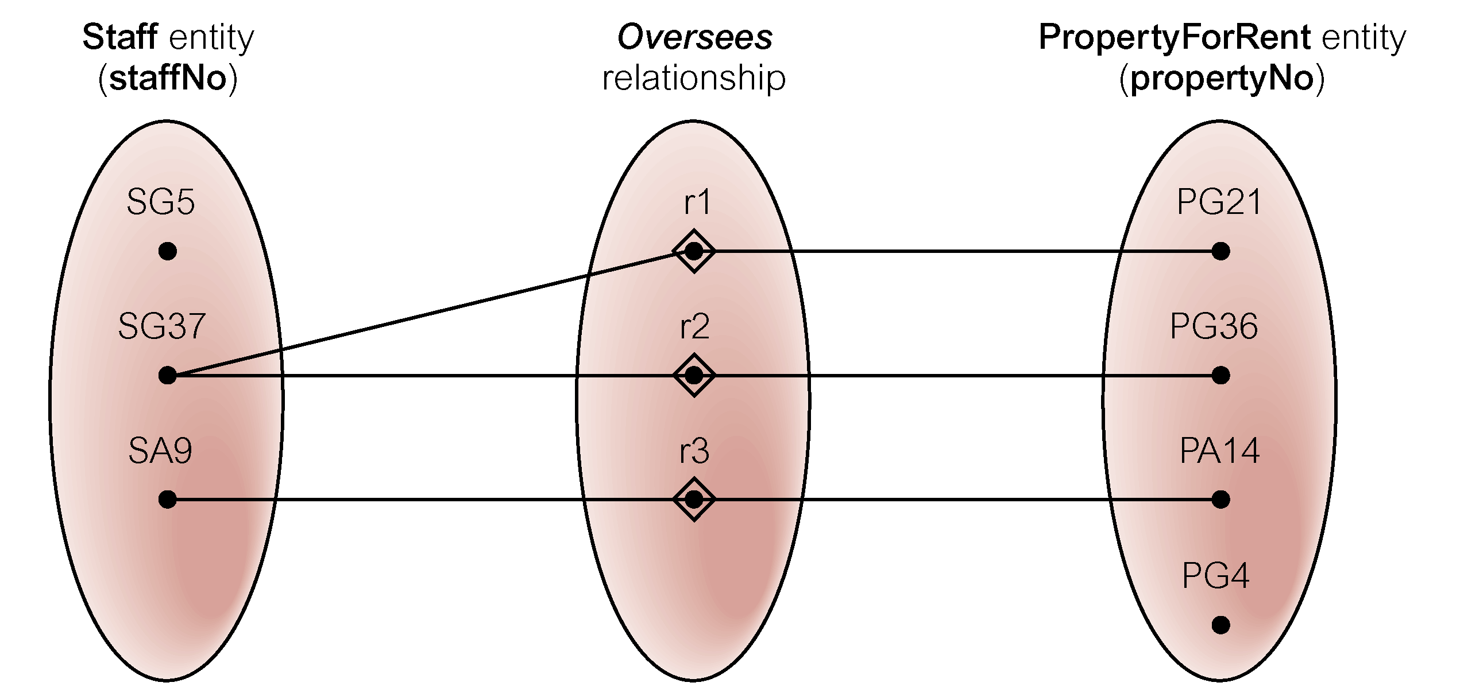
One-to-Many (1:*) Relationships..

Slide 21
One-to-Many (1:*) Relationships..
By analyzing the semantic net, we can conclude as follows:
The staffNo SG37 oversees propertyNos PG21 and PG36, and staffNo SA9 oversees propertyNo PA14 but staffNo SG5 does not oversee any properties for rent and propertyNo PG4 is not overseen by any member of staff
In summary, a member of staff can oversee zero or more properties for rent and a property for rent is overseen by zero or one member of staff
Therefore, for members of staff participating in this relationship there are many properties for rent, and for properties participating in this relationship there is a maximum of one member of staff, we refer to this type of relationship as one-to-many

Slide 22
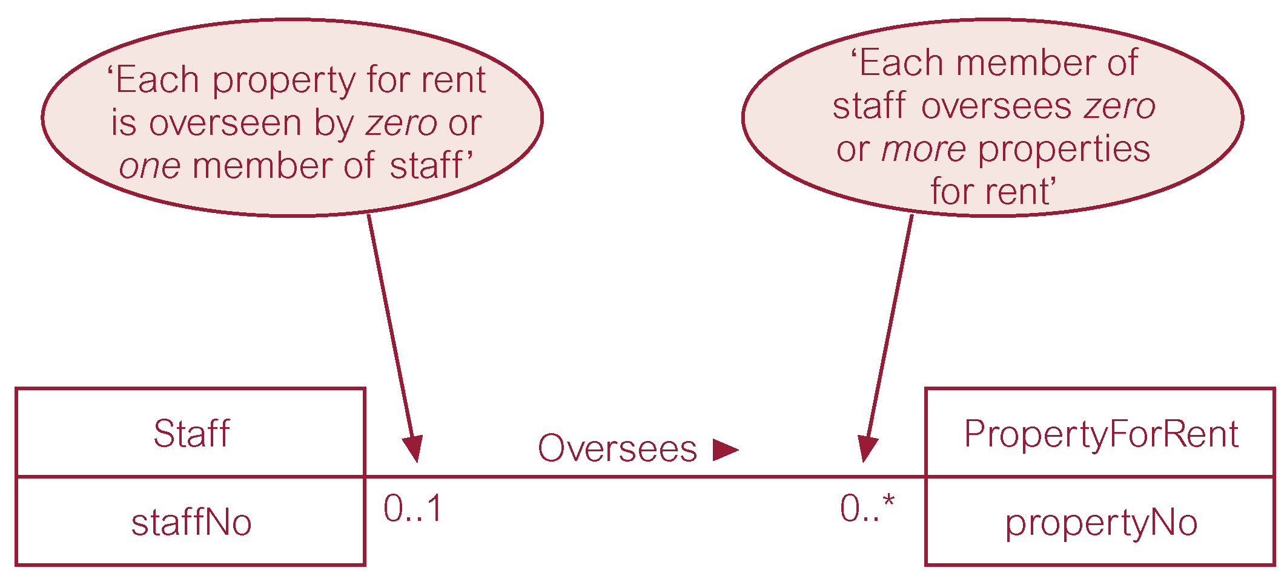
One-to-Many (1:*) Relationships..

Slide 23
One-to-Many (1:*) Relationships..
In case, we know the actual minimum and maximum values for the multiplicity, we can display these instead
For example, if a member of staff oversees a minimum of zero and a maximum of 100 properties for rent, we can replace the ‘0..*’ with ‘0..100’

Slide 24
Many-to-Many (*:*) Relationships
Determining the multiplicity
Consider the relationship Advertises, which relates the Newspaper and PropertyForRent entity types
A semantic net can be used displays sample occurrences of the Advertises relationship type

Slide 25
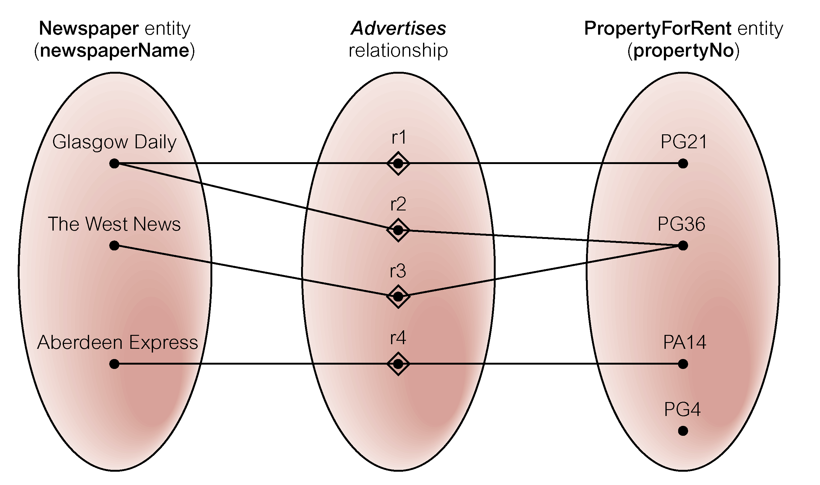
Many-to-Many (*:*) Relationships..

Slide 26
Many-to-Many (*:*) Relationships..
By analyzing the semantic net, we can conclude as follows:
The Glasgow Daily advertises propertyNos PG21 and PG36, the West News also advertises propertyNo PG36 and the Aberdeen Express advertises propertyNo PA14, however propertyNo PG4 is not advertised in any newspaper
In other words, one newspaper advertises one or more properties for rent and one property for rent is advertised in zero or more newspapers
Therefore, for newspapers there are many properties for rent, and for each property for rent participating in this relationship there are many newspapers, we refer to this type of relationship as many-to-many

Slide 27
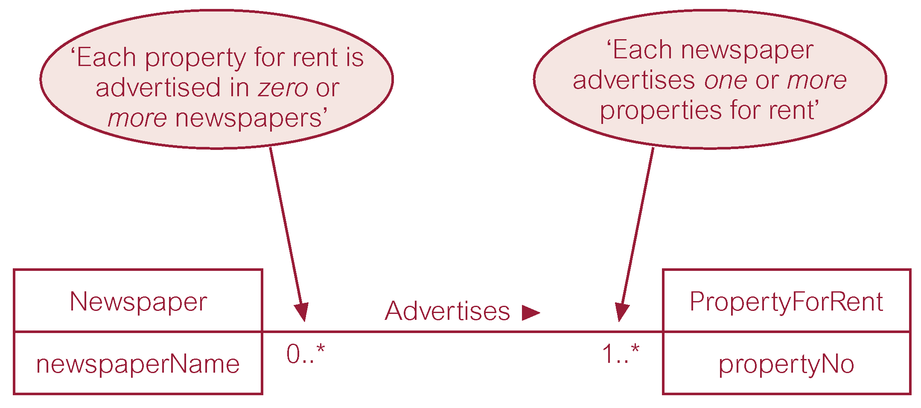
Many-to-Many (*:*) Relationships..

Slide 28
Structural Constraints
Multiplicity for Complex Relationships
The number (or range) of possible occurrences of an entity type in an n-ary relationship when the other (n−1) values are ﬁxed

Slide 29
Complex Relationships
Determining the multiplicity
Consider the ternary Registers relationship between Staff, Branch, and Client entity types
A semantic net can be used displays sample occurrences of the Registers relationship type

Slide 30
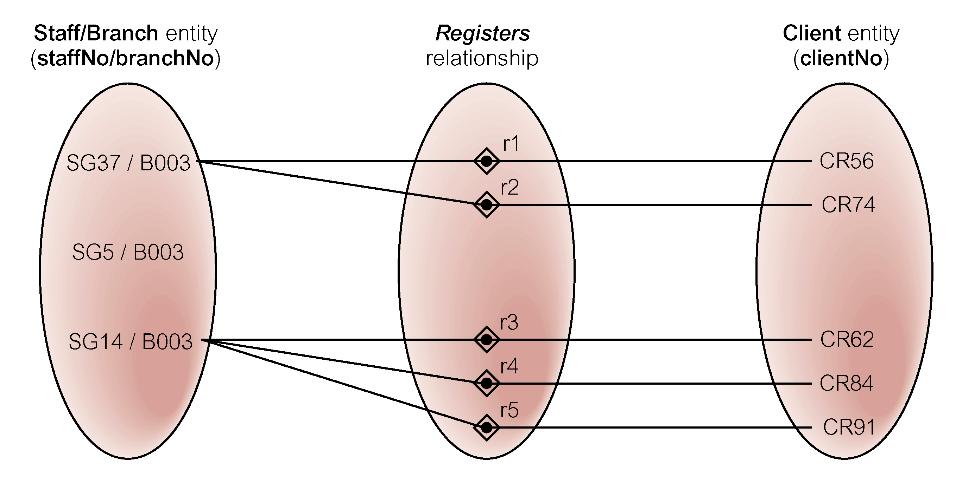
Complex Relationships..

Slide 31
Complex Relationships..
By analyzing the semantic net, we can conclude as follows:
The staffNo SG37 at branchNo B003 registers clientNo CR56 and CR74, and staffNo SG14 at branchNo B003 registers clientNo CR62, CR84, and CR91, however, SG5 at branchNo B003 registers no clients
In other words, when the staffNo and branchNo values are ﬁxed the corresponding clientNo values are zero or more
Therefore, the multiplicity of the Registers relationship from the perspective of the Staff and Branch entities is 0..*, which is represented in the ER diagram by placing the 0..* beside the Client entity

Slide 32
Complex Relationships..
What about the multiplicity of Branch and Staff entity types?
We repeat this test by keeping the Staff/Client values ﬁxed, and we get a multiplicity of 1..1, which is placed beside the Branch entity
Likewise by keeping Client/Branch values ﬁxed, a multiplicity value of 1..1 is obtained, which is placed beside the Staff entity

Slide 33
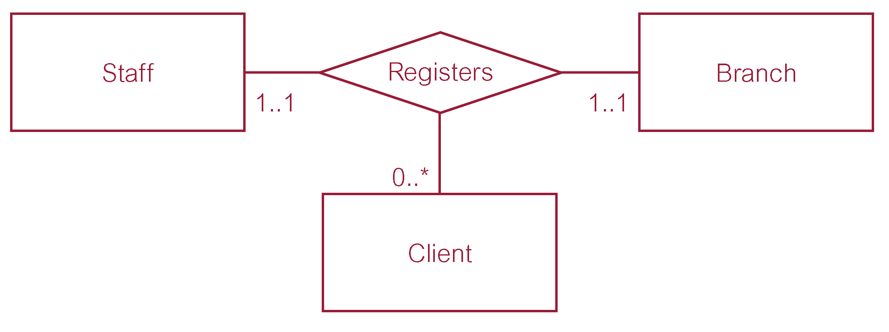
Complex Relationships..

Slide 34
Summary
Classification of entities
Attributes on relationships
Structural constraints
Multiplicity
Binary/Complex relationships

Slide 35
References
All the material (slides, diagrams etc.) presented in this lecture is taken (with modifications) from the Pearson Education website :
http://www.booksites.net/connbegg

