Slide 1
CSC271 Database Systems
Lecture # 22

Slide 2
Summary: Previous Lecture
Applying Database SDLC on DreamHome
Database planning
System definition
Requirements collection and analysis
Database design
Design methodology
Conceptual database design

Slide 3
Entity Relationship Modeling
Chapter 11

Slide 4
Difficulties in Database Design
One of the most difﬁcult aspects of database design is the fact that designers, programmers, and end-users tend to view data and its use in different ways
Unfortunately, unless we gain a common understanding that reﬂects how the enterprise operates, the design we produce will fail to meet the users’ requirements
To ensure that we get a precise understanding of the nature of the data and how it is used by the enterprise, we need to have a model for communication that is non-technical and free of ambiguities
Solution is the Entity–Relationship (ER)

Slide 5
ER-Diagram Notations
Different notations are available to represent each concept diagrammatically e.g. Chen notation, Crow’s Feet notation, UML etc.
We will use UML due to following reasons:
The Object Management Group (OMG) is currently looking at the standardization of UML and it is anticipated that UML will be the de facto standard modeling language in the near future
Although we use the UML notation for drawing ER models, we continue to describe the concepts of ER models using traditional database terminology

Slide 6
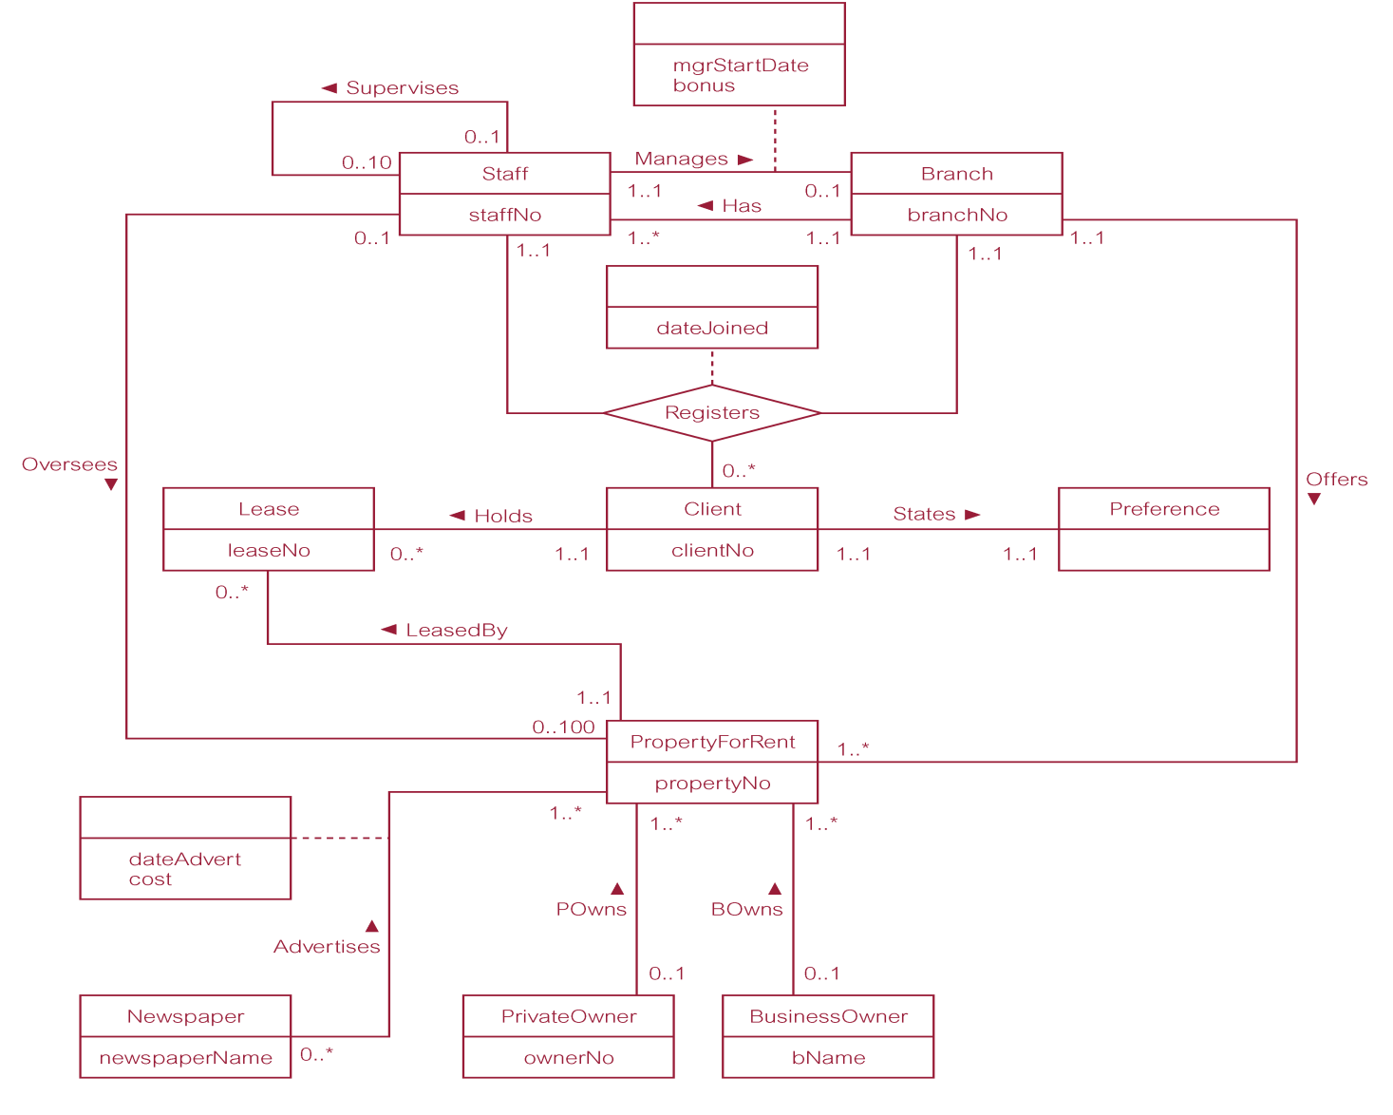
Sample ER-Diagram

Slide 7
Concepts of the ER Model
The basic concepts of the ER model are:
Entity types
Relationship types
Attributes

Slide 8
Entity Types
Entity type
A group of objects with same properties, which are identified by enterprise as having an independent existence (physical or conceptual)
Entity occurrence
A uniquely identifiable object of an entity type

Slide 9
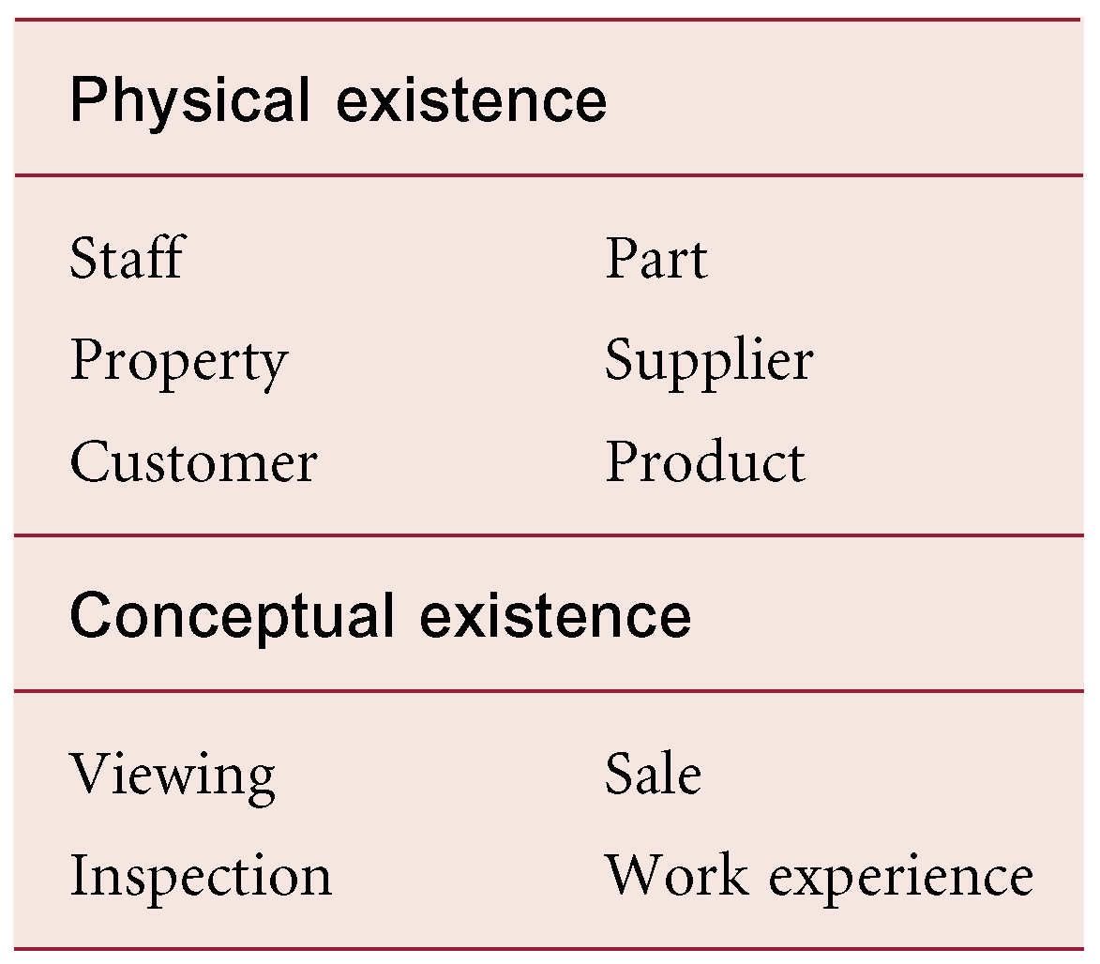
Examples of Entity Types

Slide 10
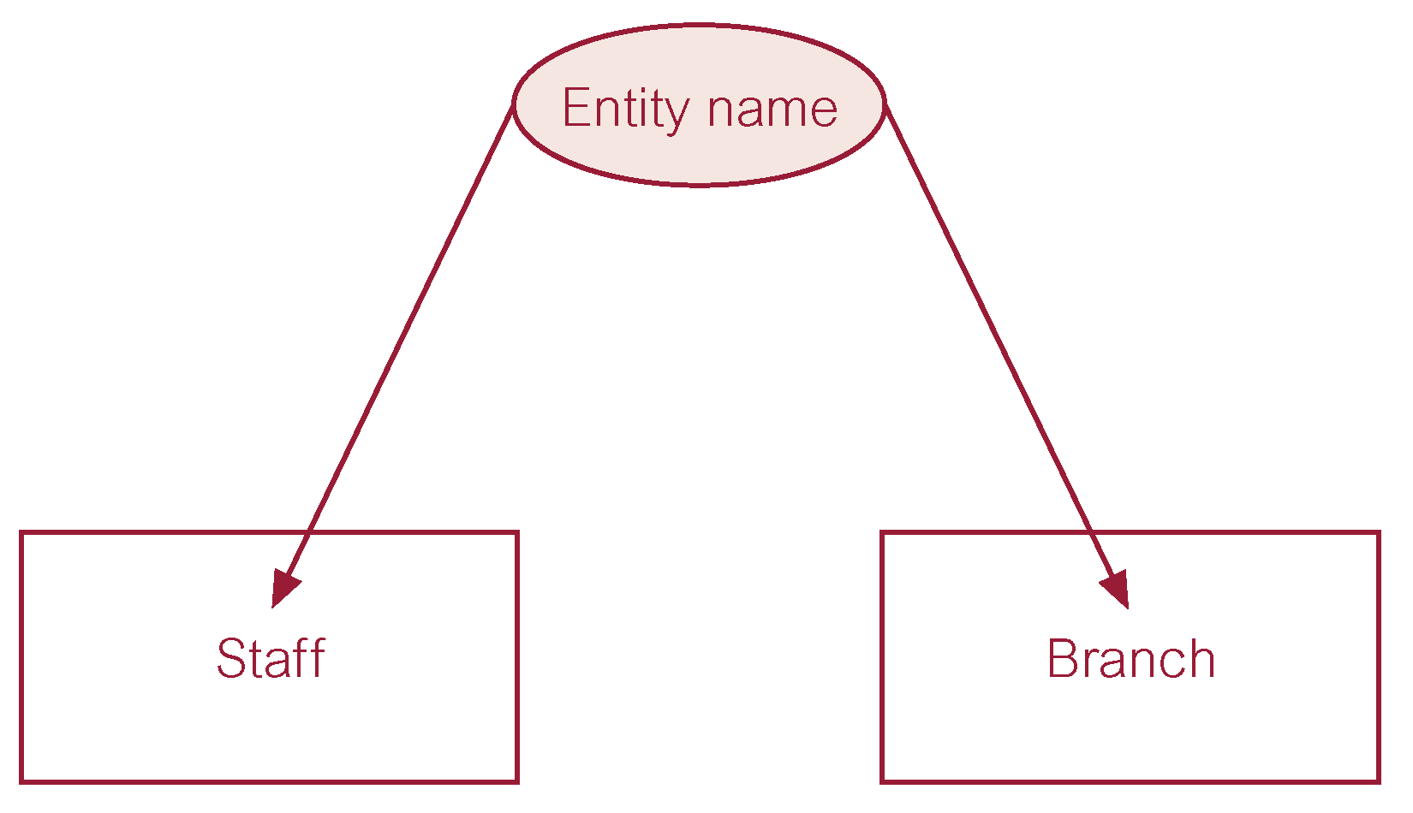
Diagrammatic Representation: Entity Types
Each entity type is shown as a rectangle labeled with the name of the entity, which is normally a singular noun
In UML, the ﬁrst letter of each word in the entity name is upper case

Slide 11
Relationship Types
Relationship type
A set of meaningful associations among entity types
Relationship occurrence
A uniquely identifiable association, which includes one occurrence from each participating entity type

Slide 12
Relationship Types
Each relationship type is shown as a line connecting the associated entity types, labeled with the name of the relationship
Normally, a relationship is named using a verb (for example, Supervises or Manages) or a short phrase including a verb (for example, LeasedBy)
Again, the ﬁrst letter of each word in the relationship name is shown in upper case

Slide 13
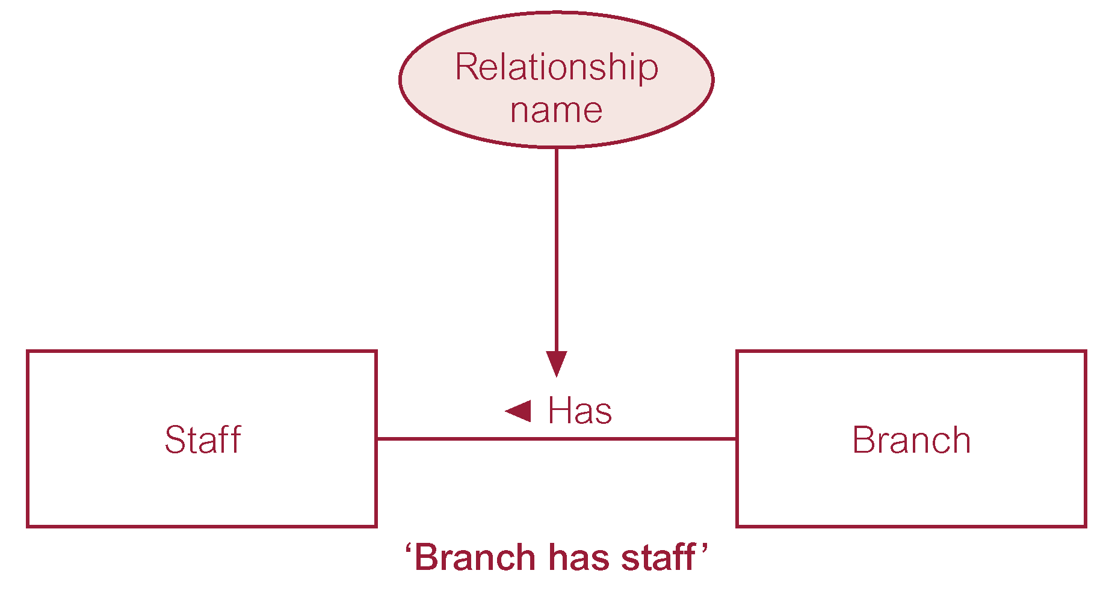
Diagrammatic Representation: Relationship Types
Whenever possible, a relationship name should be unique for a given ER model
A relationship is only labeled in one direction, which normally means that the name of the relationship only makes sense in one direction

Slide 14
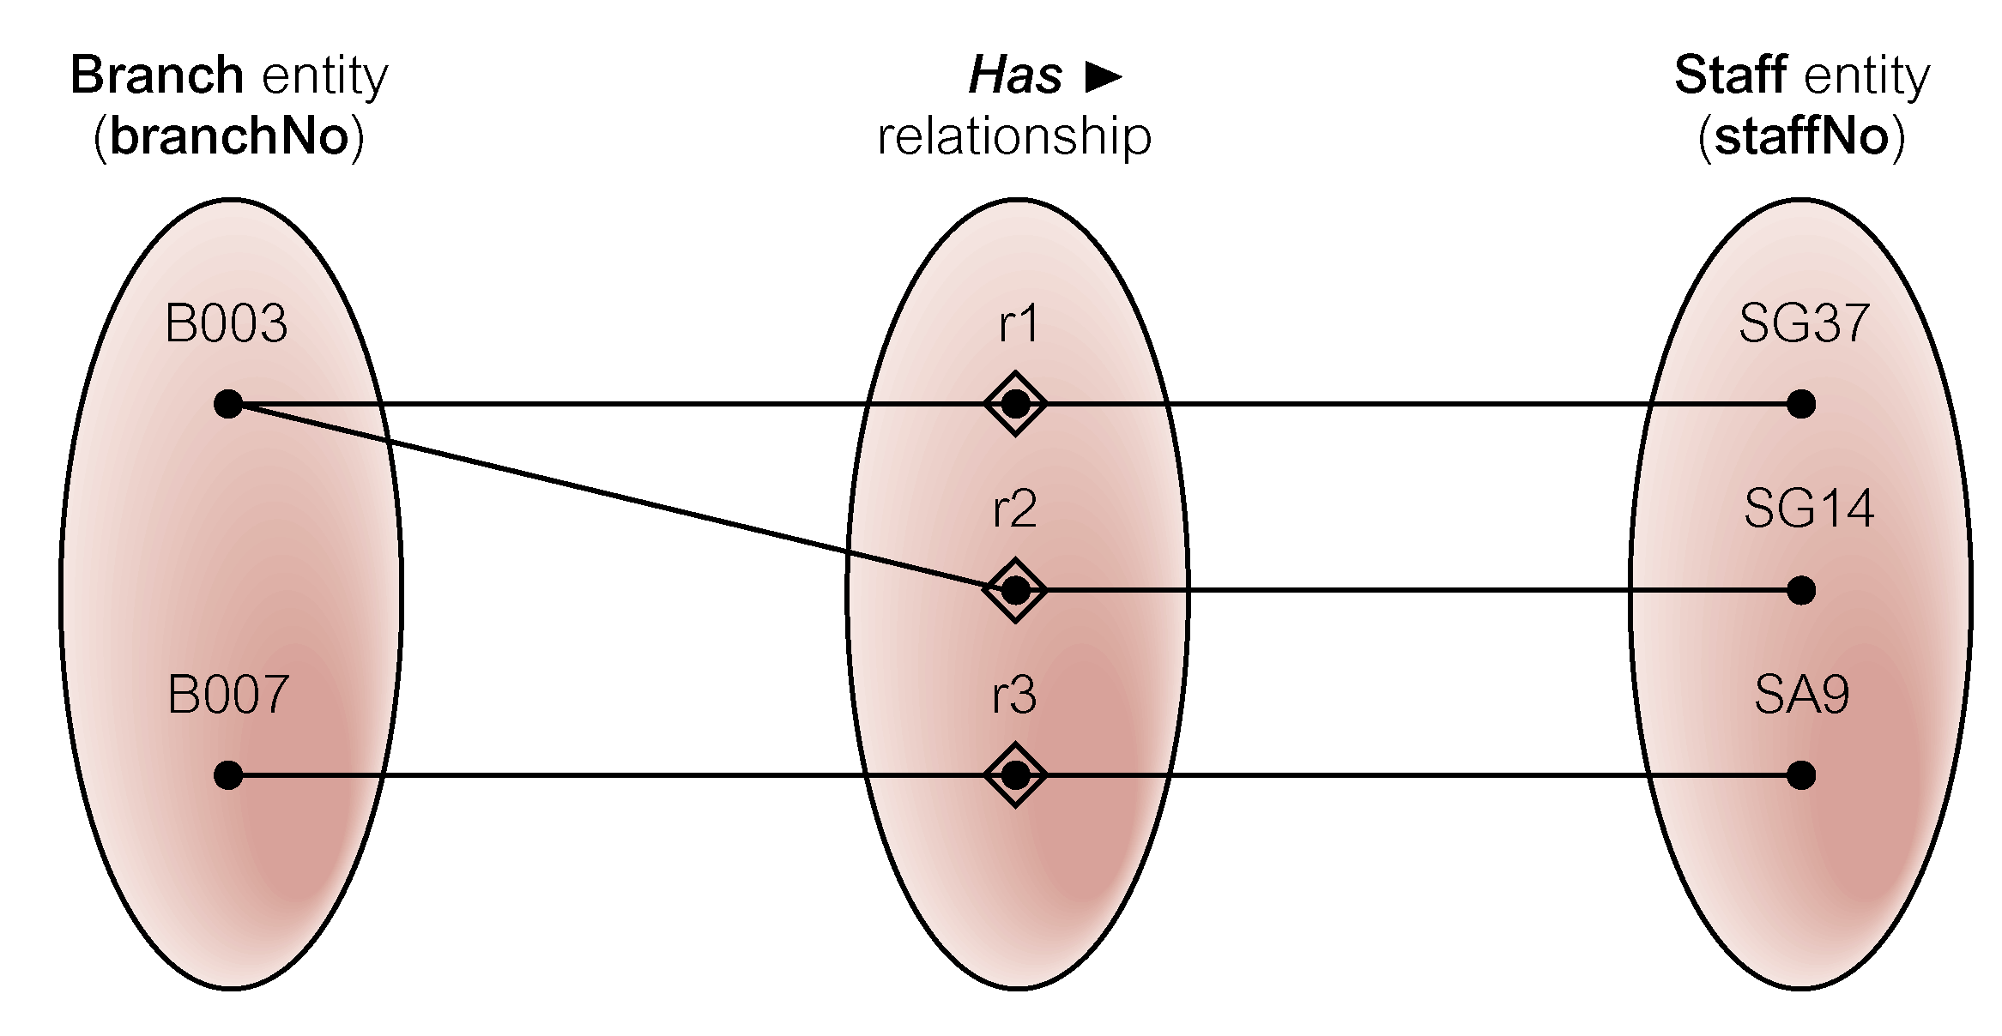
Semantic Net of Has Relationship Type
A semantic net is an object-level model, uses different symbols to entities and the relationships

Slide 15
Degree of Relationship Type
Degree of a Relationship
The number of participating entity types in a relationship
Relationship of degree :
Two is binary
Three is ternary
Four is quaternary
The term ‘complex relationship’ is used to describe relationships with degrees higher than binary

Slide 16
Binary Relationship: POwns

Slide 17
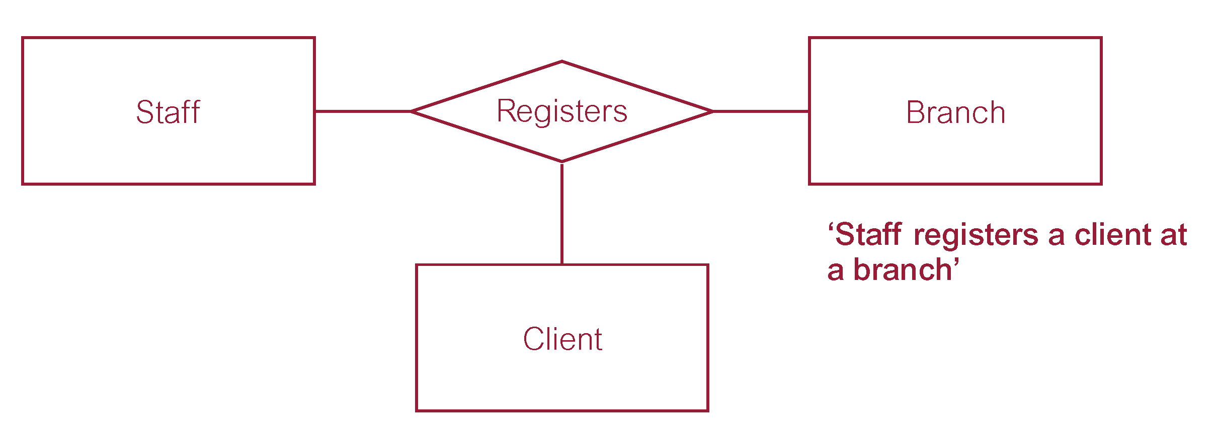
Ternary Relationship: Registers

Slide 18
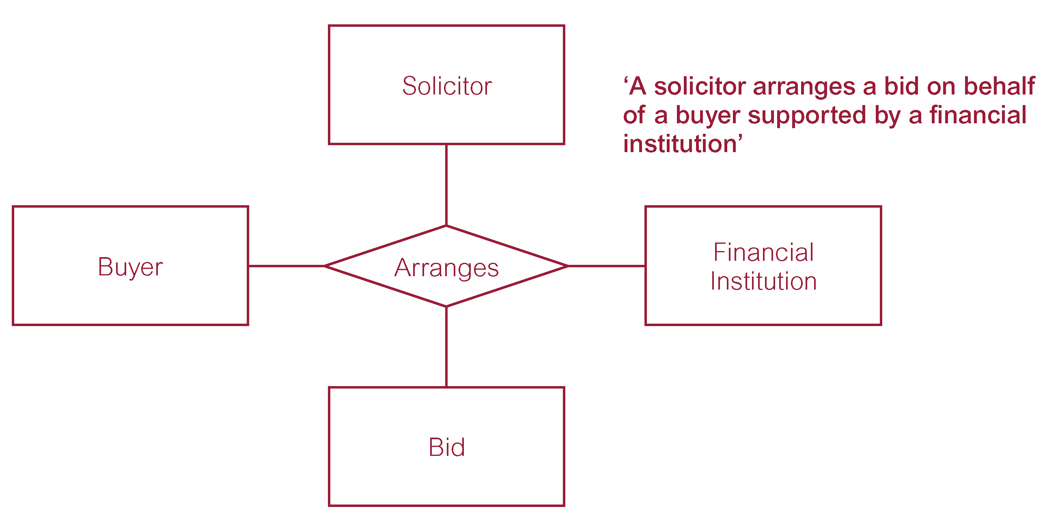
Quaternary Relationship: Arranges

Slide 19
Recursive Relationship
Relationship type where same entity type participates more than once in different roles
Relationships may be given role names to indicate purpose that each participating entity type plays in a relationship
Sometimes also called unary relationships

Slide 20
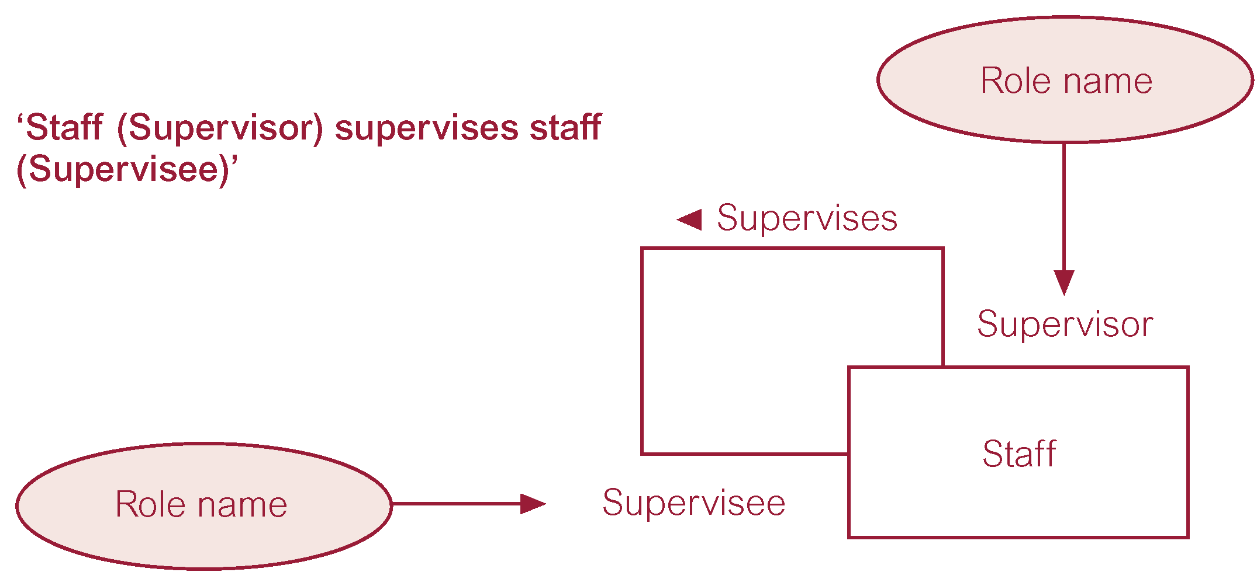
Example: Recursive Relationship

Slide 21
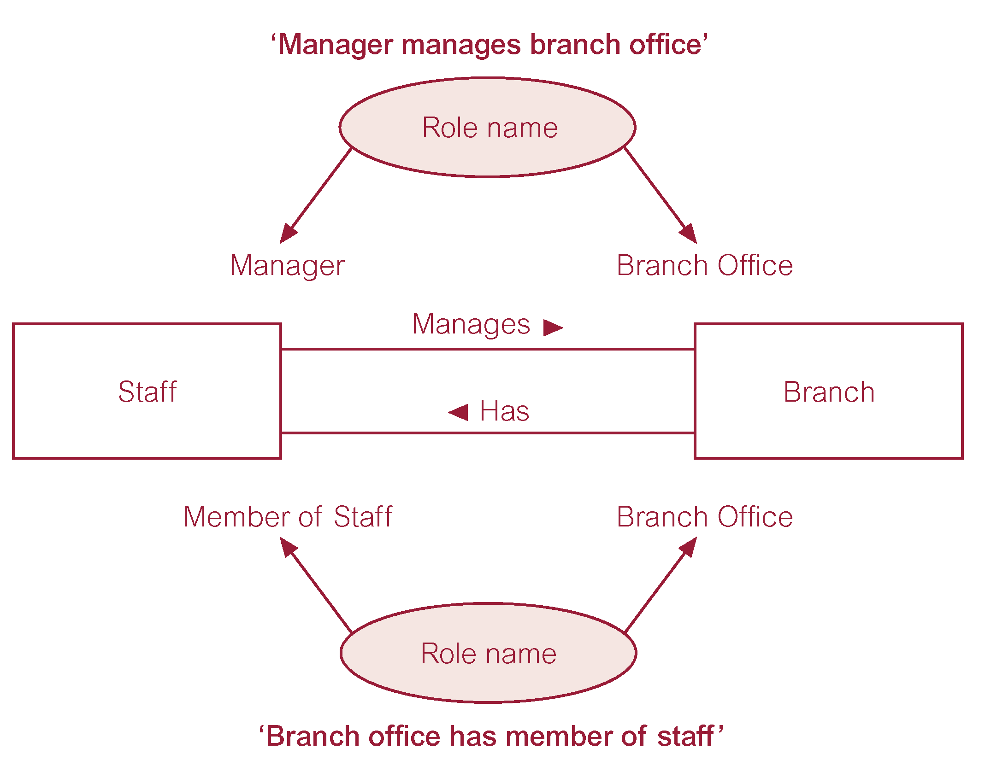
Role Names in Distinct Relationships

Slide 22
Attributes
Attribute
A property of an entity or a relationship type, e.g. a Staff entity type may be described by the staffNo, name, position, and salary attributes
The attributes hold values that describe each entity occurrence and represent the main part of the data stored in the database
A relationship type that associates entities can also have attributes similar to those of an entity type
Attribute Domain
The set of allowable values for one or more attributes

Slide 23
Attributes..
Attribute Domain
For example, the number of rooms associated with a property is between 1 and 15 for each entity occurrence
Attributes may share a domain. For example, the address attributes of the Branch, PrivateOwner, and BusinessOwner entity types share the same domain of all possible addresses
Domains can also be composed of domains. For example, the domain for the address attribute of the Branch entity is made up of subdomains: street, city, and postcode

Slide 24
Attributes..
Simple Attribute
Attribute composed of a single component with an independent existence e.g. position and salary etc.
Also called atomic attributes
Composite Attribute
Attribute composed of multiple components, each with an independent existence e.g. the address attribute of the Branch entity with the value (163 Main St, Glasgow, G11 9QX) can be subdivided into street (163 Main St), city (Glasgow), and postcode (G11 9QX) attributes

Slide 25
Attributes..
Single-valued Attribute
Attribute that holds a single value for each occurrence of an entity type e.g. branchNo, staffNo etc.
Multi-valued Attribute
Attribute that holds multiple values for each occurrence of an entity type e.g. each occurrence of the Branch entity type can have multiple values for the telNo attribute etc.
A multi-valued attribute may have a set of numbers with upper and lower limits

Slide 26
Attributes..
Derived Attribute
Attribute that represents a value that is derivable from value of a related attribute, or set of attributes, not necessarily in the same entity type
For example, the value for the duration attribute of the Lease entity is calculated from the rentStart and rentFinish attributes also of the Lease entity type
For example, consider an attribute called deposit of the Lease entity type, the value of the deposit attribute is calculated as twice the monthly rent for a property

Slide 27
Keys
Candidate Key
Minimal set of attributes that uniquely identifies each occurrence of an entity type
Primary Key
Candidate key selected to uniquely identify each occurrence of an entity type e.g. staffNo, NIN etc.
The choice of primary key for an entity is based on considerations of attribute length, the minimal number of attributes required, and the future certainty of uniqueness
NIN will be the alternate key if we select staffNo as PK

Slide 28
Keys..
Composite Key
A candidate key that consists of two or more attributes
For example, consider an entity called Advert with propertyNo (property number), newspaperName, dateAdvert, and cost attributes
Many properties are advertised in many newspapers on a given date
To uniquely identify each occurrence of the Advert entity type requires values for the propertyNo, newspaperName,and dateAdvert attributes (composite key)

Slide 29
Diagrammatic Representation: Attributes
If an entity type is to be displayed with its attributes, we divide the rectangle representing the entity in two parts
The upper part of the rectangle displays the name of the entity and the lower part lists the names of the attributes
Name of an attribute in lower, if multiword, first letter of second or onwards is upper case
{PK} tag for PK, {PPK} in case of composite key, {AK} for AK
Composite attribute with indentation
Multivalued attribute with a range [1..*]
Derived attribute with a ‘/’

Slide 30
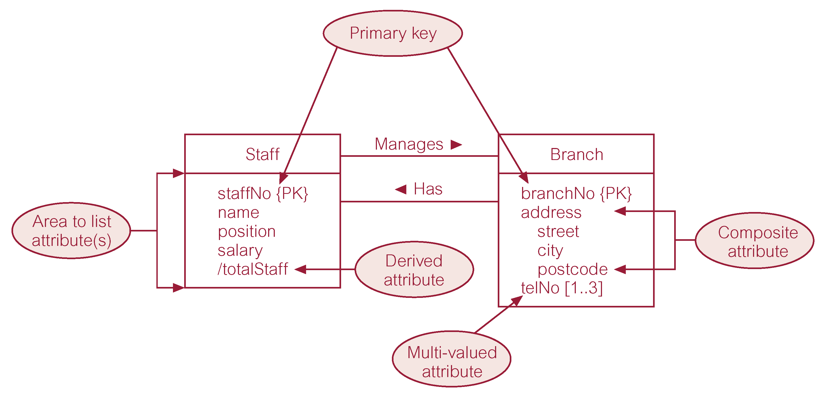
Diagrammatic Representation: Attributes

Slide 31
Summary
Database design using ER modeling
Concepts of ER model
Entities
Relationships
Attributes

Slide 32
References
All the material (slides, diagrams etc.) presented in this lecture is taken (with modifications) from the Pearson Education website :
http://www.booksites.net/connbegg

