Slide 1
CSC271 Database Systems
Lecture # 21

Slide 2
Summary: Previous Lecture
Phases of database SDLC
Prototyping (optional)
Implementation
Data conversion and loading
Testing
Operational maintenance
Fact-finding techniques
Examining documentation
Interviewing
Observing the organization in operation
Research
Questionnaires

Slide 3
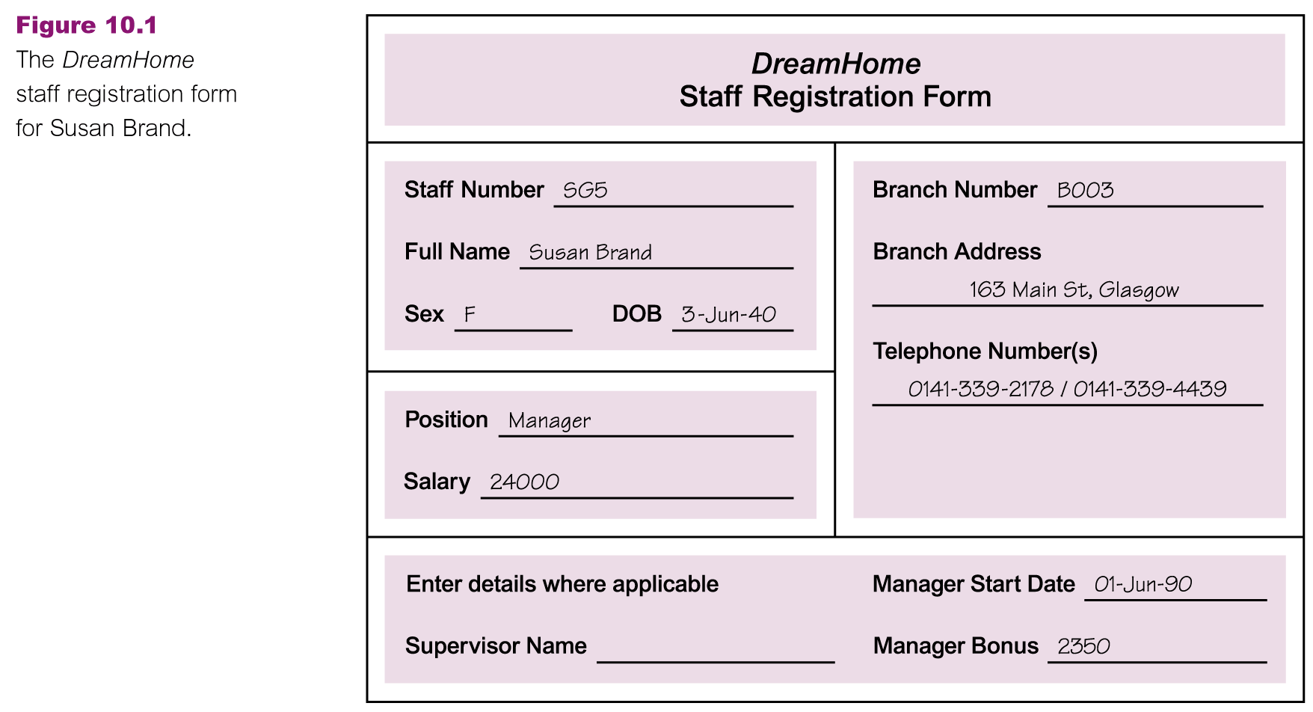
DreamHome Case Study

Slide 4
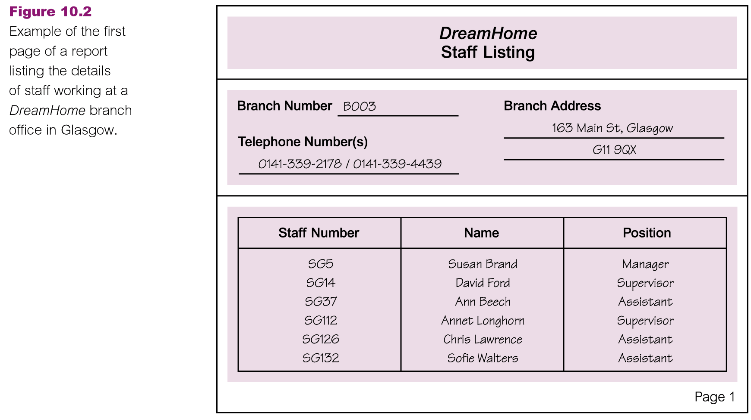
DreamHome Case Study

Slide 5
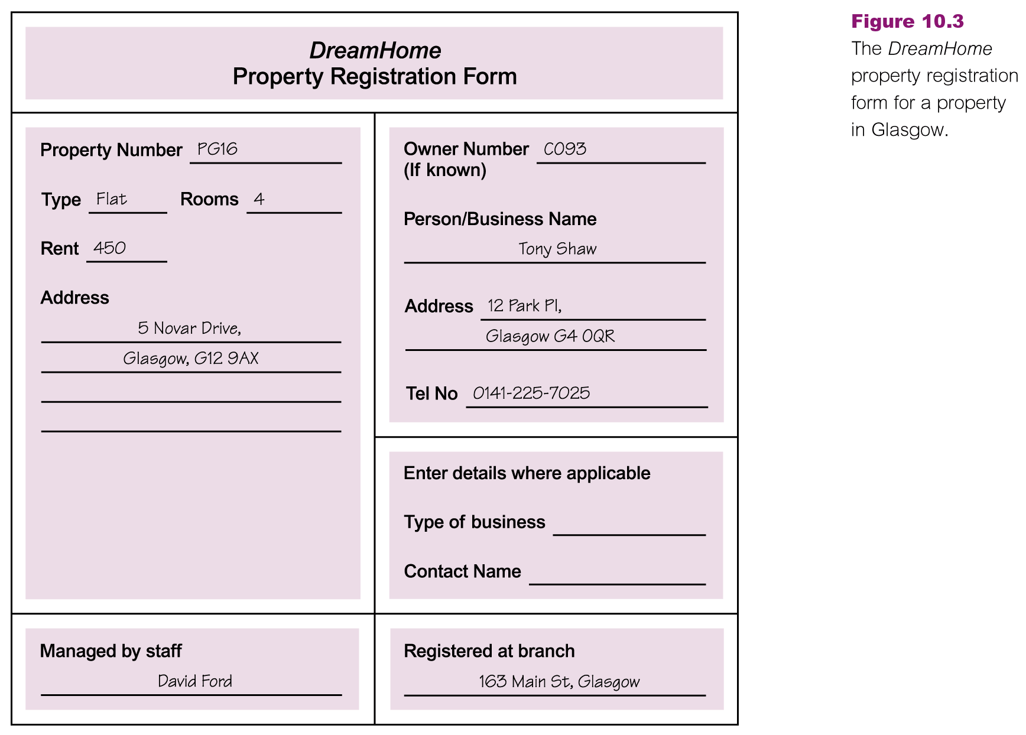
DreamHome Case Study

Slide 6
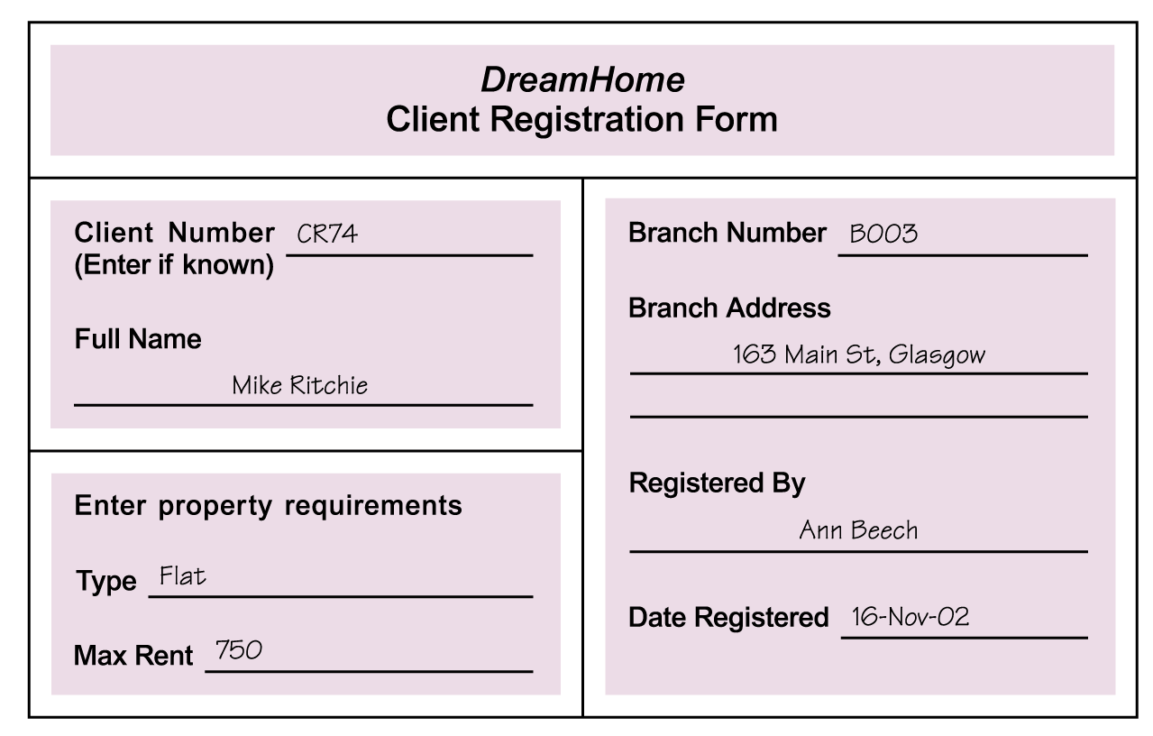
DreamHome Case Study

Slide 7
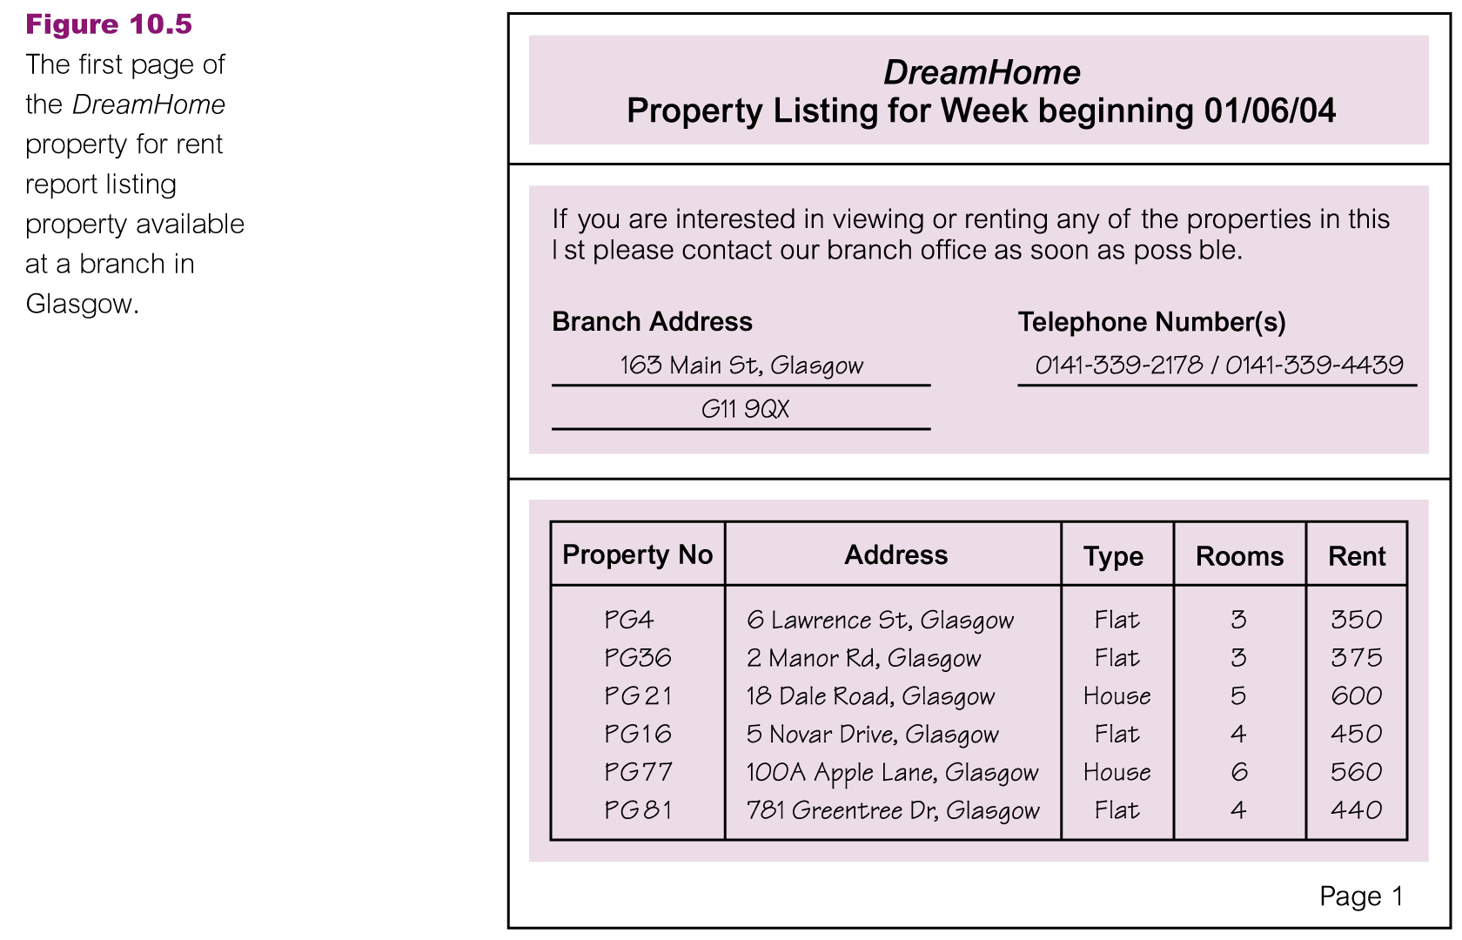
DreamHome Case Study

Slide 8
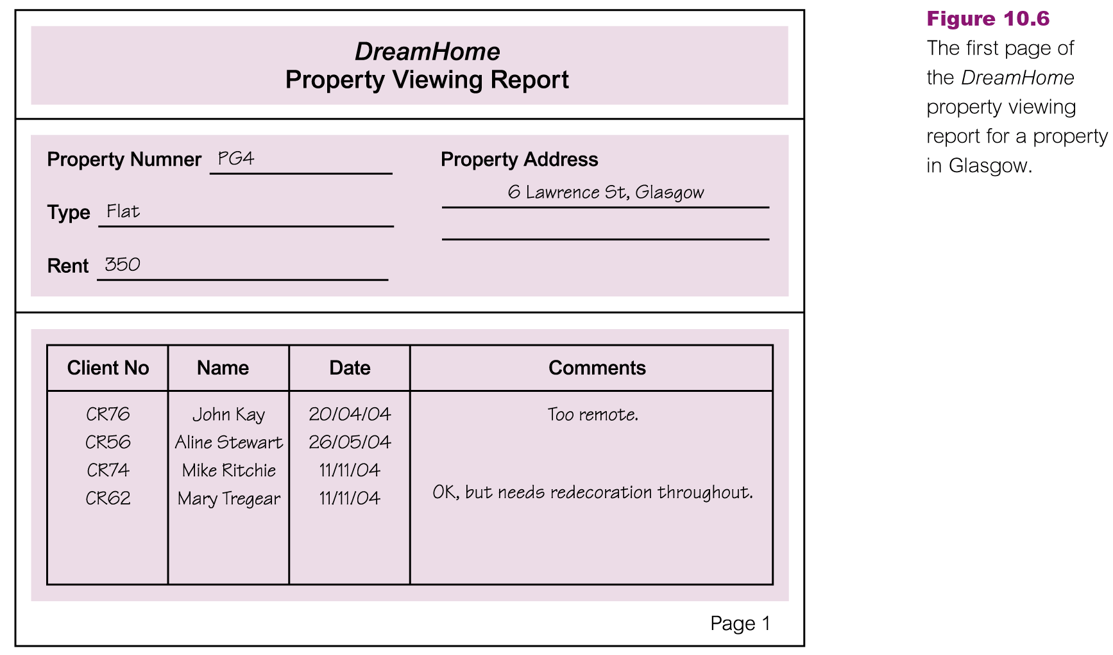
DreamHome Case Study

Slide 9
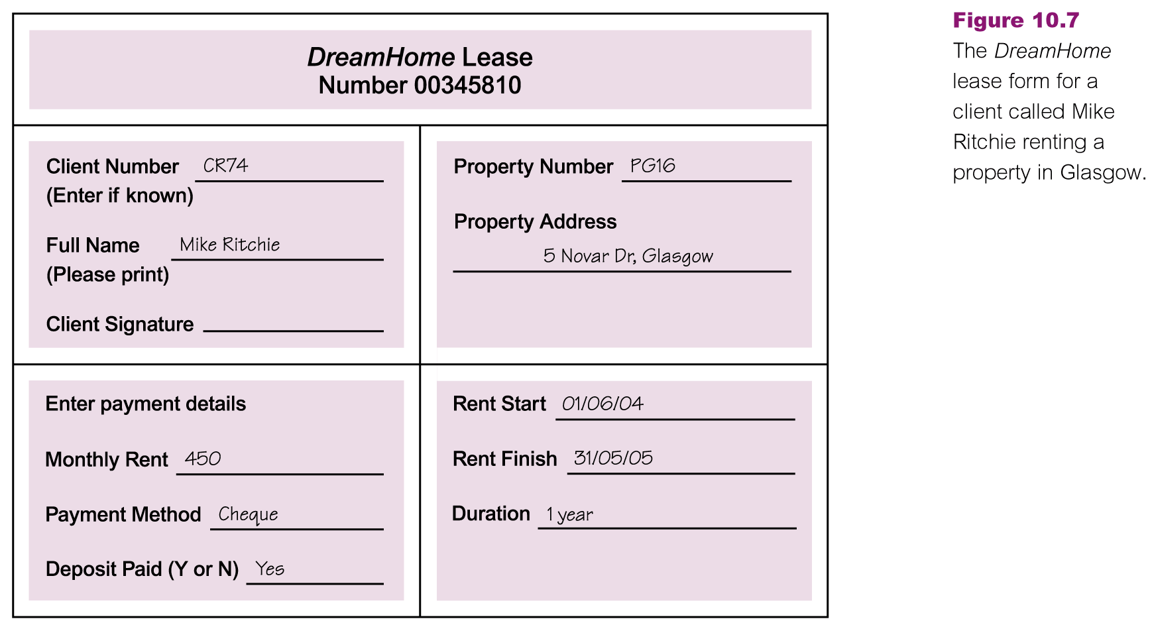
DreamHome Case Study

Slide 10
DreamHome: Database Planning
Mission statement for DreamHome
Interviews with director or appropriate staff
Open-ended questions
‘What is the purpose of your company?’
‘Why do you feel that you need a database?’
‘How do you know that a database will solve your problem?’

Slide 11
DreamHome: Database Planning..
Mission objectives for DreamHome
Interviews with staff members with different roles
Open-ended questions
‘‘What is your job description?’
‘What kinds of tasks do you perform in a typical day?’
‘What kinds of data do you work with?’
‘What types of reports do you use?’
‘What types of things do you need to keep track of?’
‘What service does your company provide to your customers?’

Slide 12
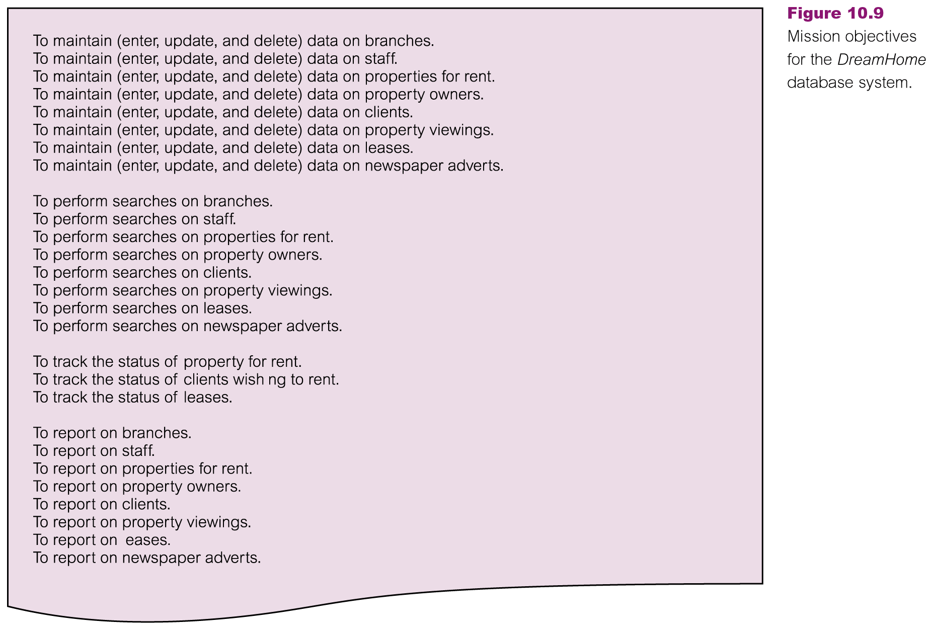
DreamHome: Mission Objectives

Slide 13
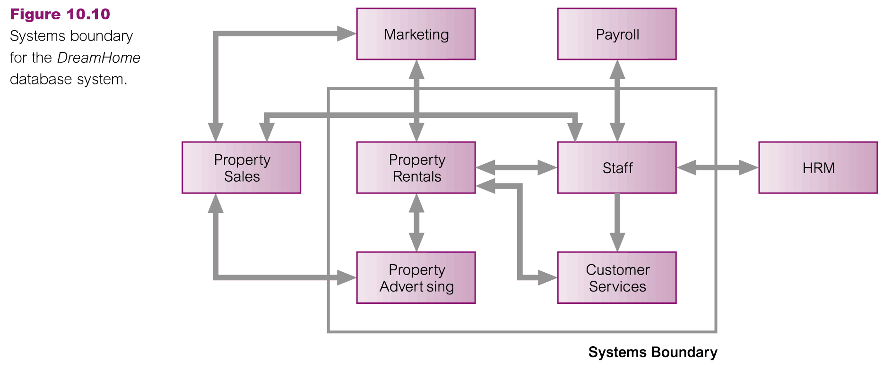
DreamHome: System Definition
To deﬁne the scope and boundary of the database system and its major user views

Slide 14
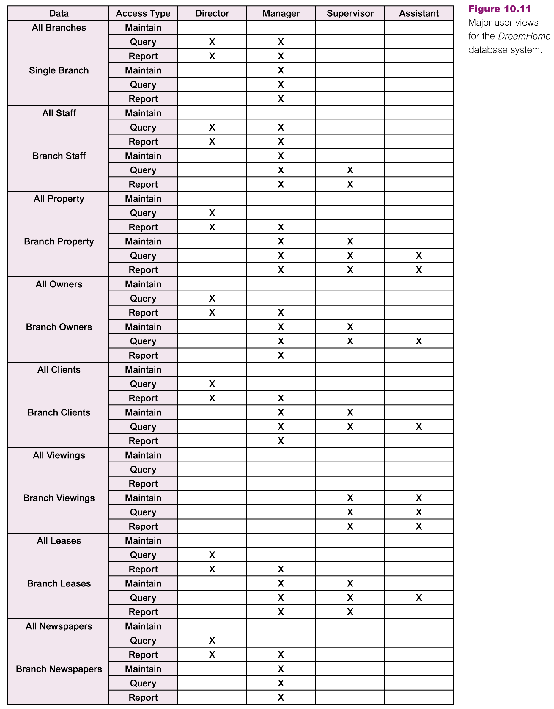
DreamHome: System Definition..

Slide 15
DreamHome: Req. Coll. & Analysis
Users’ requirements speciﬁcation
The data to be held in the database and how the data is to be used
‘What type of data do you need to hold on X?’
‘What sorts of things do you do with the data on X?’

Slide 16
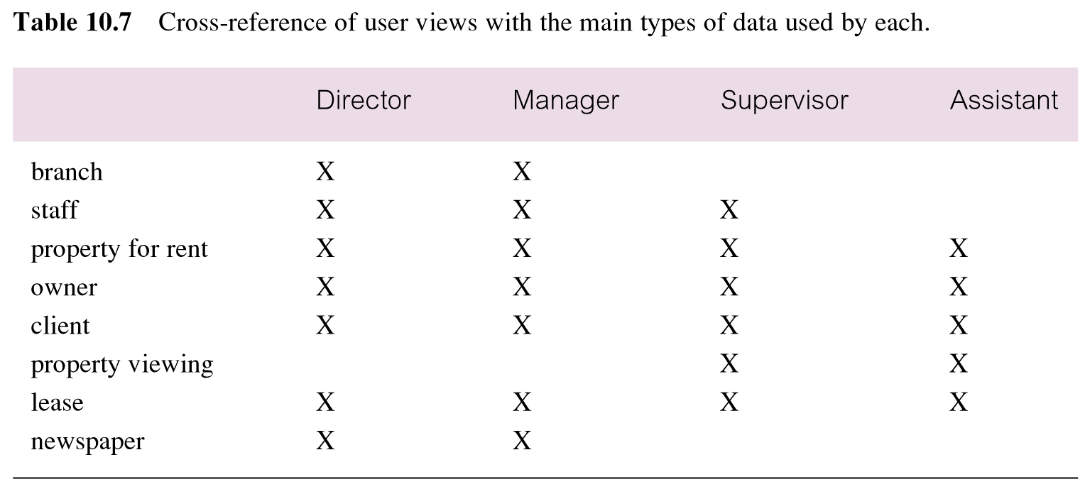
DreamHome: Req. Coll. & Analysis..

Slide 17
Managing User Views
How do we decide whether to use the centralized or view integration approach, or a combination of both to manage multiple user views?
One way to help make a decision is to examine the overlap in the data used between the user views identiﬁed during the system deﬁnition stage
Based on this analysis, we use the centralized approach to ﬁrst merge the requirements for the Director and Manager user views (Branch user views) and the requirements for the Supervisor and Assistant user views (Staff user views)
Data models representing the Branch and Staff user views are developed and then view integration approach is used to merge the two data models

Slide 18
DreamHome: Req. Coll. & Analysis..
System specification
‘What transactions run frequently on the database?’
‘What transactions are critical to the operation of the organization?’
‘When do the critical transactions run?’
‘When are the low, normal, and high workload periods for the critical transactions?’
‘What type of security do you want for the database system?’
Is there any highly sensitive data that should be accessed only by certain members of staff?’
‘What historical data do you want to hold?’
‘What are the networking and shared access requirements for the database system?’
‘What type of protection from failures or data loss do you want for the database
system?’

Slide 19
DreamHome: Req. Coll. & Analysis..
The types of features described in the systems specification include:
Initial database size
Database rate of growth
The types and average number of record searches
Networking and shared access requirements
Performance
Security
Backup and recovery
Legal issues

Slide 20
Conceptual Database Design
Chapter 15

Slide 21
DreamHome: Database Design
Conceptual database design
To build the conceptual representation of the database, which includes identiﬁcation of the important entities, relationships, and attributes
Logical database design
To translate the conceptual representation to the logical structure of the database, which includes designing the relations
Physical database design
To decide how the logical structure is to be physically implemented (as base relations) in the target Database Management System (DBMS)

Slide 22
What is a Design Methodology?
A structured approach that uses procedures, techniques, tools, and documentation aids to support and facilitate the process of design
A design methodology consists of phases each containing a number of steps, which guide the designer in the techniques appropriate at each stage of the project
A design methodology also helps the designer to plan, manage, control, and evaluate database development projects
Furthermore, it is a structured approach for analyzing and modeling a set of requirements for a database in a standardized and organized manner

Slide 23
Critical Success Factors in Database Design
Work interactively with the users as much as possible
Follow a structured methodology throughout the data modeling process
Employ a data-driven approach
Incorporate structural and integrity considerations into the data models
Combine conceptualization, normalization, and transaction validation techniques into the data modeling methodology
Use diagrams to represent as much of the data models as possible
Use a Database Design Language (DBDL) to represent additional data semantics
Build a data dictionary to supplement the data model diagrams
Be willing to repeat steps

Slide 24
Conceptual Database Design Methodology
A structured approach that uses procedures, techniques, tools, and documentation aids to support and facilitate the process of design
A design methodology consists of phases each containing a number of steps, which guide the designer in the techniques appropriate at each stage of the project
A design methodology also helps the designer to plan, manage, control, and evaluate database development projects
Furthermore, it is a structured approach for analyzing and modeling a set of requirements for a database in a standardized and organized manner

Slide 25
Building Conceptual Data Model
The ﬁrst step in conceptual database design is to build one (or more) conceptual data models of the data requirements of the enterprise
A conceptual data model comprises:
Entity types
Relationship types
Attributes and attribute domains
Primary keys and alternate keys
Integrity constraints

Slide 26
Building Conceptual Data Model
The tasks involved in building conceptual data model are:
Identify entity types
Identify relationship types
Identify and associate attributes with entity or relationship types
Determine attribute domains
Determine candidate, primary, and alternate key attributes
Consider use of enhanced modeling concepts (optional step)
Check model for redundancy
Validate conceptual model against user transactions
Review conceptual data model with user

Slide 27
Identify Entity Types
To identify the required entity types
Deﬁne the main objects
Examine the users’ requirements speciﬁcation
Look for nouns or noun phrases, major objects such as people, places, or concepts of interest etc.
It is not always obvious whether a particular object is an entity, a relationship, or an attribute
Entities identified for Staff user views of the DreamHome case study are:
Staff, PropertyForRent, PrivateOwner, BusinessOwner, Client Preference, Lease

Slide 28
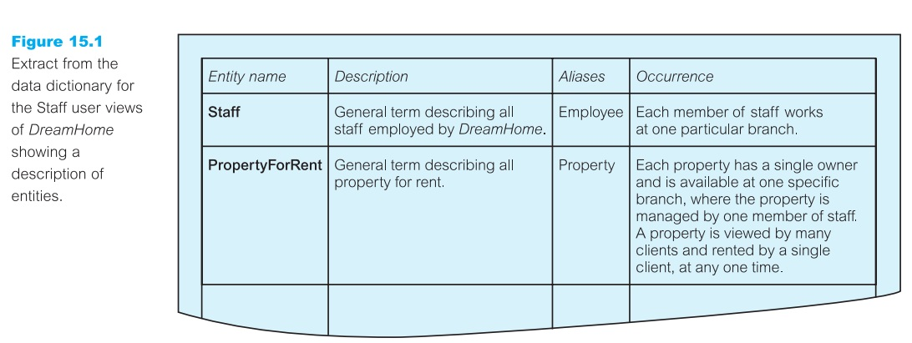
Document Entity Types

Slide 29
Identify Relationship Types
To identify the important relationships that exist between the entity types
We can use the grammar of the requirements speciﬁcation to identify relationships
Typically, relationships are indicated by verbs or verbal expressions
For example:
Staff Manages PropertyForRent
PrivateOwner Owns PropertyForRent
PropertyForRent AssociatedWith Lease
Entity–Relationship (ER) diagrams to represent entities and how they relate to one another

Slide 30
Summary
Applying Database SDLC on DreamHome
Database planning
System definition
Requirements collection and analysis
Database design
Design methodology
Conceptual database design

Slide 31
References
All the material (slides, diagrams etc.) presented in this lecture is taken (with modifications) from the Pearson Education website :
http://www.booksites.net/connbegg

