Slide 1
CSC271 Database Systems
Lecture # 20

Slide 2
Summary: Previous Lecture
Phases of database SDLC
Requirements collection and analysis
Database design
DBMS selection (optional)
Application design

Slide 3
Prototyping
Building working model of a database system
Purpose of prototyping includes:
To identify features of a system that work well, or are inadequate
To suggest improvements or even new features
To clarify the users’ requirements
To evaluate feasibility of a particular system design
Types of prototyping
Requirements prototyping
Evolutionary prototyping

Slide 4
Implementation
Physical realization of the database and application designs
Use DDL to create database schemas and empty database files
Use DDL to create any specified user views
Use 3GL or 4GL to create the application programs, this will include the database transactions implemented using the DML, possibly embedded in a host programming language

Slide 5
Data Conversion and Loading
Transferring any existing data into new database and converting any existing applications to run on new database
Only required when new database system is replacing an old system
DBMS normally has utility that loads existing files into new database
May be possible to convert and use application programs from old system for use by new system

Slide 6
Testing
Process of running the database system with intent of finding errors
Use carefully planned test strategies and realistic data
Testing cannot show absence of faults; it can show only that software faults are present
Demonstrates that database and application programs appear to be working according to requirements
Should also test usability of system
Evaluation conducted against a usability specification

Slide 7
Evaluation Criteria
Examples of the criteria that can be used to conduct the evaluation include:
Learnability
Performance
Robustness
Recoverability
Adaptability

Slide 8
Operational Maintenance
Process of monitoring and maintaining database system following installation
Monitoring performance of system
If performance falls, may require tuning or reorganization of the database
Maintaining and upgrading database application (when required)
Incorporating new requirements into database application

Slide 9
CASE Tools
Support provided by CASE tools include:
Data dictionary to store information about database system’s data
Design tools to support data analysis;
Tools to permit development of corporate data model, and conceptual and logical data models
Tools to enable prototyping of applications

Slide 10
CASE Tools
CASE tools provide following benefits:
Standards
Integration
Support for standard methods
Consistency
Automation

Slide 11
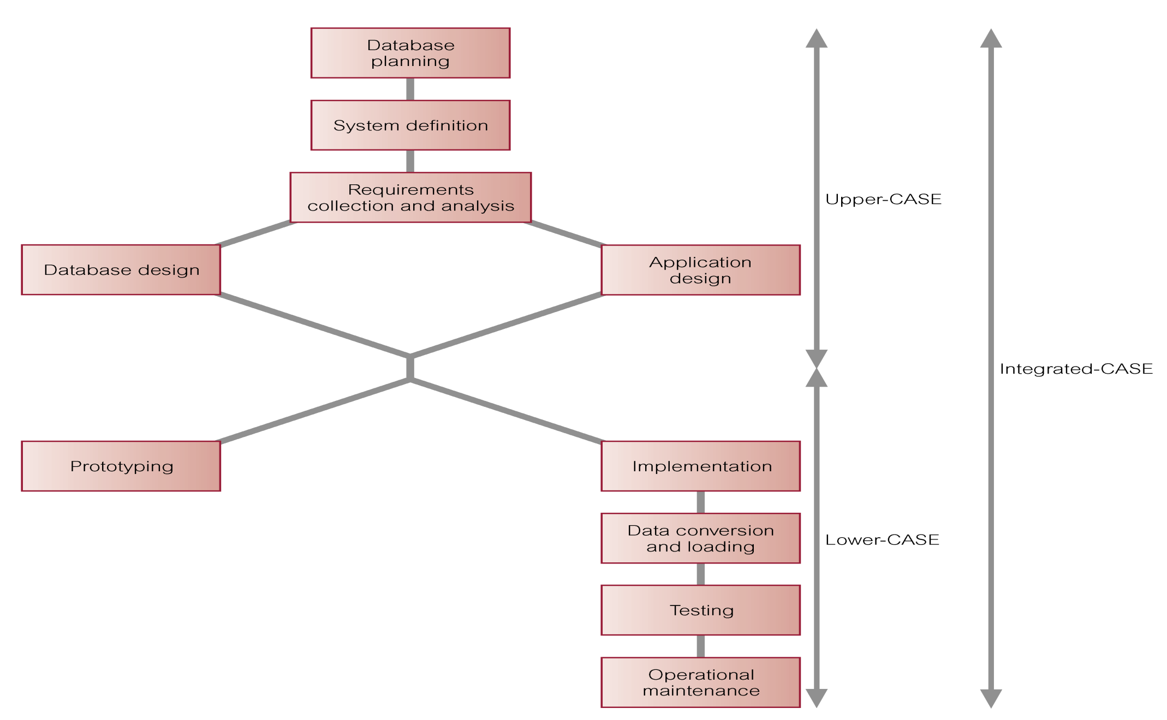
CASE Tools and DB SDLC

Slide 12
Data/Database Administration
The Data Administrator (DA) and Database Administrator (DBA) are responsible for managing and controlling the corporate data and corporate database, respectively
DA (Data Administrator) is more concerned with early stages of database system development lifecycle
DBA (Database Administrator) is more concerned with later stages

Slide 13
Data Administration
Management of data resource including:
Database planning
Development and maintenance of standards, policies and procedures, and conceptual and logical database design

Slide 14
Database Administration
Management of physical realization of a database system including:
Physical database design and implementation
Setting security and integrity controls
Monitoring system performance, and reorganizing the database

Slide 15
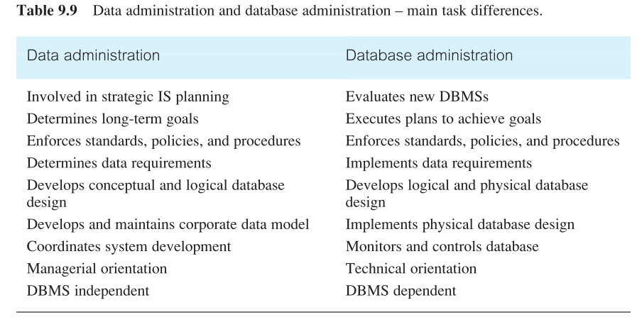
DA Vs. DBA

Slide 16
Fact-Finding Techniques
Chapter 10

Slide 17
Fact-Finding
It is critical to capture the necessary facts to build the required database application
These facts are captured using fact-finding techniques
The formal process of using techniques such as interviews and questionnaires to collect facts about systems, requirements, and preferences

Slide 18
When Are Techniques Used?
Fact-Finding used throughout the database application lifecycle, crucial to the early stages including database planning, system definition, and requirements collection and analysis stages
Enables developer to learn about the terminology, problems, opportunities, constraints, requirements, and priorities of the organization and the users of the system

Slide 19
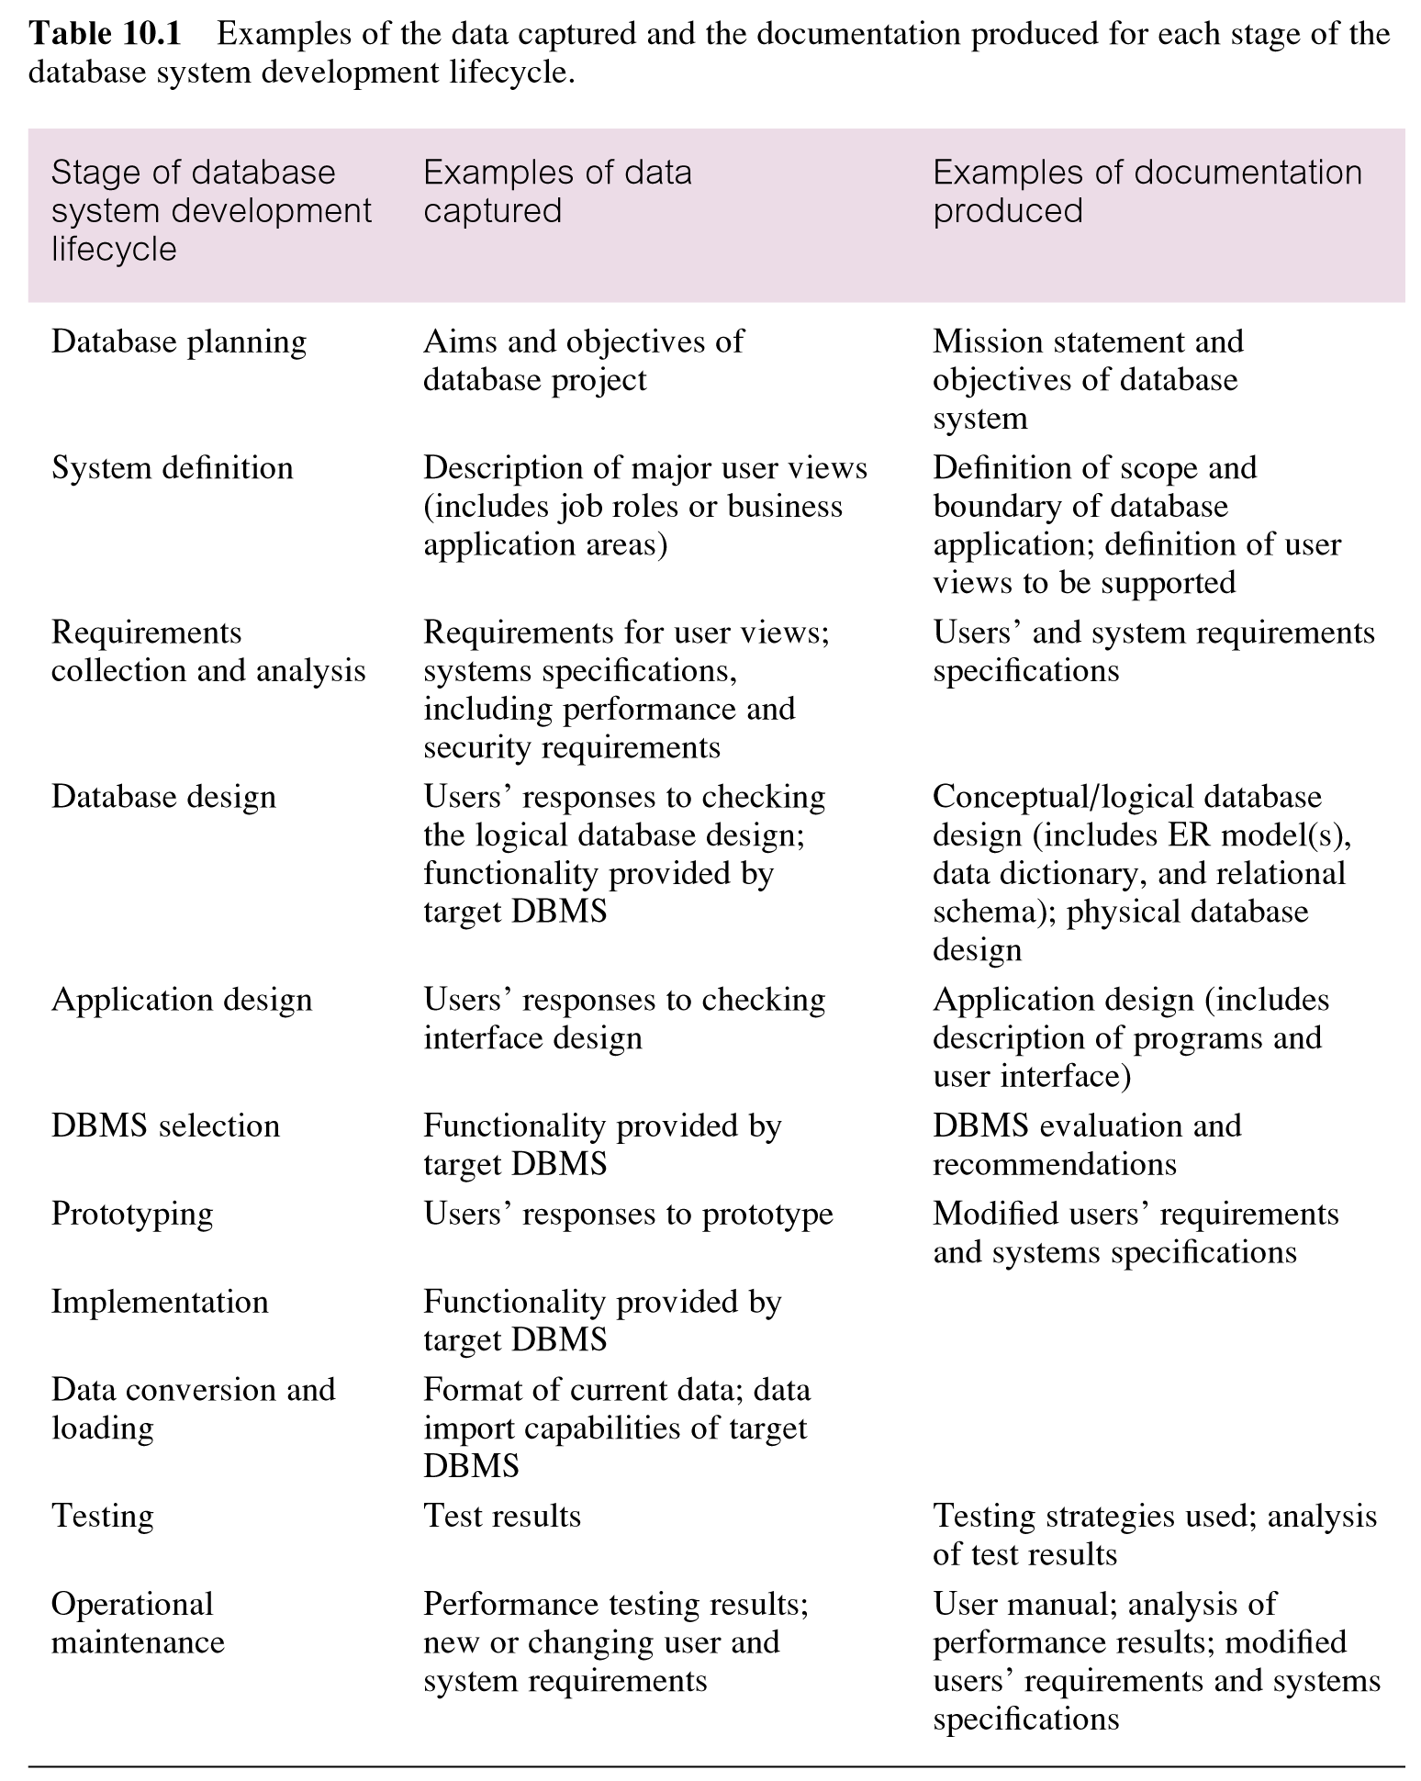

Slide 20
Fact-Finding Techniques
A database developer normally uses several fact-finding techniques during a single database project including:
Examining documentation
Interviewing
Observing the organization in operation
Research
Questionnaires

Slide 21
Examining Documentation
Can be useful
To gain some insight as to how the need for a database arose
To identify the part of the organization associated with the problem
To understand the current system

Slide 22
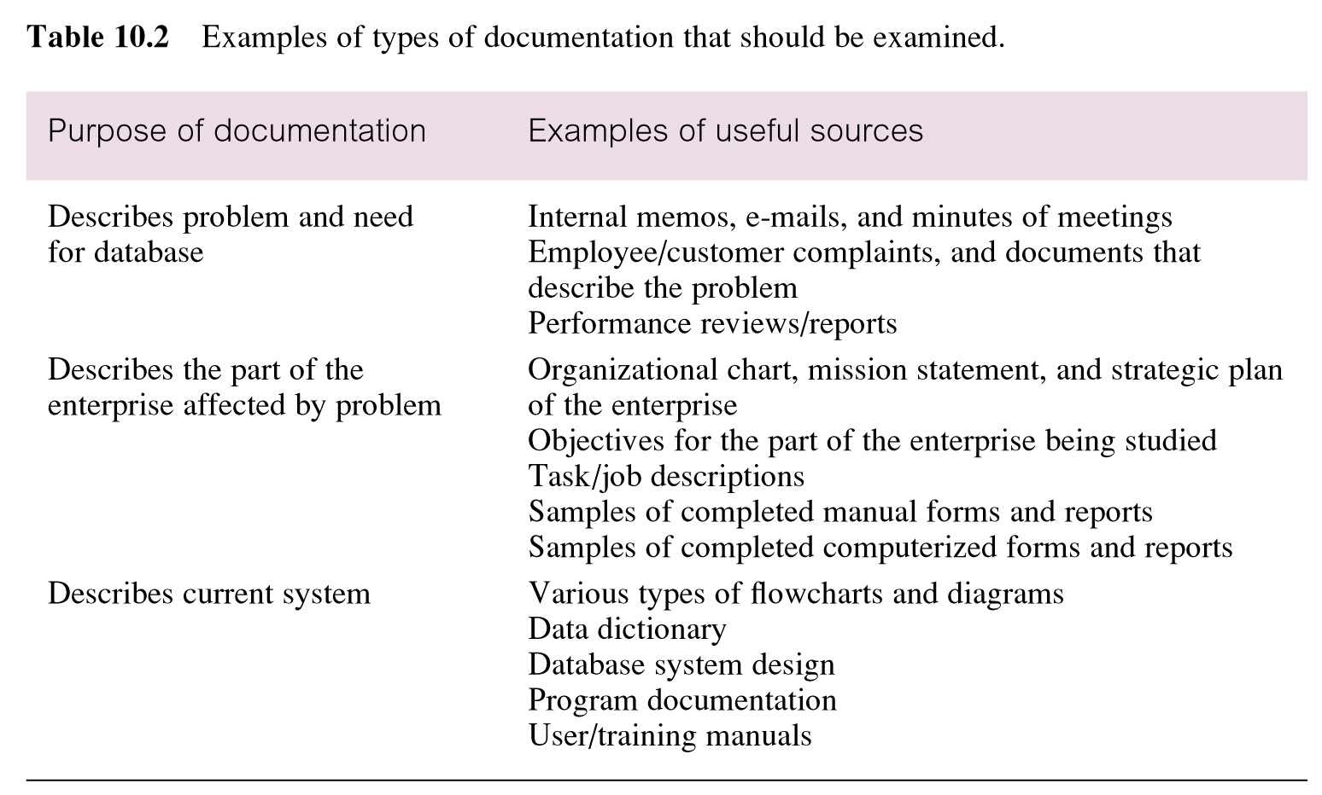
Examples: Documentation

Slide 23
Interviewing
Most commonly used, and normally most useful, fact-finding technique
Enables collection of information from individuals face-to-face
Objectives include finding out facts, verifying facts, clarifying facts, generating enthusiasm, getting the end-user involved, identifying requirements, and gathering ideas and opinions

Slide 24
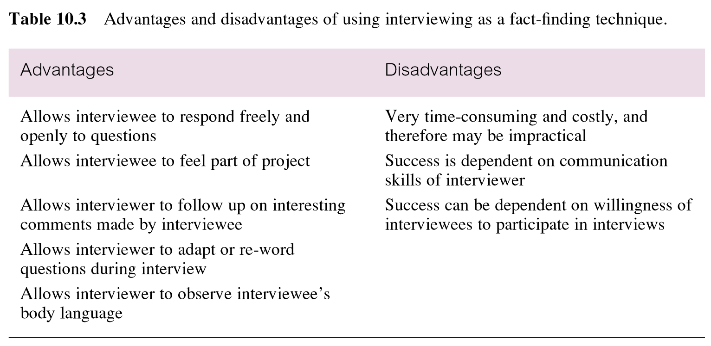
Pros/Cons: Interviewing

Slide 25
Types of Interviewing
There are two types of interviews unstructured and structured
Open-ended questions allow the interviewee to respond in any way that seems appropriate
Closed-ended questions restrict answers to either specific choices or short, direct responses

Slide 26
Observing the Organization in Operation
An effective technique for understanding a system
Possible to either participate in, or watch, a person perform activities to learn about the system
Useful when validity of data collected is in question or when the complexity of certain aspects of the system prevents a clear explanation by the end-users

Slide 27
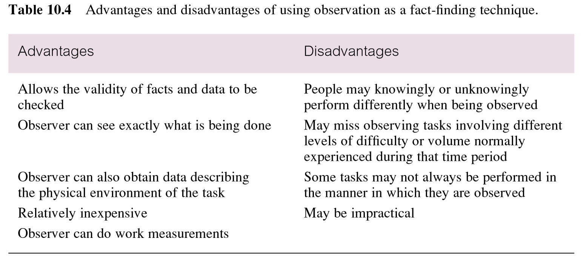
Pros/Cons: Observation

Slide 28
Research
Useful to research the application and problem
Use computer trade journals, reference books, and the Internet (including user groups and bulletin boards)
Provide information on how others have solved similar problems, plus whether or not software packages exist to solve or even partially solve the problem

Slide 29
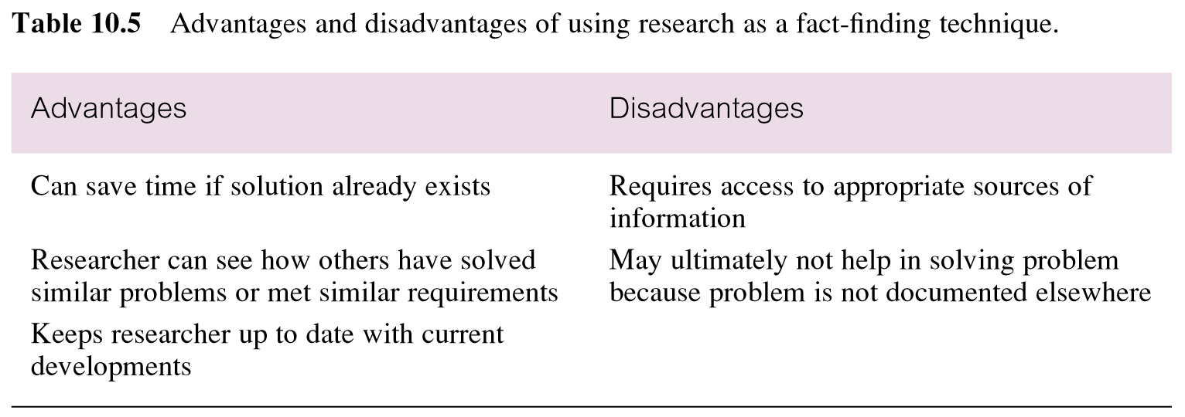
Pros/Cons: Research

Slide 30
Questionnaires
Conduct surveys through questionnaires, which are special-purpose documents that allow facts to be gathered from a large number of people while maintaining some control over their responses
There are two types of questions, namely
Free-format
Fixed-format

Slide 31
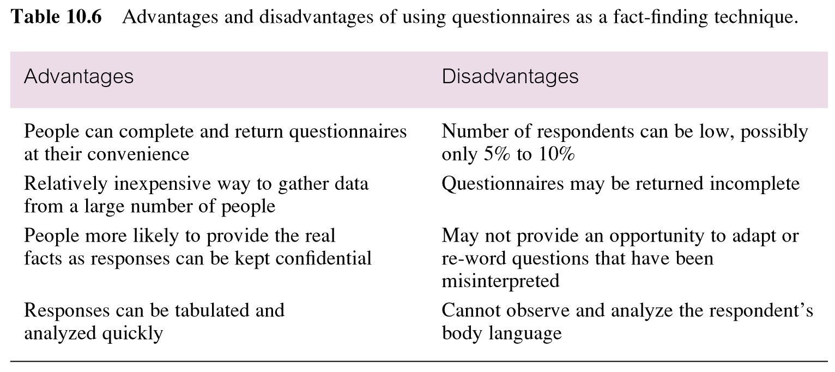
Pros/Cons: Questionnaires

Slide 32
Summary
Phases of database SDLC
Prototyping (optional)
Implementation
Data conversion and loading
Testing
Operational maintenance
Fact-finding techniques
Examining documentation
Interviewing
Observing the organization in operation
Research
Questionnaires

Slide 33
References
All the material (slides, diagrams etc.) presented in this lecture is taken (with modifications) from the Pearson Education website :
http://www.booksites.net/connbegg

