Slide 1
CSC271 Database Systems
Lecture # 2

Slide 2
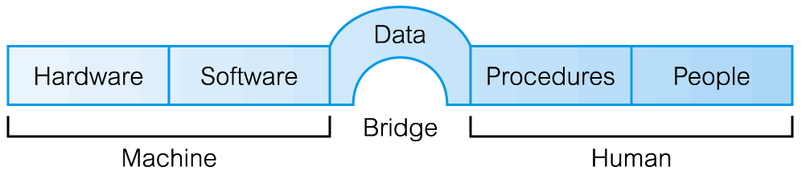
Components of the DBMS Environment

Slide 3
Components of DBMS Environment..
Hardware
  Can range from a PC to a network of computers.
Software
  DBMS, operating system, network software (if necessary) and also the application programs.
Data
  Used by the organization and a description of this data called the schema.

Slide 4
Components of DBMS Environment..
Procedures
  Instructions and rules that should be applied to the design and use of the database and DBMS.
People
  Discussed in the next section

Slide 5
Roles in the DB Environment
Data Administrator (DA)
  Database planning
  Development and maintenance of standards, policies and procedures
Database Designers (Logical/Physical)
  Logical and Physical database design
Application Programmers
  Develop Applications

Slide 6
Roles in the DB Environment..
Database Administrator (DBA)
  Physical realization of the database
  Physical database design and implementation
  Security and integrity control
  Maintenance of the operational system
  Ensuring satisfactory performance of the applications for users
End Users
  Naive
  Sophisticated

Slide 7
History of Database Systems
Roots of the DBMS
  Apollo moon-landing project, 1960s
  NAA (North American Aviation), prime contractor for the project
  Developed a software GUAM (Generalized Update Access Method), hierarchical
  In mid–1960s IBM joined NAA, result was IMS (Information Management System)

Slide 8
History of Database Systems..
IDS (Integrated Data Store)
  By General Electric, network, mid-1960
CODASYL
  Conference on Data Systems Languages
DBTG
  Data Base Task Group

Slide 9
History of Database Systems..
DBTG proposal (1971) included following components for DB system architecture:
  The schema
  The subschema
  A data management language
    Schema DDL
    Subschema DDL
    DML
Proposal was not formally adopted by ANSI

Slide 10
History of Database Systems..
E. F. Codd, 1970
  IBM Research Laboratory
  Relational model
  System R project by IBM’S San Jose Research Laboratory California
  Result of this project
    Development of SQL
    Commercial relational DBMS products e.g. DB2, SQL/DS from IBM, Oracle from Oracle Corporation

Slide 11
DBMS Generations
First-generation
  Hierarchical and Network
Second generation
  Relational
Third generation
  Object-Relational
  Object-Oriented

Slide 12
Advantages of DBMSs
Control of data redundancy
  Minimized/controlled duplication
Data consistency
  Less duplication means increased data consistency
More information from the same amount of data
  More information shared by relevant users
Sharing of data
  Data is shared by all authorized users

Slide 13
Advantages of DBMSs..
Improved data integrity
  Integrity in terms of constraints
Improved security
  Authentication, access rights
Enforcement of standards
  Data formats, naming conventions, documentation etc.
Economy of scale
  Cost savings due to database approach

Slide 14
Advantages of DBMSs..
Balance conflicting requirements
  DBA resolves conflicts between different user’s groups
Improved data accessibility/ responsiveness
  Ad hoc queries on integrated data
Increased productivity
  Developer need to focus on application
Improved maintenance
  Through program data independence

Slide 15
Advantages of DBMSs..
Increased concurrency
  Multiple users are allowed to access same data
Improved backup and recovery services
  Backup routines, recovery procedures by skilled staff

Slide 16
Disadvantages of DBMSs
Complexity
Size
Cost of DBMS
Additional hardware costs
Cost of conversion
Performance
Higher impact of a failure

Slide 17
Database Environment
Chapter 2

Slide 18
Objectives of Three-Level Architecture
All users should be able to access same data but have a different customized view
A user’s view is immune to changes made in other views
Users should not need to know physical database storage details

Slide 19
Objectives of Three-Level Architecture..
DBA should be able to change database storage structures without affecting the users’ views
Internal structure of database should be unaffected by changes to physical aspects of storage
DBA should be able to change conceptual structure of database without affecting all users

Slide 20
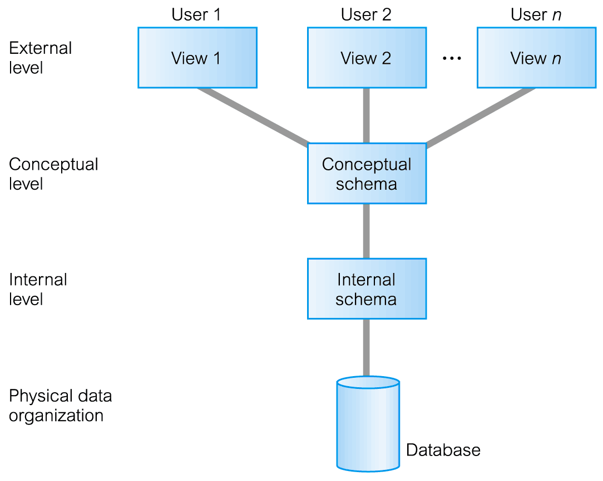
ANSI-SPARC Three-Level Architecture

Slide 21
ANSI-SPARC Three-Level Architecture..
External Level
  Users’ view of the database
  Describes that part of database that is relevant to a particular user
  Different views may have different representation of same data (e.g. different date formats, age derived from DOB etc.)

Slide 22
ANSI-SPARC Three-Level Architecture..
Conceptual Level
  Community view of the database
  Describes what data is stored in database and relationships among the data
  Along with any constraints on data
  Independent of any storage considerations

Slide 23
ANSI-SPARC Three-Level Architecture..
Internal Level
  Physical representation of the database on the computer
  Describes how the data is stored in the database
  physical implementation of the database to achieve optimal runtime performance and storage space utilization
  Data structures and ﬁle organizations used to store data on storage devices
  Interfaces with the operating system access methods to place the data on the storage devices, build the indexes, retrieve the data, and so on

Slide 24
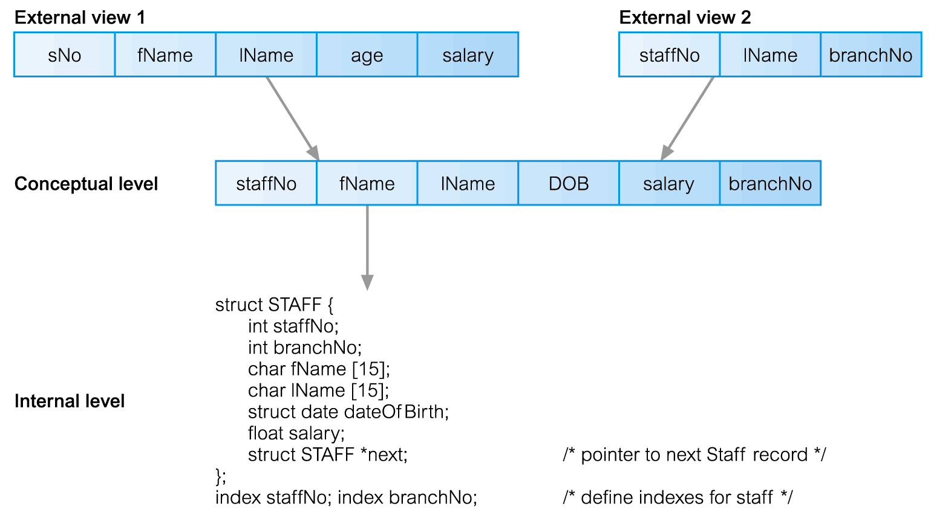
Differences between Three Levels of ANSI-SPARC Architecture

Slide 25
Schemas
External Schemas
  Also called subschemas
  Multiple schemas per database
  Corresponds to different views of data
Conceptual Schema
  Describes all the entities, attributes, and relationships together with integrity constraints
  Only one schema per database

Slide 26
Schemas..
Internal Schema
  A complete description of the internal model, containing the deﬁnitions of stored records, the methods of representation, the data ﬁelds, and the indexes and storage structures used
  Only one schema per database

Slide 27
Mappings
The DBMS is responsible for mapping between these three types of schema:
  The DBMS must check that each external schema is derivable from the conceptual schema, and it must use the information in the conceptual schema to map between each external schema and the internal schema
Types of mappings
  Conceptual/Internal mapping
  External/Conceptual mapping

Slide 28
Conceptual/Internal Mapping
Enables the DBMS to
  Find the actual record or combination of records in physical storage that constitute a logical record in the conceptual schema,
  Together with any constraints to be enforced on the operations for that logical record
  It also allows any differences in entity names, attribute names, attribute order, data types, and so on, to be resolved

Slide 29
External/Conceptual Mapping
Enables the DBMS to
  Map names in the user’s view on to the relevant part of the conceptual schema

Slide 30
Instances
Database Schema
  Description of database (also called intension)
  Specified during design phase
  Remain almost static
Database Instance
  Data in the database at any particular point in time
  Dynamic (changes with the time)
  Also called an extension (or state) of database

Slide 31
Data Independence
Logical Data Independence
  Refers to immunity of external schemas to changes in conceptual schema
  Conceptual schema changes (e.g. addition/removal of entities)
  Should not require changes to external schema or rewrites of application programs

Slide 32
Data Independence
Physical Data Independence
  Refers to immunity of conceptual schema to changes in the internal schema
  Internal schema changes (e.g. using different file organizations, storage structures, storage devices etc.)
  Should not require change to conceptual or external schemas

Slide 33
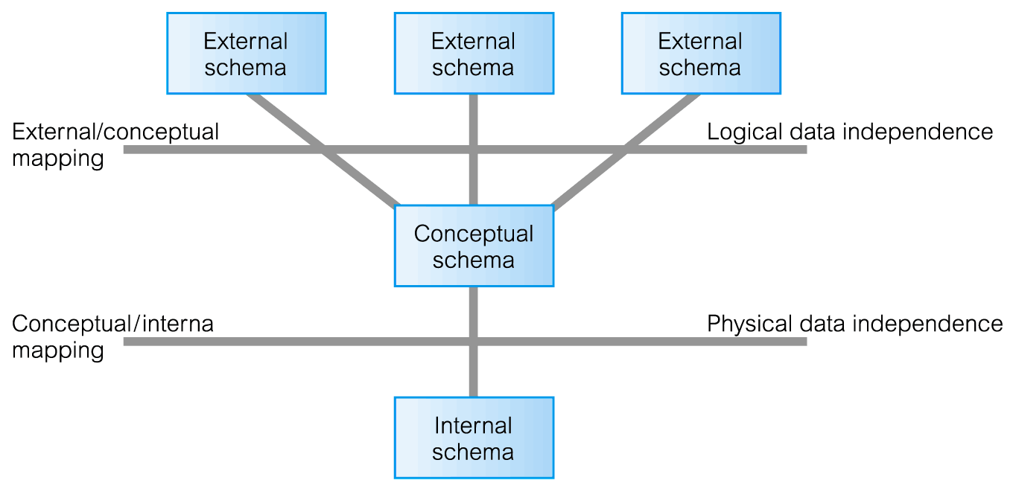
Data Independence and the ANSI-SPARC Three-Level Architecture

Slide 34
Summary
Components of the DBMS environment
Roles in the DB environment
History of DBMS
Advantages/Disadvantages of DBMSs
ANSI-SPARC three-level architecture
Schemas, mappings, and instances
Data independence

