Slide 1
CSC271 Database Systems
Lecture # 19

Slide 2
Summary: Previous Lecture
Information system
Database System Development Life Cycle
Database planning
System definition
Requirements collection and analysis (To be continued…)

Slide 3
Requirements Collection and Analysis..
Another important activity is deciding how to manage the requirements for a database system with multiple user views
Three main approaches
Centralized approach
View integration approach
Combination of both approaches (Hybrid)

Slide 4
Centralized Approach
Requirements for each user view are merged into a single set of requirements
A data model is created representing all user views during the database design stage

Slide 5
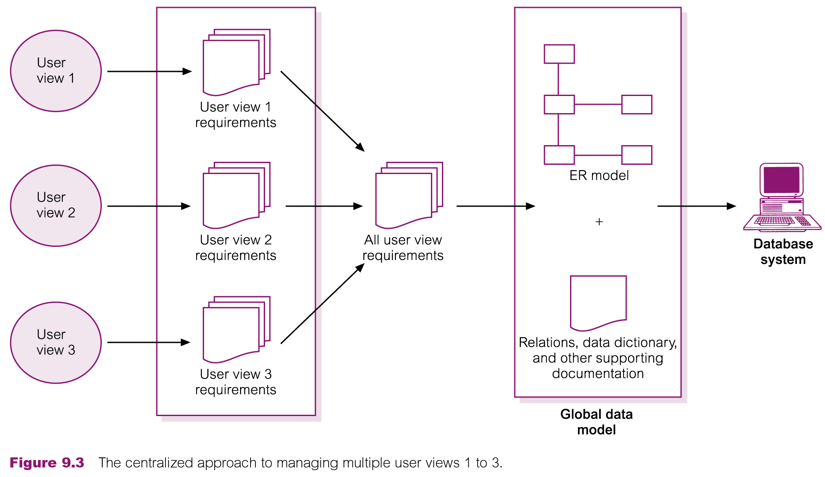
Centralized Approach

Slide 6
View Integration Approach
Requirements for each user view remain as separate lists
Data models representing each user view are created and then merged later during the database design stage

Slide 7
View Integration Approach..
Local/Global data models
Data model representing single user view (or a subset of all user views) is called a local data model
Each model includes diagrams and documentation describing requirements for one or more but not all user views of database
Local data models are then merged at a later stage during database design to produce a global data model, which represents all user views for the database

Slide 8
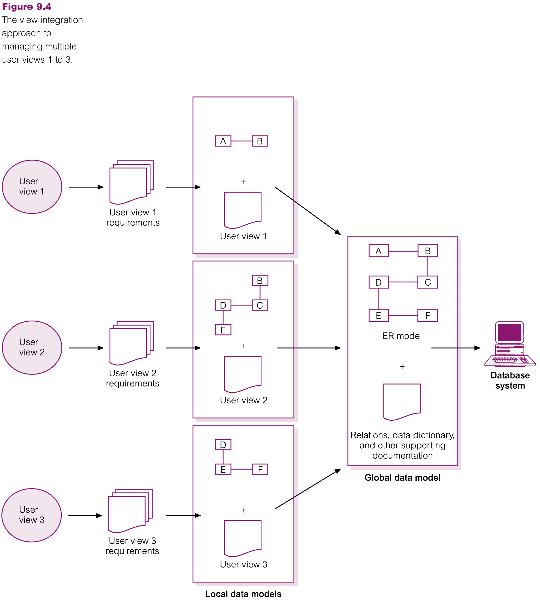
View Integration Approach..

Slide 9
Database Design
Process of creating a design for a database that will support the enterprise’s mission statement and mission objectives for the required database system
Main database design approaches include:
Top-down
Bottom-up
Inside-out
Mixed

Slide 10
Data Modelling
Main purposes of data modeling include:
To assist in understanding the meaning (semantics) of the data
To facilitate communication about the information requirements
Building data model requires answering questions about entities, relationships, and attributes

Slide 11
Data Modelling..
A data model ensures we understand:
Each user’s perspective of the data
Nature of the data itself, independent of its physical representations
Use of data across user views

Slide 12
Phases of Database Design
Three phases of database design:
Conceptual database design
Logical database design
Physical database design

Slide 13
Conceptual Database Design
Process of constructing a model of the data used in an enterprise, independent of all physical considerations
Data model is built using the information in users’ requirements specification
Conceptual data model is source of information for logical design phase

Slide 14
Logical Database Design
Process of constructing a model of the data used in an enterprise based on a specific data model (e.g. relational), but independent of a particular DBMS and other physical considerations
Conceptual data model is refined and mapped on to a logical data model

Slide 15
Physical Database Design
Process of producing a description of the database implementation on secondary storage
Describes base relations, file organizations, and indexes used to achieve efficient access to data
Also describes any associated integrity constraints and security measures
Tailored to a specific DBMS system

Slide 16
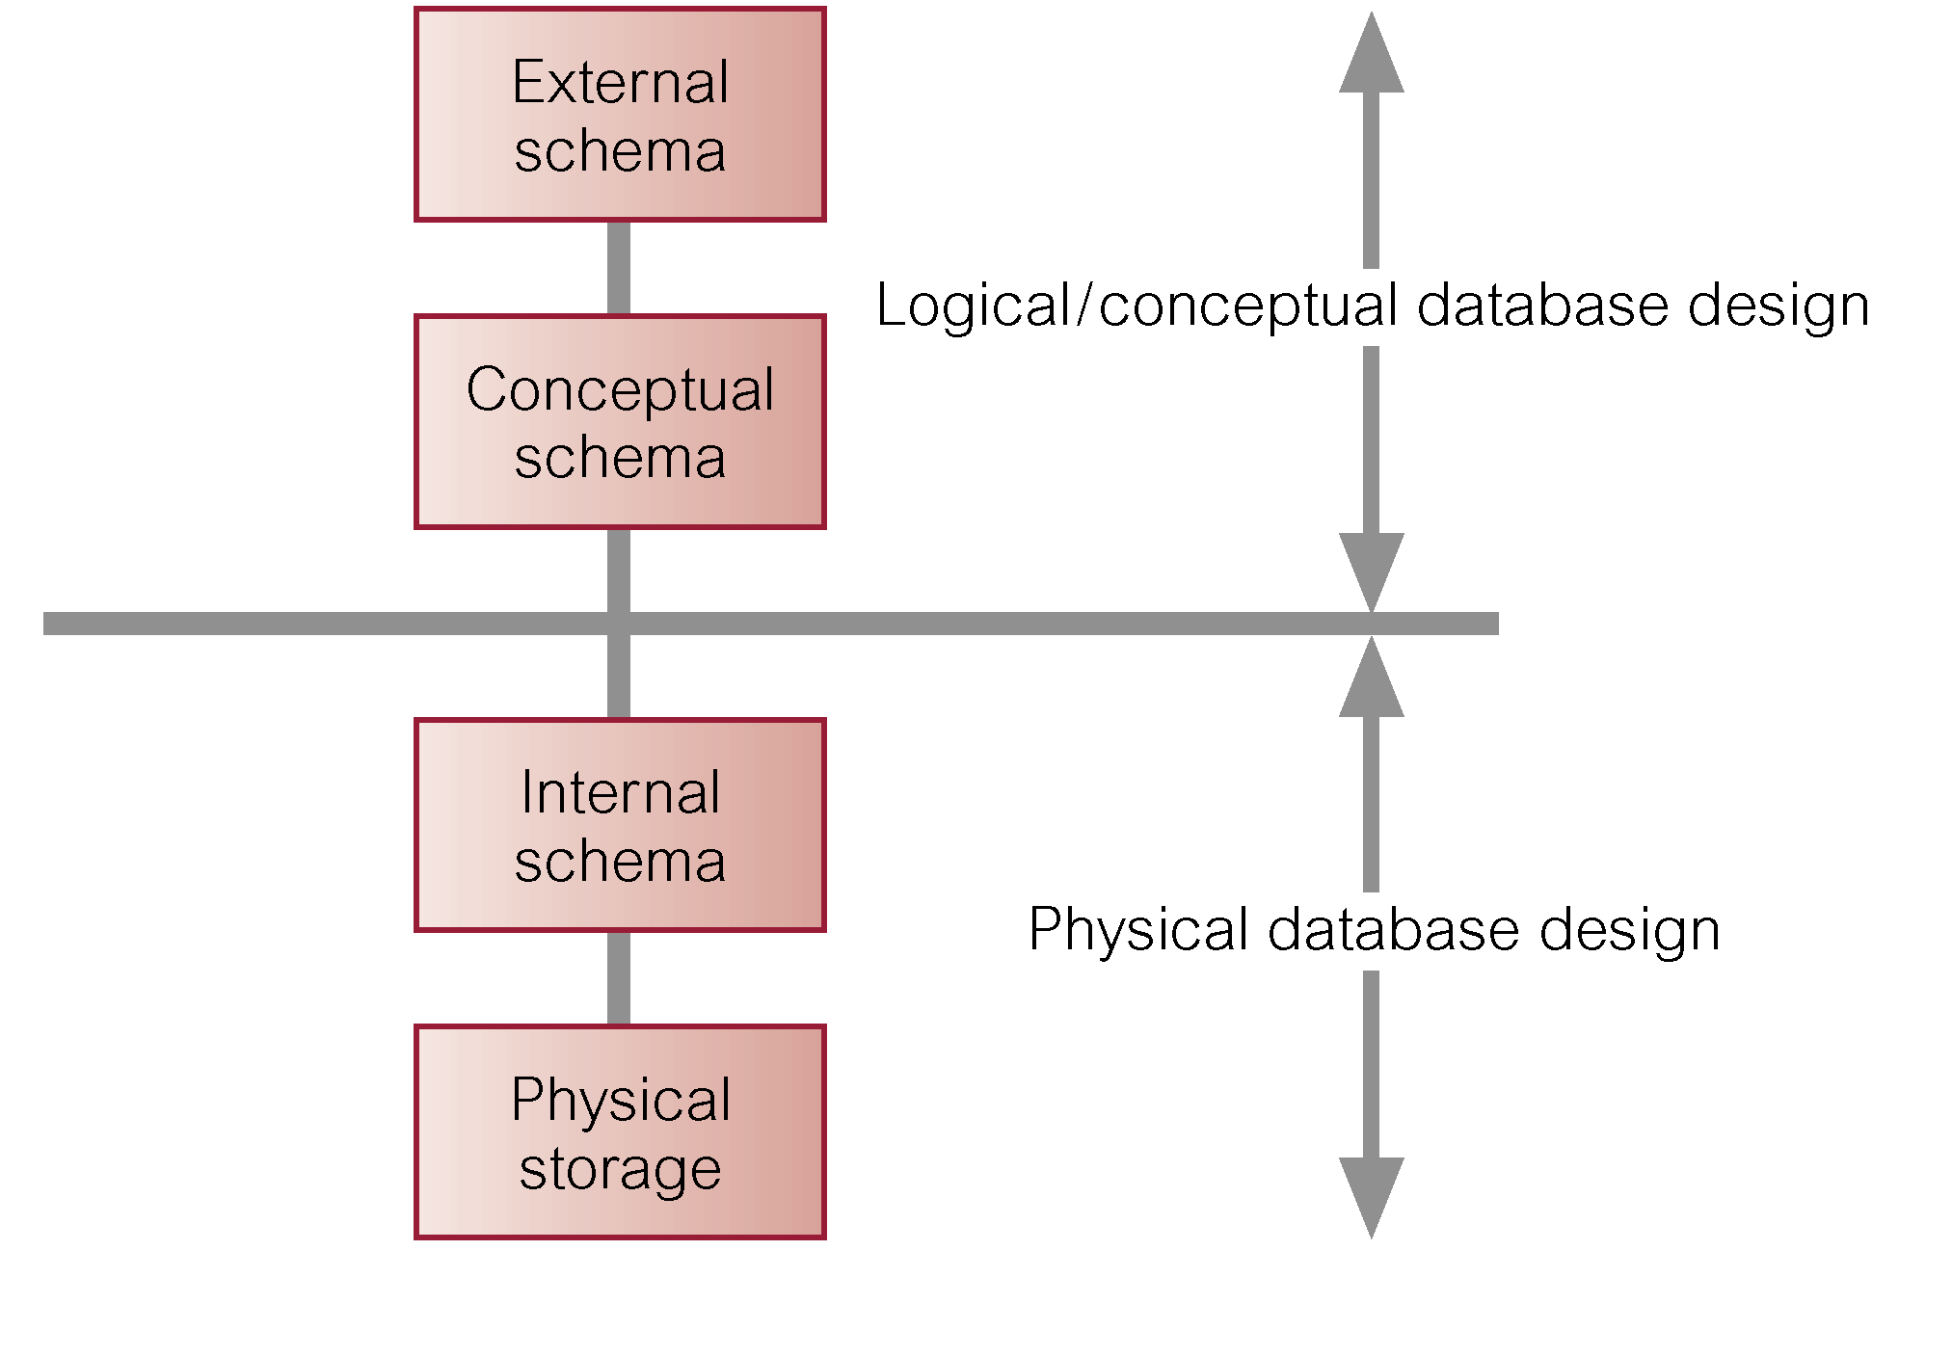
Database Design
Three-Level ANSI-SPARC architecture and phases of database design

Slide 17
DBMS Selection
Selection of an appropriate DBMS to support the database system
Undertaken at any time prior to logical design provided sufficient information is available regarding system requirements
Main steps to selecting a DBMS:
Define Terms of Reference of study
Shortlist two or three products
Evaluate products
Recommend selection and produce report

Slide 18
DBMS Evaluation Features

Slide 19
DBMS Evaluation Features..

Slide 20
Application Design
Design of user interface and application programs that use and process the database
Database design and application design are parallel activities
Application design includes two important activities:
Transaction design
User interface design

Slide 21
Transaction Design
An action, or series of actions, carried out by a single user or application program, which accesses or changes content of the database
Should define and document the high-level characteristics of the transactions required
Important characteristics of transactions:
Data to be used by the transaction
Functional characteristics of the transaction
Output of the transaction
Importance to the users
Expected rate of usage

Slide 22
Types of Transactions
Three main types of transactions:
Retrieval
Update
Mixed

Slide 23
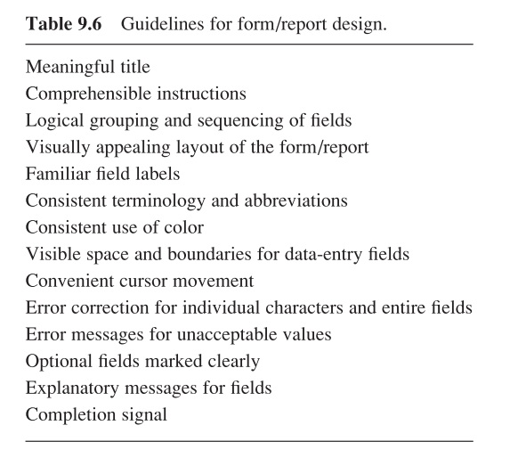
User Interface Design

Slide 24
Summary
Phases of database SDLC
Requirements collection and analysis
Database design
DBMS selection (optional)
Application design

Slide 25
References
All the material (slides, diagrams etc.) presented in this lecture is taken (with modifications) from the Pearson Education website :
http://www.booksites.net/connbegg

