Slide 1
CSC271 Database Systems
Lecture # 18

Slide 2
Summary: Previous Lecture
Transactions
Authorization
Authorization identifier, ownership, privileges
GRANT/REVOKE

Slide 3
Database Planning, Design, and Administration
Chapter 9

Slide 4
Software Depression
Last few decades have seen proliferation of software applications, many requiring constant maintenance involving:
Correcting faults
Implementing new user requirements
Modifying software to run on new or upgraded platforms
Effort spent on maintenance began to absorb resources at an alarming rate

Slide 5
Software Depression..
As a result, many major software projects were
Late
Over budget
Unreliable
Difficult to maintain
Performed poorly
In late 1960s, led to ‘software crisis’, now refer to as the ‘software depression’

Slide 6
Software Depression..
Major reasons for failure of software projects includes:
Lack of a complete requirements specification
Lack of appropriate development methodology
Poor decomposition of design into manageable components
Structured approach to development was proposed called Information Systems Lifecycle (ISLC)

Slide 7
Information System
Resources that enable collection, management, control, and dissemination of information throughout an organization
Database is fundamental component of IS, and its development/usage should be viewed from perspective of the wider requirements of the organization

Slide 8
DB System Development Life Cycle
Database planning
System definition
Requirements collection and analysis
Database design
DBMS selection (optional)
Application design
Prototyping (optional)
Implementation
Data conversion and loading
Testing
Operational maintenance

Slide 9
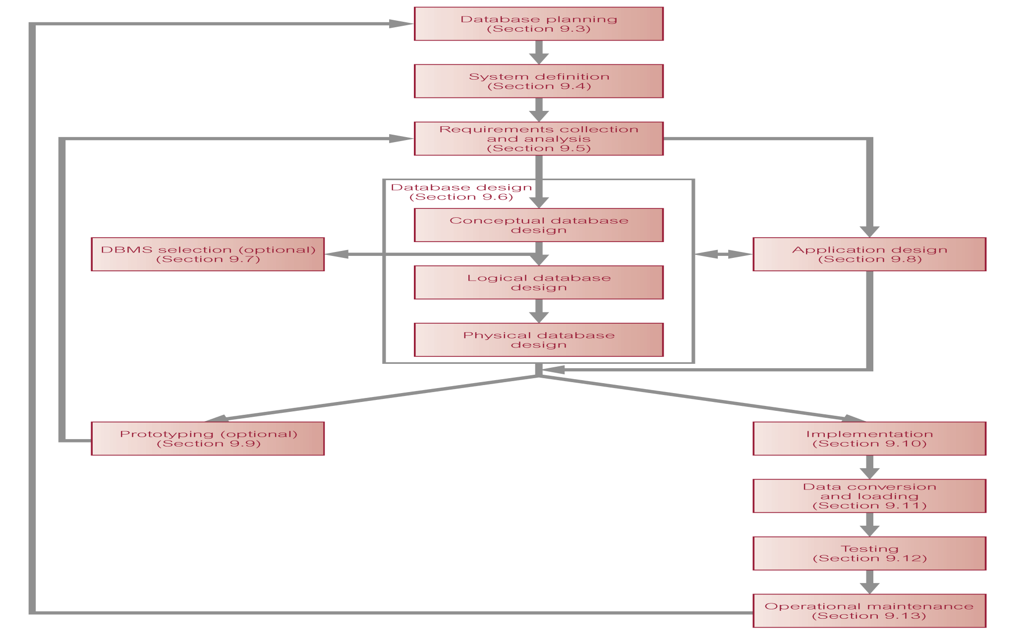
DB System Development Lifecycle..

Slide 10
Database Planning
Begins with customer request to develop a database system
Must be integrated with overall IS strategy of the organization

Slide 11
Database Planning..
Mission statement for the database project defines major aims of database application
Those driving database project normally define the mission statement
Mission statement helps clarify purpose of the database project and provides clearer path towards the efficient and effective creation of required database system

Slide 12
Database Planning..
Once mission statement is defined, mission objectives are defined
Each objective should identify a particular task that the database must support
May be accompanied by some additional information that specifies the work to be done, the resources with which to do it, and the money to pay for it all

Slide 13
Database Planning..
Database planning should also include development of standards that govern:
How data will be collected?
How the format should be specified?
What necessary documentation will be needed?
How design and implementation should proceed?

Slide 14
System Definition
Describes scope and boundaries of database system and the major user views
User view defines what is required of a database system from perspective of:
A particular job role (such as Manager or Supervisor) or enterprise application area (such as marketing, personnel, or stock control)

Slide 15
System Definition..
Database application may have one or more user views
Identifying user views helps ensure that no major users of the database are forgotten when developing requirements for new system
User views also help in development of complex database system allowing requirements to be broken down into manageable pieces

Slide 16
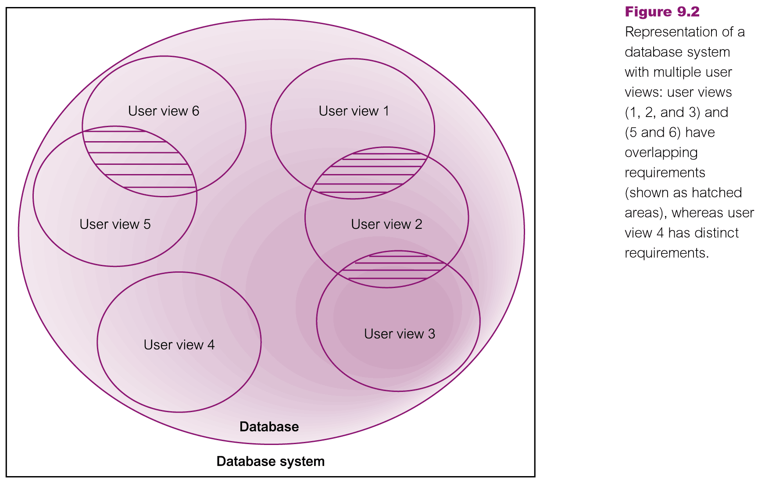
Multiple User Views

Slide 17
Requirements Collection and Analysis
Process of collecting and analyzing information about the part of organization to be supported by the database system, and using this information to identify users’ requirements of new system

Slide 18
Requirements Collection and Analysis..
Information is gathered for each major user view including:
A description of data used or generated
Details of how data is to be used/generated
Any additional requirements for new database system
Information is analyzed to identify requirements to be included in new database system, described in the requirements specification

Slide 19
Requirements Collection and Analysis..
Requirements collection and analysis is a preliminary stage to database design
Too much study too soon leads to paralysis by analysis
Too little thought can result in an unnecessary waste of both time and money due to working on the wrong solution to the wrong problem
The information collected at this stage may be poorly structured and include some informal requests, which must be converted into a more structured statement of requirements

Slide 20
Requirements Collection and Analysis..
Requirements speciﬁcation techniques can used to structure the requirements, such techniques include for example:
Structured Analysis and Design (SAD) techniques
Data Flow Diagrams (DFD)
Hierarchical Input Process Output (HIPO) charts supported by documentation
Computer-Aided Software Engineering (CASE) tools may provide automated assistance to ensure that the requirements are complete and consistent
Uniﬁed Modeling Language (UML) supports requirements collection and analysis

Slide 21
Requirements Collection and Analysis..
Identifying the required functionality for a database system is a critical activity
Systems with inadequate or incomplete functionality will annoy the users, which may lead to rejection or underutilization of the system
However, excessive functionality can also be problematic as it can overcomplicate a system making it difﬁcult to implement, maintain, use, or learn

Slide 22
Requirements Collection and Analysis..
Another important activity is deciding how to manage the requirements for a database system with multiple user views
Three main approaches
Centralized approach
View integration approach
Combination of both approaches (Hybrid)

Slide 23
Summary
Information system
Database System Development Life Cycle
Database planning
System definition
Requirements collection and analysis (To be continued…)

Slide 24
References
All the material (slides, diagrams etc.) presented in this lecture is taken (with modifications) from the Pearson Education website :
http://www.booksites.net/connbegg

