Slide 1
CSC271 Database Systems
Lecture # 17

Slide 2
Summary: Previous Lecture
View updatability
Advantages and disadvantages of views
View materialization

Slide 3
Transactions
SQL defines transaction model based on COMMIT and ROLLBACK
Transaction is logical unit of work with one or more SQL statements guaranteed to be atomic with respect to recovery
An SQL transaction automatically begins with a transaction-initiating SQL statement (e.g., SELECT, INSERT)
Changes made by transaction are not visible to other concurrently executing transactions until transaction completes

Slide 4
Transactions..
Transaction can complete in one of four ways:
COMMIT ends transaction successfully, making changes permanent
ROLLBACK aborts transaction, backing out any changes made by transaction
For programmatic SQL, successful program termination ends final transaction successfully, even if COMMIT has not been executed
For programmatic SQL, abnormal program aborts the transaction

Slide 5
Transactions..
New transaction starts with next transaction-initiating statement
SQL transactions cannot be nested
SET TRANSACTION configures transaction:
SET TRANSACTION
[READ ONLY | READ WRITE] |
[ISOLATION LEVEL READ UNCOMMITTED | READ COMMITTED | REPEATABLE READ | SERIALIZABLE ]

Slide 6
READ ONLY/ READ WRITE
The READ ONLY and READ WRITE qualiﬁers indicate whether the transaction is read only or involves both read and write operations
The default is READ WRITE
Confusingly, READ ONLY allows a transaction to issue INSERT, UPDATE, and DELETE statements against temporary tables (but only temporary tables)

Slide 7
Isolation Level
The isolation level indicates the degree of interaction that is allowed from other transactions during the execution of the transaction
Dirty read: A transaction reads data that has been written by another as yet uncommitted transaction
Non-repeatable read: A transaction rereads data it has previously read but another committed transaction has modiﬁed or deleted the data in the intervening period
Phantom read: A transaction executes a query that retrieves a set of rows satisfying a certain search condition. When the transaction re-executes the query at a later time additional rows are returned that have been inserted by another committed transaction in the intervening period

Slide 8
Isolation Level

Slide 9
IMMEDIATE/DEFERRED Constraints
Do not always want constraints to be checked immediately, but instead at transaction commit
Constraint may be defined as INITIALLY IMMEDIATE (default) or INITIALLY DEFERRED, indicating mode the constraint assumes at start of each transaction
In former case, also possible to specify whether mode can be changed subsequently using qualifier [NOT] DEFERRABLE
SET CONSTRAINTS statement used to set mode for specified constraints for current transaction:
SET CONSTRAINTS
{ALL | constraintName [, . . . ]}
{DEFERRED | IMMEDIATE}

Slide 10
Authorization
Discretionary access control
Each user is given appropriate access rights (or privileges) on speciﬁc database objects
Typically users obtain certain privileges when they create an object and can pass some or all of these privileges to other users at their discretion
Circumvention by a devious unauthorized user tricking an authorized user into revealing sensitive data
Mandatory access control
Each database object is assigned a certain classiﬁcation level (e.g. Top Secret, Secret, Conﬁdential, Unclassiﬁed) and each subject (e.g. users, program) a clearance level

Slide 11
Authorization Identifiers and Ownership
Authorization identifier is normal SQL identifier used to establish identity of a user, usually has an associated password
Used to determine which objects user may reference and what operations may be performed on those objects
Each object created in SQL has an owner, as defined in AUTHORIZATION clause of schema to which object belongs
Owner is only person who may know about it

Slide 12
Privileges
Privileges are the actions that a user is permitted to carry out on a given base table or view, the privileges deﬁned by the ISO standard are:
SELECT Retrieve data from a table
INSERT Insert new rows into a table
UPDATE Modify rows of data in a table
DELETE Delete rows of data from a table
REFERENCES Reference columns of named table in
integrity constraints
USAGE Use domains, character sets etc.

Slide 13
Privileges..
Can restrict INSERT/UPDATE/REFERENCES to named columns
Owner of table must grant other users the necessary privileges using GRANT statement
To create view, user must have SELECT privilege on all tables that make up view and REFERENCES privilege on the named columns, likewise INSER, UPDATE, DELTE privileges only if owner has these privileges for every table in view

Slide 14
GRANT
The GRANT statement is used to grant privileges on database objects to speciﬁc users
The format of the GRANT statement is:
GRANT {PrivilegeList | ALL PRIVILEGES}
ON ObjectName
TO {AuthorizationIdList | PUBLIC}
[WITH GRANT OPTION]

Slide 15
Example 6.7
Give the user with authorization identiﬁer ‘Manager’ full privileges to the Staff table
GRANT ALL PRIVILEGES
ON Staff
TO Manager WITH GRANT OPTION;

Slide 16
Example 6.8
Give users ‘Personnel’ and ‘Director’ the privileges SELECT and UPDATE on column salary of the Staff table
GRANT SELECT, UPDATE (salary)
ON Staff
TO Personnel, Director;

Slide 17
Example 6.9
Give all users the privilege SELECT on the Branch table
GRANT SELECT
ON Branch
TO PUBLIC;

Slide 18
REVOKE
REVOKE takes away privileges granted with GRANT
REVOKE [GRANT OPTION FOR]
{PrivilegeList | ALL PRIVILEGES}
ON ObjectName
FROM {AuthorizationIdList | PUBLIC} [RESTRICT | CASCADE]

Slide 19
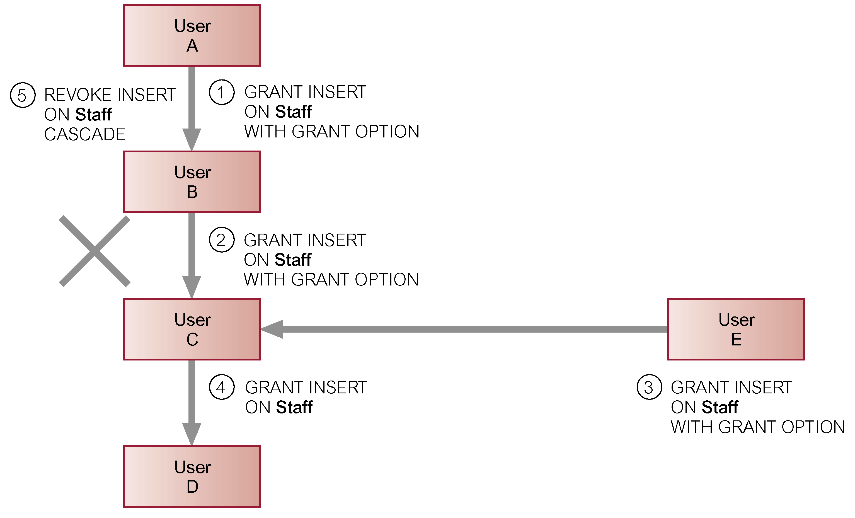
Effects of REVOKE

Slide 20
Example 6.10
Revoke the privilege SELECT on the Branch table from all users
REVOKE SELECT
ON Branch
FROM PUBLIC;

Slide 21
Example 6.11
Revoke all privileges given to ‘Director’ on the Staff table
REVOKE ALL PRIVILEGES
ON Staff
FROM Director;

Slide 22
Summary
Transactions
Authorization
Authorization identifier, ownership, privileges
GRANT/REVOKE

Slide 23
References
All the material (slides, diagrams etc.) presented in this lecture is taken (with modifications) from the Pearson Education website :
http://www.booksites.net/connbegg

