Slide 1
CSC271 Database Systems
Lecture # 16

Slide 2
Summary: Previous Lecture
Integrity Enhancement Feature
Referential integrity, general constraint
Data definition
CREATE/ALTER/DROP TABLE
CREATE/DROP INDEX
View
CREATE/DROP VIEW
View Resolution and restrictions

Slide 3
View Updatability
All updates to a base table are immediately reﬂected in all views that encompass that base table
Similarly, we may expect that if a view is updated then the base table(s) will reﬂect that change

Slide 4
View Updatability..
However, consider again the view StaffPropCnt, consider what would happen if we tried to insert a record that showed that at branch B003, staff member SG5 manages two properties, using the following insert statement:
INSERT INTO StaffPropCnt
VALUES (‘B003’, ‘SG5’, 2);
Have to insert 2 records into PropertyForRent showing which properties SG5 manages
However, do not know which properties they are; i.e. do not know primary keys

Slide 5
View Updatability..
Lets change definition of view and replace count with actual property numbers:
CREATE VIEW StaffPropList (branchNo, staffNo, propertyNo)
AS SELECT s.branchNo, s.staffNo, p.propertyNo
FROM Staff s, PropertyForRent p
WHERE s.staffNo = p.staffNo;
And we try to insert the record:
INSERT INTO StaffPropList
VALUES (‘B003’, ‘SG5’, ‘PG19’);

Slide 6
View Updatability..
Still problem, because in PropertyForRent all columns except postcode/staffNo are not allowed nulls
However, have no way of inserting values for remaining non-null columns

Slide 7
View Updatability..
ISO specifies that a view is updatable if and only if:
DISTINCT is not speciﬁed; that is, duplicate rows must not be eliminated from the query results
Every element in the SELECT list of the deﬁning query is a column name (rather than a constant, expression, or aggregate function) and no column name appears more than once

Slide 8
View Updatability..
The FROM clause speciﬁes only one table i.e. the view must have a single source table for which the user has the required privileges, If the source table is itself a view, then that view must satisfy these conditions
This, therefore, excludes any views based on a join, union, intersection, or difference
The WHERE clause does not include any nested SELECTs that reference the table in the FROM clause

Slide 9
View Updatability..
There is no GROUP BY or HAVING clause in the deﬁning query
In addition, every row that is added through the view must not violate the integrity constraints of the base table
For example, if a new row is added through a view, columns that are not included in the view are set to null, but this must not violate a NOT NULL integrity constraint in the base table

Slide 10
Updateable View
For a view to be updatable, the DBMS must be able to trace any row or column back to its row or column in the source table

Slide 11
WITH CHECK OPTION
Rows exist in a view because they satisfy WHERE condition of defining query
If a row changes and no longer satisfies condition, it disappears from the view
New rows appear within view when INSERT/UPDATE on view cause them to satisfy WHERE condition
Rows that enter or leave a view are called migrating rows
WITH CHECK OPTION prohibits a row migrating out of the view

Slide 12
WITH CHECK OPTION..
LOCAL/CASCADED apply to view hierarchies
With LOCAL, any ROW INSERT/UPDATE on view and any view directly or indirectly defined on this view must not cause row to disappear from view unless row also disappears from derived view/table
With CASCADED (default), any row INSERT/ UPDATE on this view and on any view directly or indirectly defined on this view must not cause row to disappear from the view

Slide 13
Example 6.6
CREATE VIEW Manager3Staff AS
SELECT *
FROM Staff
WHERE branchNo = ‘B003’
WITH CHECK OPTION;
Cannot update branch number of row B003 to B002 as this would cause row to migrate from view
Also cannot insert a row into view with a branch number that does not equal B003

Slide 14
Example 6.6
Now consider the following:
CREATE VIEW LowSalary AS SELECT * FROM Staff WHERE salary > 9000; | CREATE VIEW HighSalary AS SELECT * FROM LowSalary WHERE salary > 10000 WITH LOCAL CHECK OPTION;
CREATE VIEW Manager3Staff AS SELECT * FROM HighSalary WHERE branchNo = ‘B003’;

Slide 15
Example 6.6
UPDATE Manager3Staff
SET salary = 9500
WHERE staffNo = ‘SG37’;
This update would fail: although update would cause row to disappear from HighSalary, row would not disappear from LowSalary
However, if update tried to set salary to 8000, update would succeed as row would no longer be part of LowSalary

Slide 16
Example 6.6
If HighSalary had specified WITH CASCADED CHECK OPTION, setting salary to 9500 or 8000 would be rejected because row would disappear from HighSalary
To prevent anomalies like this, each view should be created using WITH CASCADED CHECK OPTION

Slide 17
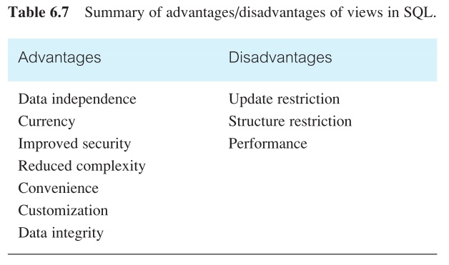
Advantages/Disadvantages of Views
Views
Single user environment, convenience, simplify DB requests
Multi user environment, define structure of DB and security

Slide 18
View Materialization
View resolution mechanism requires additional computer resources, may be slow, particularly if view is accessed frequently
View materialization stores view as temporary table when view is first queried
Thereafter, queries based on materialized view can be faster than re-computing view each time
Difficulty is maintaining the currency of view while base tables(s) are being updated

Slide 19
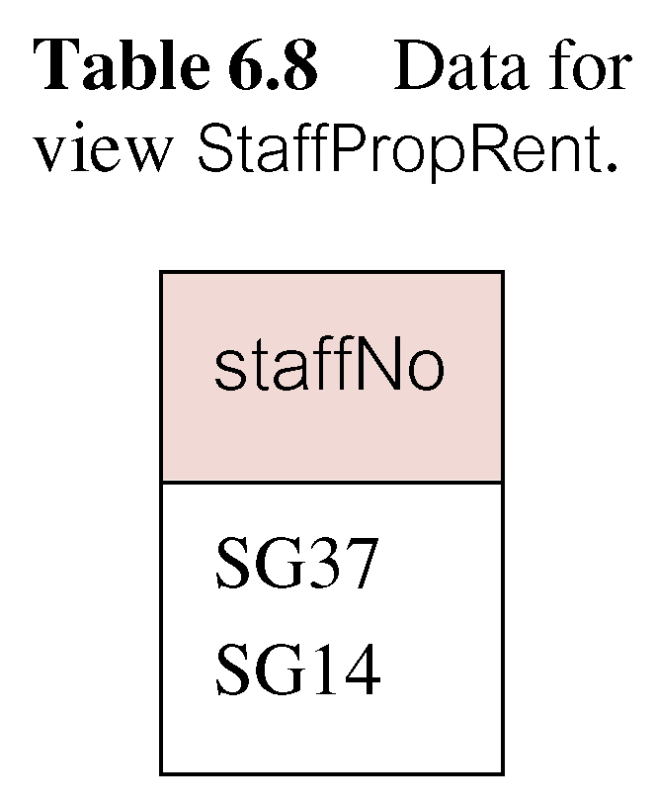
View Maintenance
View maintenance aims to apply only those changes necessary to keep view current, consider following view:
CREATE VIEW StaffPropRent(staffNo)
AS
SELECT DISTINCT staffNo
FROM PropertyForRent
WHERE branchNo = ‘B003’ AND rent > 400;

Slide 20
Issues: View Maintenance
If insert row into PropertyForRent with rent <= 400 then view would be unchanged
If insert row for property PG24 at branch B003 with staffNo = SG19 and rent = 550, then row would appear in materialized view
If insert row for property PG54 at branch B003 with staffNo = SG37 and rent = 450, then no new row would need to be added to materialized view
If delete property PG24, row should be deleted from materialized view
If delete property PG54, then row for PG37 should not be deleted (because of existing property PG21)

Slide 21
Summary
View updatability
Advantages and disadvantages of views
View materialization

Slide 22
References
All the material (slides, diagrams etc.) presented in this lecture is taken (with modifications) from the Pearson Education website :
http://www.booksites.net/connbegg

