Slide 1
CSC271 Database Systems
Lecture # 14

Slide 2
Summary: Previous Lecture
Multi-Table Queries (Continued..)
Outer join
Left, right, full
EXISTS and NOT EXISTS
UNIION, INTERSECT,EXCEPT(MINUS)
Database updates
INSERT, UPDATE, DELETE

Slide 3
SQL Data Definition
Chapter 6

Slide 4
SQL Identifiers
SQL Identifiers are used to identify objects in the database e.g. table , view names and columns.
The characters that can be used in a user defined SQL-identifier must appear in a character set.
The ISO Standard provides a default character set which consists of the
Upper case letters A-Z and Lower Case Letters a-z
Digits 0-9
The underscore (-)

Slide 5
SQL Identifiers
The following restrictions are imposed on an identifer.
An identifier can be no longer than 128 characters (most dialects have a much lower limit than this)
An identifier must start with a letter.
An identifier cannot contain spaces.

Slide 6
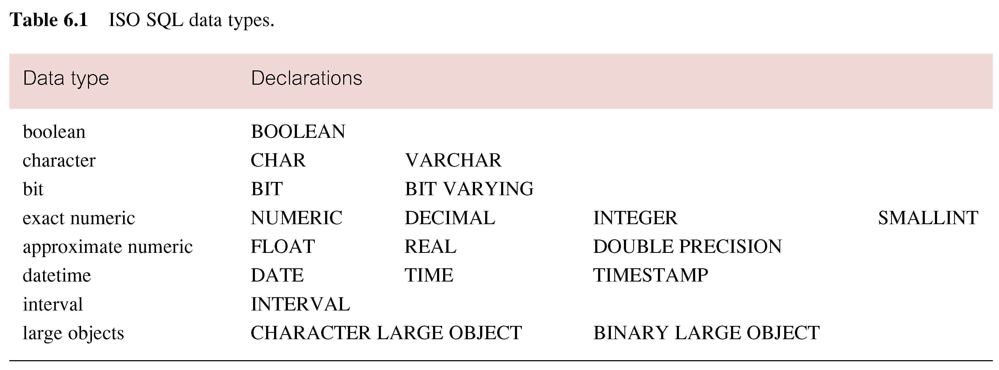
ISO SQL Data Types

Slide 7
SQL Scalar Operators
SQL Provides a number of built-in scalar operators and functions that can be used to construct a scalar expression: that is an expression that evaluates to a scalar value.
BIT_LENGTH , CHAR_LENGTH
CAST , ||, CURRENT USER
LOWER, UPPER, TRIM, POSITION
SUBSTRING , CURRENT_DATE
CURRENT_TIME, CASE

Slide 8
Integrity Enhancement Feature
The 1989 ISO SQL Standard introduced an Integrity Enhancement Feature, which provide facilities for defining referential integrity and other constraints.
Prior to this standard, it was the responisbility of each application program to ensure compliance with constraints.
The provision of IEF greatly enhances the functionality of SQL and allow constraint checking to be centralized and standardized.

Slide 9
Integrity Enhancement Feature….
The ISO SQL Standards provides facility for integrity control.
Integrity control consists of constraints that we wish to impose in order to protect the database from being inconsistent.

Slide 10
Integrity Enhancement Feature….
We Consider five types of integrity constraints:
Required data
Domain constraints
Entity integrity
Referential integrity
General constraints.

Slide 11
Required Data
Some columns must contain a valid value; they are not allowed to contain nulls.
A null is distinct from blank or zero, and is used to represent data that is either not available, missing, or not applicable
For example, every member of staff musthave an associated job position
position VARCHAR(10) NOT NULL

Slide 12
Domain Constraints
Every column has a domain, in other words a set of legal values
The ISO Standard provides a mechanisms for specifying domains in the CREATE and ALTER TABLE statements.
CHECK clause, which allows a constraint to be defined on a column or the entire table.
CREATE DOMAIN statement.

Slide 13
Check Clause
The format of the CHECK clause is:
CHECK (searchCondition)
In a column constraint, the CHECK clause can reference only the column being defined.
For example to ensure that the column sex can only be specified as ‘M’ or ‘F’, column could be definedas:
sex CHAR NOT NULL CHECK (sex IN (‘M’, ‘F’))

Slide 14
CREATE DOMAIN
The ISO standard allows domains to be defined more explicitly using the CREATE DOMAIN statement:
CREATE DOMAIN DomainName [AS] dataType
[DEFAULT defaultOption]
[CHECK (searchCondition)]

Slide 15
Create Domain
For example to define a domain name for sex column
CREATE DOMAIN DomainName [AS] dataType
[DEFAULT defaultOption]
[CHECK (searchCondition)]
When defining the column sex, we can now use the domain name SexType in place of the data type CHAR:
sex SexType NOT NULL

Slide 16
CREATE DOMAIN
The searchCondition can involve a table lookup. For example, we can create a domain
BranchNumber to ensure that the values entered correspond to an existing branch number in the Branch table, using the statement:
CREATE DOMAIN BranchNumber AS CHAR(4)
CHECK (VALUE IN (SELECT branchNo FROM Branch));

Slide 17
DROP DOMAIN
Domains can be removed from the database using the DROP DOMAIN statement:
DROP DOMAIN DomainName [RESTRICT | CASCADE]
DROP fails in case of RESTRICT, if domain is being used in the database e.g. Table, View etc.
CASCADE changes any table column that is based on the domain to use the domain’s underlying data type, and any constraint or default clause if appropriate.

Slide 18
Entity Integrity
The primary key of a table must contain a unique, non-null value for each row.
ISO standard supports entity integrity with the PRIMARY KEY clause in the CREATE and ALTER TABLE statements.
PRIMARY KEY (StaffNo) for Staff
PRIMARY KEY (PropertyNo) for PropertyForRent
PRIMARY KEY (Property No, ClientNo) for Viewing
Primary key clause can only be specified once per table.

Slide 19
Entity Integrity
keyword UNIQUE is used to ensure uniqueness for any alternate keys in the table
Unique clause must be declared as Not Null
There may be as many unique clauses per table as required.
SQL rejects any INSERT or UPDATE operation that attempts to create a duplicate value within each candidate key (that is, primary key or alternate key).
UNIQUE (telNo)

Slide 20
Referential Integrity
A foreign key is a column, or set of columns, that links each row in the child table containing the foreign key to the row of the parent table containing the matching candidate key value.
Referential integrity means that, if the foreign key contains a value, that value must refer to an existing, valid row in the parent table
The ISO standard supports the definition of foreign keys with the FOREIGN KEY clause in the CREATE and ALTER TABLE statements.
FOREIGN KEY(branchNo) REFERENCES Branch

Slide 21
Referential Integrity
SQL rejects any INSERT or UPDATE operation that attempts to create a foreign key value in a child table without a matching candidate key value in the parent table.
The action SQL takes for any UPDATE or DELETE operation that attempts to update or delete a candidate key value in the parent table that has some matching rows in the child table is dependent on the referential action specified using the ON UPDATE and ON DELETE subclauses of the FOREIGN KEY clause.

Slide 22
Referential Clause
When the user attempts to delete a row from a parent table, and there are one or more matching rows in the child table, SQL supports four options regarding the action to be taken:
CASCADE
SET NULL
SET DEFAULT
NO ACTION

Slide 23
CASCADE
Delete the row from the parent table and automatically delete the matching rows in the child table.
Since these deleted rows may themselves have a candidate key that is used as a foreign key in another table, the foreign key rules for these tables are triggered, and so on in a cascading manner.

Slide 24
SET NULL
Delete the row from the parent table and set the foreign key value(s) in the child table to NULL.
This is valid only if the foreign key columns do not have the NOT NULL qualifier specified.

Slide 25
SET DAFAULT
Delete the row from the parent table and set each component of the foreign key in the child table to the specified default value.
This is valid only if the foreign key columns have a DEFAULT value specified

Slide 26
NO ACTION
Reject the delete operation from the parent table.
This is the default setting if the ON DELETE rule is omitted.

Slide 27
Summary
SQL Identifiers and Data Types
Integrity Enhancement Feature
Required Data, Domain Constraint
Entity Integrity, Referential Integrity

