Slide 1
CSC271 Database Systems
Lecture # 13

Slide 2
Summary: Previous Lecture
Grouping through GROUP BY clause
Restricted groupings
Subqueries
Multi-Table queries

Slide 3
DreamHome Case Study
Consist of following tables:
Branch (branchNo, street, city, postcode)
Staff (staffNo, fName, lName, position, sex, DOB, salary, branchNo)
PropertyForRent (propertyNo, street, city, postcode, type, rooms, rent, ownerNo, staffNo, branchNo)
Client (clientNo, fName, lName, telNo, prefType, maxRent)
PrivateOwner (ownerNo, fName, lName, address, telNo)
Viewing (clientNo, propertyNo, viewDate, comment)

Slide 4
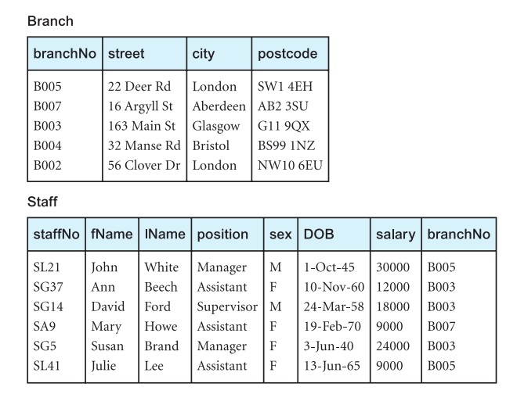
Instance of DreamHome

Slide 5
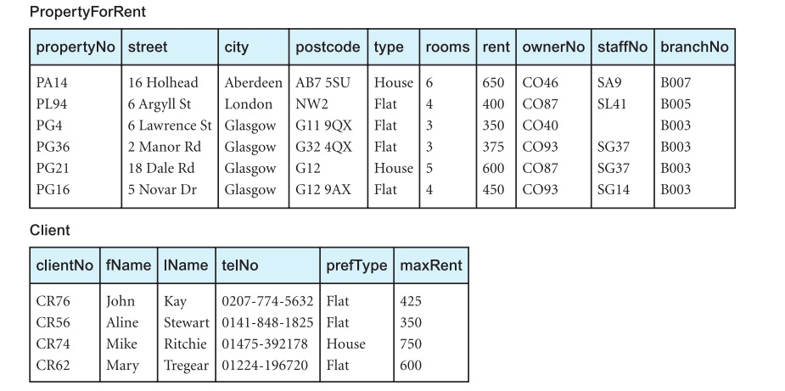
Instance of DreamHome

Slide 6
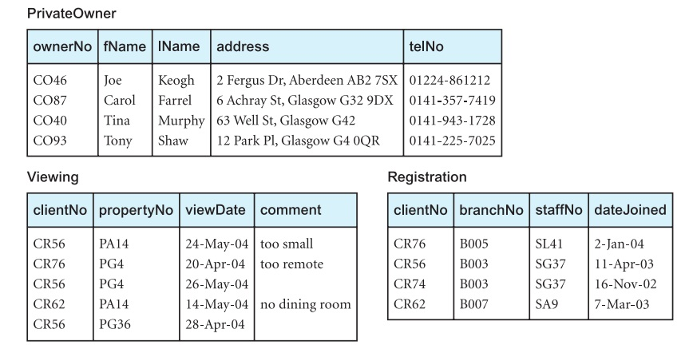
Instance of DreamHome

Slide 7
Example 5.26
For each branch, list staff who manage properties, including city in which branch is located and properties they manage
SELECT b.branchNo, b.city, s.staffNo, fName, lName,
propertyNo
FROM Branch b, Staff s, PropertyForRent p
WHERE b.branchNo = s.branchNo AND
s.staffNo = p.staffNo
ORDER BY b.branchNo, s.staffNo, propertyNo;

Slide 8
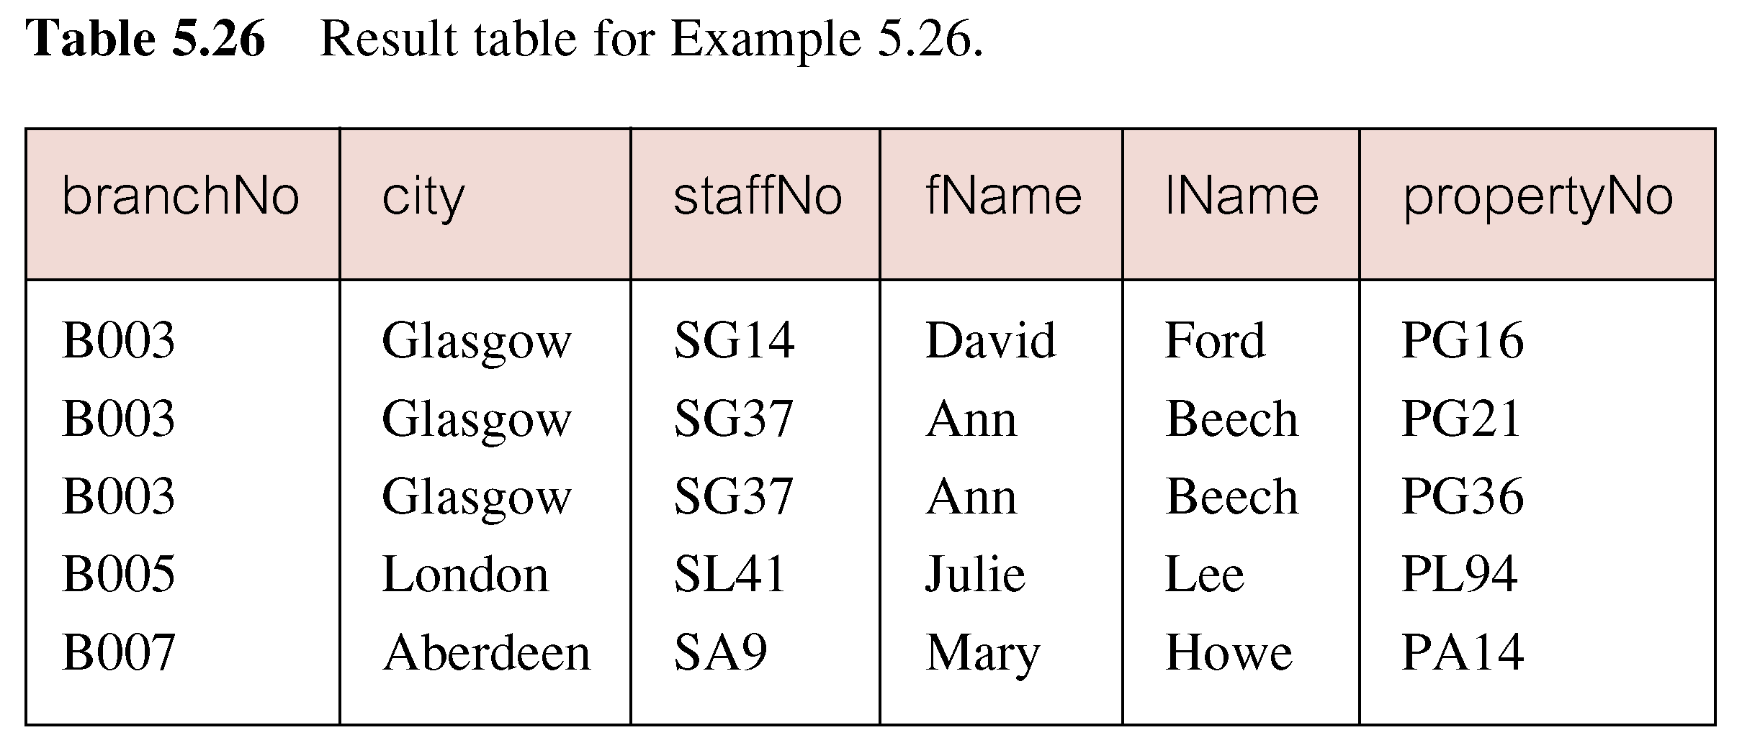
Result: Example 5.26

Slide 9
Example 5.27 (a)
Find number of properties handled by each staff member
SELECT s.branchNo, s.staffNo, COUNT(*) AS
myCount
FROM Staff s, PropertyForRent p
WHERE s.staffNo = p.staffNo
GROUP BY s.branchNo, s.staffNo
ORDER BY s.branchNo, s.staffNo;

Slide 10
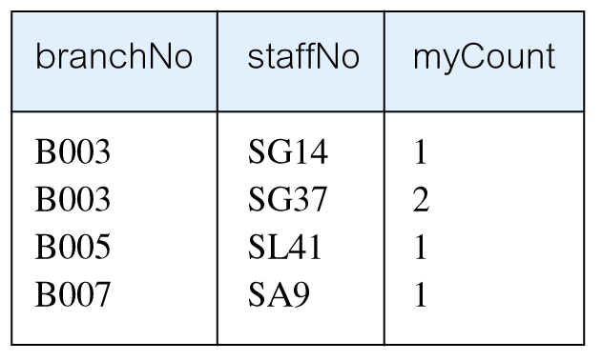
Result: Example 5.27 (a)

Slide 11
Cartesian Product and Join
A join is a subset of a more general combination of two tables known as the Cartesian product
Cardinality of Cartesian product
Degree of Cartesian product
ISO standard provides a special form of the SELECT statement for the Cartesian product:
SELECT [DISTINCT | ALL] {* | columnList}
FROM Table1 CROSS JOIN Table2

Slide 12
Computing a Join
Form the Cartesian product of the tables named in the FROM clause
If there is a WHERE clause, apply the search condition to each row of the product table, retaining those rows that satisfy the condition
For each remaining row, determine the value of each item in the SELECT list to produce a single row in the result table

Slide 13
Computing a Join..
If SELECT DISTINCT has been speciﬁed, eliminate any duplicate rows from the result table
If there is an ORDER BY clause, sort the result table as required

Slide 14
Outer Join
The join operation combines data from two tables by forming pairs of related rows where the matching columns in each table have the same value
If one row of a joined table is unmatched, row is omitted from result table
Outer join operations retain rows that do not satisfy the join condition

Slide 15
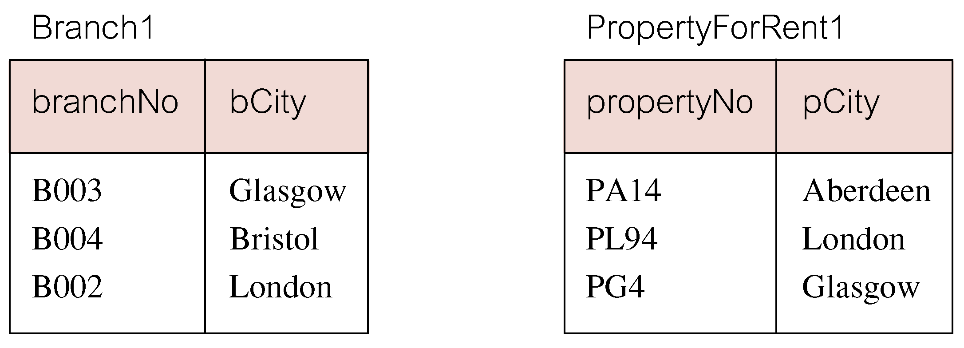
Outer Join..
Consider following tables derived from ‘Branch’ and ‘PropertyForRent’ respectively

Slide 16
Example 5.27 (b)
The (inner) join of these two tables Branch1 and PropertyForRent1 respectivley:
SELECT b.*, p.*
FROM Branch1 b, PropertyForRent1 p
WHERE b.bCity = p.pCity;

Slide 17
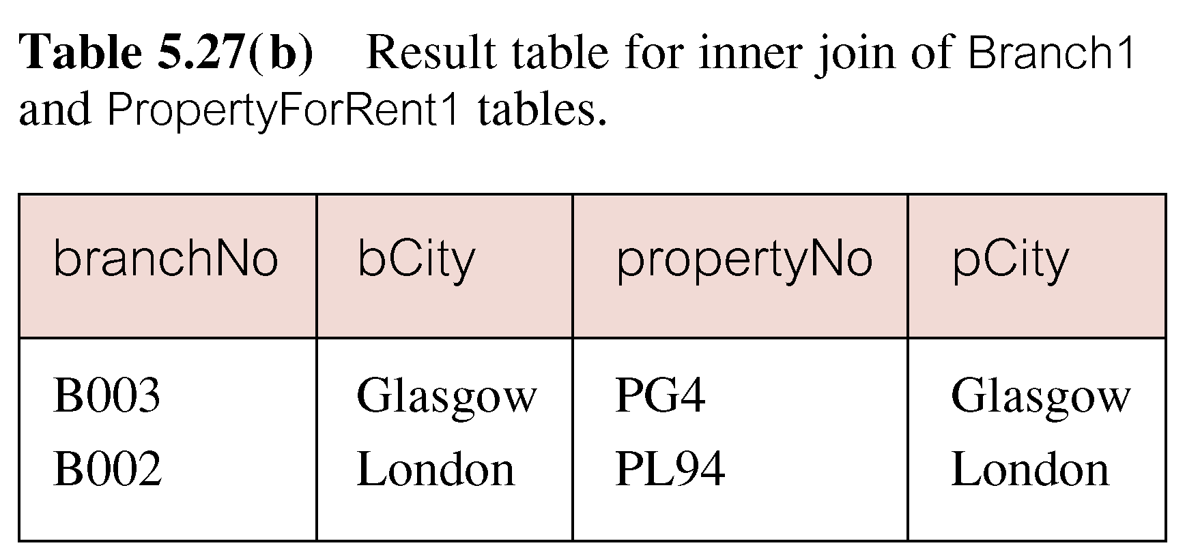
Result: Example 5.27 (b)

Slide 18
Outer Join
Result table has two rows where cities are same
There are no rows corresponding to branches in ‘Bristol’ and ‘Aberdeen’
To include unmatched rows in result table, use an Outer join
Types of outer join
Left outer join
Right outer join
Full outer join

Slide 19
Example 5.28
Left outer join
List branches and properties that are in same city along with any unmatched branches
SELECT b.*, p.*
FROM Branch1 b LEFT JOIN PropertyForRent1 p
ON b.bCity = p.pCity;

Slide 20
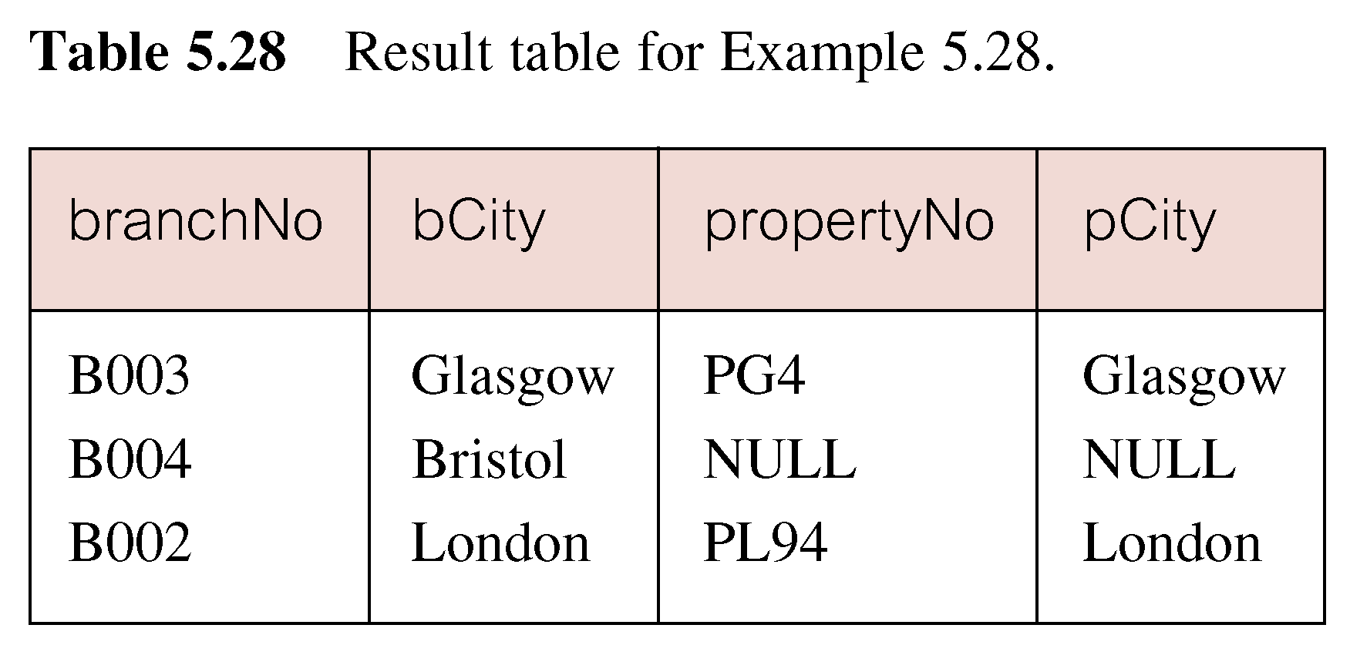
Result: Example 5.28

Slide 21
Example 5.29
Right outer join
List branches and properties in same city and any unmatched properties
SELECT b.*, p.*
FROM Branch1 b RIGHT JOIN PropertyForRent1 p
ON b.bCity = p.pCity;

Slide 22
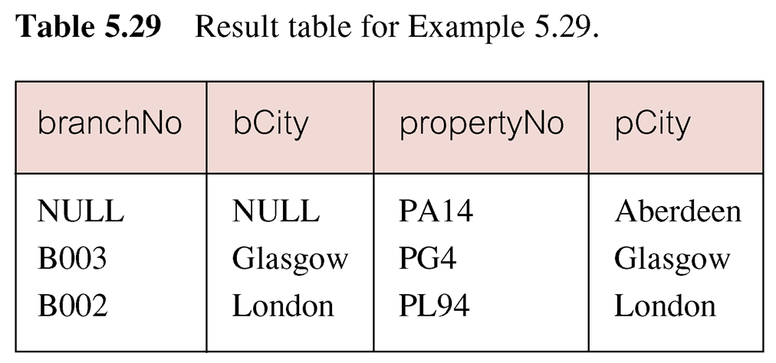
Result: Example 5.29

Slide 23
Example 5.30
Full outer join
List branches and properties in same city and any unmatched branches or properties
SELECT b.*, p.*
FROM Branch1 b FULL JOIN PropertyForRent1 p
ON b.bCity = p.pCity;

Slide 24
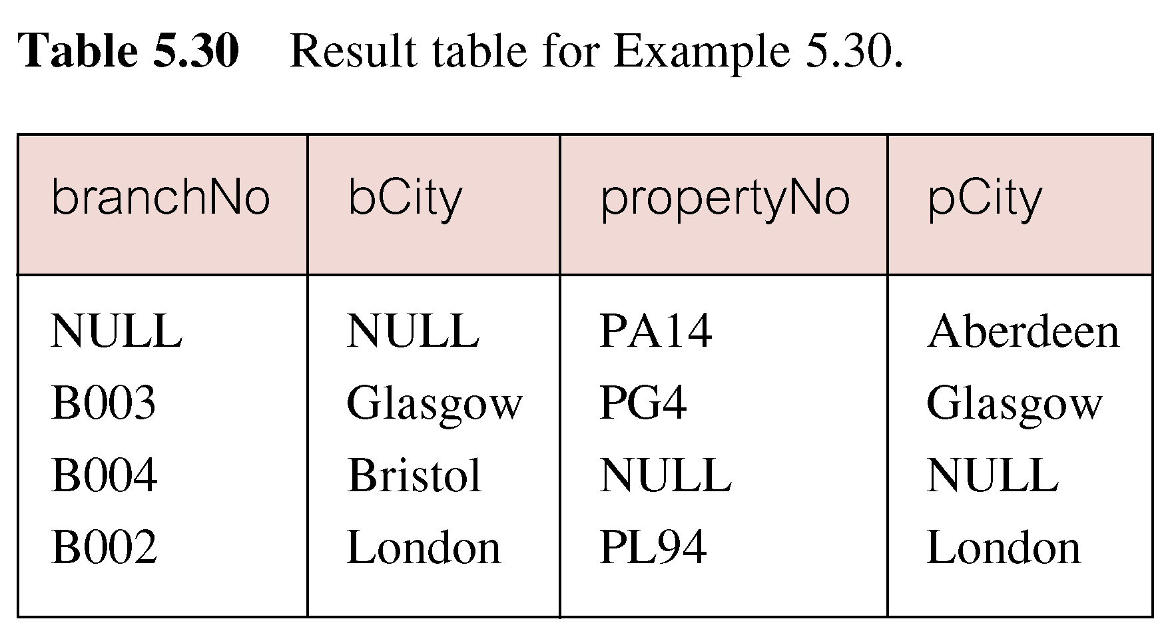
Result: Example 5.30

Slide 25
EXISTS and NOT EXISTS
EXISTS and NOT EXISTS are for use only with subqueries
Produce a simple true/false result
True if and only if there exists at least one row in result table returned by subquery
False if subquery returns an empty result table
NOT EXISTS is the opposite of EXISTS

Slide 26
EXISTS and NOT EXISTS..
As (NOT) EXISTS check only for existence or non-existence of rows in subquery result table, subquery can contain any number of columns
Common for subqueries following (NOT) EXISTS to be of form:
(SELECT * ...)

Slide 27
Example 5.31
Find all staff who work in a London branch
SELECT staffNo, fName, lName, position
FROM Staff s
WHERE EXISTS
(SELECT *
FROM Branch b
WHERE s.branchNo = b.branchNo AND
city = ‘London’);

Slide 28
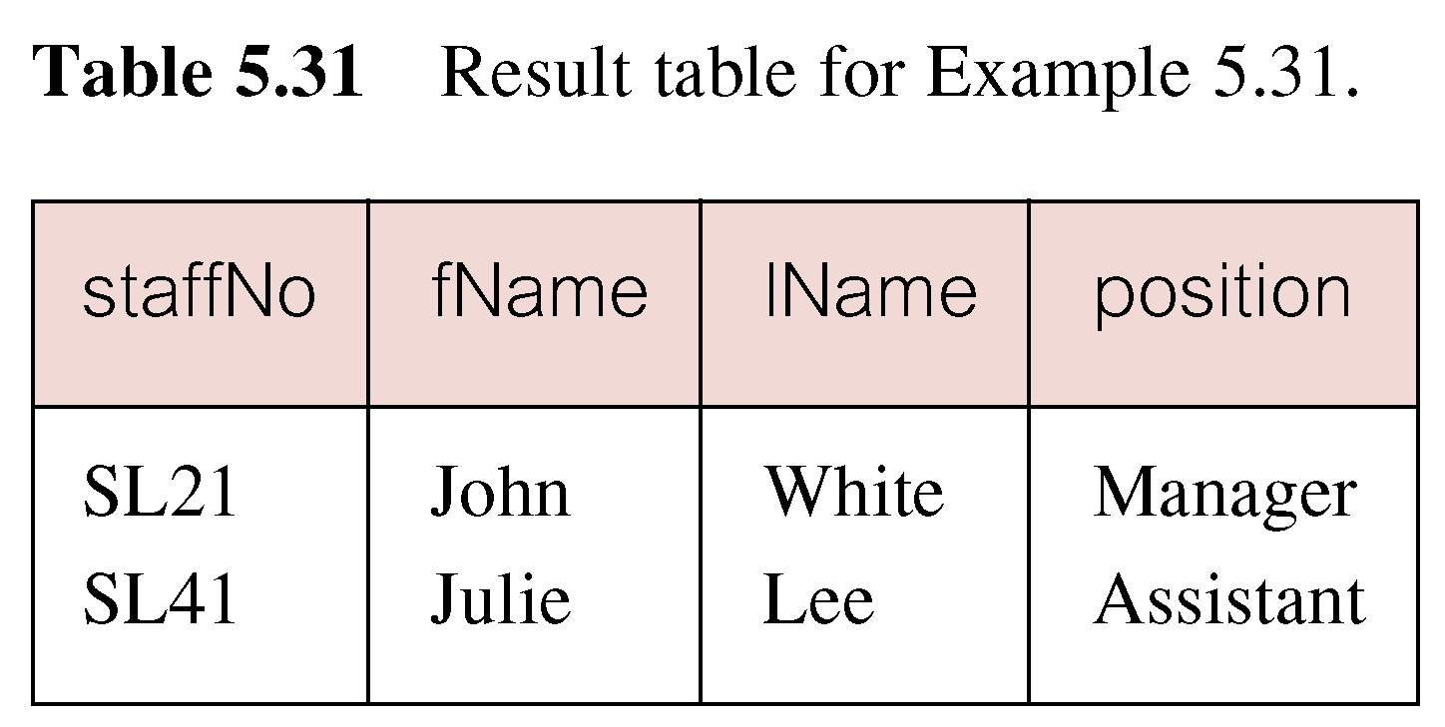
Result: Example 5.31

Slide 29
Query using EXISTS
Note, search condition s.branchNo = b.branchNo is necessary to consider correct branch record for each member of staff
If omitted, would get all staff records listed out because subquery:
SELECT * FROM Branch WHERE city=‘London’
Would always be true and query would be:
SELECT staffNo, fName, lName, position
FROM Staff
WHERE true;

Slide 30
Query using EXISTS..
Same query could also be written using join construct:
SELECT staffNo, fName, lName, position
FROM Staff s, Branch b
WHERE s.branchNo = b.branchNo AND city = ‘London’;

Slide 31
Union, Intersect, Difference
Can use normal set operations of Union, Intersection, and Difference to combine results of two or more queries into a single result table
UNION of two tables, A and B, is table containing all rows in either A or B or both
INTERSECTION is table containing all rows common to both A and B
DIFFERENCE (EXCEPT) is table containing all rows in A but not in B
Two tables must be union compatible

Slide 32
Union, Intersect, Difference..
The three set operators in the ISO standard are called UNION, INTERSECT, and EXCEPT
The format of the set operator clause in each case is:
operator [ALL] [CORRESPONDING [BY {column1 [, ...]}]]
If CORRESPONDING BY specified, set operation performed on the named column(s)
If CORRESPONDING specified but not BY clause, operation performed on common columns
If ALL specified, result can include duplicate rows

Slide 33
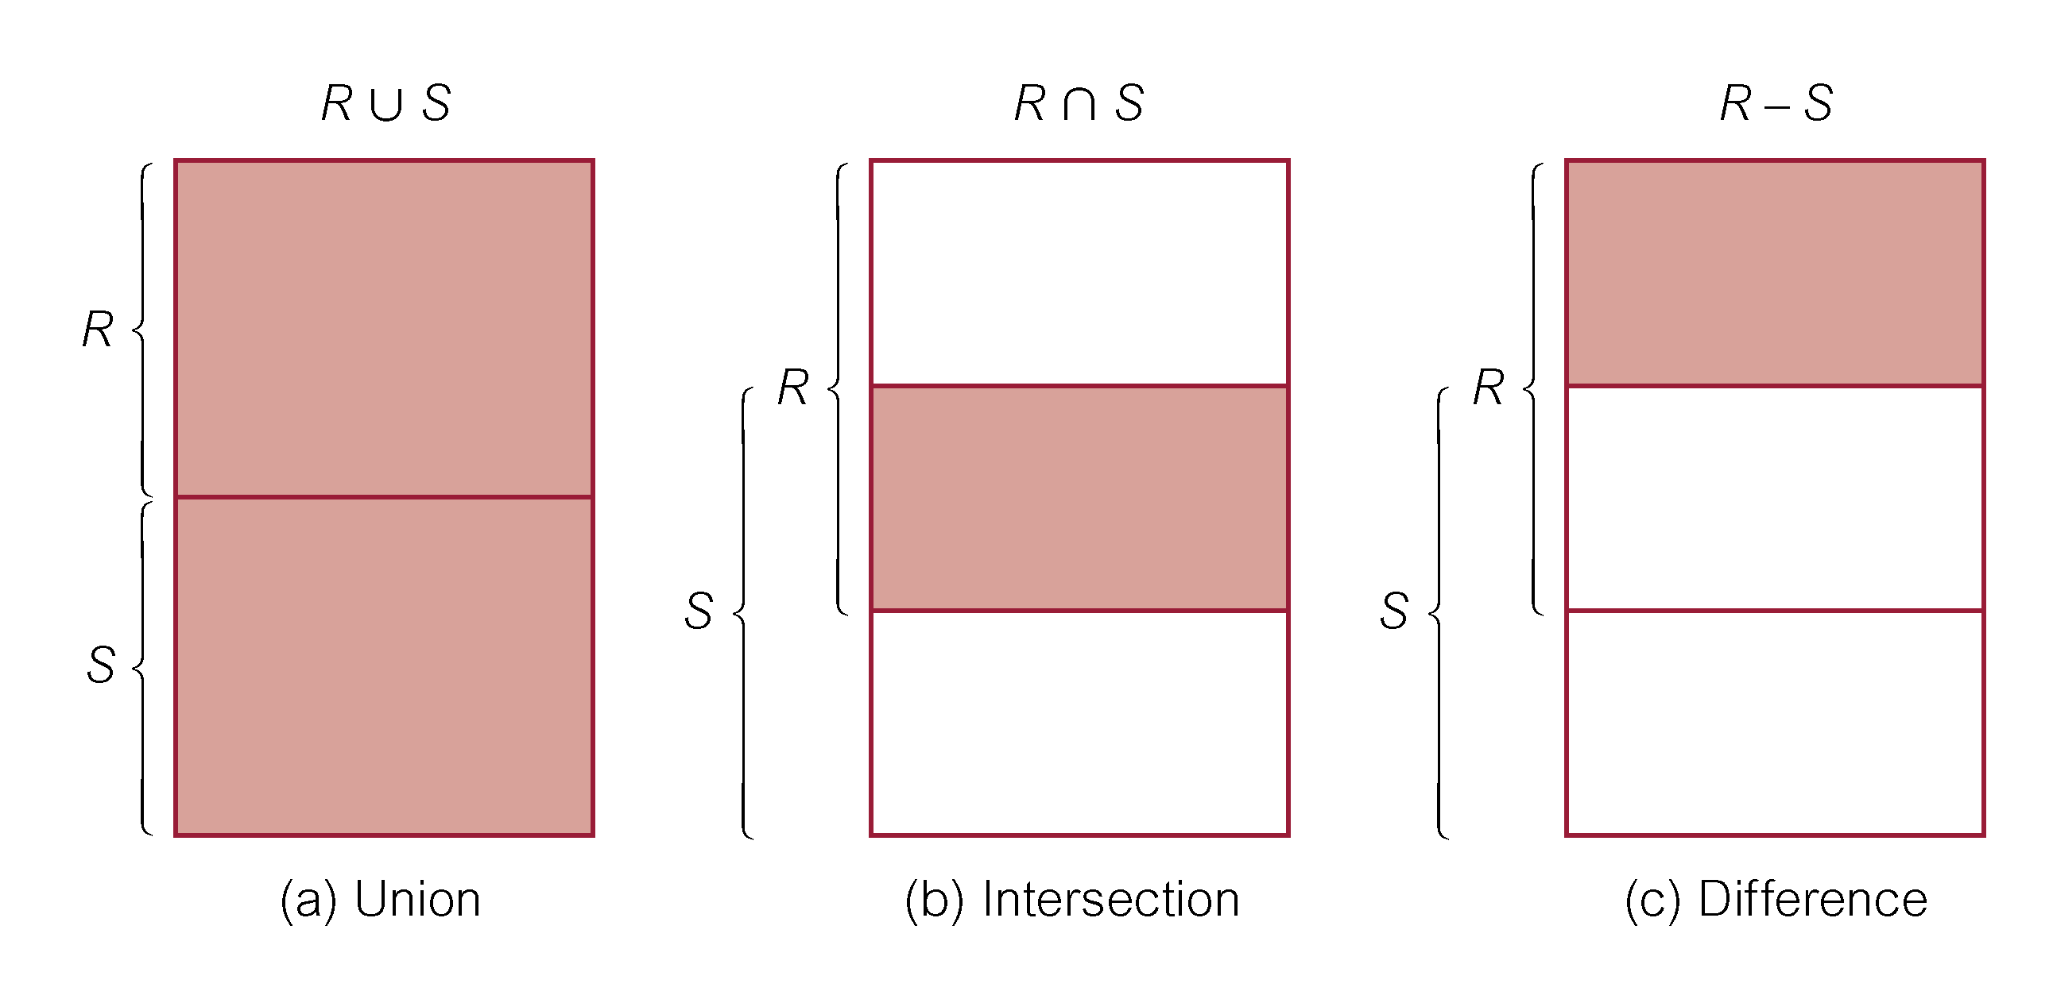
Union, Intersect, Difference..

Slide 34
Example 5.32
List all cities where there is either a branch office or a property
(SELECT city
FROM Branch
WHERE city IS NOT NULL)
UNION
(SELECT city
FROM PropertyForRent
WHERE city IS NOT NULL);

Slide 35
Example 5.32
Same query could be written as:
(SELECT *
FROM Branch
WHERE city IS NOT NULL)
UNION CORRESPONDING BY city
(SELECT *
FROM PropertyForRent
WHERE city IS NOT NULL);

Slide 36
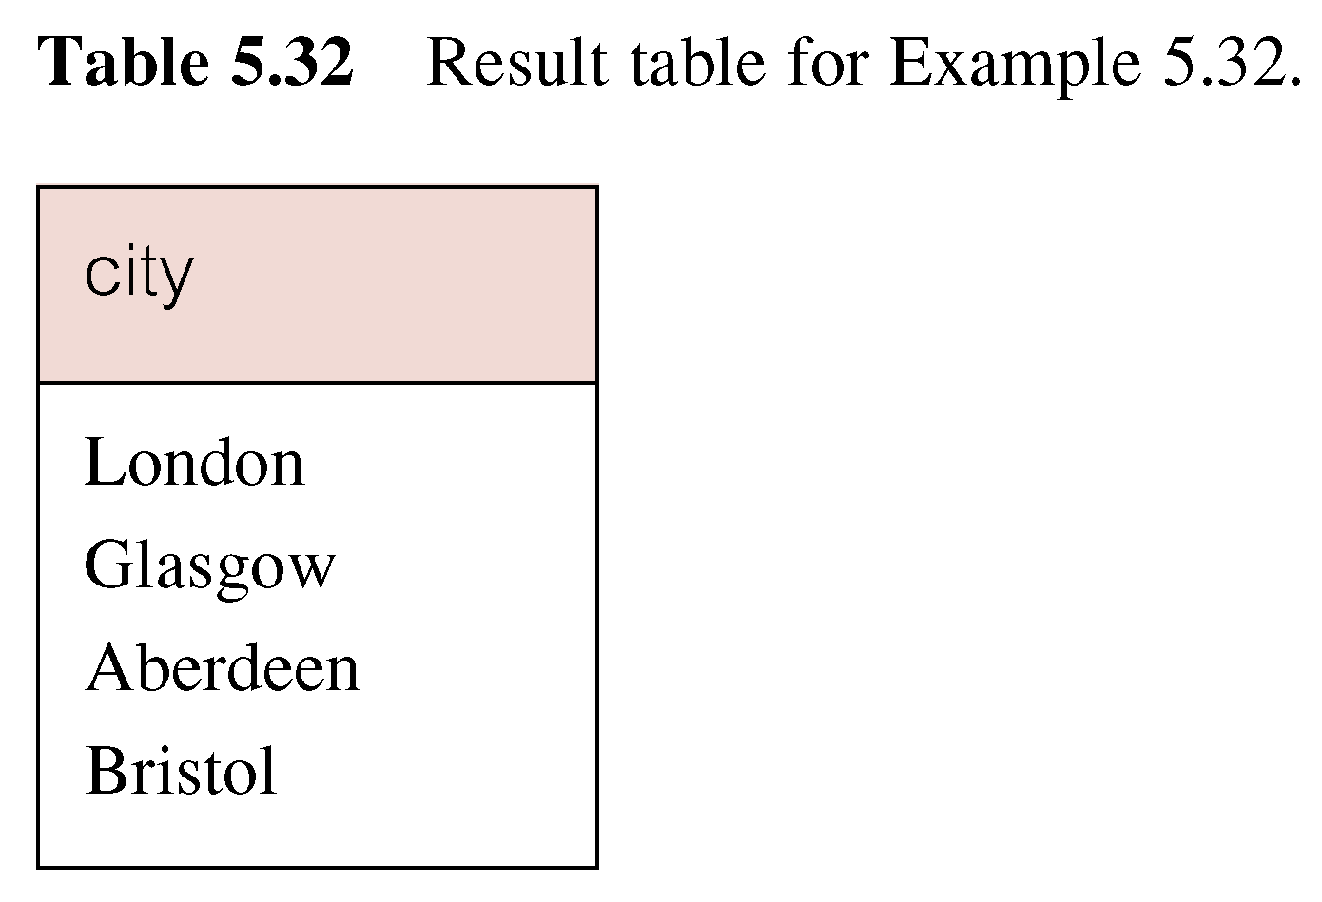
Result: Example 5.32

Slide 37
Example 5.33
List all cities where there is both a branch office and a property
(SELECT city
FROM Branch)
INTERSECT
(SELECT city
FROM PropertyForRent);

Slide 38
Example 5.33
Same query could be written as:
(SELECT *
FROM Branch)
INTERSECT CORRESPONDING BY city
(SELECT *
FROM PropertyForRent);

Slide 39
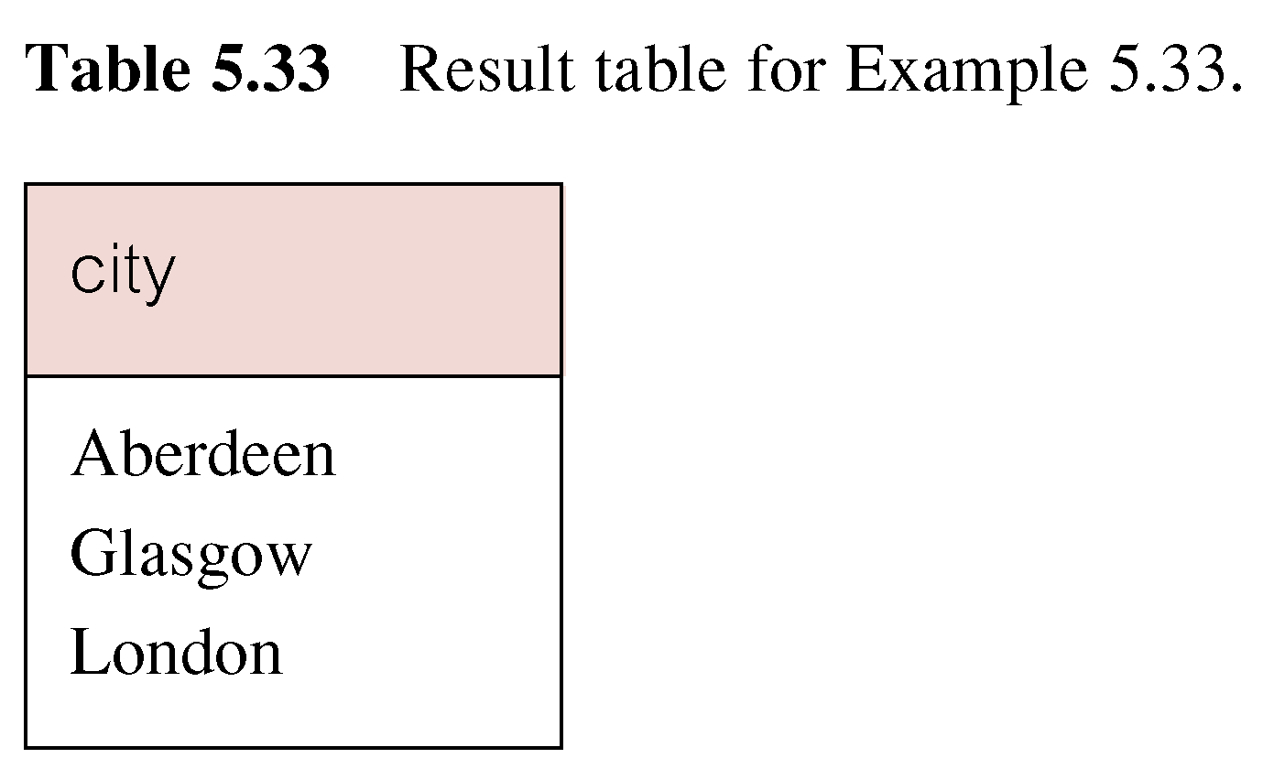
Result: Example 5.33

Slide 40
Example 5.33
Same query could be rewritten without using INTERSECT operator, using join construct or EXISTS:
SELECT DISTINCT b.city
FROM Branch b, PropertyForRent p
WHERE b.city = p.city ;
OR SELECT DISTINCT city
FROM Branch b,
WHERE EXISTS (SELECT *
FROM PropertyForRent p
WHER b.city = p.city);

Slide 41
Example 5.34
List of all cities where there is a branch office but no properties
(SELECT city FROM Branch)
EXCEPT
(SELECT city FROM PropertyForRent);
OR
(SELECT * FROM Branch)
EXCEPT CORRESPONDING BY city
(SELECT * FROM PropertyForRent);

Slide 42
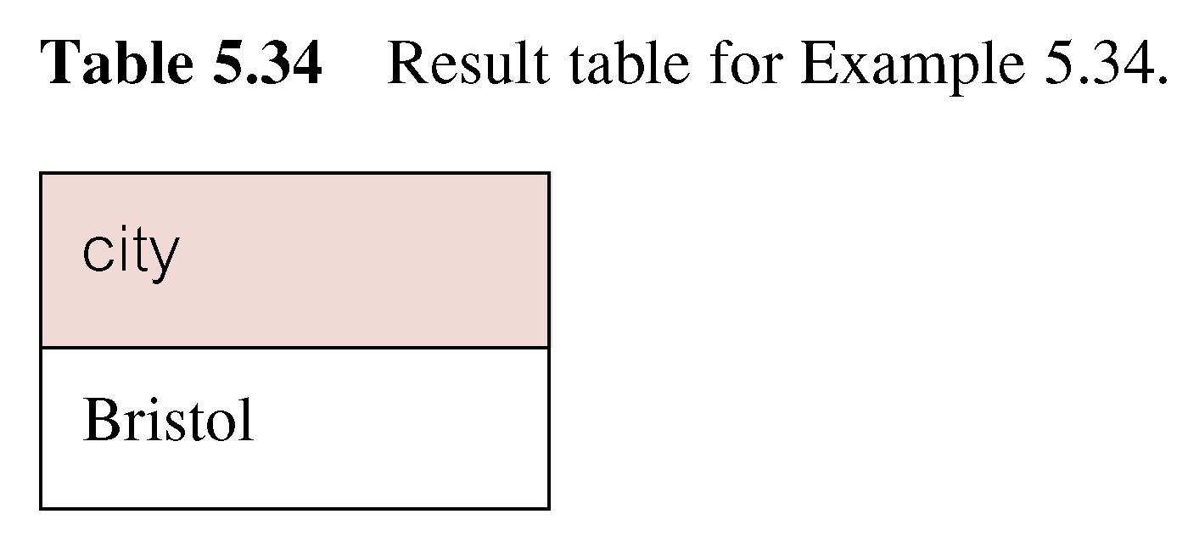
Result: Example 5.34

Slide 43
Example 5.34
Same query could be rewritten without using EXCEPT operator, using NOT IN or NOT EXISTS operator:
SELECT DISTINCT city
FROM Branch
WHERE city NOT IN (SELECT city
FROM PropertyForRent);
SELECT DISTINCT city
FROM Branch b,
WHERE NOT EXISTS (SELECT *
FROM PropertyForRent p
WHER b.city = p.city);

Slide 44
Database Updates
SQL is a complete data manipulation language that can be used for modifying the data in the database as well as querying the database
The commands for modifying the database are not as complex as the SELECT statement
Three SQL statements that are available to modify the contents of the tables in the database:
INSERT – adds new rows of data to a table
UPDATE – modiﬁes existing data in a table
DELETE – removes rows of data from a table

Slide 45
INSERT(Single Row)
INSERT has the following format:
INSERT INTO TableName [ (columnList) ]
VALUES (dataValueList)
TableName may be either a base table or an updatable view
The columnList represents a list of one or more column names separated by commas
The columnList is optional; if omitted, SQL assumes a list of all columns in their original CREATE TABLE order

Slide 46
INSERT (Single Row)..
If speciﬁed, then any columns that are omitted from the list must have been declared as NULL when the table was created, unless the DEFAULT option was used
The dataValueList must match the columnList as follows:
The number of items in each list must be the same;
There must be a direct correspondence in the position of items in the two lists, i.e. the ﬁrst item in dataValueList applies to the ﬁrst item , and so on
The data type of each item in dataValueList must be compatible with the data type of the corresponding column

Slide 47
Example 5.35
Insert a new row into Staff table supplying data for all columns
INSERT INTO Staff
VALUES (‘SG16’, ‘Alan’, ‘Brown’, ‘Assistant’, ‘M’,
‘1957-05-25’, 8300, ‘B003’);

Slide 48
Example 5.36
Insert a new row into Staff table supplying data for all mandatory columns.
INSERT INTO Staff
(staffNo, fName, lName, position, salary, branchNo)
VALUES
(‘SG44’, ‘Anne’, ‘Jones’, ‘Assistant’, 8100, ‘B003’);
Or
INSERT INTO Staff
VALUES (‘SG44’, ‘Anne’, ‘Jones’, ‘Assistant’, NULL, NULL,
8100, ‘B003’);

Slide 49
INSERT (Multiple Rows)
Second form of INSERT allows multiple rows to be copied from one or more tables to another:
INSERT INTO TableName [ (columnList) ]
SELECT ...
Assume there is a table StaffPropCount that contains names of staff and number of properties they manage:
StaffPropCount(staffNo, fName, lName, propCnt)
Populate StaffPropCount using Staff and PropertyForRent tables

Slide 50
Example 5.37
INSERT INTO StaffPropCount
(SELECT s.staffNo, fName, lName, COUNT(*)
FROM Staff s, PropertyForRent p
WHERE s.staffNo = p.staffNo
GROUP BY s.staffNo, fName, lName)
UNION
(SELECT staffNo, fName, lName, 0
FROM Staff
WHERE staffNo NOT IN
(SELECT DISTINCT staffNo
FROM PropertyForRent)
);

Slide 51
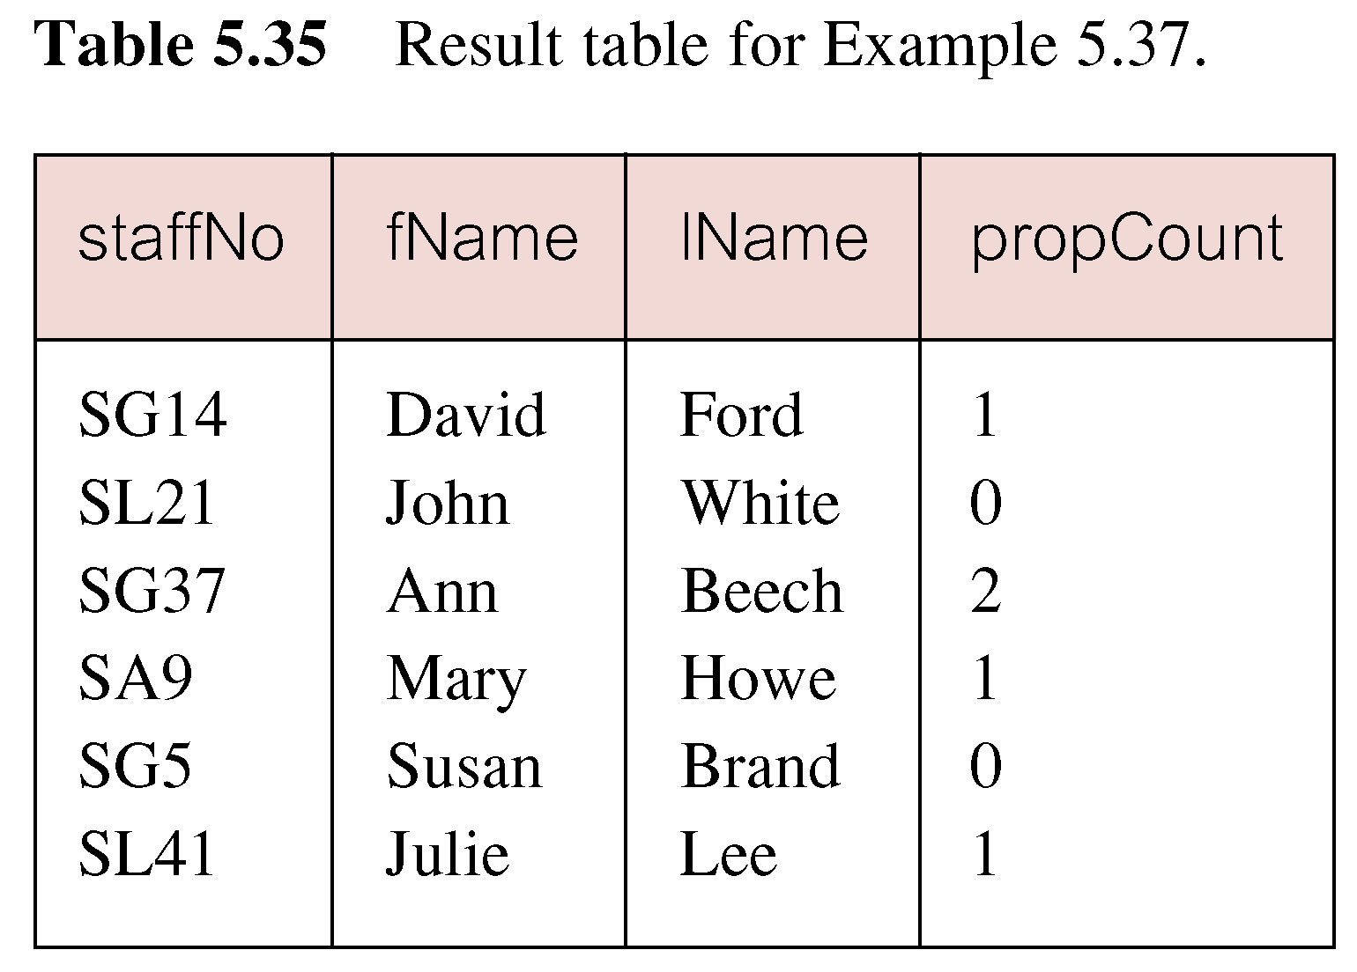
Result: Example 5.37
If second part of UNION is omitted, excludes those staff who currently do not manage any properties

Slide 52
UPDATE
The UPDATE statement allows the contents of existing rows in a named table to be changed
The format of the command is:
UPDATE TableName
SET columnName1= dataValue1 [, columnName2= dataValue2...]
[WHERE searchCondition]
TableName can be the name of a base table or an updatable view
The SET clause speciﬁes the names of one or more columns that are to be updated

Slide 53
UPDATE..
The WHERE clause is optional; if omitted, the named columns are updated for all rows in the table
If a WHERE clause is speciﬁed, only those rows that satisfy the searchCondition are updated
The new dataValue(s) must be compatible with the data type(s) for the corresponding column(s)

Slide 54
Example 5.38/5.39
Give all staff a 3% pay increase
UPDATE Staff
SET salary = salary*1.03;
Give all Managers a 5% pay increase
UPDATE Staff
SET salary = salary*1.05
WHERE position = ‘Manager’;

Slide 55
Example 5.40
Promote David Ford (staffNo=‘SG14’) to Manager and change his salary to £18,000
UPDATE Staff
SET position = ‘Manager’, salary = 18000
WHERE staffNo = ‘SG14’;

Slide 56
DELETE
The DELETE statement allows rows to be deleted from a named table
The format of the command is:
DELETE FROM TableName
[WHERE searchCondition]
TableName can be the name of a base table or an updatable view

Slide 57
DELETE..
The searchCondition is optional; if omitted, all rows are deleted from the table
This does not delete the table itself – to delete the table contents and the table deﬁnition, the DROP TABLE statement must be used instead
If a searchCondition is speciﬁed, only those rows that satisfy the condition are deleted

Slide 58
Example 5.41/5.42
Delete all viewings that relate to property PG4
DELETE FROM Viewing
WHERE propertyNo = ‘PG’4;
Delete all records from the Viewing table.
DELETE FROM Viewing;

Slide 59
Summary
Multi-Table Queries (Continued..)
Outer join
Left, right, full
EXISTS and NOT EXISTS
UNIION, INTERSECT,EXCEPT(MINUS)
Database updates
INSERT, UPDATE, DELETE

Slide 60
References
All the material (slides, diagrams etc.) presented in this lecture is taken (with modifications) from the Pearson Education website :
http://www.booksites.net/connbegg

