Slide 1
CSC271 Database Systems
Lecture # 12

Slide 2
Summary: Previous Lecture
Row selection using WHERE clause
WHERE clause and search conditions
Sorting results using ORDER BY clause
SQL aggregate functions

Slide 3
DreamHome Case Study
Consist of following tables:
Branch (branchNo, street, city, postcode)
Staff (staffNo, fName, lName, position, sex, DOB, salary, branchNo)
PropertyForRent (propertyNo, street, city, postcode, type, rooms, rent, ownerNo, staffNo, branchNo)
Client (clientNo, fName, lName, telNo, prefType, maxRent)
PrivateOwner (ownerNo, fName, lName, address, telNo)
Viewing (clientNo, propertyNo, viewDate, comment)

Slide 4
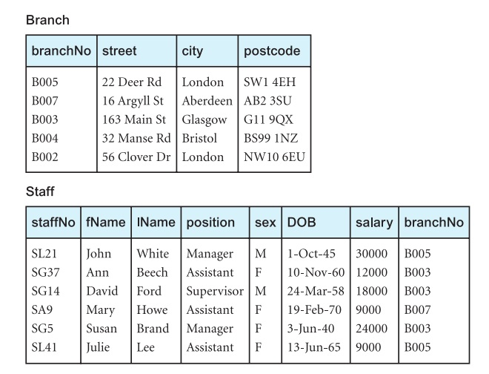
Instance of DreamHome

Slide 5
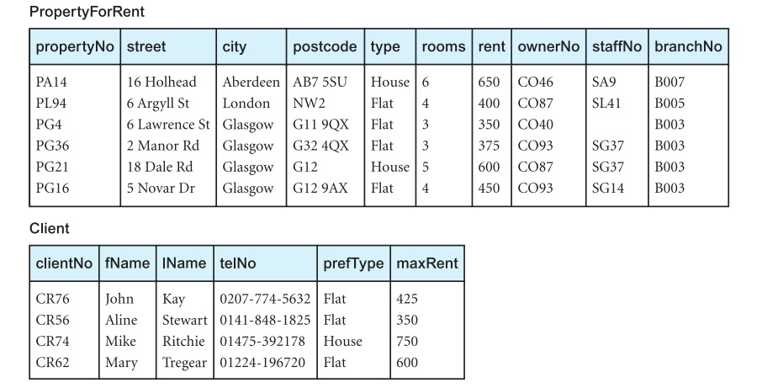
Instance of DreamHome

Slide 6
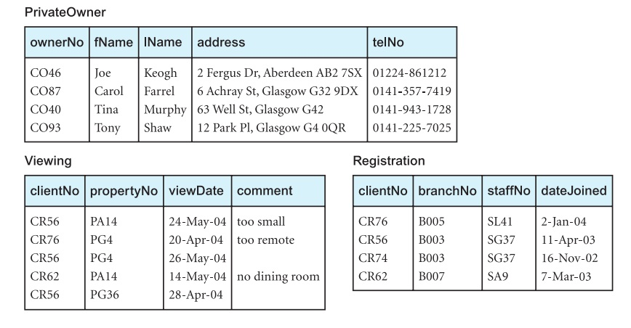
Instance of DreamHome

Slide 7
Grouping Results
Aggregate functions provide the totals at the bottom of a report
However to obtain subtotals in the reports, we can use GROUP BY clause
A query that includes the GROUP BY clause is called a grouped query
It groups the data from the SELECT table(s) and produces a single summary row for each group
The columns named in the GROUP BY clause are called the grouping columns

Slide 8
Grouping Results..
The ISO standard requires the SELECT clause and the GROUP BY clause to be closely integrated
When GROUP BY is used, each item in the SELECT list must be single-valued per group
Further, the SELECT clause may contain only:
column names
aggregate functions
constants
expression involving combinations of the above

Slide 9
Grouping Results..
All column names in the SELECT list must appear in the GROUP BY clause unless the name is used only in an aggregate function
The contrary is not true: there may be column names in the GROUP BY clause that do not appear in the SELECT list
When the WHERE clause is used with GROUP BY, the WHERE clause is applied ﬁrst, then groups are formed from the remaining rows that satisfy the search condition
The ISO standard considers two nulls to be equal for purposes of the GROUP BY clause

Slide 10
Example 5.17
Find number of staff in each branch and their total salaries
SELECT branchNo, COUNT(staffNo) AS myCount,
SUM(salary) AS mySum
FROM Staff
GROUP BY branchNo
ORDER BY branchNo;

Slide 11
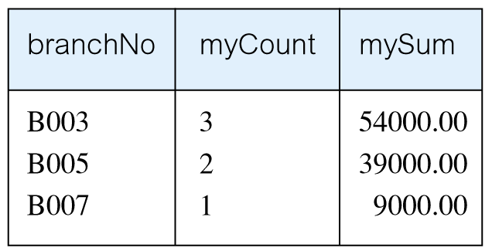
Result: Example 5.17

Slide 12
GROUP BY Clause
It is not necessary to include the column names staffNo and salary in the GROUP BY list because they appear only in the SELECT list within aggregate functions
On the other hand, branchNo is not associated with an aggregate function and so must appear in the GROUP BY list

Slide 13
Working of GROUP BY
Conceptually, SQL performs the query as follows:
SQL divides the staff into groups according to their respective branch numbers
For each group, SQL computes the number of staff members and calculates the sum of salary column, a single summary row for each group
Finally, the result is sorted in ascending order of branch number, branchNo

Slide 14
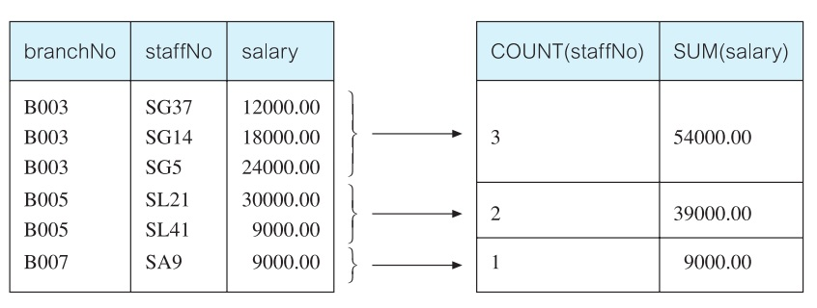
Working of GROUP BY..

Slide 15
Alternative Approach
The SQL standard allows the SELECT list to contain nested queries
SELECT branchNo, (SELECT COUNT(staffNo) AS myCount
FROM Staff s
WHERE s.branchNo= b.branchNo),
(SELECT SUM(salary) AS mySum
FROM Staff s
WHERE s.branchNo= b.branchNo)
FROM Branch b
ORDER BY branchNo;
What will be the result of this query?

Slide 16
Restricted Groupings
HAVING clause is designed for use with GROUP BY to restrict groups that appear in result table
Similar to WHERE, but WHERE filters individual rows whereas HAVING filters groups
Column names in HAVING clause must also appear in the GROUP BY list or be contained within an aggregate function
In practice, the search condition in the HAVING clause always includes at least one aggregate function
Remember that aggregate functions cannot be used in the WHERE clause

Slide 17
Example 5.18
For each branch with more than 1 member of staff, find number of staff in each branch and sum of their salaries
SELECT branchNo, COUNT(staffNo) AS myCount,
SUM(salary) AS mySum
FROM Staff
GROUP BY branchNo
HAVING COUNT(staffNo) > 1
ORDER BY branchNo;

Slide 18
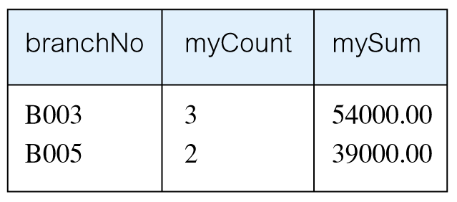
Result: Example 5.18

Slide 19
Subqueries
Some SQL SELECT statements can have a SELECT statement embedded within them
A subselect can be used in WHERE and HAVING clauses of an outer SELECT, where it is called a subquery or nested query
Subselects may also appear in INSERT, UPDATE, and DELETE statements

Slide 20
Types of Subquery
There are three types of a subquery:
A scalar subquery returns a single column and a single row i.e. a single value
A row subquery returns multiple columns, but again only a single row
A table subquery returns one or more columns and multiple rows

Slide 21
Example 5.19
List staff who work in branch at ‘163 Main St’
SELECT staffNo, fName, lName, position
FROM Staff
WHERE branchNo = ( SELECT branchNo
FROM Branch
WHERE street = ‘163 Main St’);

Slide 22
Working of Subquery
Inner SELECT finds branch number for branch at ‘163 Main St’, which is ‘B003’
Outer SELECT then retrieves details of all staff who work at this branch
Outer SELECT then becomes:
SELECT staffNo, fName, lName, position
FROM Staff
WHERE branchNo = ‘B003’;

Slide 23
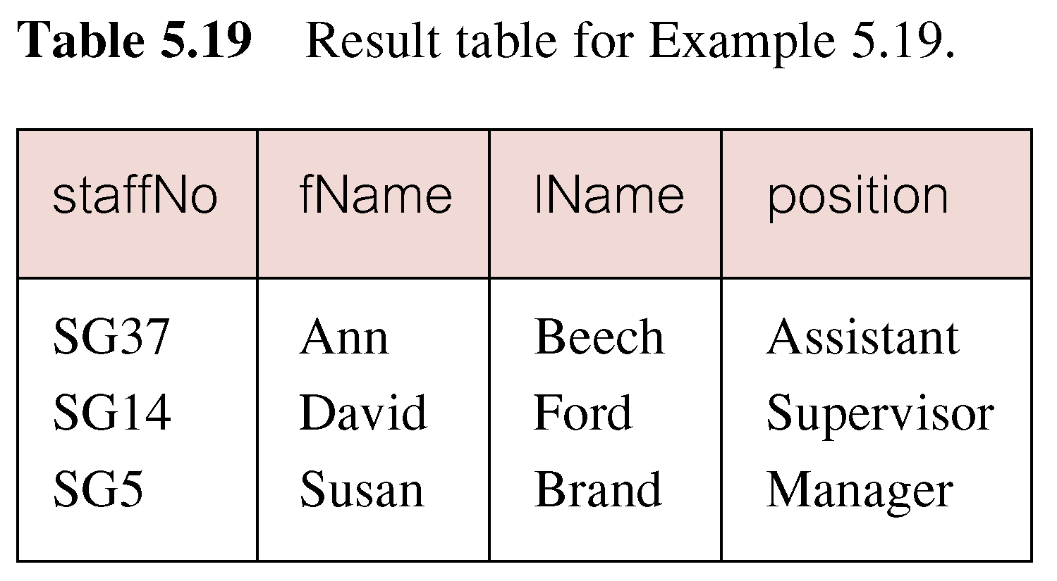
Result: Example 5.19

Slide 24
Example 5.20
List all staff whose salary is greater than the average salary, and show by how much their salary is greater than the average
SELECT staffNo, fName, lName, position,
salary – (SELECT AVG(salary) FROM Staff) AS
SalDiff
FROM Staff
WHERE salary > (SELECT AVG(salary)
FROM Staff);

Slide 25
Working of Subquery
Cannot write ‘WHERE salary > AVG(salary)’
Instead, use subquery to find average salary (17000), and then use outer SELECT to find those staff with salary greater than this:
SELECT staffNo, fName, lName, position, salary-17000 AS salDiff
FROM Staff
WHERE salary > 17000;

Slide 26
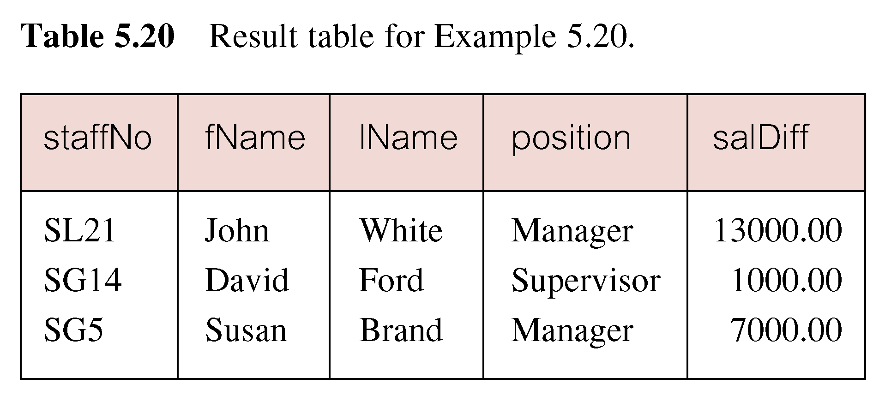
Result: Example 5.20

Slide 27
Subquery Rules
ORDER BY clause may not be used in a subquery (although it may be used in outermost SELECT)
Subquery SELECT list must consist of a single column name or expression, except for subqueries that use EXISTS
By default, column names refer to table name in FROM clause of subquery, It is possible to refer to a table in a FROM clause of an outer query by qualifying the column name

Slide 28
Subquery Rules..
When a subquery is one of the two operands involved in a comparison, the subquery must appear on the right-hand side of the comparison
For example, it would be incorrect to express the last example as:
SELECT staffNo, fName, lName, position, salary
FROM Staff
WHERE (SELECT AVG(salary) FROM Staff) < salary;

Slide 29
Example 5.21
List properties handled by staff at ‘163 Main St’
SELECT propertyNo, street, city, postcode, type,
rooms, rent
FROM PropertyForRent
WHERE staffNo IN (SELECT staffNo
FROM Staff
WHERE branchNo = (SELECT branchNo
FROM Branch
WHERE street = ‘163 Main St’));

Slide 30
Result: Example 5.21

Slide 31
ANY(SOME) and ALL
ANY and ALL may be used with subqueries that produce a single column of numbers
With ALL, condition will only be true if it is satisfied by all values produced by subquery
With ANY, condition will be true if it is satisfied by any values produced by subquery
If subquery is empty, ALL returns true, ANY returns false
SOME may be used in place of ANY

Slide 32
Example 5.22
Find staff whose salary is larger than salary of at least one member of staff at branch B003
SELECT staffNo, fName, lName, position, salary
FROM Staff
WHERE salary > SOME
(SELECT salary
FROM Staff
WHERE branchNo = ‘B003’);

Slide 33
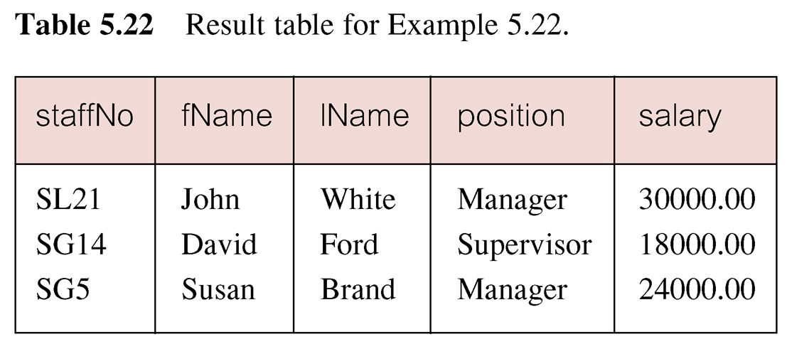
Result: Example 5.22
Inner query produces set {12000, 18000, 24000} and outer query selects those staff whose salaries are greater than any of the values in this set

Slide 34
Example 5.23
Find staff whose salary is larger than salary of every member of staff at branch B003
SELECT staffNo, fName, lName, position, salary
FROM Staff
WHERE salary > ALL
(SELECT salary
FROM Staff
WHERE branchNo = ‘B003’);

Slide 35
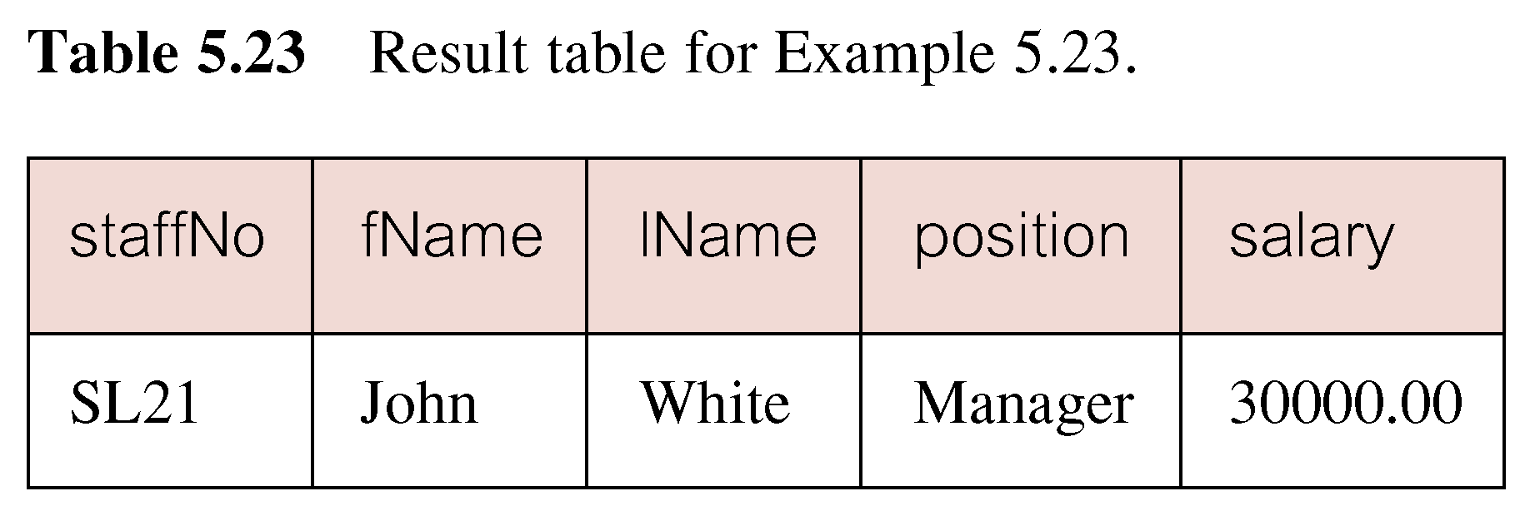
Result: Example 5.23
Inner query produces set {12000, 18000, 24000} and outer query selects those staff whose salaries are greater than all of the values in this set

Slide 36
Multi-Table Queries
Can use subqueries provided result columns come from same table
If result columns come from more than one table must use a join
To perform join, include more than one table in FROM clause
Use comma as separator and typically include WHERE clause to specify join column(s)

Slide 37
Multi-Table Queries..
Also possible to use an alias for a table named in FROM clause
Alias is separated from table name with a space
Alias can be used to qualify column names when there is ambiguity

Slide 38
Example 5.24
List names of all clients who have viewed a property along with any comment supplied
SELECT c.clientNo, fName, lName, propertyNo,
comment
FROM Client c, Viewing v
WHERE c.clientNo = v.clientNo;

Slide 39
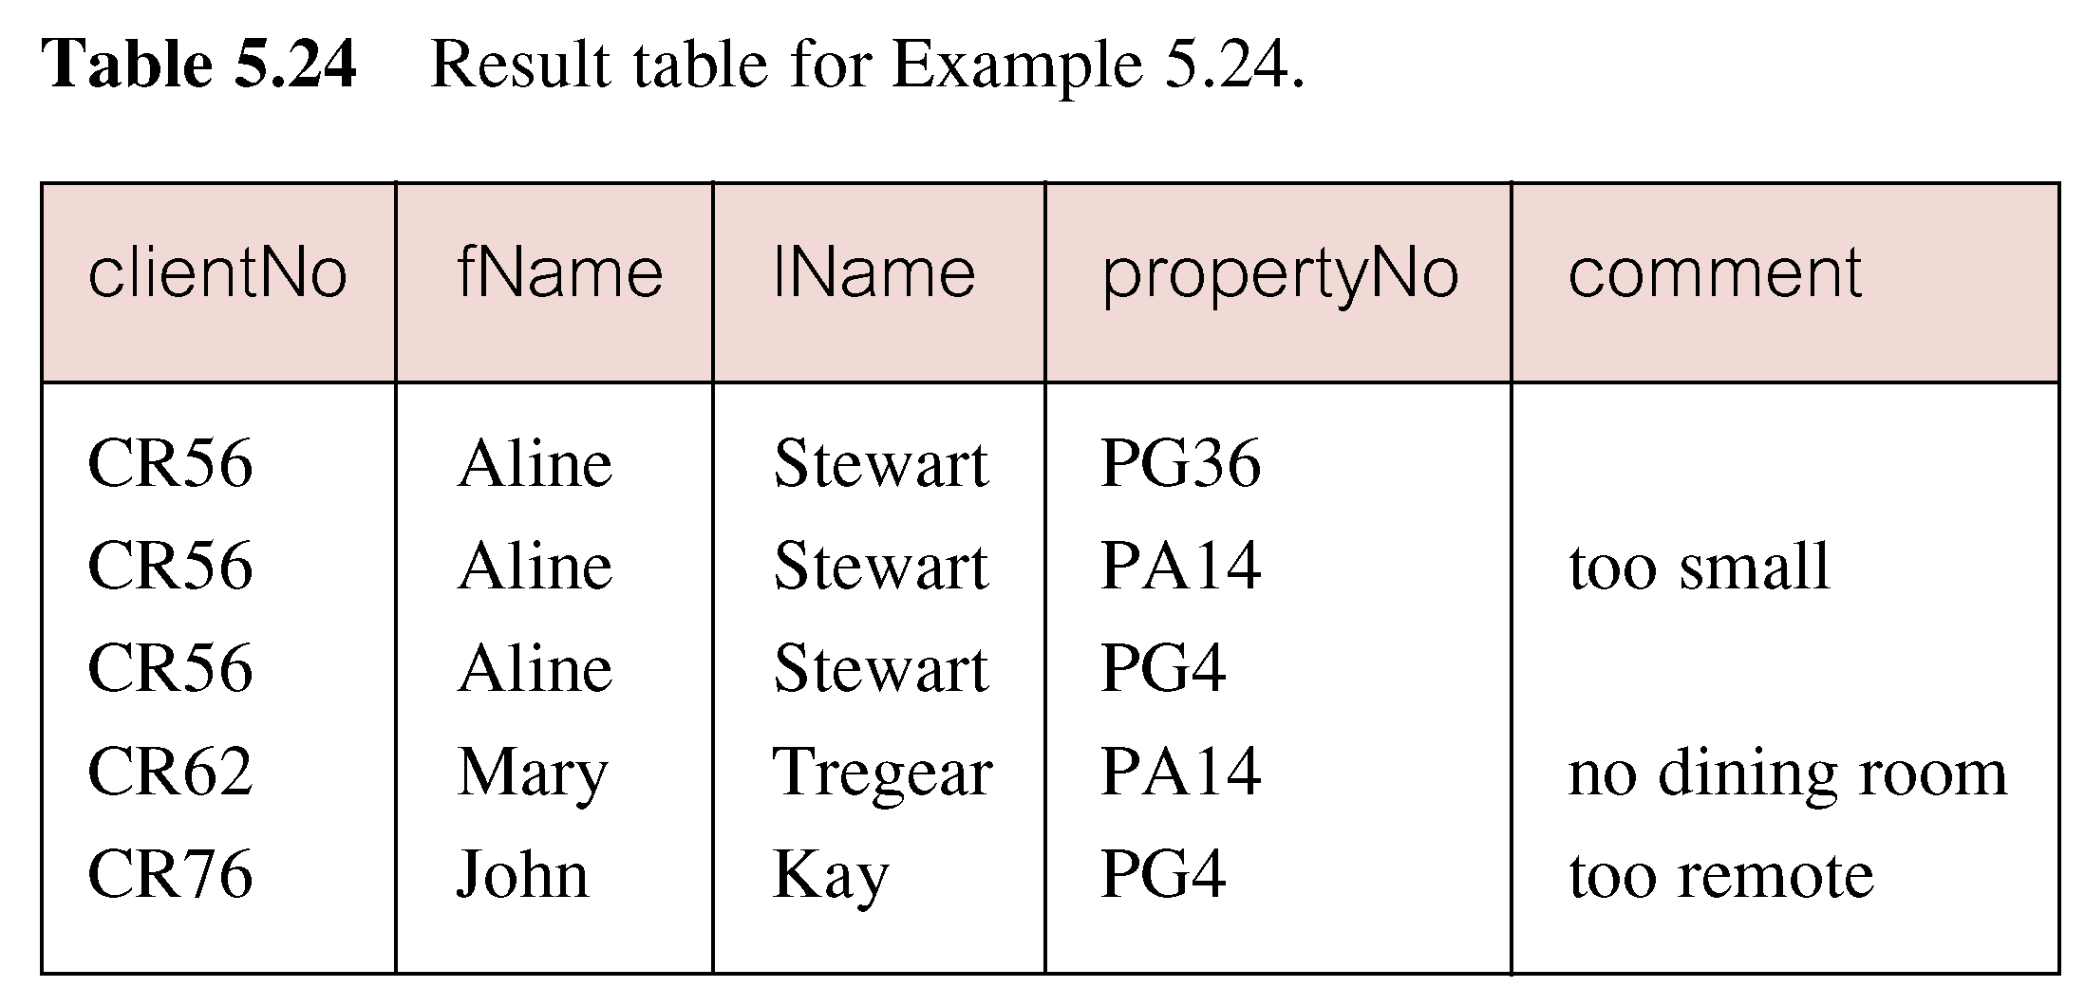
Result: Example 5.24

Slide 40
Simple Join
Only those rows from both tables that have identical values in the clientNo columns (c.clientNo = v.clientNo) are included in result
Equivalent to equijoin in relational algebra
The most common multi-table queries involve two tables that have a one-to-many (1:*) (or a parent/child) relationship
The table containing the primary key is the parent table and the table containing the foreign key is the child table

Slide 41
Alternatives of Join
The SQL standard provides the following alternative ways to specify this join:
FROM Client c JOIN Viewing v ON c.clientNo= v.clientNo
FROM Client JOIN Viewing USING clientNo
FROM Client NATURAL JOIN Viewing
In each case, the FROM clause replaces the original FROM and WHERE clauses
However, the ﬁrst alternative produces a table with two identical clientNo columns; the remaining two produce a table with a single clientNo column

Slide 42
Example 5.25
For each branch, list numbers and names of staff who manage properties, and properties they manage
SELECT s.branchNo, s.staffNo, fName, lName,
propertyNo
FROM Staff s, PropertyForRent p
WHERE s.staffNo = p.staffNo
ORDER BY s.branchNo, s.staffNo, propertyNo;

Slide 43
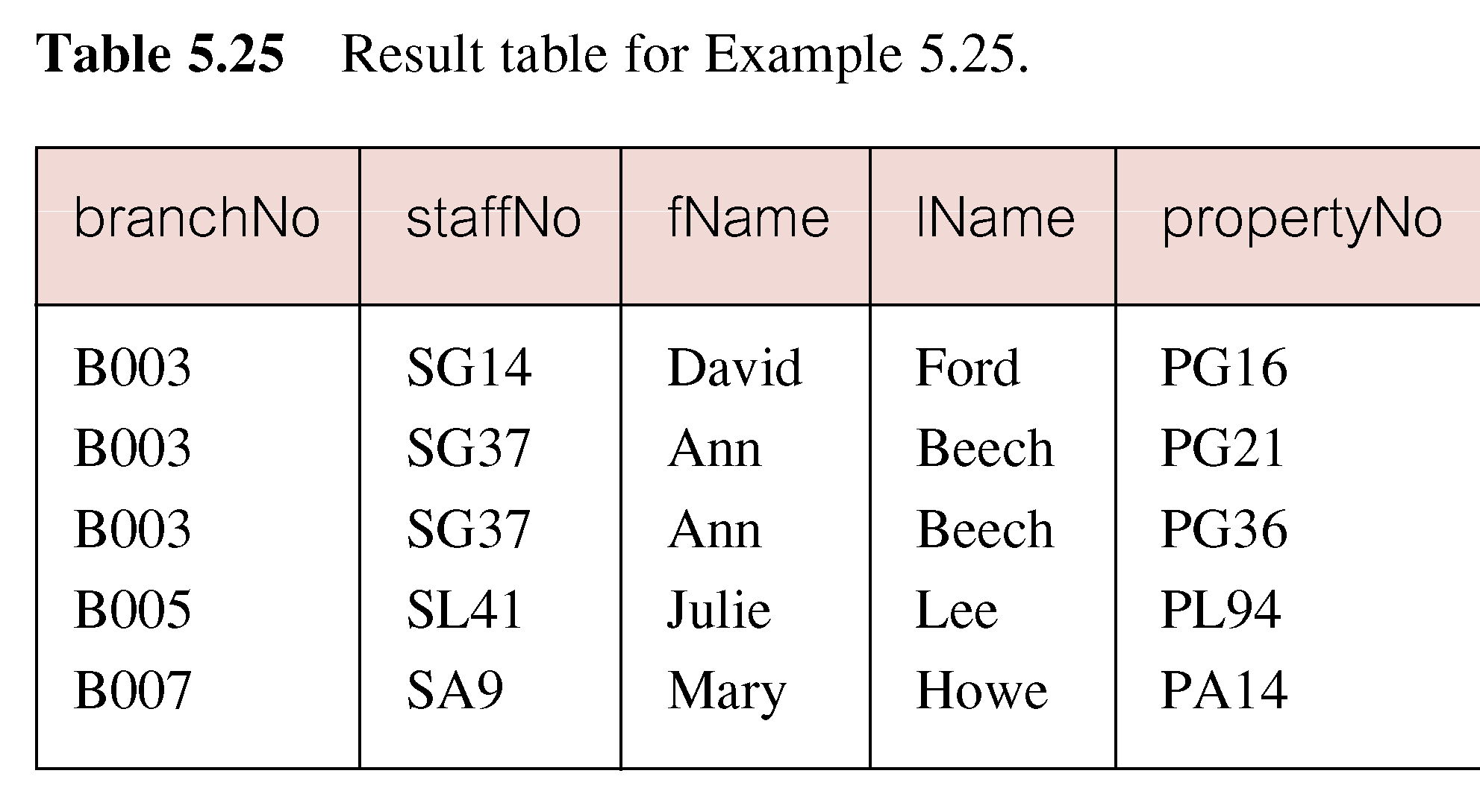
Result: Example 5.25

Slide 44
Summary
Grouping through GROUP BY clause
Restricted groupings
Subqueries
Multi-Table queries

Slide 45
References
All the material (slides, diagrams etc.) presented in this lecture is taken (with modifications) from the Pearson Education website :
http://www.booksites.net/connbegg

