Slide 1
CSC271 Database Systems
Lecture # 11

Slide 2
Summary: Previous Lecture
Objectives of SQL
History of SQL
Importance of SQL
Writing SQL statements
DML (Data Manipulation Language)
SELECT statement

Slide 3
DreamHome Case Study
Consist of following tables:
Branch (branchNo, street, city, postcode)
Staff (staffNo, fName, lName, position, sex, DOB, salary, branchNo)
PropertyForRent (propertyNo, street, city, postcode, type, rooms, rent, ownerNo, staffNo, branchNo)
Client (clientNo, fName, lName, telNo, prefType, maxRent)
PrivateOwner (ownerNo, fName, lName, address, telNo)
Viewing (clientNo, propertyNo, viewDate, comment)

Slide 4
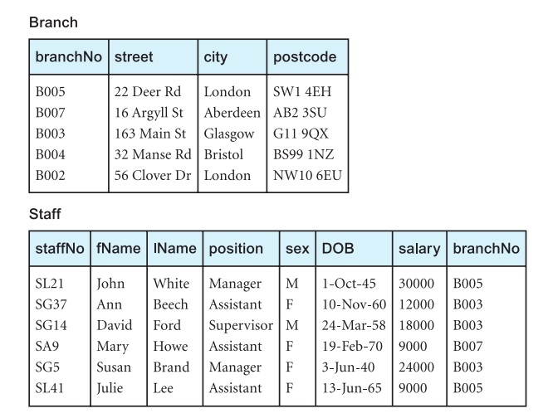
Instance of DreamHome

Slide 5
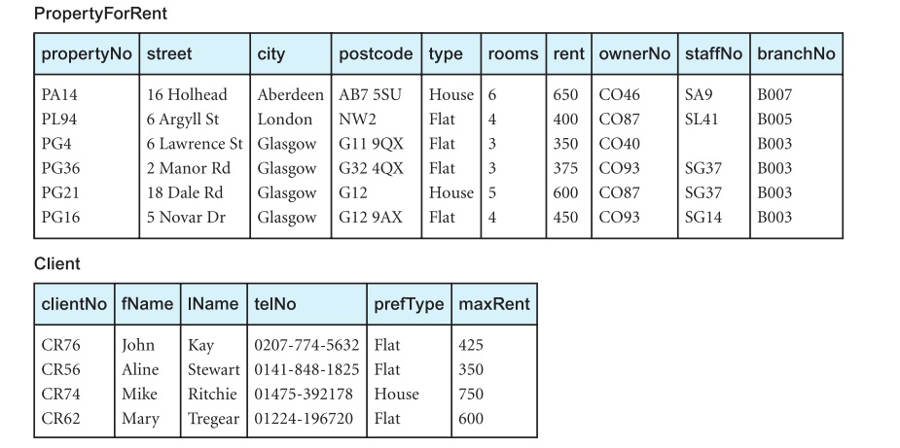
Instance of DreamHome

Slide 6
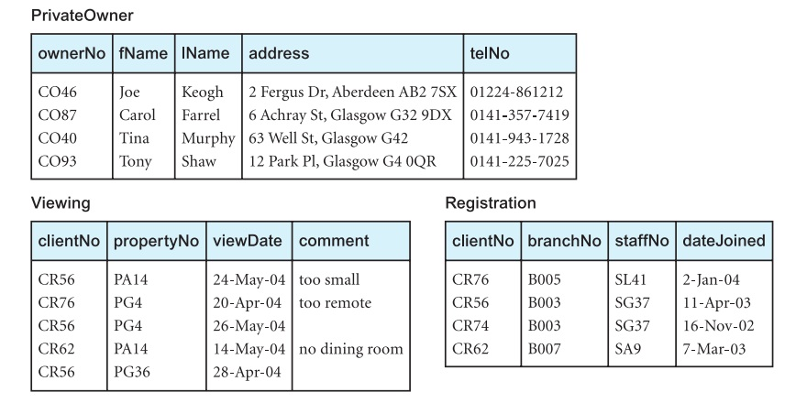
Instance of DreamHome

Slide 7
Row Selection (WHERE)
To restrict rows that are to be retrieved, use WHERE clause
Keyword WHERE is followed by a search condition
There are ﬁve basic search conditions (or predicates using the ISO terminology) available
The WHERE clause is equivalent to the relational algebra Selection operation

Slide 8
Search Conditions
Comparison
Compare the value of one expression to the value of another expression
Range
Test whether the value of an expression falls within a speciﬁed range of values
Set membership
Test whether the value of an expression equals one of a set of values

Slide 9
Search Conditions..
Pattern match
Test whether a string matches a speciﬁed pattern.
Null
Test whether a column has a null (unknown) value

Slide 10
Example 5.5
Comparison search condition
List all staff with a salary greater than 10,000
SELECT staffNo, fName, lName, position, salary
FROM Staff
WHERE salary > 10000;

Slide 11
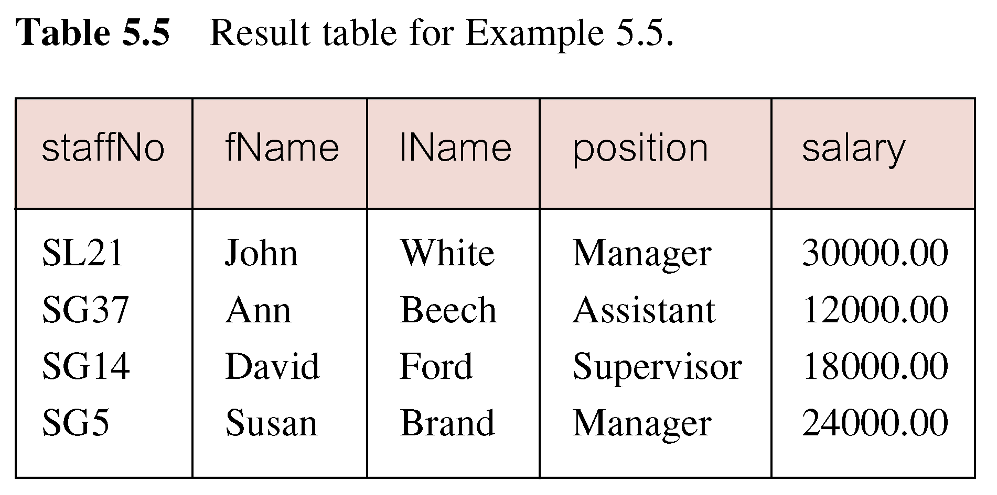
Result: Example 5.5

Slide 12
SQL Comparison Operators
In SQL, the following simple comparison operators are available:
= , < > (ISO standard) / != (allowed in some dialects)
< , <= , >, >=
Complex predicate using logical operators AND, OR, NOT
Parenthesis to show the order of evaluation

Slide 13
Expression Evaluation
The rules for evaluating a conditional expression are:
An expression is evaluated left to right
Sub expressions in brackets are evaluated ﬁrst
NOTs are evaluated before ANDs and ORs
ANDs are evaluated before ORs
The use of parentheses is always recommended in order to remove any possible ambiguities

Slide 14
Example 5.6
Compound comparison search condition
List addresses of all branch offices in London or Glasgow
SELECT *
FROM Branch
WHERE city = ‘London’ OR city = ‘Glasgow’;

Slide 15
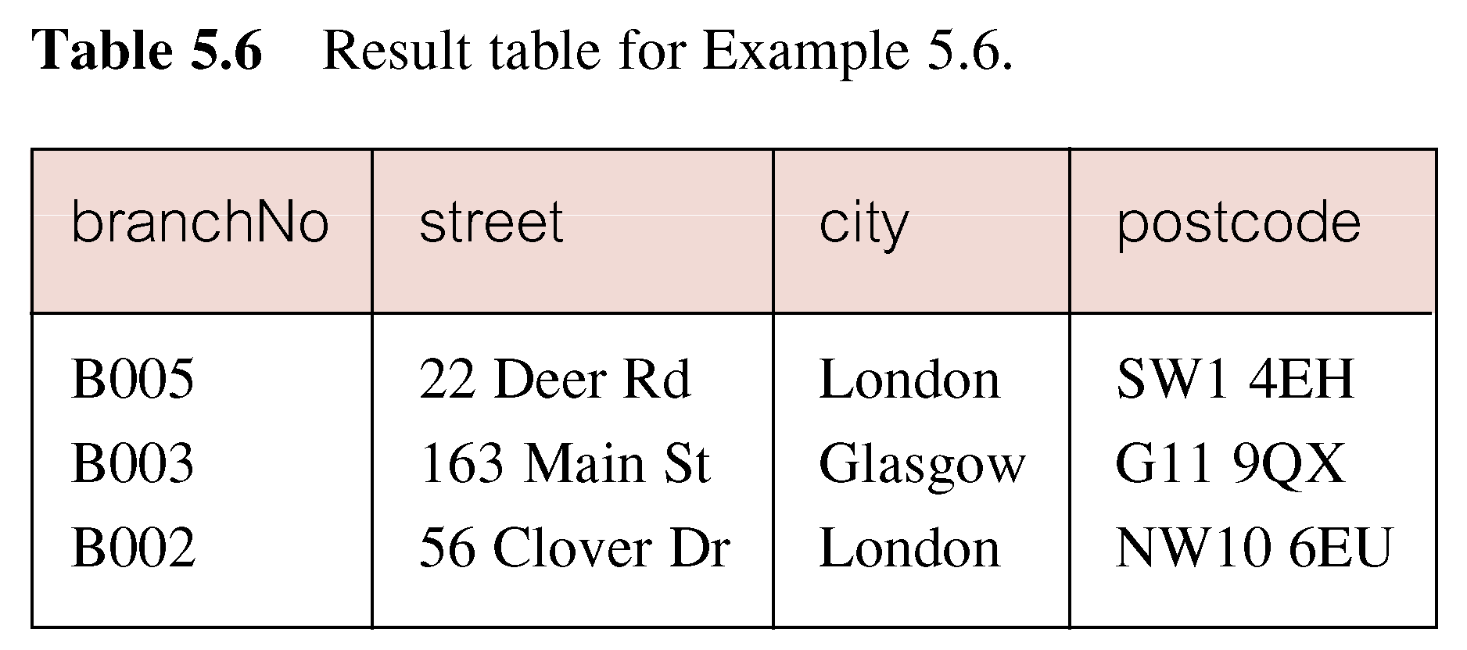
Result: Example 5.6

Slide 16
Example 5.7
Range search condition (BETWEEN/NOT BETWEEN)
List all staff with a salary between 20,000 and 30,000
SELECT staffNo, fName, lName, position,salary
FROM Staff
WHERE salary BETWEEN 20000 AND 30000;
BETWEEN test includes the endpoints of range

Slide 17
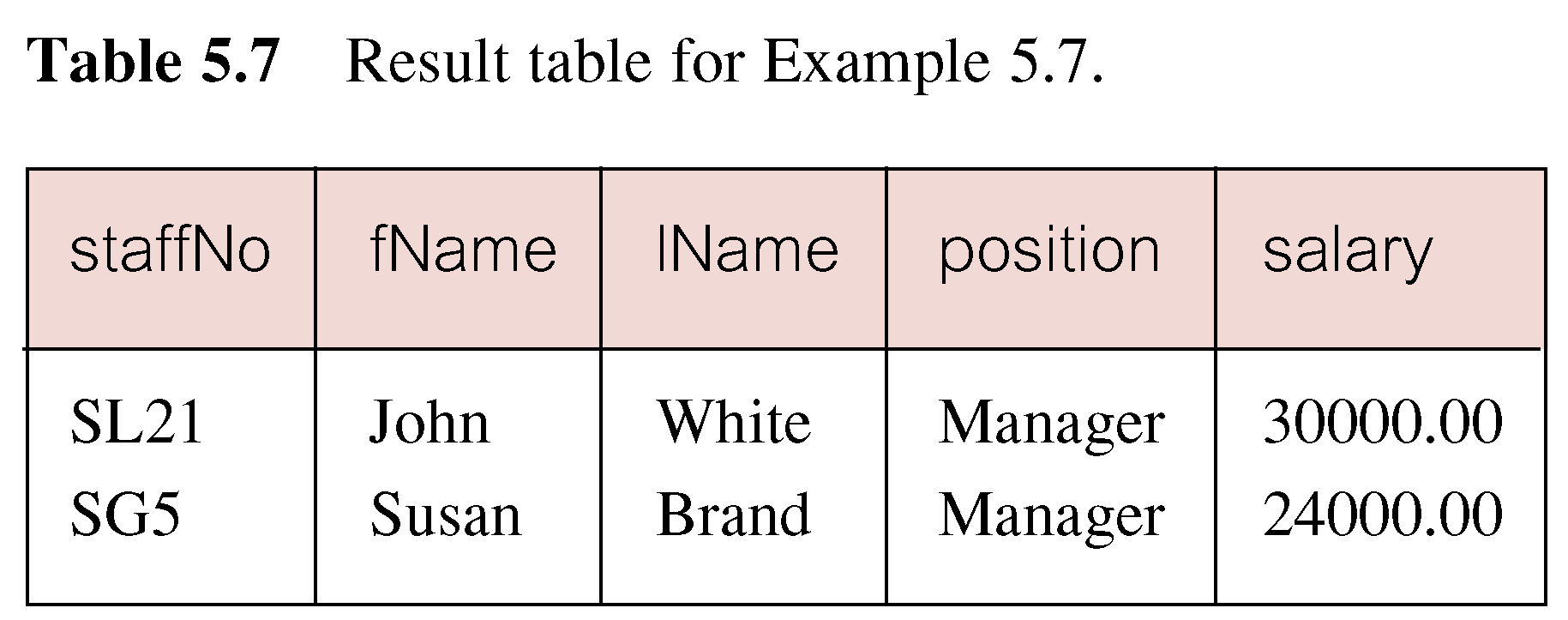
Result: Example 5.7

Slide 18
Range Search Condition
Also a negated version, NOT BETWEEN
BETWEEN does not add much to the expressive power of SQL, because
SELECT staffNo, fName, lName, position, salary
FROM Staff
WHERE salary >= 20000 AND salary <= 30000;
Useful and simple, though, for a range of values

Slide 19
Example 5.8
Set membership condition (IN/NOT IN)
List all managers and supervisors
SELECT staffNo, fName, lName, position
FROM Staff
WHERE position IN (‘Manager’, ‘Supervisor’);

Slide 20
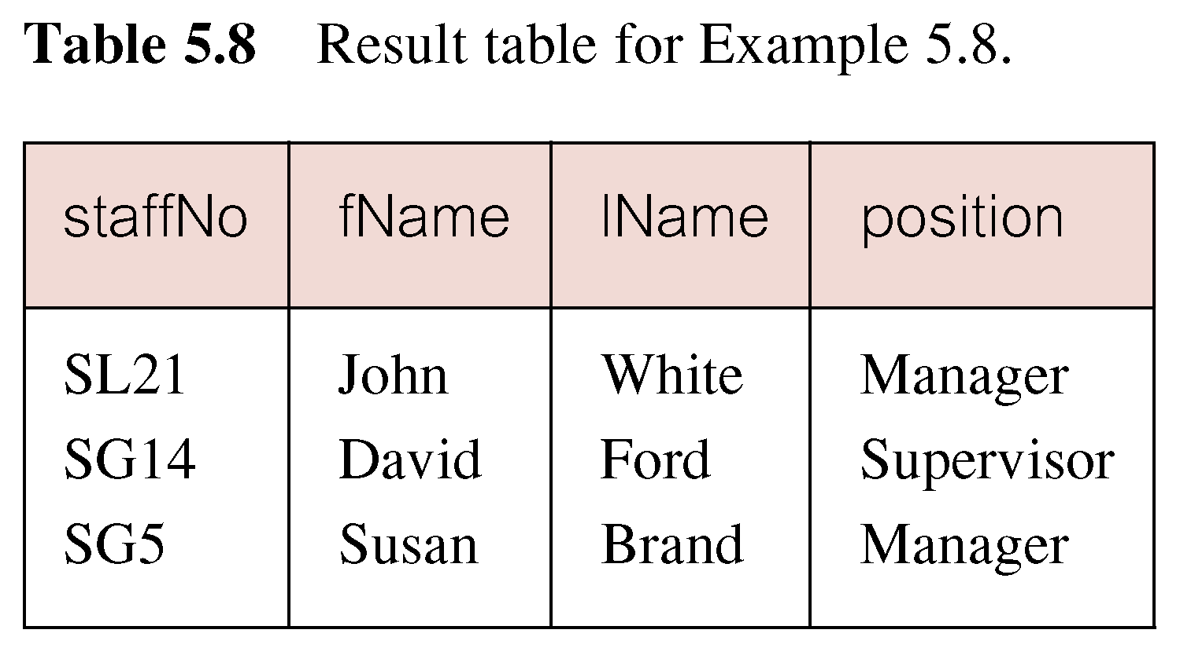
Result: Example 5.8

Slide 21
Set Membership Search Condition
There is a negated version (NOT IN)
IN does not add much to the expressive power of SQL, because
SELECT staffNo, fName, lName, position
FROM Staff
WHERE position=‘Manager’ OR position=‘Supervisor’;
IN is more efficient particularly if the set contains many values

Slide 22
Example 5.9
Pattern match search condition (LIKE/NOT LIKE)
Find all owners with the string ‘Glasgow’ in their address
SELECT ownerNo, fName, lName, address, telNo
FROM PrivateOwner
WHERE address LIKE ‘%Glasgow%’;

Slide 23
Result: Example 5.9

Slide 24
Pattern Match Search Condition
SQL has two special pattern matching symbols:
% (percent): any sequence of zero or more characters
_ (underscore): any single character
Address LIKE ‘H%’ means the ﬁrst character must be H, but the rest of the string can be anything
Address LIKE ‘H_ _ _’ means that there must be exactly four characters in the string, the ﬁrst of which must be an H
LIKE ‘%Glasgow%’ means a sequence of characters of any length containing ‘Glasgow’

Slide 25
Pattern Match Search Condition..
If the search string can include the pattern-matching character itself, we can use an escape character to represent the pattern-matching character
For example, to check for the string ‘15%’, we can use the predicate:
LIKE ‘15#%’ ESCAPE ‘#’
Some RDBMSs, such as Microsoft Ofﬁce Access, use the wildcard characters * and ? instead of % and _

Slide 26
Example 5.10
NULL search condition (IS NULL/IS NOT NULL)
List the details of all viewings on property PG4 where a comment has not been supplied
SELECT clientNo, viewDate
FROM Viewing
WHERE propertyNo= ‘PG4’ AND comment IS NULL;
Negated version (IS NOT NULL) can test for non-null values

Slide 27
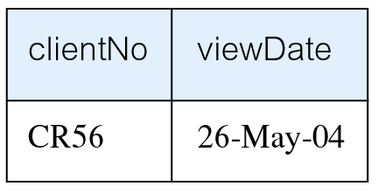
Result: Example 5.10

Slide 28
Sorting Results (ORDER BY Clause)
In general, the rows of an SQL query result table are not arranged in any particular order
Although some DBMSs may use a default ordering based, for example, on a primary key
We can use ORDER BY clause to sort query results
Sorting in ASC or DESC order on a column(s)
Single column ordering or multiple column ordering
ORDER BY clause must always be the last clause of the SELECT statement

Slide 29
Example 5.11
Single-column ordering
List salaries for all staff, arranged in descending order of salary.
SELECT staffNo, fName, lName, salary
FROM Staff
ORDER BY salary DESC;

Slide 30
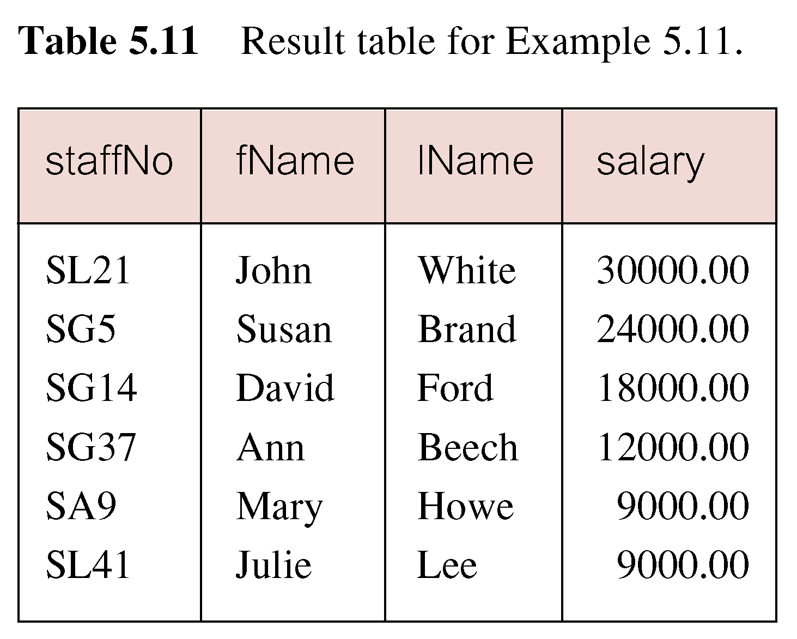
Result: Example 5.11

Slide 31
Example 5.12
Multiple column ordering
Minor/Major sort key (one sort key)
Produce an abbreviated list of properties arranged in order of property type
SELECT propertyNo, type, rooms, rent
FROM PropertyForRent
ORDER BY type;

Slide 32
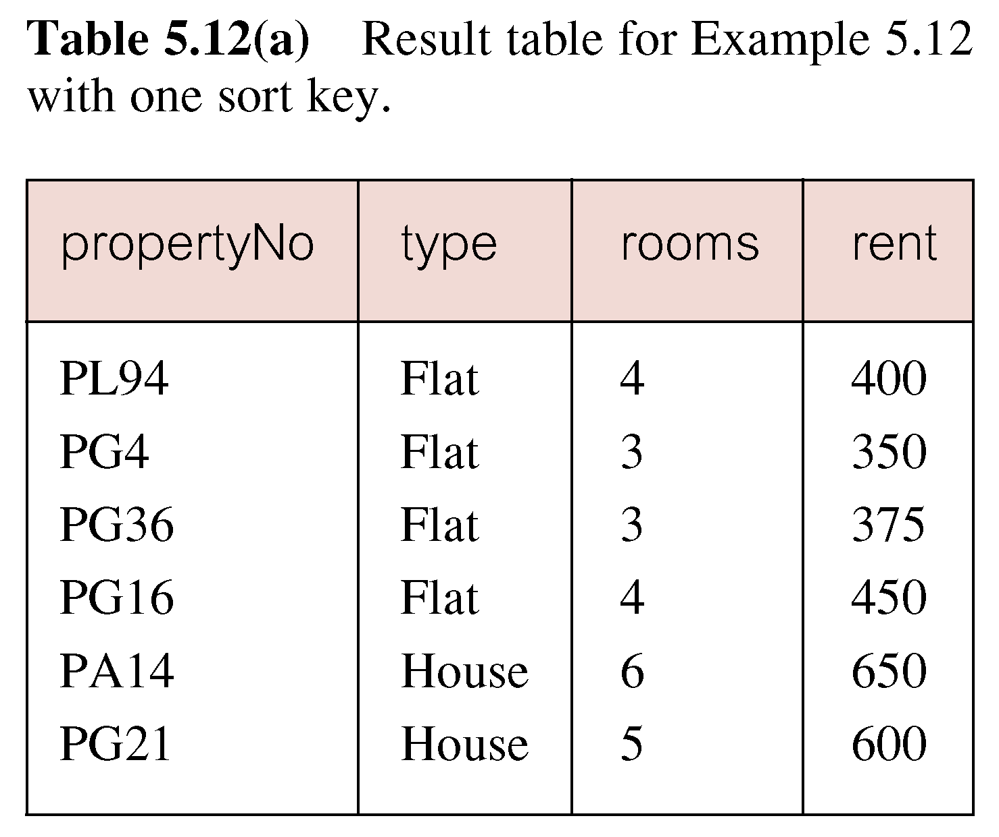
Result: Example 5.12

Slide 33
Example 5.12
Multiple column ordering
Minor/Major sort key (two sort keys)
Produce an abbreviated list of properties arranged in order of property type
SELECT propertyNo, type, rooms, rent
FROM PropertyForRent
ORDER BY type, rent DESC;

Slide 34
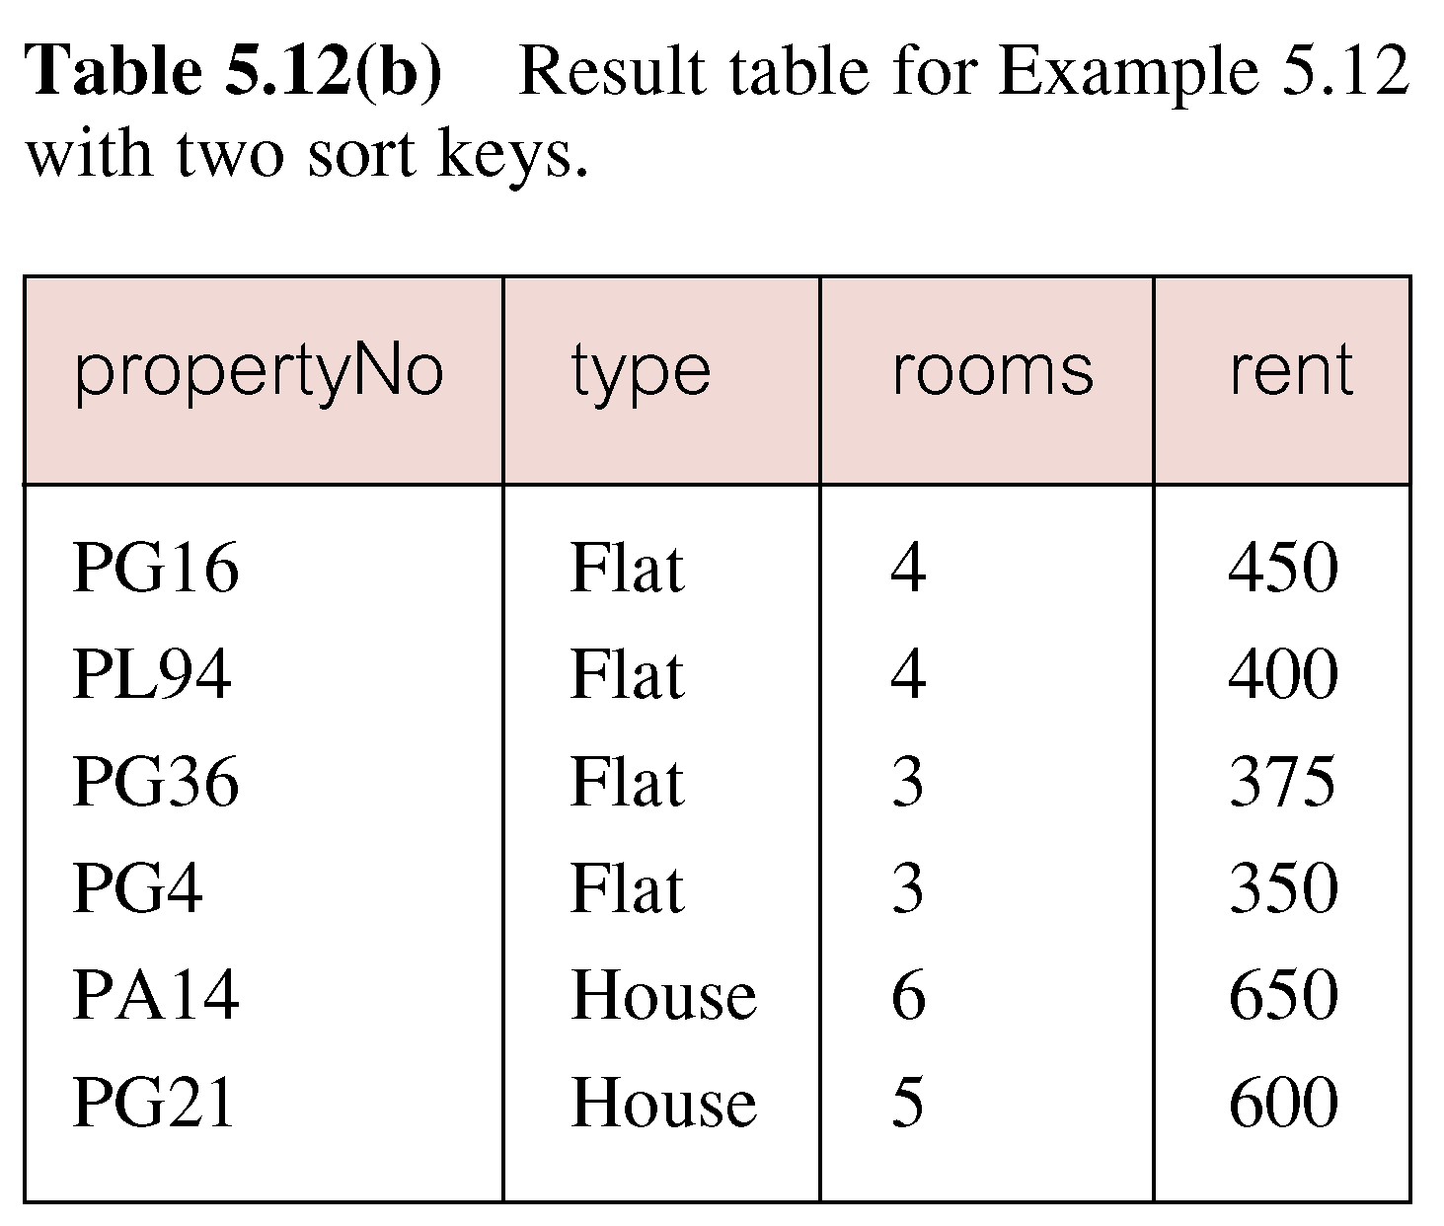
Result: Example 5.12

Slide 35
SQL Aggregate Functions
The ISO standard deﬁnes ﬁve aggregate functions:
COUNT: returns the number of values in a speciﬁed column
SUM: returns the sum of the values in a speciﬁed column
AVG: returns the average of the values in a speciﬁed column
MIN: returns the smallest value in a speciﬁed column
MAX: returns the largest value in a speciﬁed column

Slide 36
SQL Aggregate Functions..
These functions operate on a single column of a table and return a single value
COUNT, MIN, and MAX apply to both numeric and non-numeric ﬁelds
SUM and AVG may be used on numeric ﬁelds only
Apart from COUNT(*), each function eliminates nulls ﬁrst and operates only on the remaining non-null values

Slide 37
SQL Aggregate Functions..
COUNT(*) is a special use of COUNT, which counts all the rows of a table, regardless of whether nulls or duplicate values occur
If we want to eliminate duplicates before the function is applied, we use the keyword DISTINCT before the column name in the function

Slide 38
SQL Aggregate Functions..
The ISO standard allows the keyword ALL to be speciﬁed if we do not want to eliminate duplicates, although ALL is assumed if nothing is speciﬁed
DISTINCT has no effect with the MIN and MAX functions
However, it may have an effect on the result of SUM or AVG
DISTINCT can be speciﬁed only once in a query

Slide 39
SQL Aggregate Functions..
It is important to note that an aggregate function can be used only in the
SELECT list
HAVING clause
It is incorrect to use it elsewhere

Slide 40
SQL Aggregate Functions..
If the SELECT list includes an aggregate function and no GROUP BY clause is being used to group data together, then no item in the SELECT list can include any reference to a column unless that column is the argument to an aggregate function
For example, the following query is illegal:
SELECT staffNo, COUNT(salary)
FROM Staff;

Slide 41
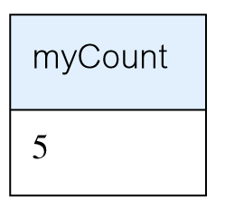
Example 5.13
Use of COUNT(*)
How many properties cost more than £350 per month to rent?
SELECT COUNT(*) AS myCount
FROM PropertyForRent
WHERE rent > 350;

Slide 42
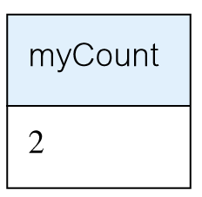
Example 5.14
Use of COUNT(DISTINCT)
How many different properties were viewed in May 2004?
SELECT COUNT(DISTINCT propertyNo) AS myCount
FROM Viewing
WHERE viewDate BETWEEN
‘1-May-04’ AND ‘31-May-04’;

Slide 43
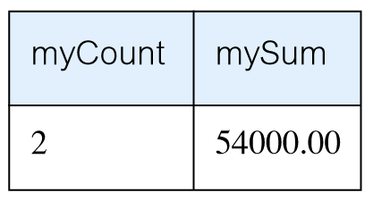
Example 5.15
Use of COUNT and SUM
Find the total number of Managers and the sum of their salaries
SELECT COUNT(staffNo) AS myCount,
SUM(salary) AS mySum
FROM Staff
WHERE position= ‘Manager’;

Slide 44
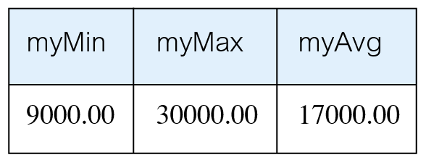
Example 5.16
Use of MIN, MAX, AVG
Find the minimum, maximum, and average staff salary
SELECT MIN(salary) AS myMin,
MAX(salary) AS myMax,
AVG(salary) AS myAvg
FROM Staff;

Slide 45
Summary
Row selection using WHERE clause
WHERE clause and search conditions
Sorting results using ORDER BY clause
SQL aggregate functions

Slide 46
References
All the material (slides, diagrams etc.) presented in this lecture is taken (with modifications) from the Pearson Education website :
http://www.booksites.net/connbegg

