Slide 1
CSC271 Database Systems
Lecture # 10

Slide 2
Summary: Previous Lecture
The relation algebra operations
Division
Aggregate and grouping operations
The relational calculus
Tuple relational calculus
Domain relational calculus

Slide 3
SQL: Data Manipulation
Chapter 5

Slide 4
Objectives of SQL
Ideally, database language should allow user to:
Create the database and relation structures
Perform insertion, modification, deletion of data from relations
Perform simple and complex queries
Must perform these tasks with minimal user effort and command structure/syntax must be easy to learn
It must be portable

Slide 5
Objectives of SQL..
SQL is a transform-oriented language with 2 major components:
A DDL for defining database structure
A DML for retrieving and updating data
Until SQL:1999, SQL did not contain flow of control commands. These had to be implemented using a programming or job-control language, or interactively by the decisions of user

Slide 6
Objectives of SQL..
SQL is relatively easy to learn
It is non-procedural language, you specify what information you require, rather than how to get it
It is essentially free-format

Slide 7
Objectives of SQL..
Consists of standard English words:
1) CREATE TABLE Staff(staffNo VARCHAR(5),
lName VARCHAR(15),
salary DECIMAL(7,2));
2) INSERT INTO Staff VALUES (‘SG16’, ‘Brown’, 8300);
3) SELECT staffNo, lName, salary
FROM Staff
WHERE salary > 10000;

Slide 8
Objectives of SQL..
Can be used by range of users including DBAs, management, application developers, and other types of end users
An ISO standard now exists for SQL, making it both the formal and de facto standard language for relational databases (ISO, 1992, 1999a)

Slide 9
History of SQL
In 1974, D. Chamberlin (IBM San Jose Laboratory) defined language called ‘Structured English Query Language’ (SEQUEL)
A revised version, SEQUEL/2, was defined in 1976 but name was subsequently changed to SQL for legal reasons

Slide 10
History of SQL..
Still pronounced ‘see-quel’, though official pronunciation is ‘S-Q-L’
IBM subsequently produced a prototype DBMS called System R, based on SEQUEL/2
Roots of SQL, however, are in SQUARE (Specifying Queries as Relational Expressions), which predates System R project

Slide 11
History of SQL..
In late 70s, ORACLE appeared and was probably first commercial RDBMS based on SQL
In 1987, ANSI and ISO published an initial standard for SQL
In 1989, ISO published an addendum that defined an ‘Integrity Enhancement Feature’
In 1992, first major revision to ISO standard occurred, referred to as SQL2 or SQL/92

Slide 12
History of SQL..
In 1999, SQL:1999 was released with support for object-oriented data management
In late 2003, SQL:2003 was released

Slide 13
Importance of SQL
SQL has become part of application architectures such as IBM’s Systems Application Architecture
It is strategic choice of many large and influential organizations (e.g. X/OPEN Cons. for UNIX)
SQL is Federal Information Processing Standard (FIPS) to which conformance is required for all sales of databases to American Government

Slide 14
Importance of SQL..
SQL is used in other standards and even influences development of other standards as a definitional tool. Examples include:
ISO’s Information Resource Directory System (IRDS) Standard
Remote Data Access (RDA) Standard
Specialized implementations of SQL
OLAP (OnLine Analytical Processing)

Slide 15
ISO SQL Standard
Does not use the formal terms of relations, attributes, and tuples, instead using the terms tables, columns, and rows
SQL allows the table produced as the result of the SELECT statement to contain duplicate rows, it imposes an ordering on the columns, and it allows the user to order the rows of a result table

Slide 16
Writing SQL Commands
SQL statement consists of reserved words and user-defined words
Reserved words are a fixed part of SQL and must be spelt exactly as required and cannot be split across lines
User-defined words are made up by user and represent names of various database objects such as relations, columns, views etc.
Many dialects of SQL require the use of a statement terminator to mark the end of each SQL statement (usually the semicolon ‘;’ is used)

Slide 17
Writing SQL Commands..
Most components of an SQL statement are case insensitive, except for literal character data
Letters can be typed in either upper or lower case
The literal character data must be typed exactly as it appears in the database e.g. If we store a person’s surname as ‘SMITH’ and then search for it using the string ‘Smith’, the row will not be found
Readability with indentation and lineation

Slide 18
Writing SQL Commands..
Extended form of BNF (Backus Naur Form) notation will be used to define SQL statements:
Upper-case letters represent reserved words
Lower-case letters represent user-defined words
| indicates a choice among alternatives
{ }Curly braces indicate a required element
[ ]Square brackets indicate an optional element
An optional ellipsis (…) indicates optional repetition (0 or more)

Slide 19
DreamHome Case Study
Consist of following tables:
Branch (branchNo, street, city, postcode)
Staff (staffNo, fName, lName, position, sex, DOB, salary, branchNo)
PropertyForRent (propertyNo, street, city, postcode, type, rooms, rent, ownerNo, staffNo, branchNo)
Client (clientNo, fName, lName, telNo, prefType, maxRent)
PrivateOwner (ownerNo, fName, lName, address, telNo)
Viewing (clientNo, propertyNo, viewDate, comment)

Slide 20
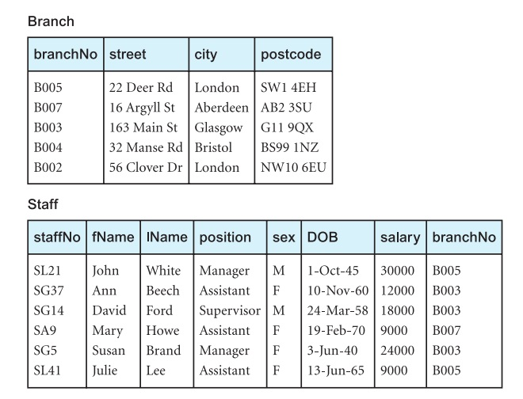
Instance of DreamHome

Slide 21
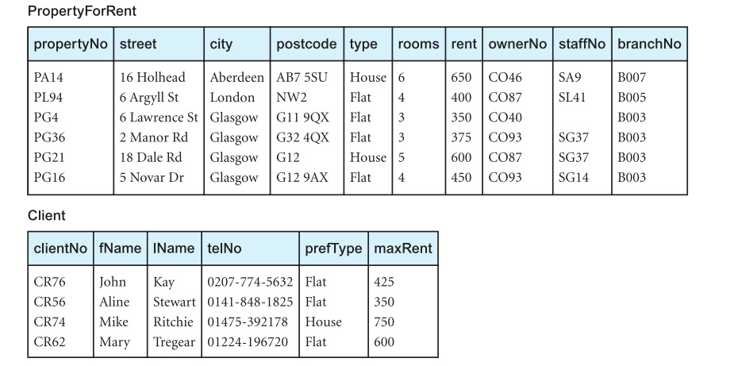
Instance of DreamHome

Slide 22
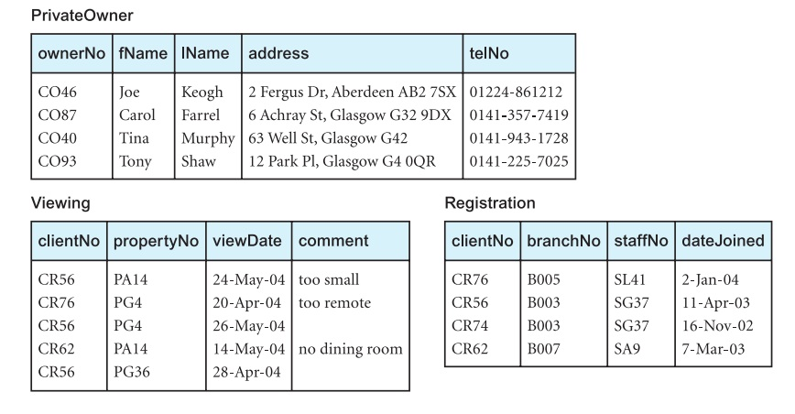
Instance of DreamHome

Slide 23
Data Manipulation
SQL DML statements include:
SELECT – to query data in the database
INSERT – to insert data into a table
UPDATE – to update data in a table
DELETE – to delete data from a table

Slide 24
Literals
Literals are constants used in SQL statements
All non-numeric literals must be enclosed in single quotes (e.g. ‘London’)
All numeric literals must not be enclosed in quotes (e.g. 650.00)

Slide 25
SQL SELECT Statement
The purpose of the SELECT statement is to retrieve and display data from one or more database tables
Extremely powerful command capable of performing the equivalent of the relational algebra’s Selection, Projection, and Join operations in a single statement
SELECT is the most frequently used SQL command

Slide 26
SELECT General Form
SELECT [DISTINCT | ALL]
{* | [columnExpression [AS newName]] [,...] }
FROM TableName [alias] [, ...]
[WHERE condition]
[GROUP BY columnList] [HAVING condition]
[ORDER BY columnList]

Slide 27
Processing Sequence
The sequence of processing in a SELECT statement is:
FROM speciﬁes the table or tables to be used
WHERE ﬁlters the rows subject to some condition
GROUP BY forms groups of rows with same column value
HAVING ﬁlters the groups subject to some condition
SELECT speciﬁes which columns to appear in the output
ORDER BY speciﬁes the order of the output

Slide 28
Important
The order of the clauses in the SELECT statement cannot be changed
The only two mandatory clauses are:
SELECT
FROM
The remainder are optional
The SELECT operation is closed:
The result of a query on a table is another table

Slide 29
Example 5.1
List full details of all staff (all rows, columns)
SELECT staffNo, fName, lName, address, position, sex,
DOB, salary, branchNo
FROM Staff;
Or
SELECT *
FROM Staff;

Slide 30
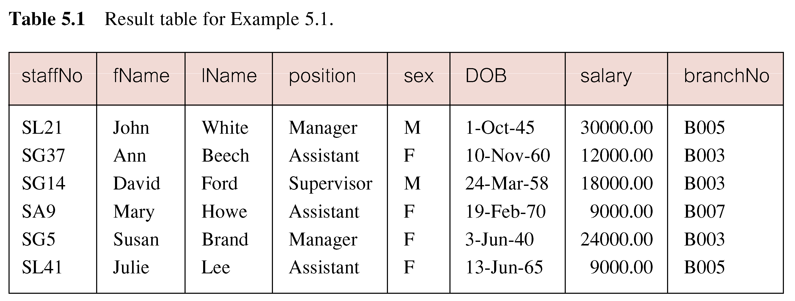
Result: Example 5.1

Slide 31
Example 5.2
Produce a list of salaries for all staff, showing only staff number, first and last names, and salary (specific columns, all rows)
SELECT staffNo, fName, lName, salary
FROM Staff;

Slide 32
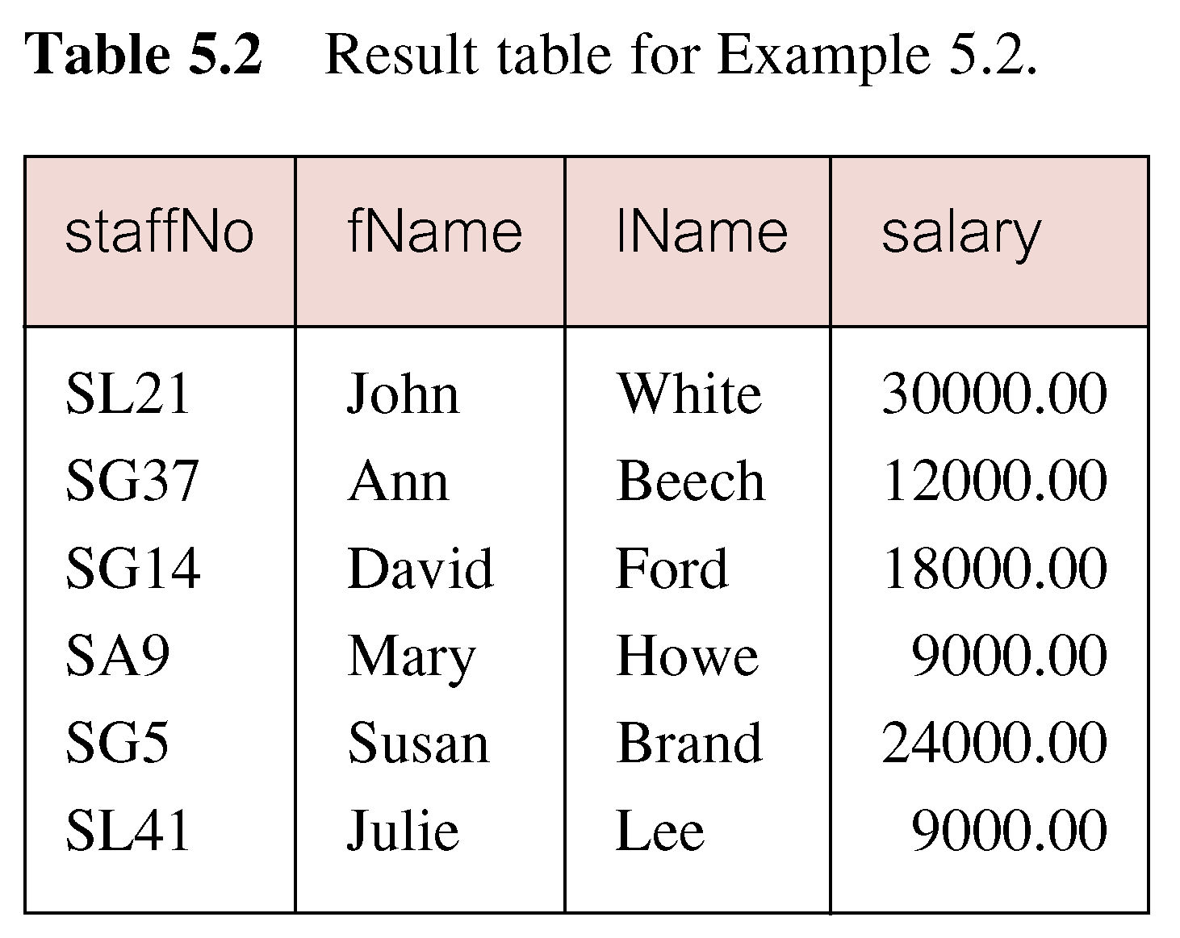
Result: Example 5.2

Slide 33
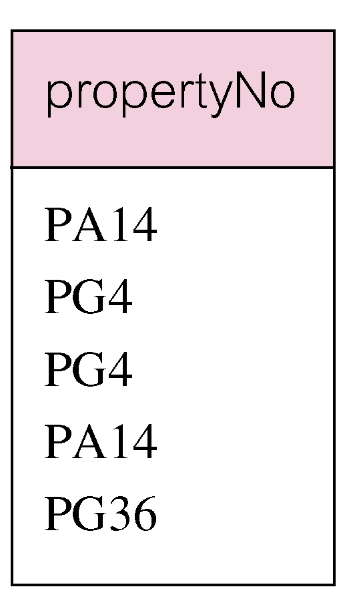
Example 5.3
List the property numbers of all properties that have been viewed (SELECT does not eliminate duplicate values)
SELECT propertyNo
FROM Viewing;

Slide 34
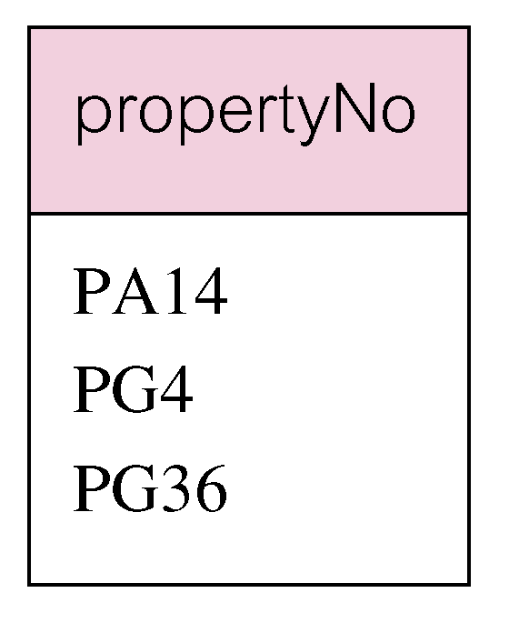
Example 5.3
List the property numbers of all properties that have been viewed (to eliminate the duplicates, use DISTINCT keyword)
SELECT DISTINCT propertyNo
FROM Viewing;

Slide 35
Example 5.4
Produce list of monthly salaries for all staff, showing staff number, first/last name, and salary (calculated/derived/computed fields)
SELECT staffNo, fName, lName, salary/12
FROM Staff;

Slide 36
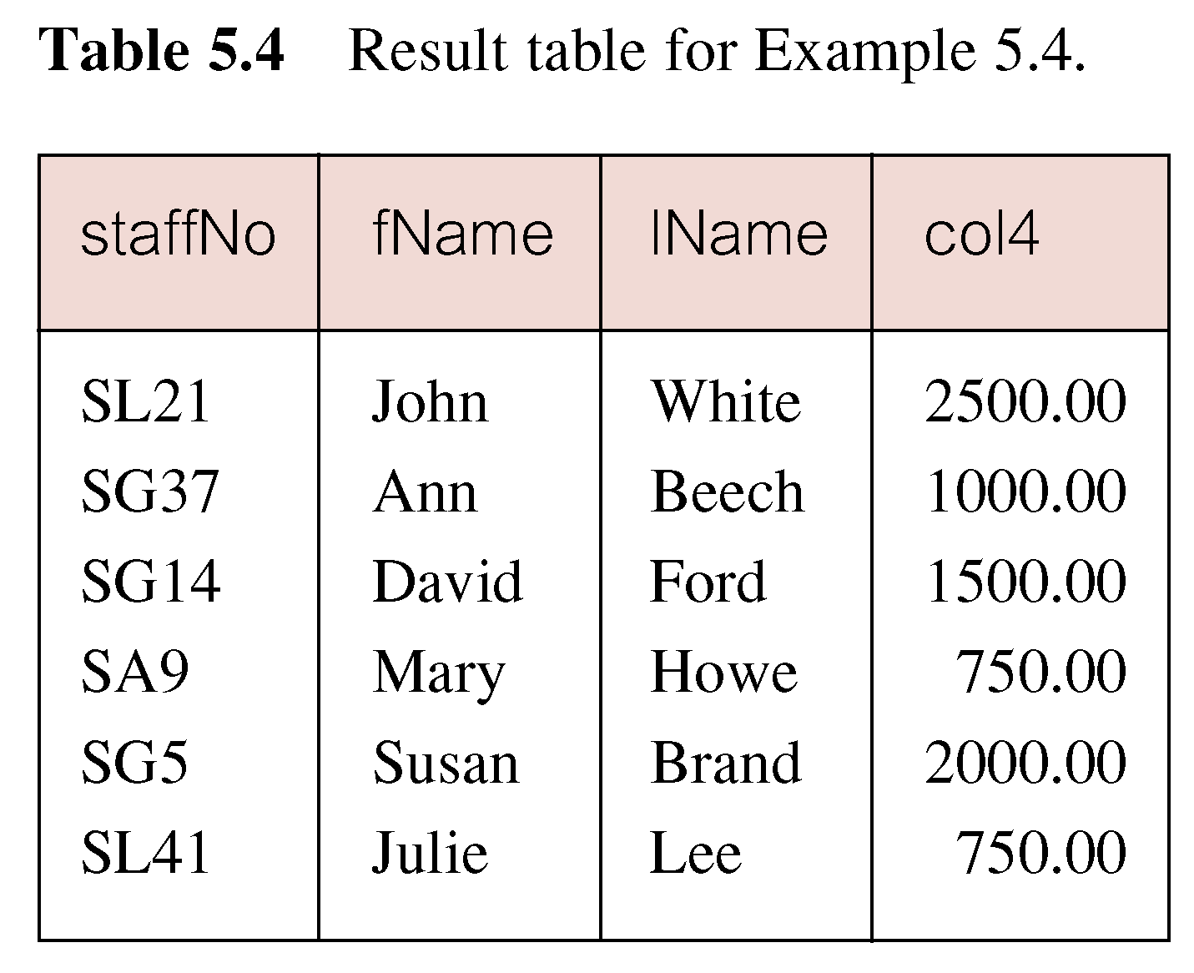
Result: Example 5.4

Slide 37
Calculated Fields/Columns
An SQL expression can involve
Addition, subtraction, multiplication, and division
Parentheses can be used to build complex expressions
More than one table column can be used in a calculated column/field
However, the columns referenced in an arithmetic expression must have a numeric type
The fourth column of this result table has been output as col4, could be different depending upon the dialect of SQL

Slide 38
Rename Column (AS Clause)
The ISO standard allows the column to be named using an AS clause
The previous example could be written as follows:
SELECT staffNo, fName, lName, salary/12 AS monthlySalary
FROM Staff;

Slide 39
Summary
Objectives of SQL
History of SQL
Importance of SQL
Writing SQL statements
DML (Data Manipulation Language)
SELECT statement

Slide 40
References
All the material (slides, diagrams etc.) presented in this lecture is taken (with modifications) from the Pearson Education website :
http://www.booksites.net/connbegg

