Slide 1
CSC271 Database Systems
Lecture # 1

Slide 2
About Instructor
Mr. Asif Muneer
Assistant Professor
Department of Computer Science
COMSATS Institute of Information Technology Islamabad, Pakistan
asifmuneer@comsats.edu.pk

Slide 3
Required Text Book
Book Authors
  Connolly, T. M., and Begg, C. E.
Book Title
  Database Systems
  A Practical Approach to Design,
  Implementation, and Management
Book Edition and Publisher
  4th Edition, Addison Wesley, 2005.

Slide 4
Reference Books
Book Authors
  Hoffer, Jeffrey A., and Prescott, Mary B., and McFadden, Fred R.
Book Title
  Modern Database Management
Book Edition and Publisher
  7th Edition, Prentice Hall, 2005.

Slide 5
Reference Books
Book Author
  Kroenke, David M.
Book Title
  Database Processing
  Fundamentals, Design and
  Implementation
Book Edition and Publisher
  10th Edition, Prentice Hall, 2006.

Slide 6
Reference Books
Book Author
  Date, C. J.
Book Title
  An Introduction to Database Systems
Book Edition and Publisher
  8th Edition, Addison Wesley, 2003.

Slide 7
Course Objectives
To be able to understand the underlying concepts of database, and database management system (DBMS)
To introduce students to the concepts of relational data model
Analysis and design of database application or information system

Slide 8
Course Objectives..
Experience with SQL
Implementation of database using SQL
Learn to work with Microsoft SQL Server 2008 environment

Slide 9
Course Contents at a Glance
Introduction to Database Concepts
Database Environment
The Relational Model
Relational Algebra
SQL: Data Manipulation
SQL: Data Definition
Database Planning, Design, and Administration

Slide 10
Course Contents at a Glance..
Fact-Finding Techniques
Entity-Relationship Model
Enhanced E-R Model
Normalization
Advanced Normalization
Conceptual, Logical, and Physical Database Design

Slide 11
Course Contents at a Glance..
Transaction Management
Security

Slide 12
Marks Distribution
Quizzes/Assignments 25%
Sessional-I 10%
Sessional-II 15%
Final 50%

Slide 13
Introduction to Databases
Chapter 1

Slide 14
Chapter 1 - Objectives
Some common uses of database systems
Characteristics of file-based systems
Problems with file-based approach
Meaning of the term database (DB)
Meaning of the term Database Management System (DBMS)

Slide 15
Chapter 1 - Objectives
Typical functions of a DBMS.
Major components of the DBMS environment.
Personnel involved in the DBMS environment.
History of the development of DBMSs.
Advantages and disadvantages of DBMSs.

Slide 16
Examples of Database Applications
Purchases from the supermarket
Purchases using your credit card
Booking a holiday at the travel agents
Using the local library
Taking out insurance
Renting a video
Using the Internet
Studying at university

Slide 17
File-Based Systems
Early attempt to Computerize the manual filing system
Collection of application programs that perform services for the end users (e.g. reports).
Each program defines and manages its own data.

Slide 18
Manual Filing Systems
Works well
  while number of items to be stored is small
  For only storage or retrieval functionality of large number of items

Slide 19
File-Based Systems
Consider DreamHome example for file-based systems
  Sales Department : responsible for selling and renting of properties
  Contract Department: responsible for handling lease agreements

Slide 20
Sales Department
PropertyForRent
(propertyNo, street, city, postcode, type, rooms, rent, ownerNo)
Client
(clientNo, fName, lName, telNo, preftype, maxRent)
PrivateOwner
(ownerNo, fName, lName, address, telNo)

Slide 21
PropertyForRent
propertyNo | street | city | postcode | type | rooms | rent | ownerNo
PA14 | … | Aberdeen | … | House | 6 | 650 | CO46
PL94 | … | London | … | Flat | 4 | 400 | CO87
PG4 | … | Glasgow | … | Flat | 3 | 350 | CO40
PG36 | … | Glasgow | … | Flat | 3 | 375 | CO93
PG21 | … | Glasgow | … | House | 5 | 600 | CO87
PG16 | … | Glasgow | … | Flat | 4 | 450 | CO93
PrivateOwner
ownerNo | fName | lName | address | telNo
CO46 | Joe | Keogh | … | 01224-861212
CO87 | Carol | Farrel | … | 0141-357-7419
CO40 | … | … | … | …
CO93 | … | … | … | …

Slide 22
Client
clientNo | fName | lName | telNo | prefType | maxRent
CR76 | John | Kay | 0207-774-5632 | Flat | 425
CR56 | Aline | Stewart | 0141-848-1825 | Flat | 350
CR74 | Mike | Ritchie | 01475-392178 | House | 750
CR62 | Mary | Tregear | 01224-196720 | Flat | 600

Slide 23
Contract Department
Lease
(leaseNo, propertyNo, clientNo, rent , paymentMethod, deposit, paid, rentStart, rentFinish, duration)
PropertyForRent
(propertyNo, street, city, postcode, type, rooms, rent)
Client
(clientNo, fName, lName, telNo, preftype, maxRent)

Slide 24
PropertyForRent
propertyNo | street | city | postcode | type | rooms | rent
PA14 | … | Aberdeen | … | House | 6 | 650
PL94 | … | London | … | Flat | 4 | 400
PG4 | … | Glasgow | … | Flat | 3 | 350
PG36 | … | Glasgow | … | Flat | 3 | 375
PG21 | … | Glasgow | … | House | 5 | 600
PG16 | … | Glasgow | … | Flat | 4 | 450
Lease
leaseNo | propertyNo | clientNo | rent | --- | rentStart | rentFinish | duration
10024 | PA14 | CR62 | 650 |  | 1-Jun-05 | 31-May-06 | 12
… | … | … | … | … | … | … | …

Slide 25
Client
clientNo | fName | lName | telNo
CR76 | John | Kay | 0207-774-5632
CR56 | Aline | Stewart | 0141-848-1825
CR74 | Mike | Ritchie | 01475-392178
CR62 | Mary | Tregear | 01224-196720

Slide 26
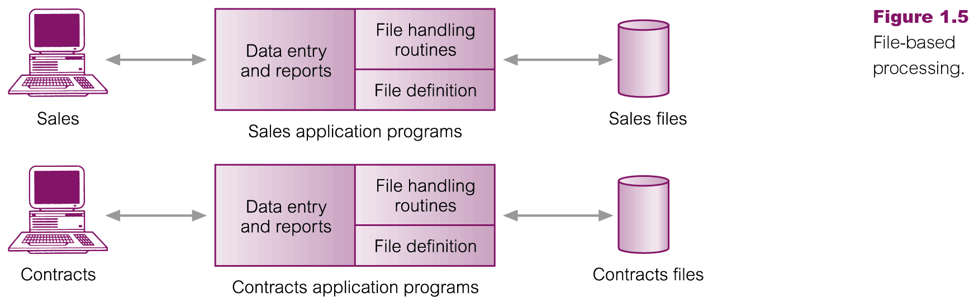
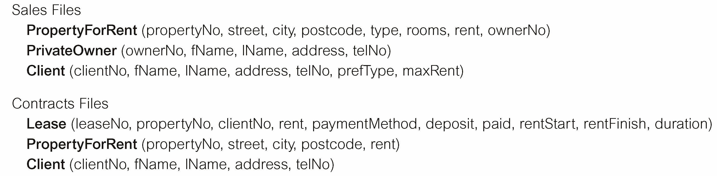
File-Based Processing

Slide 27
Limitations of File-Based Approach
Separation and isolation of data
  Each program maintains its own set of data.
  Users of one program may be unaware of potentially useful data held by other programs.
  For example, if we want to produce a list of all houses that match the requirements of the clients.
Duplication of data
  Decentralized approach taken by each department.
  Same data is held by different programs.
  Wasted space and potentially different values and/or different formats for the same item.

Slide 28
Limitations of File-Based Approach..
Data dependence
  File structure is defined in the program code.
Incompatible file formats
  Programs are written in different languages, and so cannot easily access each other’s files.
Fixed Queries/Proliferation of application programs
  Programs are written to satisfy particular functions.
  Any new requirement needs a new program.

Slide 29
Database Approach
Arose because:
  Definition of data was embedded in application programs, rather than being stored separately and independently.
  No control over access and manipulation of data beyond that imposed by application programs.
Result:
  the database and Database Management System (DBMS).

Slide 30
Database
Shared collection of logically related data, and a description of this data, designed to meet the information needs of an organization.
System catalog (metadata) provides description of data to enable program-data independence.
Logically related data comprises entities, attributes, and relationships of an organization’s information.

Slide 31
Database Management System (DBMS)
A software system that enables users to define, create, maintain, and control access to the database.
(Database) application program: a computer program that interacts with database by issuing an appropriate request (SQL statement) to the DBMS.

Slide 32
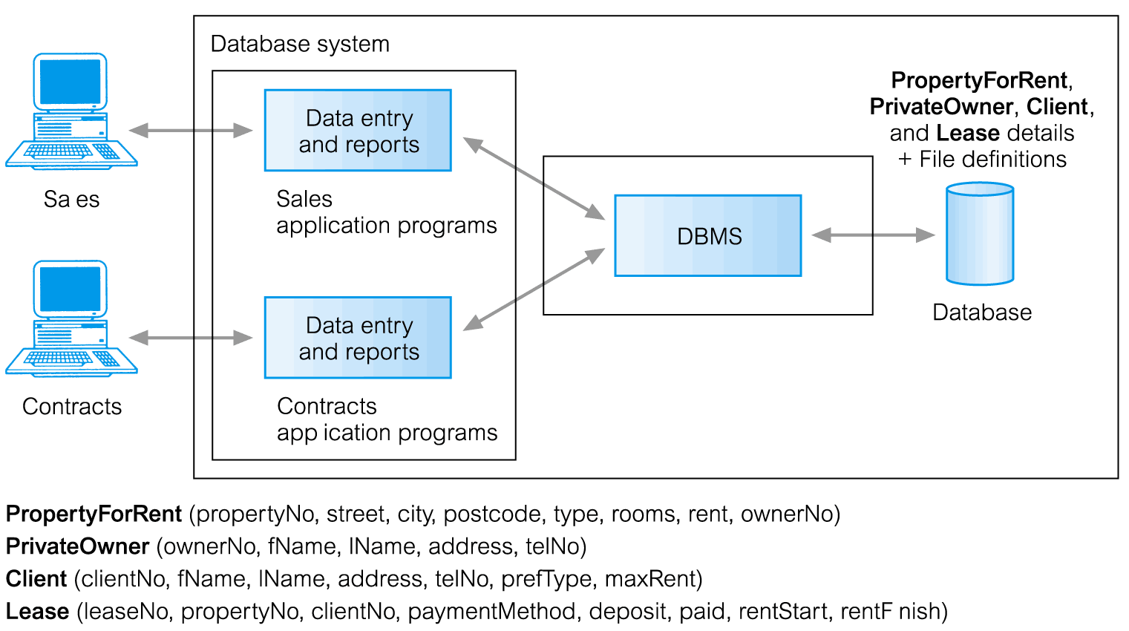
Database Management System (DBMS)..

Slide 33
Database Approach
Data definition language (DDL).
  Permits specification of data types, structures and any data constraints.
  All specifications are stored in the database.
Data manipulation language (DML).
  General enquiry facility (query language) of the data.

Slide 34
Database Approach..
Controlled access to database may include
  A security system
    Which prevents unauthorized users accessing the database
  An integrity system
    Which maintains the consistency of stored data
  A concurrency control system
    Which allows shared access of the database
  A recovery control system
    Which restores the database to a previous consistent state in case of hardware or software failure
  A user-accessible catalog
    Which contains description of the data in the database

Slide 35
Views
Allows each user to have his or her own view of the database.
A view is essentially some subset of the database.

Slide 36
Views - Benefits
Reduce complexity
Provide a level of security
Provide a mechanism to customize the appearance of the database
Present a consistent, unchanging picture of the structure of the database, even if the underlying database is changed

Slide 37
Summary
Introduction to DB and DBMS
File-based systems and their limitations
Database approach

Slide 38
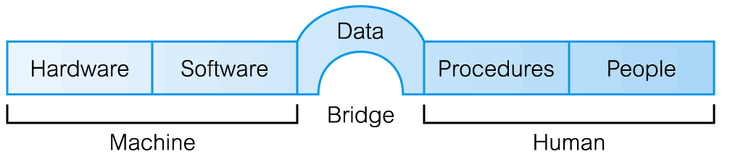
Components of DBMS Environment

Slide 39
Components of DBMS Environment..
Hardware
  Can range from a PC to a network of computers.
Software
  DBMS, operating system, network software (if necessary) and also the application programs.
Data
  Used by the organization and a description of this data called the schema.

Slide 40
Components of DBMS Environment..
Procedures
  Instructions and rules that should be applied to the design and use of the database and DBMS.
People

Slide 41
Roles in the Database Environment
Data Administrator (DA)
  Database planning
  Development and maintenance of standards, policies and procedures
Database Administrator (DBA)
  Physical realization of the database
  Physical database design and implementation
  Security and integrity control
  Maintenance of the operational system
  Ensuring satisfactory performance of the applications for users
Database Designers (Logical and Physical)
Application Programmers
End Users (naive and sophisticated)

Slide 42
History of Database Systems
Roots of the DBMS
  Apollo moon-landing project, 1960s
  NAA (North American Aviation), prime contractor for the project
  Developed a software GUAM (Generalized Update Access Method), hierarchical
  In mid – 1960s IBM joined NAA, result was IMS(Information Management System)

Slide 43
History of Database Systems..
IDS ( Integrated Data Store)
  By General Electric, network, mid-1960
CODASYL ( Conference on Data Systems Languages)
DBTG (Data Base Task Group)

Slide 44
History of Database Systems..
DBTG proposal in 1971, components
  The network schema: the logical organization of the entire database as seen by the DBA – which includes a deﬁnition of the database name, the type of each record, and the components of each record type.
  The subschema: the part of the database as seen by the user or application program;
  A data management language to deﬁne the data characteristics and the data structure, and to manipulate the data.

Slide 45
History of Database Systems..
DBTG specified three languages
  A schema Data Deﬁnition Language (DDL), which enables the DBA to deﬁne the schema.
  A subschema DDL, which allows the application programs to deﬁne the parts of the database they require.
  A Data Manipulation Language (DML), to manipulate the data.

Slide 46
History of Database Systems..
E. F. Codd, 1970
  IBM Research Laboratory
  Relational model
  System R project by IBM’S San Jose Research Laboratory California
  Result of this project
    Development of SQL
    Commercial relational DBMS products e.g. DB2, SQL/DS from IBM, Oracle from Oracle Corp.

Slide 47
DBMS Generations
First-generation
  Hierarchical and Network
Second generation
  Relational
Third generation
  Object-Relational
  Object-Oriented

Slide 48
Advantages of DBMSs
Control of data redundancy
Data consistency
More information from the same amount of data
Sharing of data
Improved data integrity (constraints)
Improved security (authentication, rights)
Enforcement of standards (data formats, naming conventions, documentation etc.)

Slide 49
Advantages of DBMSs..
Economy of scale (economical cost)
Balance conflicting requirements
Improved data accessibility and responsiveness (ad hoc queries)
Increased productivity (developer)
Improved maintenance through data independence
Increased concurrency

Slide 50
Advantages of DBMSs..
Improved backup and recovery services

Slide 51
Disadvantages of DBMSs
Complexity
Size (disk space for DBMS)
Cost of DBMS
Additional hardware costs
Cost of conversion
Performance
Higher impact of a failure

Slide 52
Summary
Introduction to DB and DBMS
File-based systems and their limitations
Database approach
Components of the DBMS environment
Roles in the DB environment
History of DBMS
Advantages/Disadvantages of DBMSs

